Slide 1

Cisco SDWAN Viptela Interacting with the Cisco SDWAN Viptlea API to export and import feature templates NTT Chile

Slide 2
Requirements
Python 3.X Installed
Libraries:
requests
json (built-in)
tqdm
tabulate
os (built-in)
sys (built-in)
Network connectivity to the vManage Server
If any Firewall, http/https/8443 protocol should be allowed

Slide 3
Script Positional Arguments
This script uses positional arguments to pass information about variables like vmanage ip, username and son on, example:
python <script name> <vmanage-ip> <username> <password> <action>
Practical Example:
python backup_restore_vmanage_templates.py 10.1.12.5 admin admin export
python backup_restore_vmanage_templates.py 192.168.10.180 admin admin import

Slide 4
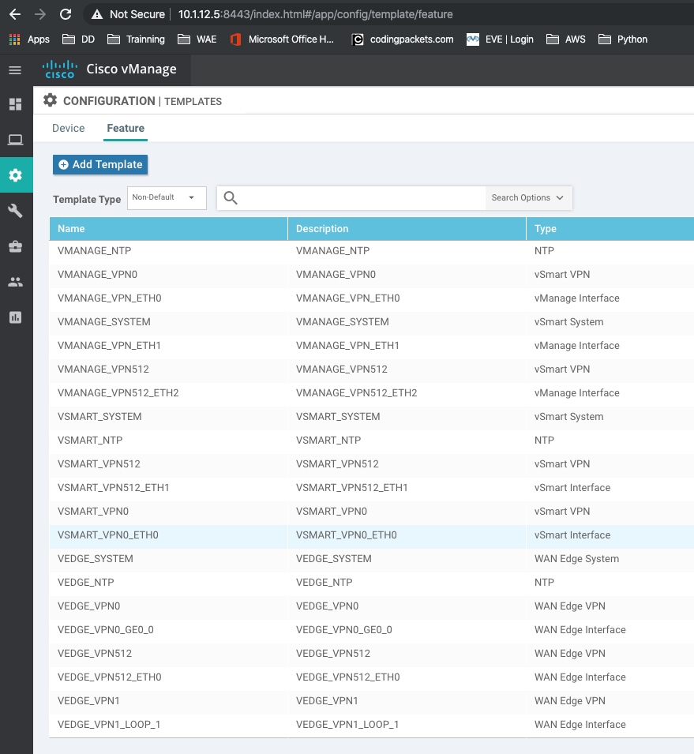
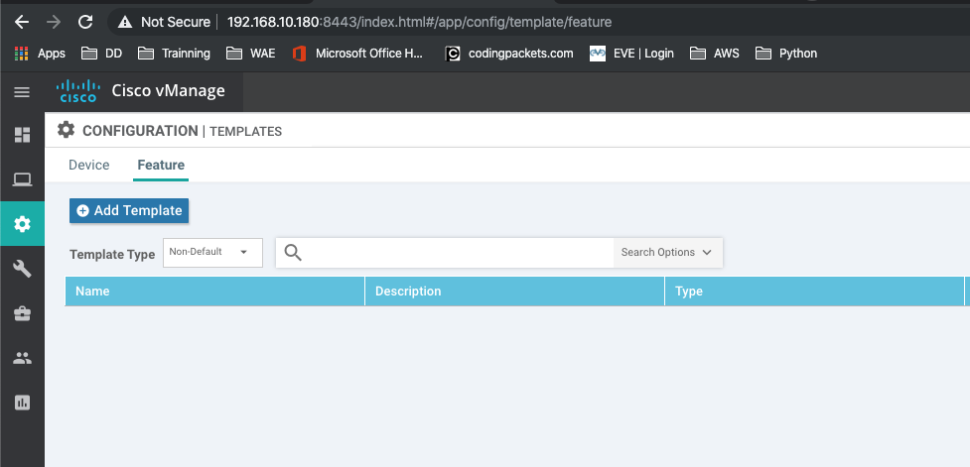
vManage - 10.1.12.5
Multiple Feature Templates
We want to export those templates to
vManage - 192.168.10.150
With no Feature Templates

Slide 5
Backup Process
Via terminal, step into the folder where the script is sitting:
Execute the script giving the vmanage-ip, username, password and action as positional arguments. In this case the action == ”export”.
The Scripts then creates a folder called “backup_vmanage_templates” with all the backed templates in json format inside

Slide 6
Restore Process
Via terminal, step into the folder where the script and backups are:
Execute the script giving the vmanageip, username, password and action as positional arguments. In this case the action == ”import”.
Now, login to the vmanage where you imported the templates and check that the templates were in fact created.

Slide 7
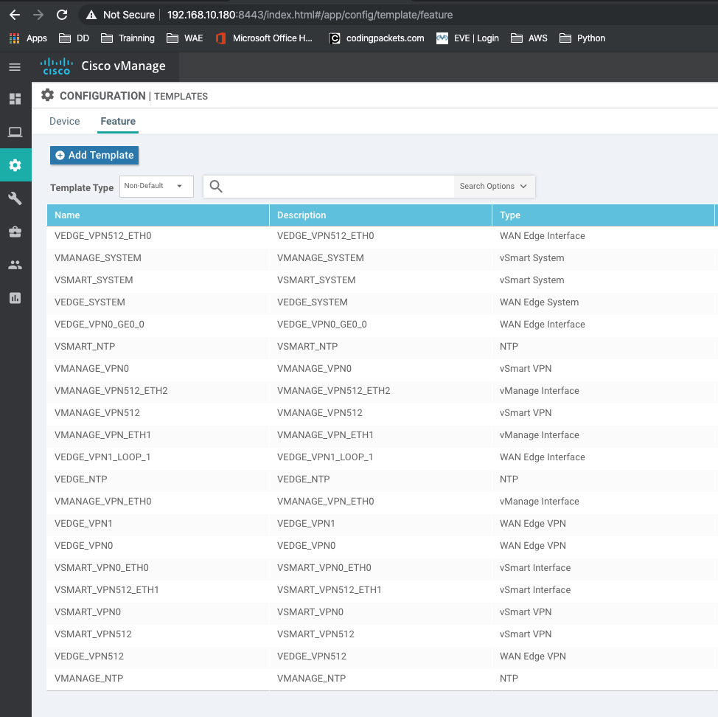
Now vManage - 192.168.10.150
Has all the templates !!

Slide 8
Additional Resources
API Doc: https://sdwan-docs.cisco.com/Product_Documentation/Command_Reference/Command_Reference/vManage_REST_APIs/vManage_REST_APIs_Overview/Using_the_vManage_REST_APIs
Python 3.8: https://www.python.org/downloads/release/python-380/
Using vManage Rest API: https://www.youtube.com/watch?v=OYy1pByYfrI

Slide 9
Thanks

