Slide 1
MODULE 1
Develop Azure Computing Solutions
App Service · Azure Containers Apps · Azure Functions
Modern Enterprise Software Engineering — Day 1, Morning (3.5h)

Slide 2
BEFORE WE START
Quick show of hands
Rate your experience 1 (never used) – 5 (comfortable) with:
1
Containers (Docker)
2
Azure (Portal / any service)
3
.NET / C#
4
Git
Opening poll
Module 1 · Develop Azure Computing Solutions

Slide 3
AGENDA
This morning
Implement Azure App Service Web Apps
01
Plans, tiers, and deploying a container to App Service
Implement Containerized Solutions
02
ACA · ACI · AKS — which one, and why · revisions and canary
Azure Functions — theory (we build it in Module 5)
03
Event-driven compute: triggers, bindings, hosting plans
Interleaved format: theory → live demo → mini-practice, per topic · FYI: AZ-204 retired 31 July 2026 and is replaced by AI-200 — we teach the ÉSTIAM programme as defined
Module 1 · Develop Azure Computing Solutions

Slide 4
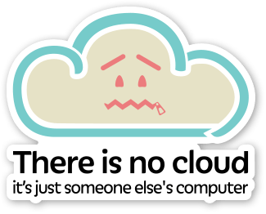
0
What’s Azure ??
It’s just somebody else’s server...

Slide 5
AZURE
Why should I use it ?
Scalability
01
Easily scale applications up or down based on demand
Reduced Infra Management
02
Focus on software instead of maintaining physical servers
Pay-as-you-go pricing
03
Pay primarily for the resources you consume
Module 1 · Develop Azure Computing Solutions

Slide 6
AZURE
Why should I use it ?
Security
04
Built-in identity, access control, encryption, monitoring, and compliance capabilities
Fast Deployment
05
Provision infrastructure and deploy applications quickly
Managed services
06
Use databases, messaging, storage, AI, APIs, and other services without managing the underlying infrastructure
Module 1 · Develop Azure Computing Solutions

Slide 7
AZURE
Why should I use it ?
DevOps integration
07
Strong support for CI/CD, GitHub, Azure DevOps, monitoring, and automation
Global reach
08
Deploy applications closer to users using Azure regions worldwide.
Microsoft ecosystem
09
Excellent integration with .NET, Windows, Microsoft 365, Entra ID, Visual Studio, and GitHub
Module 1 · Develop Azure Computing Solutions

Slide 8
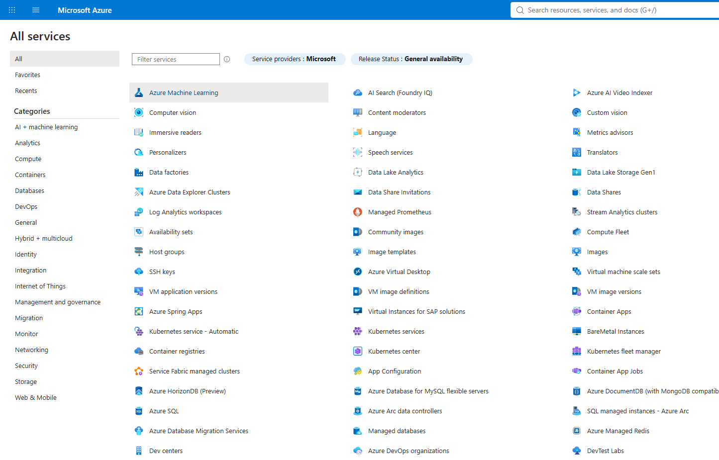
AZURE
Services
Module 1 · Develop Azure Computing Solutions

Slide 9
SETUP · LIVE DEMO
Subscription, CLI, resource group, providers
Everything from here on assumes these four things are done.
az --version # 64-bit build only (an x86 CLI breaks extensions later)
az login
az account show
az account list --output table
az account set --subscription "<name-or-id>"
# Names go in variables: one place to change them when Azure rejects one.
$LOCATION = "westcentralus"
$RG = "rg-estiam-dev-2"
az group create --name $RG --location $LOCATION
az group list --output table
# Every resource TYPE must be registered on the subscription before first use:
az provider register --namespace <Provider.Namespace>
az provider show --namespace <Provider.Namespace> --query registrationState -o tsv
Variables do not survive closing the terminal. Re-run them (or materials/variables.ps1) at the start of every session — including tomorrow morning.
One resource group for all three days — do not delete it tonight
Module 1 · Develop Azure Computing Solutions

Slide 10
1
Deploy Applications with Azure App Service
Fully managed PaaS: you own the app, Azure owns everything under it.

Slide 11
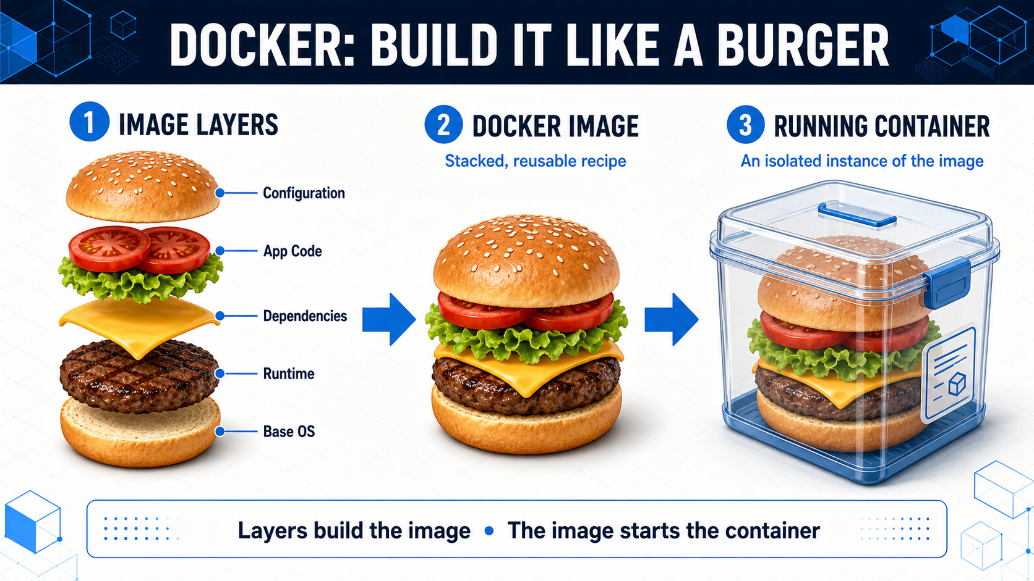
TOPIC 1 · WHERE A CONTAINER CAN RUN
Quick refresher: image vs container
Module 1 · Develop Azure Computing Solutions

Slide 12
TOPIC 1 · WHERE A CONTAINER CAN RUN
Four places to run a container
Azure Container Apps
Container Instances (ACI)
Kubernetes Service (AKS)
App Service (containers)
Microservices, event-driven, scale to zero
Simple, one-off runs — no orchestration
Full K8s API control needed
Web app/API — container is just packaging
The modern default
A building block
Real thing, real ops
Web-app features
Decision path: web app? → App Service. Microservices / scale-to-zero? → Container Apps. Need K8s API control? → AKS. Simple one-off? → ACI.
ACI is not deprecated — it's now a low-level building block, not the default
Module 1 · Develop Azure Computing Solutions

Slide 13
TOPIC 1 · WHERE A CONTAINER CAN RUN
App Service — the container is just packaging
APP SERVICE PLAN (the VM you pay for)
Users
HTTPS
image pulled on start
Web App
Web App 2
Azure Container
Registry
your container image
shares the plan
your private images
Basic keeps at least one instance running — no scale to zero. You size and pay for the Plan directly.
Managed web hosting · Built-in HTTPS + domains · Plan-based scaling
Module 1 · Develop Azure Computing Solutions

Slide 14
TOPIC 1 · WHERE A CONTAINER CAN RUN
Azure Container Apps — the modern default
CONTAINER APPS ENVIRONMENT
Users
Frontend app
Orders API
Queue
Worker 0 → N
HTTP traffic
container app
container app
work to do
scales on queue depth
No traffic → replicas drop to 0. First request after idle pays a short cold start (KEDA).
Microservices · Event-driven · Scale to zero
Module 1 · Develop Azure Computing Solutions

Slide 15
TOPIC 1 · WHERE A CONTAINER CAN RUN
Azure Container Instances — a building block
Orders CSV
One container
Database
a file lands
runs once, then exits
result written
start → process → stop
No autoscaling, no load balancing, no service discovery — and none needed.
Single container · No orchestration · Pay per second
Module 1 · Develop Azure Computing Solutions

Slide 16
TOPIC 1 · WHERE A CONTAINER CAN RUN
Azure Kubernetes Service — real thing, real ops
AKS CLUSTER
Kubernetes API
Node 1
Node 2
Node 3
Users
Ingress
full control
kubectl / Helm
your tooling
You run the ops
your pods, your scheduling, your upgrades
patching, scaling, cost
Full Kubernetes API · Advanced networking · Most operational overhead
Module 1 · Develop Azure Computing Solutions

Slide 17
TOPIC 1 · WHERE A CONTAINER CAN RUN
Scenario check
“Independent APIs, each in a container, need to scale independently on HTTP traffic and scale to zero overnight.”
ACR — Azure Container Registry
Your private image registry. Integrates with every compute option here. ACR Tasks can even build images in the cloud on a git push.
KEDA — Kubernetes Event-Driven Autoscaling
Scales on events (queue depth, HTTP rate) instead of just CPU, and can scale to zero. Container Apps uses KEDA under the hood — that's HOW scale-to-zero works.
GitHub is to code what ACR is to container images
Module 1 · Develop Azure Computing Solutions

Slide 18
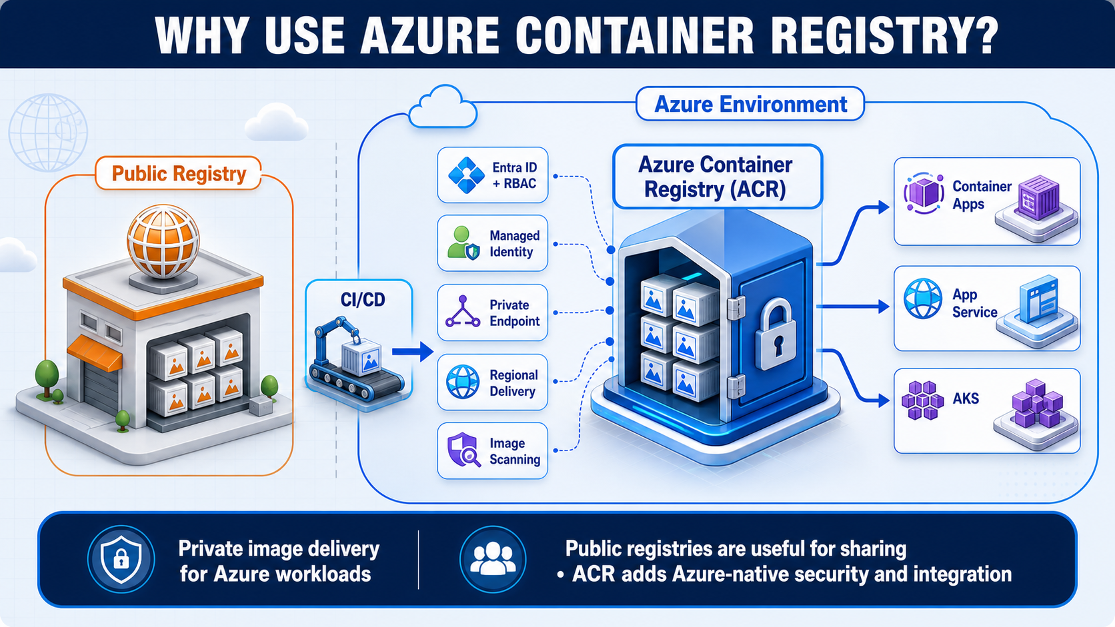
TOPIC 1 · WHERE A CONTAINER CAN RUN
Azure Container Registry — where your images live
Module 1 · Develop Azure Computing Solutions

Slide 19
TOPIC 1
The App Service Plan & its tiers
Multiple web apps can share one Plan — it's the underlying compute (VM size + instance count).
Free / Shared
Testing only — no custom domain or SSL
Basic
Dedicated VM, custom domains + SSL — no auto-scale, no slots
Standard / Premium
Auto-scale, deployment slots, daily backups
Isolated
Dedicated network (App Service Environment) — compliance needs
Standard = 5 slots max · Premium = 20+, faster swaps
Module 1 · Develop Azure Computing Solutions

Slide 20
TOPIC 1
Three ways to get code onto App Service
1
Local Git / ZIP deploy
2
GitHub Actions / Azure DevOps CI/CD (real-world default)
3
Container image (same App Service, running your Docker image)
Today we use option 3 — the same container image runs on App Service now and on
Container Apps after the break. One image, two very different hosts.
az webapp up is deprecated: it guesses a runtime from your folder and fails on an
empty one. Use the explicit pair — az appservice plan create, then az webapp create
plus az webapp config container set.
One image, two hosts — that is what makes containers worth the packaging step
Module 1 · Develop Azure Computing Solutions

Slide 21
TOPIC 1 · LIVE DEMO
Catalog UI → ACR → App Service
Build the image locally, push it to your private registry, run it on an App Service Plan.
$LOCATION = "westcentralus" ; $RG = "rg-estiam-dev-2"
$PLAN = "asp-estiam-dev-2" ; $ACR = "acrestiamdev2"
$WEBAPP = "webapp-estiam-dev-2"
az group create --name $RG --location $LOCATION
az appservice plan create -g $RG --name $PLAN --sku B1 --is-linux --location $LOCATION
az provider register --namespace Microsoft.ContainerRegistry
az acr create -g $RG --name $ACR --sku Basic --location $LOCATION
az acr login --name $ACR
docker build -t "${ACR}.azurecr.io/catalog-ui:v1" . # from the catalog-ui folder
docker push "${ACR}.azurecr.io/catalog-ui:v1"
az acr update --name $ACR --admin-enabled true # App Service must authenticate
az webapp create --name $WEBAPP --plan $PLAN -g $RG \
--deployment-container-image-name "${ACR}.azurecr.io/catalog-ui:v1"
az webapp config container set ... # + registry url / user / password (manual §4.2)
az webapp create carries no registry credentials on its own — without the config container set step the pull silently fails and you get a blank page.
Resource names here are examples — choose your own. $ACR, $WEBAPP and the Function App name must be globally unique across Azure.
Module 1 · Develop Azure Computing Solutions

Slide 22
2
Implement Containerized Solutions
The modern default: serverless containers, scale to zero, safe releases.

Slide 23
TOPIC 2 · LIVE DEMO
Catalog API → Container Apps
Same registry, same pattern — a serverless host that scales to zero.
$ENVNAME = "env-estiam-dev-2" ; $APP = "app-estiam-dev-2"
az extension add --name containerapp --upgrade
az provider register --namespace Microsoft.App
az provider register --namespace Microsoft.OperationalInsights
docker build -t "${ACR}.azurecr.io/catalog-api:v1" . # from the catalog-api folder
docker push "${ACR}.azurecr.io/catalog-api:v1"
az containerapp env create --name $ENVNAME -g $RG --location $LOCATION
$ACR_PASSWORD = az acr credential show --name $ACR -g $RG `
--query "passwords[0].value" --output tsv
az containerapp create --name $APP -g $RG --environment $ENVNAME `
--image "${ACR}.azurecr.io/catalog-api:v1" --target-port 8080 --ingress external `
--registry-server "${ACR}.azurecr.io" --registry-username $ACR `
--registry-password $ACR_PASSWORD --query properties.configuration.ingress.fqdn
--target-port 8080, not 80. .NET 8 container images listen on 8080, and a port mismatch here is what makes a revision fail activation.
Then leave it idle a few minutes and show Portal → Scale: replicas drop to 0
Module 1 · Develop Azure Computing Solutions

Slide 24
TOPIC 2 · REVISIONS
Two ways to release without downtime
Blue / green
Canary
The new version is fully deployed on its own URL and validated BEFORE any real user reaches it. Then one atomic switch sends 100% of traffic across.
Rollback is switching back — the old version was never touched.
App Service does this with a deployment slot and a swap. Container Apps can do it too: a revision has its own URL.
A percentage of REAL traffic goes to the new version before you commit to it.
Strictly stronger validation: it catches what only appears under real production load and real edge-case input — things out-of-band testing cannot reach.
The cost is honest: some live users are part of the test. Only Container Apps revisions can do this.
App Service slots give you the first one. Container Apps revisions give you both — which is why we demo the canary.
Module 1 · Develop Azure Computing Solutions
Module 1 · Develop Azure Computing Solutions

Slide 25
TOPIC 2 · REVISIONS
Canary: one URL, two revisions, weights you choose
50%
app--0000001 (image catalog-api:v1)
returns { "version": "v1" } · no /titles endpoint
Client
Ingress
calls one FQDN
app-…azurecontainerapps.io
50%
app--v2 (image catalog-api:v2)
returns { "version": "v2" } · /titles now works
A new revision starts at 0% traffic — deploying it changes nothing until you assign a weight. That is the safety net.
Module 1 · Develop Azure Computing Solutions

Slide 26
TOPIC 2 · LIVE DEMO
Deploy a revision, then choose the traffic
# v2 is a separate folder (catalog-api-v2) — no live code editing mid-demo.
# It adds a static in-memory GET /titles; real persistence arrives in Module 2.
docker build -t "${ACR}.azurecr.io/catalog-api:v2" . ; docker push "${ACR}.azurecr.io/catalog-api:v2"
# 1 — let old and new revisions run side by side (BEFORE deploying v2)
az containerapp revision set-mode --name $APP -g $RG --mode multiple
# 2 — deploy v2 as a new revision. It comes up at 0% traffic: nothing changes yet.
az containerapp update --name $APP -g $RG `
--image "${ACR}.azurecr.io/catalog-api:v2" --revision-suffix v2
# 3 — get the exact revision names and their current weights
az containerapp revision list --name $APP -g $RG --output table `
--query "[].{Revision:name, Active:properties.active, Traffic:properties.trafficWeight}"
# 4 — the canary: half the real traffic to the new revision
az containerapp ingress traffic set --name $APP -g $RG `
--revision-weight <old-revision>=50 <new-revision>=50
# 5 — happy? send it all across. Unhappy? set the old one back to 100.
az containerapp ingress traffic set --name $APP -g $RG --revision-weight <new-revision>=100
set-mode multiple must run BEFORE the update — deploying with a --revision-suffix while still in single mode replaces the old revision instead of running beside it.
Revision names look like app-estiam-dev-2--0000001 and app-estiam-dev-2--v2
Module 1 · Develop Azure Computing Solutions

Slide 27
3
Azure Functions
"I just need to run code in response to something" — no server, not even a container. Theory today; we build one in Module 5.

Slide 28
TOPIC 3
Triggers & bindings
Trigger
Binding
What starts the function. Exactly one per function.
Declarative input/output connection to a service — zero or many per function.
• HttpTrigger — a web request
Example: a QueueTrigger + a CosmosDBOutput binding — the plumbing for "read queue / write Cosmos DB" is config, not hand-written SDK calls.
• QueueTrigger — a message arrives
• TimerTrigger — a schedule (cron-like)
• BlobTrigger — a file changes
Trigger + bindings, made concrete in code, in the live demo
Module 1 · Develop Azure Computing Solutions

Slide 29
TOPIC 3
Five hosting plans
Plan
Billing
VNet
Containers
Status
Flex Consumption
Per-execution, scale 0→1000
Yes
No
Recommended default
Premium
Core-seconds, always warm
Yes
Yes (Linux)
Continuous workloads
Dedicated (App Service Plan)
Fixed pricing
Yes
Yes (Linux)
Full control + slots
Container Apps hosting
ACA-style
Yes
Only
No K8s overhead
Consumption (legacy)
Cheapest, per-exec
No
No
Linux retiring Sep 2028
Container Apps hosting = the bridge back to Topic 2: a Function can run inside the same Container Apps environment, with no Kubernetes overhead. Dedicated is literally an App Service Plan from Topic 1 — same compute model, and it supports deployment slots.
Linux Consumption retires 30 Sept 2028 — migrate to Flex Consumption
Module 1 · Develop Azure Computing Solutions

Slide 30
TOPIC 3 · PREVIEW — BUILT IN MODULE 5
What Module 5 will build
# Toolchain first — none of this ships with the Azure CLI:
# .NET SDK 8 (LTS) · VS Code + C# Dev Kit + Azure Functions extension
# Azure Functions Core Tools v4 → the `func` command below:
# npm install -g azure-functions-core-tools@4 --unsafe-perm true func init . --worker-runtime dotnet-isolated --target-framework net8.0
func new --name HelloEstiam --template "HTTP trigger"
func start # test locally first
az functionapp create --resource-group $RG --name <app-name> `
--storage-account <storage-name> --flexconsumption-location <region> `
--runtime dotnet-isolated --runtime-version 8.0
func azure functionapp publish <app-name>
Why the deployed URL 401s — and why that is a feature
Default trigger uses AuthorizationLevel.Function — requires a key in the cloud (func start doesn't enforce this locally). Preview of Module 3: Azure Security.
A) Real pattern: az functionapp function keys list ... then call ?code=<key>
B) Quick demo: switch to AuthorizationLevel.Anonymous in code and republish
Read-only preview today — no one should type these commands this morning
Module 1 · Develop Azure Computing Solutions

Slide 31
WRAP-UP
Module 1 — key takeaways
Choosing a host
1
Container Apps is the modern default; App Service, AKS and ACI each answer a narrower need.
One image, two hosts
2
One image ran on App Service and on Container Apps — the host is a choice, not a rewrite.
Containers, continued
3
Revisions give safe releases: a new revision starts at 0% traffic and you choose the weights.
Keep your resource group until the END of Day 3 — we build on it all week. Delete it only at the very end.
Module 1 · Develop Azure Computing Solutions

Slide 32
→
Next: Module 2 — Azure Storage
Cosmos DB and Blob Storage — where the Catalog stops being a static list.

