Slide 1
INTRODUCTION
Getting Set Up
Your own Azure account — and a spending guardrail before anything else
Modern Enterprise Software Engineering | ÉSTIAM | Day 1

Slide 2
AGENDA
What we'll set up
1
Choosing an account type — free account vs. pay as you go, and why it matters here
2
Creating the personal Microsoft account the subscription will sit on
3
Azure free account sign-up — profile, identity, and the card that won't be charged
4
First sign-in — and the two things that look broken but aren't
5
Cost Management + Billing — finding your billing scope in the portal
6
A budget and an alert — the guardrail to set before creating a single resource
Modern Enterprise Software Engineering | ÉSTIAM | Day 1

Slide 3
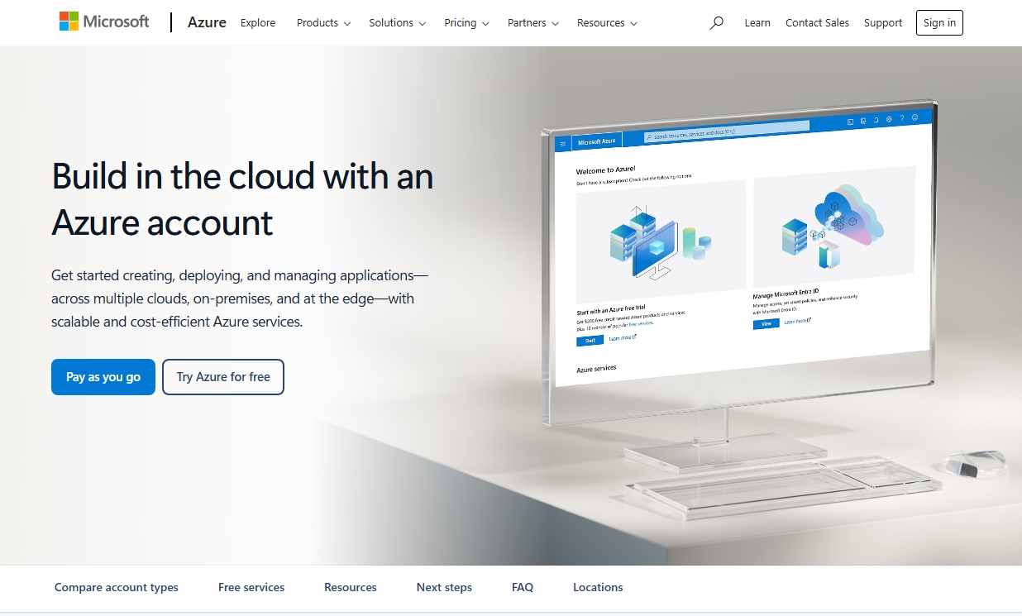
STEP 01
Start at azure.microsoft.com
Two doors on the landing page: Pay as you go, or Try Azure for free. For this course, take the free account.
Modern Enterprise Software Engineering | ÉSTIAM | Day 1

Slide 4
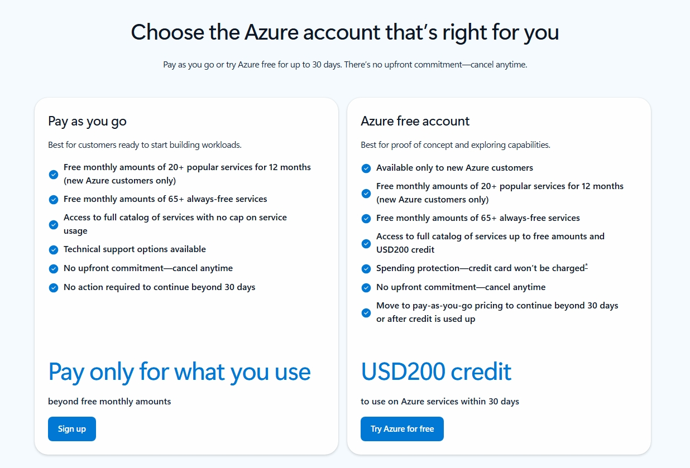
STEP 02
Free account vs. pay as you go
Free account: USD200 credit for 30 days, 12 months of popular services free, and spending protection — the card is not charged automatically.
Modern Enterprise Software Engineering | ÉSTIAM | Day 1

Slide 5
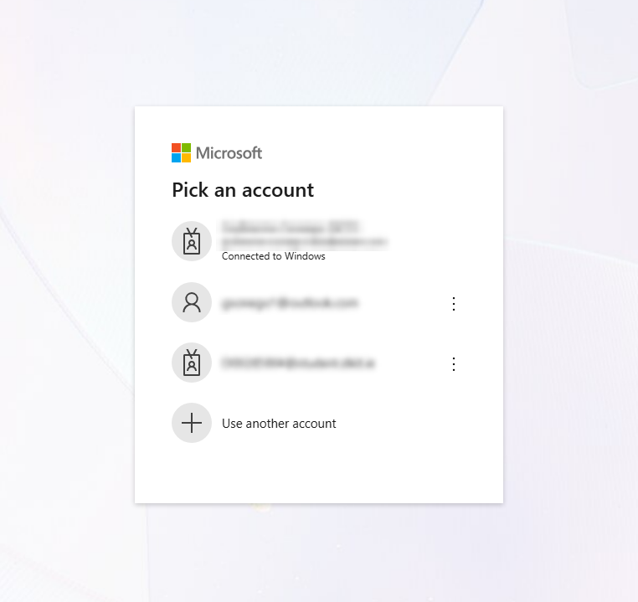
STEP 03
Pick an account — carefully
Windows offers accounts you are already signed in to. Do not use a work or school account here — choose 'Use another account'.
Modern Enterprise Software Engineering | ÉSTIAM | Day 1

Slide 6
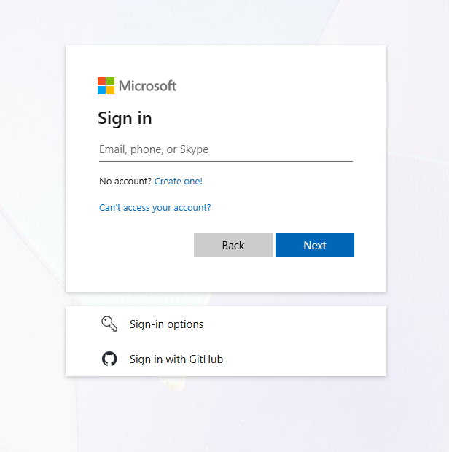
STEP 04
Sign in, or create one
No personal Microsoft account yet? 'Create one!' branches into account creation before the Azure sign-up resumes.
Modern Enterprise Software Engineering | ÉSTIAM | Day 1

Slide 7
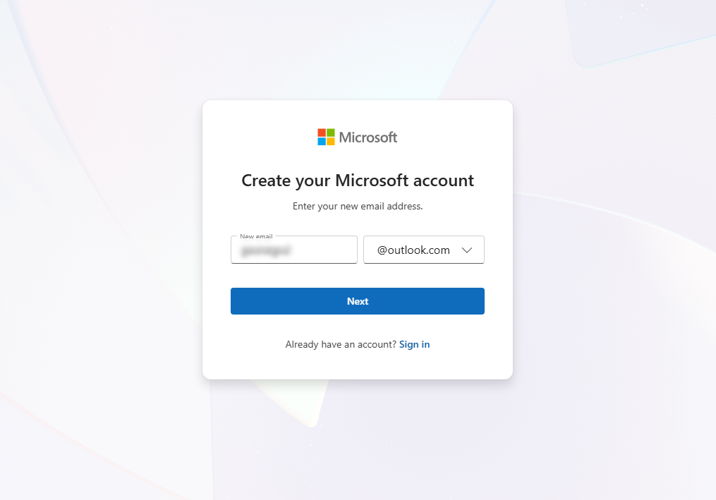
STEP 05
Create your Microsoft account
Pick a new @outlook.com address, or use the dropdown to register an email you already own.
Modern Enterprise Software Engineering | ÉSTIAM | Day 1

Slide 8
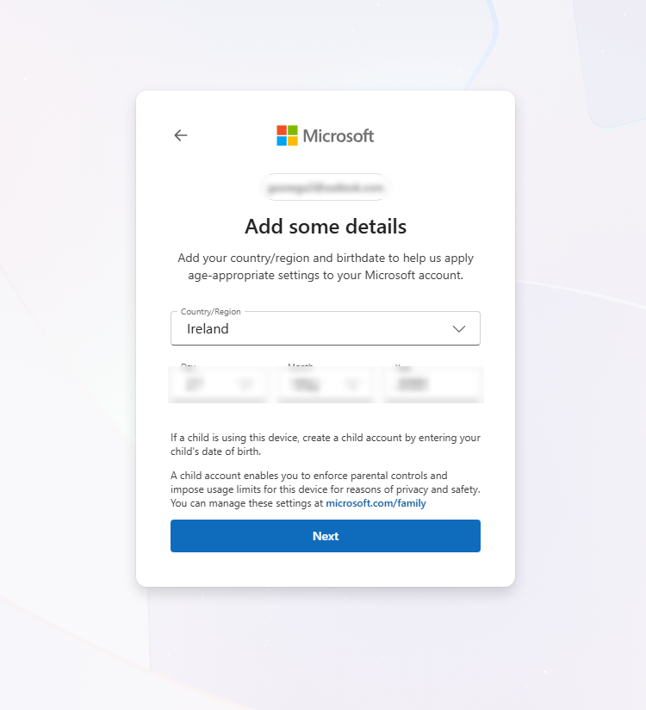
STEP 06
Country/region and date of birth
This country setting is about age-appropriate defaults. The billing country comes later — and that one cannot be changed afterwards.
Modern Enterprise Software Engineering | ÉSTIAM | Day 1

Slide 9
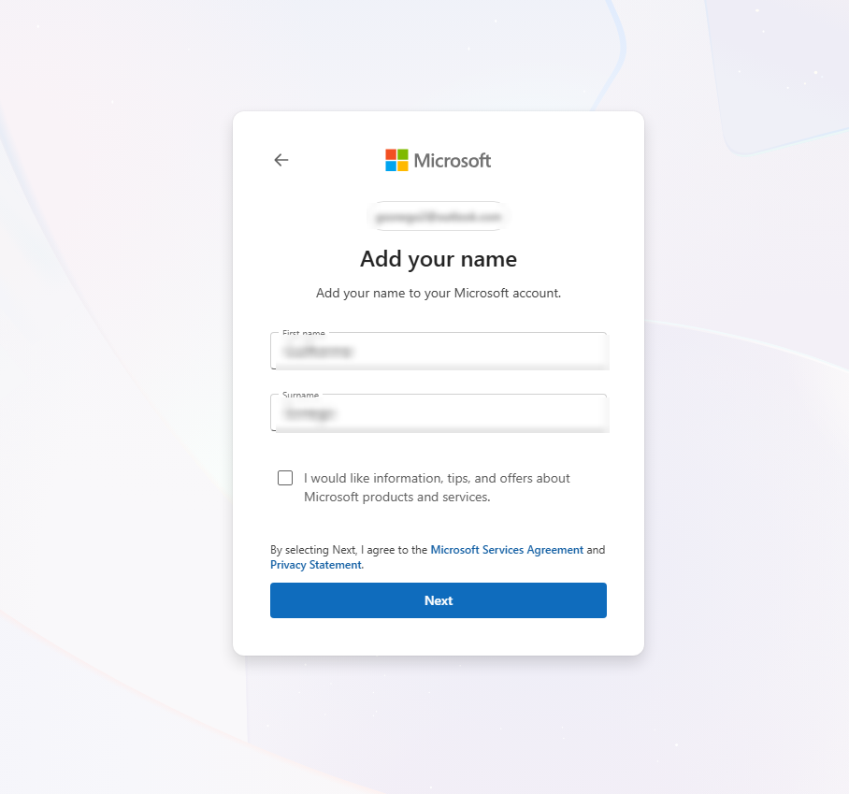
STEP 07
Name on the account
Use the real name — it has to match the card details entered at the payment step.
Modern Enterprise Software Engineering | ÉSTIAM | Day 1

Slide 10
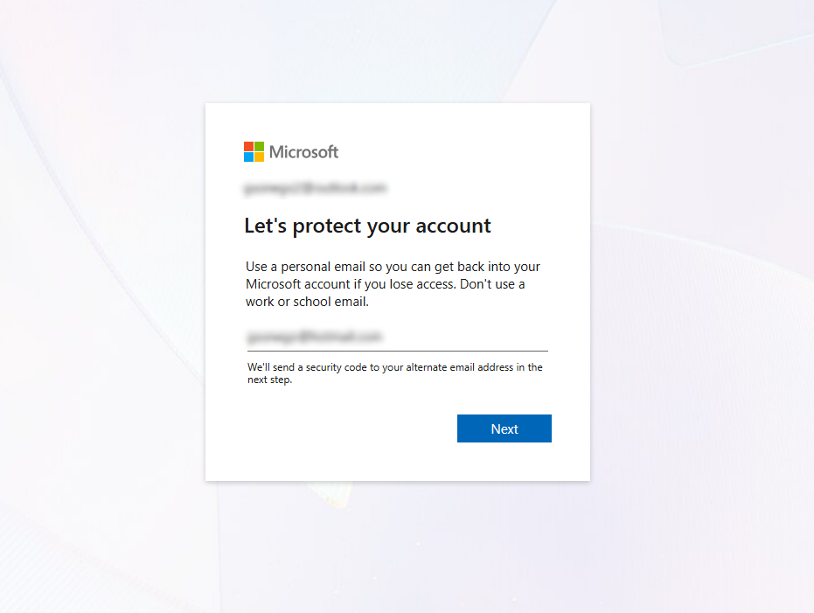
STEP 08
Add a recovery email
An alternate personal address. Microsoft sends a security code there in the next step — again, not a work or school email.
Modern Enterprise Software Engineering | ÉSTIAM | Day 1

Slide 11
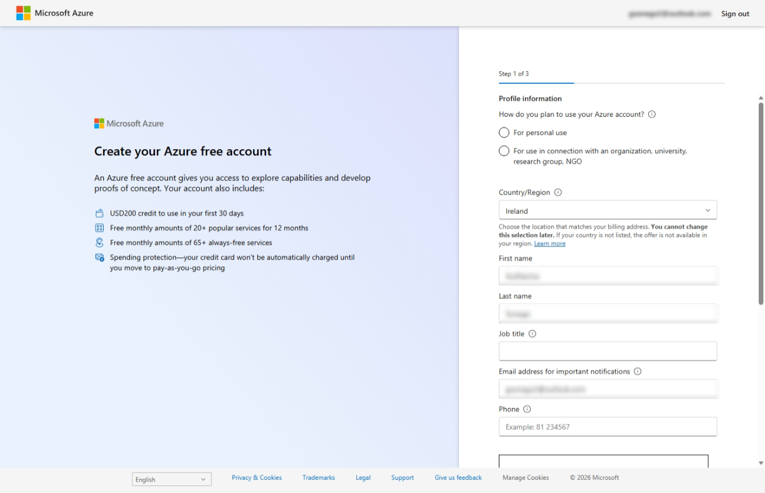
STEP 09
Azure free account — step 1 of 3
Profile information: personal use, country/region, name, notification email, phone. The country/region choice is permanent and sets the billing currency.
Modern Enterprise Software Engineering | ÉSTIAM | Day 1

Slide 12
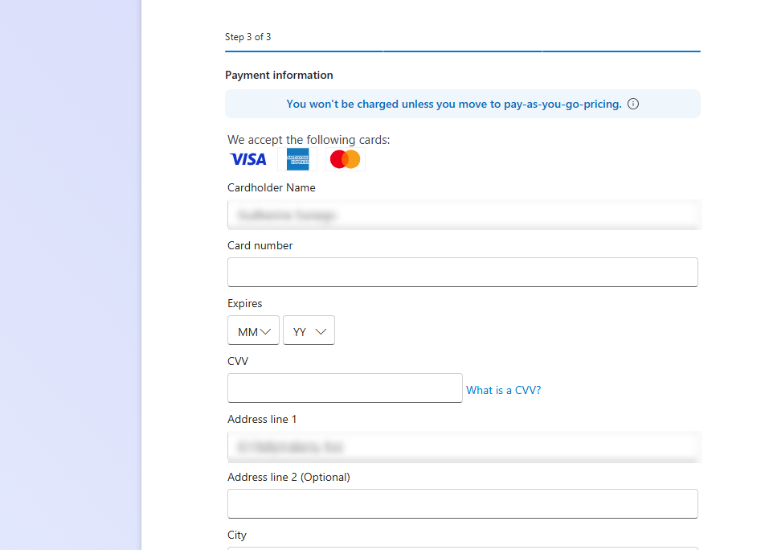
STEP 10
Step 3 of 3 — card verification
A real card is required for identity verification. It is not charged unless you move to pay-as-you-go; a small temporary authorisation may appear and reverse.
Modern Enterprise Software Engineering | ÉSTIAM | Day 1

Slide 13
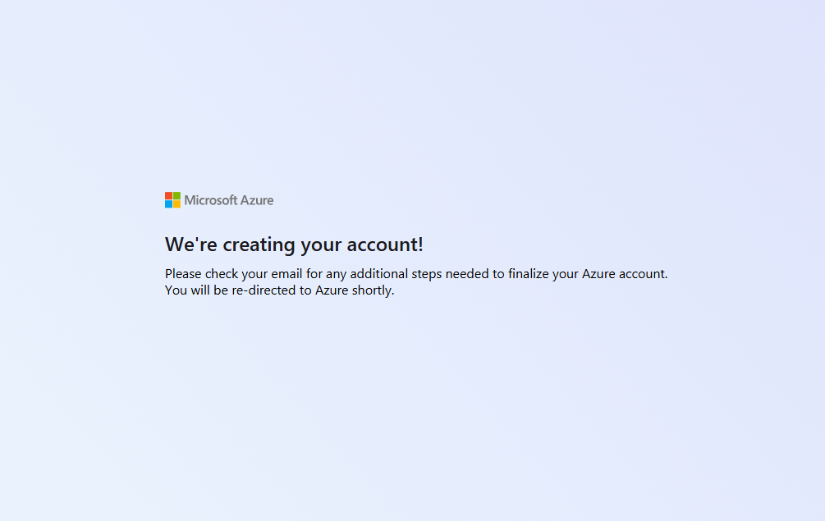
STEP 11
Provisioning the account
Takes a couple of minutes. Check email — some accounts need an extra verification step before Azure finishes.
Modern Enterprise Software Engineering | ÉSTIAM | Day 1

Slide 14
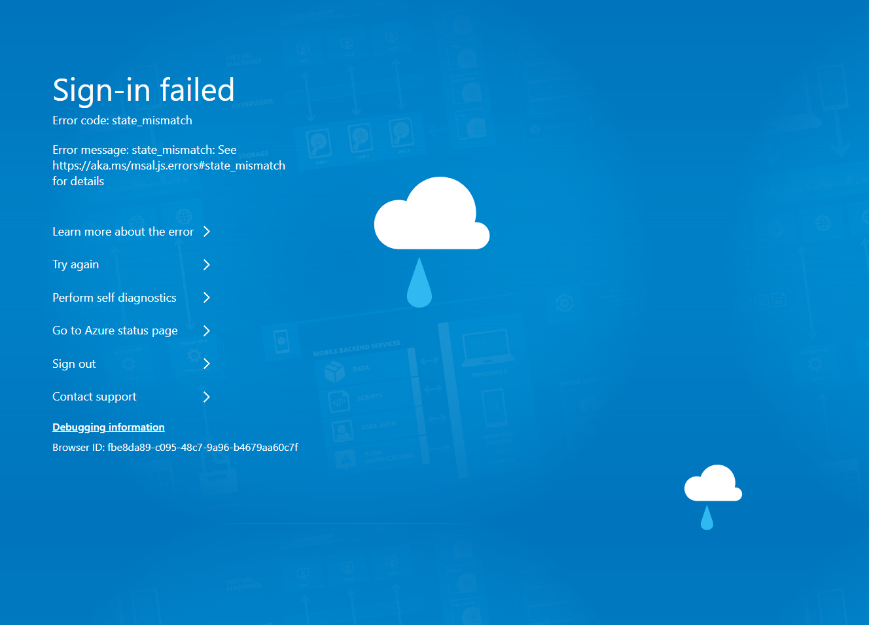
STEP 12
When sign-in fails: state_mismatch
Not a broken account — a stale auth state in the browser. Fix: sign out, clear cookies for the site, or reopen in a private window.
Modern Enterprise Software Engineering | ÉSTIAM | Day 1

Slide 15
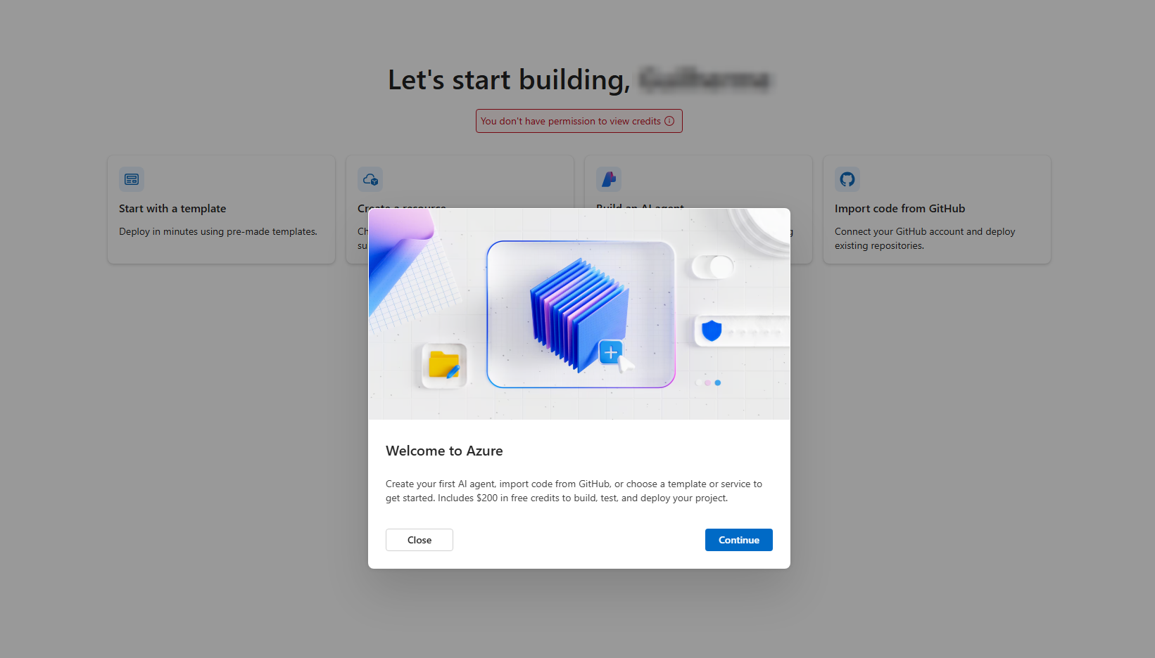
STEP 13
First sign-in to the portal
'You don't have permission to view credits' right after sign-up is normal — billing takes a few minutes to propagate. Refresh later.
Modern Enterprise Software Engineering | ÉSTIAM | Day 1

Slide 16
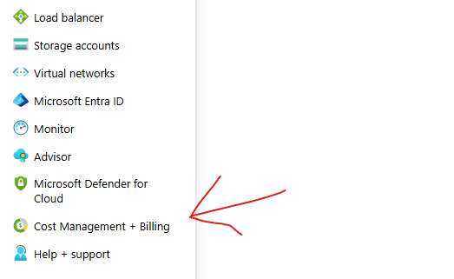
STEP 14
Find Cost Management + Billing
Portal menu, left-hand rail. This is the first thing to configure — before creating a single resource.
Modern Enterprise Software Engineering | ÉSTIAM | Day 1

Slide 17
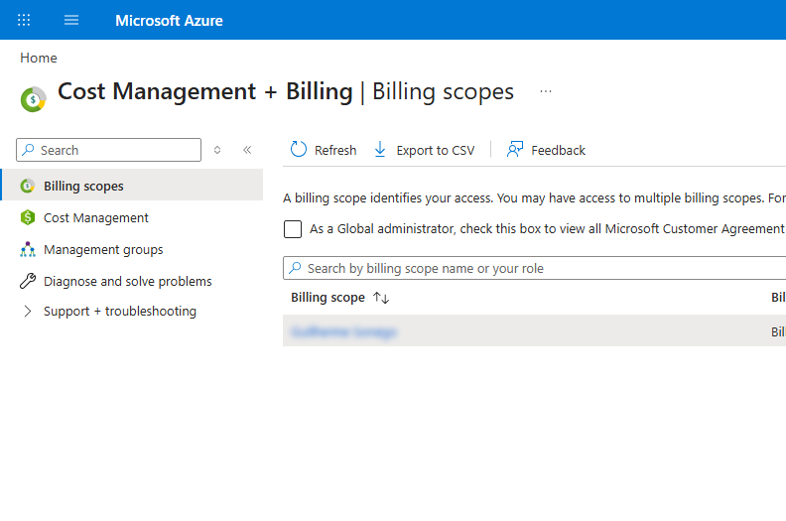
STEP 15
Billing scopes
Your billing account appears here. Open it — budgets are set on a scope, not on an individual resource.
Modern Enterprise Software Engineering | ÉSTIAM | Day 1

Slide 18
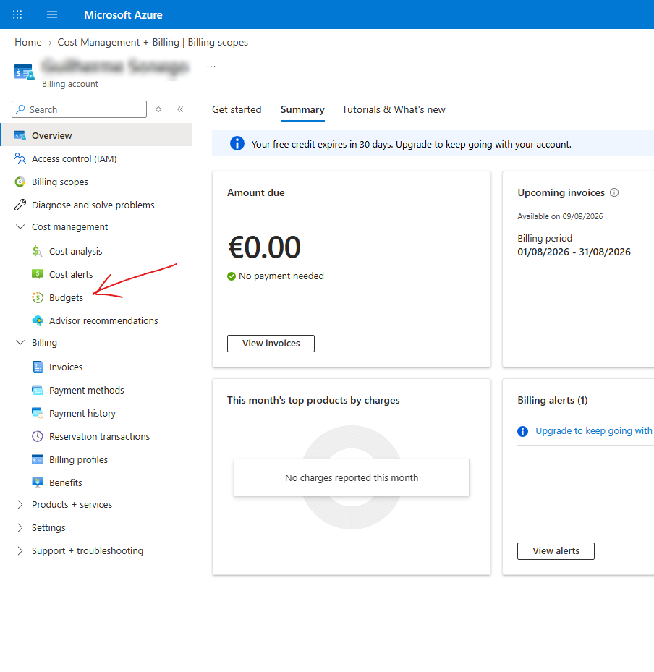
STEP 16
Billing account overview
€0.00 due, free credit expiring in 30 days. Cost management → Budgets is where the guardrail goes.
Modern Enterprise Software Engineering | ÉSTIAM | Day 1

Slide 19
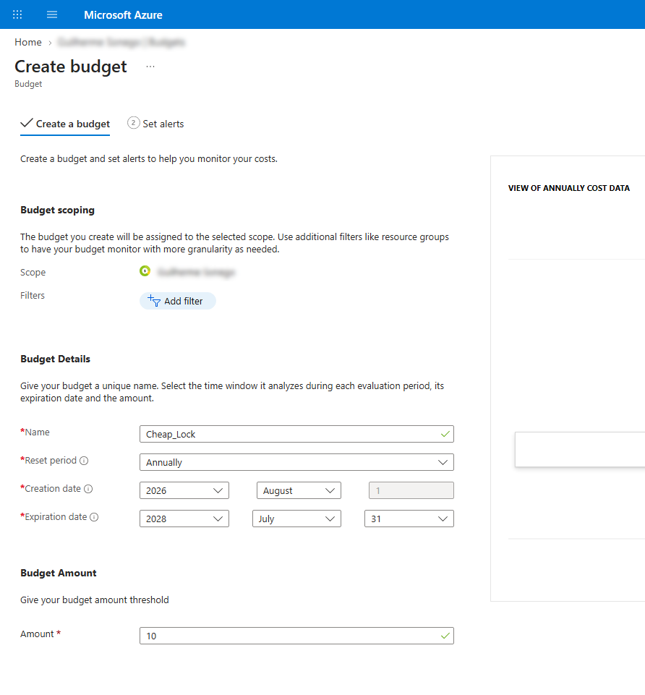
STEP 17
Create a budget
Name it, choose a reset period, set a low amount. This one is annual, €10 — on a free account the point is the alert, not the ceiling.
Modern Enterprise Software Engineering | ÉSTIAM | Day 1

Slide 20
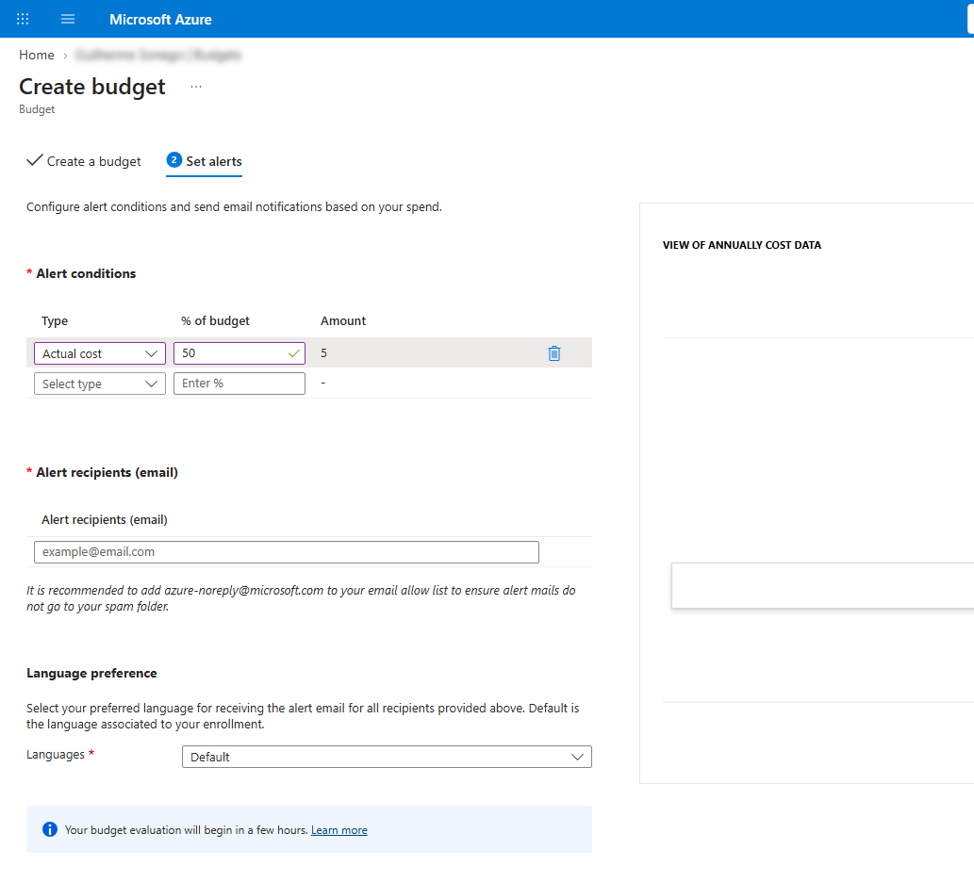
STEP 18
Set the alert
Actual cost at 50% of budget, emailed to you. A budget does not stop spending — it tells you. Allow-list azure-noreply@microsoft.com.
Modern Enterprise Software Engineering | ÉSTIAM | Day 1

Slide 21
Next: Module 1 — Develop Azure Computing Solutions
Everyone has a subscription and a budget alert on it. Now let's put something in it — and start paying attention to what that something costs.

