Slide 1
Title
Name and details

Slide 2
Inventory Management
Considering the big size of the firm, effective and efficient inventory management is of critical importance.
Walmart uses many types of inventory. Each type fulfills a certain role in the firm’s inventory and supply chain. However, the following types of inventory are the most notable in Walmart’s practices:
Finished Goods Inventory
Transit Inventory
Buffer Inventory
Anticipation Inventory
Walmart is known for its advanced information systems. These information systems cover every area of the business. In inventory management, Walmart uses an inventory system that allows suppliers to access data on the inventory levels of their products.

Slide 3
Store System Management
Store system management take care of content of inventory, users and orders.
Store management is "to receive inventory, to protect them while in storage from damage & unauthorized removal, to issue the material in the right quantities, at the right time to the right place and to provide these service promptly and at lease cost"

Slide 4
Employee Management
Objective of the Employee Management
To Store up-to-date information of the employees.
To Make the employees understand the rules of the company
To reduce extra cost for the security of the database
To improve efficiency of company's administration

Slide 5
Finance Management
Finance management determine how financial resources will be used to achieve goals and objectives.
It assigns financial resources to specific programs, activities, or initiatives.
Finance management controls financial resources through the processes of accounting, reconciliation, quality assurance and reporting.
It assessing financial management performance.

Slide 6
Customer Management
Customer management aims to understand, anticipate and manage the needs of an organization's current and potential customers.
It provides seamless integration of every area of business that touches the customer-namely marketing, sales, customer services and field support through the integration of people, process and technology.
Customer management focuses on the retention of customers in addition to the acquisition of new customers.

Slide 7
Components of Architecture
Database: It will store information of inventory, users information,
employee and payment details.
Store: This is the component of store system management.
Employee: Later now a lot of manual power is down by keeping kiosk/self order desks in retail market.

Slide 8
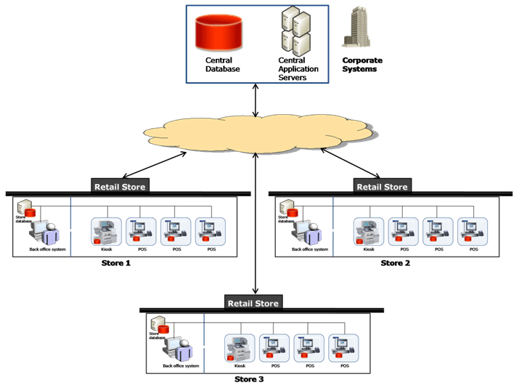
Distributed Software

Slide 9
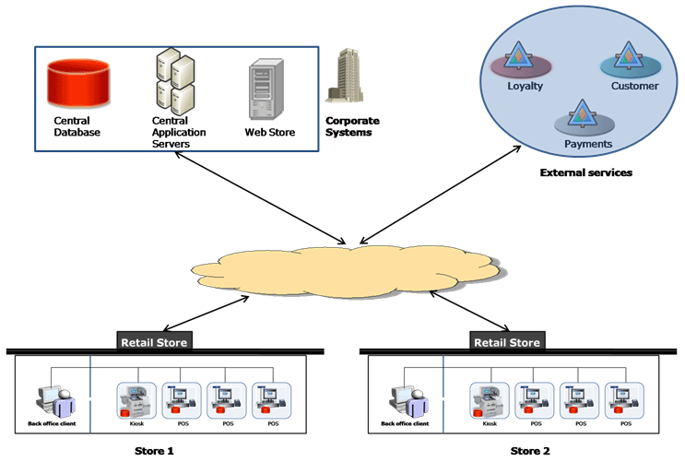
Service Oriented Software

Slide 10
Conclusion
The IT industry is going through a major change and technology is enabling this disruption. The lowering cost of bandwidth, the availability of computing in new and cheaper forms factors and devices, and the increases in productivity and usability have caused a massive growth in services over the Internet. The retail industry, which operates on razor-thin margins, can certainly take advantage of these services to reduce overall cost and enhance services.

