Slide 1



Journey to the center of movies
James Bryant II, Amee Yang, Rebecca Lubera, & Greg Spahlinger
(aka ’The Brat Pack’)

Slide 2
goals
Identify correlations between user ratings and various factors that influences user enjoyment.
Different variables that track enjoyment are budget, gross revenue, runtime, release year, release month, etc.
Metric IMDb user ratings

Slide 3
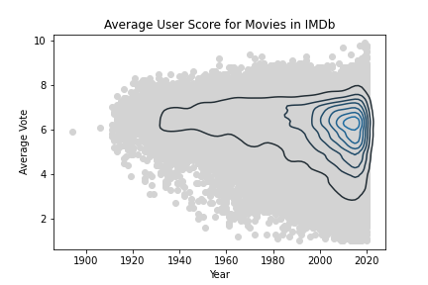
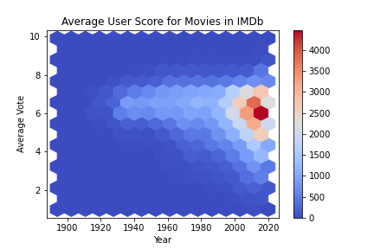
Figure 1 – The Average Score Distribution of Movies on IMDb Broadens Downward Over Time.
Throughout time the central tendency of the score data doesn’t change all that much. From the 1920s onward, most of the movies are getting average scores between a 5 and a 7. The most obvious change that can be observed is the broadening of the scores into the lower reaches of the scale. In the earliest movies there are practically no cases of movies with average scores lower than 4, but by 2000 these became fairly common, and they got more common as the 21st century progressed. There are a number of interpretations we could make for this trend, but all of them are speculative. It could be that as the movie industry progressed, more movies are being released that are considered “bad” (boring, tasteless, offensive, etc.) or it could be that the bad ones from the early days have been forgotten, and are not included in the database.

Slide 4
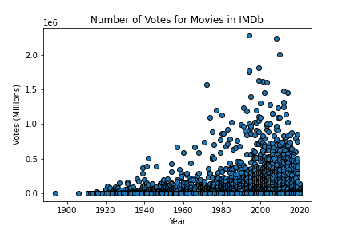
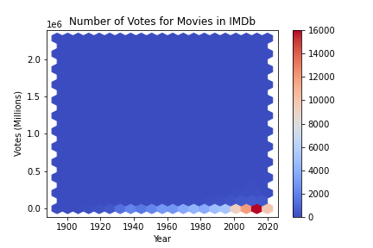
Figure 2 – The Number of Votes for an Average Movie is Consistently Low - With Significant Outliers.
The hexbin plot in figure 2 has a y axis formatted in the millions, but it’s clear from the plot that almost all the data lined up on the bottom of the plot.
This oddity is clarified by the scatter plot to the left of it. For the entire 20th and 21st centuries, the median number of votes for a movie in IMDb has stayed between 100 and 700 votes, with some oscillation (data not shown). As time has passed, a significant number of outliers have appeared, which dwarf the level of engagement of the average movie by orders of magnitude.
Big budget “Hollywood movies” are outliers with respect to the dataset as a whole.

Slide 5
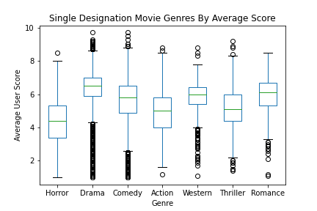
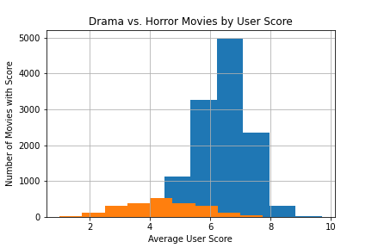
Figure 3 – Audiences are More Likely to Give High Marks to Drama, Less Likely to Praise Horror.
Of these singly designated movies, the drama films were most numerous (12543 films) and had the highest median score (6.5). The least numerous single category we looked at was romance, which contained 439 films. The lowest rated genre was horror, with a median score of 4.4. Figure 3 shows a comparison of these categories using a boxplot, which shows some notable differences.

Slide 6
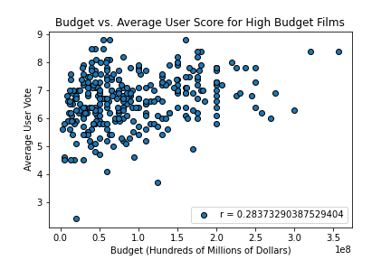
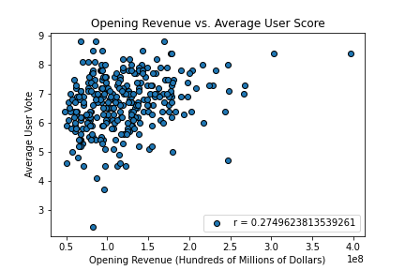
Figure 4 – Budget and Opening Revenue Show Weak Correlation with Average User Score in Big Budget Films
In figure 4 we can see that budget and opening revenue are weakly correlated to average user vote (roughly 0.28 and 0.27 respectively).

Slide 7
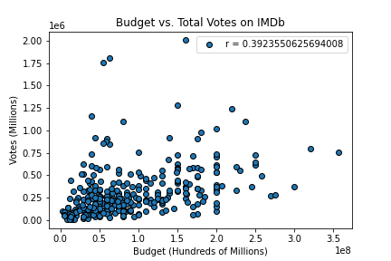
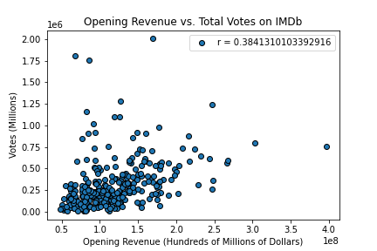
Figure 5 – Budget and Opening Revenue Show a Slightly Stronger Correlation with Total Votes in Big Budget Films
It appears that the more money is spent on a movie, or the more that it makes on opening weekend, the less likely it is to be panned by its audience. The opposite does not appear to be true though, as there are a large number of points that show lower budget films, and lower earning films getting high average scores. Budget and opening weekend revenue appear correlated with the total number of votes to a slightly higher degree (0.39 and 0.38 respectively) but still not all that strongly.

Slide 8
Conclusion
CERTAIN GENRES HAVE HIGHER SCORES THAN OTHERS
MORE RECENT MOVIES ARE CONSIDERED CRAPPY
EACH FILMS PROFIT DON’T DETERMINE USER SCORE (BIG BUDGET MOVIES)

