Slide 1



Journey to the center of movies
James Bryant II, Amee Yang, Rebecca Lubera, & Greg Spahlinger
(aka ’The Brat Pack’)

Slide 2
goals
Hypothesis: Measurable quantities that correlate user enjoyment
Using two different metrics of average votes and number of votes
Release Year, Opening Revenue, Budget, Duration, etc.
Predicting what viewers like = Money

Slide 3
Acquisition and Cleaning
Acquire Data from Kaggle - two useful sets
Removed unnecessary columns
During exploration found bad year value, but fix it
Merged two data sets on (name)
Filtered bad merges
Drop null values
IMDb extensive – 85,855 entries
IMDb merged with opening revenue – 304 entries

Slide 4
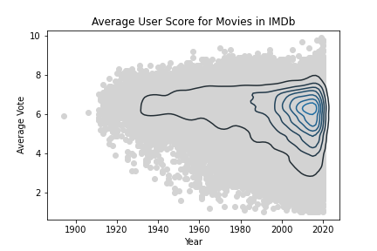
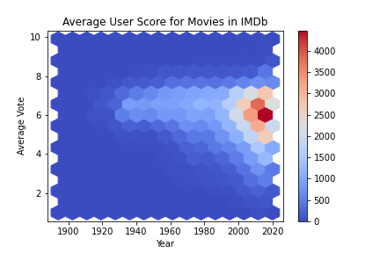
Figure 1 – The Average Score Distribution of Movies on IMDb Broadens Downward Over Time.
From the 1920s onward, most of the movies are getting average scores between a 5 and a 7.
More lower score movies as were getting towards the present.

Slide 5
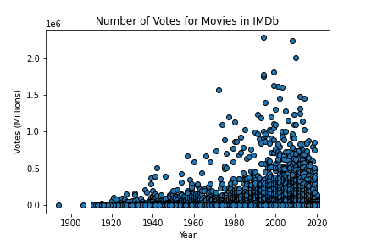
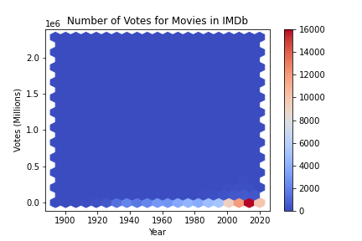
Figure 2 – The Number of Votes for an Average Movie is Consistently Low - With Significant Outliers.
Most movies in the database only get median votes between 400-700.
Outliers have millions of votes (big budget films)

Slide 6
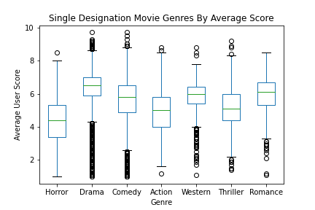
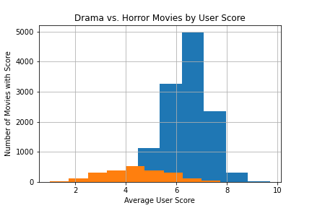
Figure 3 – Audiences are More Likely to Give High Marks to Drama, Less Likely to Praise Horror.
The drama films were most numerous (12543 films) and had the highest median score (6.5).
The least numerous single category we looked at was romance, which contained 439 films.
The lowest rated genre was horror, with a median score of 4.4.
Differences were found statistically significant

Slide 7
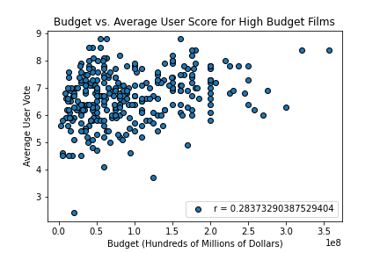
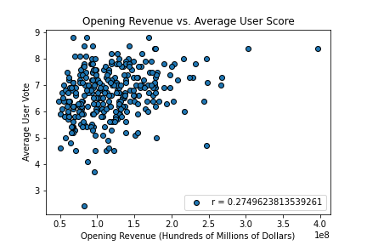
Figure 4 – Budget and Opening Revenue Show Weak Correlation with Average User Score in Big Budget Films
In figure 4 we can see that budget and opening revenue are weakly correlated to average user vote (roughly 0.28 and 0.27 respectively).
-Merged Data of 304 entries

Slide 8
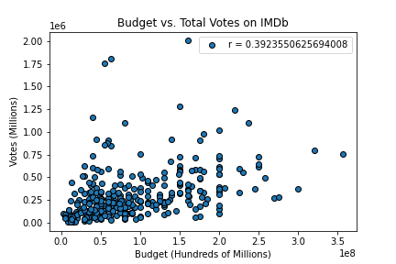
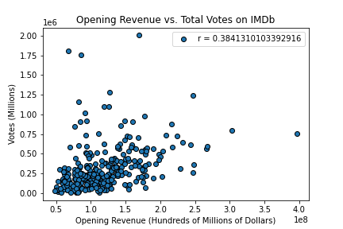
Figure 5 – Budget and Opening Revenue Show a Slightly Stronger Correlation with Total Votes in Big Budget Films
- Budget correlates slightly stronger with total number of votes vs the average user score

Slide 9
Conclusion
CERTAIN GENRES HAVE HIGHER SCORES THAN OTHERS
MORE RECENT MOVIES ARE MORE LIKELY CONSIDERED UNLIKABLE ON IMDb
EACH FILMS PROFIT DON’T DETERMINE USER SCORE (BIG BUDGET MOVIES)

