Slide 1

JBoss Drools example of expert system, or develop your own House, M.D.
Przemek Różycki
Cybercom Poland

Slide 2
Knowledge Representation and Reasoning (KRR)
KRR is about how we represent our knowledge in symbolic form, i.e. how we describe something.
Reasoning is about how we go about the act of thinking using this knowledge.
The whole concept of Drools is based around Knowledge Representation and Reasoning

Slide 3
What is rule engine?
The rule engine is the computer program that delivers KRR functionality to the developer. At a high level it has three components:
Ontology
Rules
Data
In practice, it’s any system that use rules in any form, that can be applied to data to produce outcome.

Slide 4
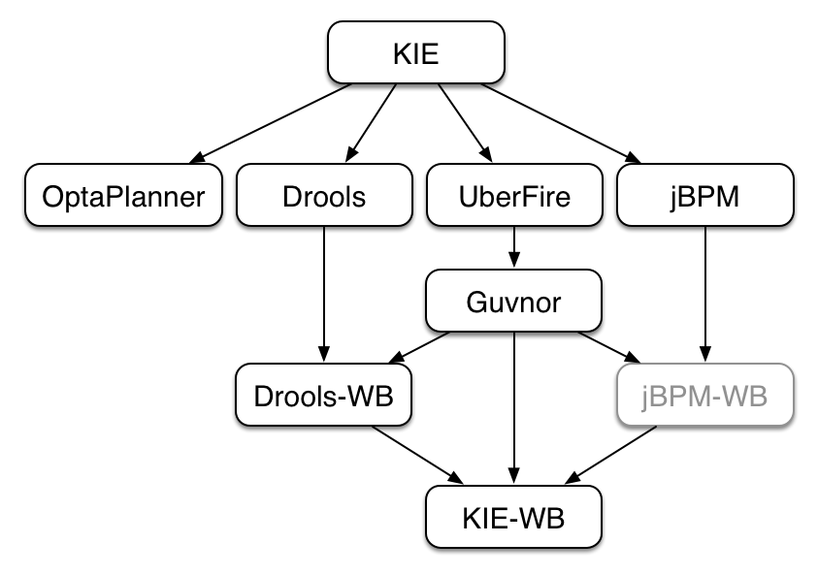
KIE – Knowledge Is Everything

Slide 5
Knowledge representation in Drools
insert(new Fact())

Slide 6
Drools rule
rule "Hello World"
when
m : Message( status == Message.HELLO, myMessage : message )
then
System.out.println( myMessage );
m.setMessage( "Goodbye cruel world" );
m.setStatus( Message.GOODBYE );
update( m );
end

Slide 7
Left Hand Side (LHS)
when
condition 1
condition 2

Slide 8
Left Hand Side (conditions)
when
f : Fact ( confirmed == true)
vehicle : Vehicle (noOfWheels > 2)
eval ()

Slide 9
Right Hand Side (RHS)
then
insert(fact)
insertLogical(fact)
update(fact)
retract(fact)
modify ( <fact-expression> ) {
<expression>
[ , <expression> ]
}
some Java

Slide 10
Knowlegde base
KnowledgeBuilder knowledgeBuilder =
KnowledgeBuilderFactory.newKnowledgeBuilder();
Resource diagnosticRuleResource =
ResourceFactory.newClassPathResource(„diagnostics.drl");
knowledgeBuilder.add(diagnosticRuleResource , ResourceType.DRL);
if (knowledgeBuilder.hasErrors()) {
//handle errors
}
knowledgeBase = knowledgeBuilder.newKnowledgeBase();

Slide 11
Stateful session
StatefulKnowledgeSession session = knowledgeBase.newStatefulKnowledgeSession();
session.insert(new ChestPain().exists());

Slide 12
Fire!
session.fireAllRules();

Slide 13
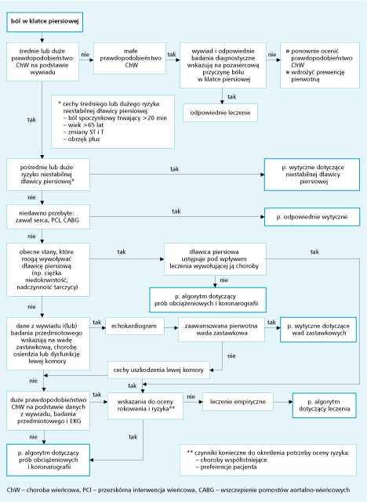
Postępowanie w przewlekłej stabilnej dławicy piersiowej

Slide 14
Changesets
<change-set> <add> <resource source='myrules.drl' type='DRL' /> </add> </change-set>
KnowledgeBuilder kbuilder = KnowledgeBuilderFactory.newKnowledgeBuilder();
kbuilder.add(
ResourceFactory.newClasspathResource( "myChangeSet.xml", getClass() ),
ResourceType.CHANGE_SET );

Slide 15
Knowledge Agents
KnowledgeAgent kagent =
KnowledgeAgentFactory.newKnowledgeAgent("MyAgent"); kagent.applyChangeSet(
ResourceFactory.newUrlResource( url )); KnowledgeBase kbase = kagent.getKnowledgeBase();
ResourceFactory.getResourceChangeNotifierService().start(); ResourceFactory.getResourceChangeScannerService().start();

Slide 16
Domain Specific Languages
[when]There is a person with name of "{name}„ = Person(name=="{name}")
[when]Person is at least {age} years old and lives in "{location}” = Person(age >= {age}, location=="{location}")
[then]Log "{message}„ = System.out.println("{message}");
[when]And = and

Slide 17
Persistence framework integration
Environment env = KnowledgeBaseFactory.newEnvironment(); env.set( EnvironmentName.ENTITY_MANAGER_FACTORY, Persistence.createEntityManagerFactory( "emf-name" ) ); env.set( EnvironmentName.TRANSACTION_MANAGER, TransactionManagerServices.getTransactionManager() ); StatefulKnowledgeSession ksession = JPAKnowledgeService.newStatefulKnowledgeSession( kbase, null, env ); int sessionId = ksession.getId(); UserTransaction ut = (UserTransaction) new InitialContext().lookup(
"java:comp/UserTransaction" ); ut.begin(); ksession.insert( data1 ); ksession.insert( data2 ); ksession.startProcess( "process1" ); ut.commit();

Slide 18
Adventages of rule engine
Declarative programming
Logic and data separation
Speed and Scalability
Centralization of Knowledge
Tool Integration
Explanation facility
Understandable rules

Slide 19
When to use, when not to
The problem is too fiddly for traditional code
The problem is beyond any obvious algorithmic solution
The logic changes often
Domain experts are readily available and nontechnical
Rules engines are not really intended to handle workflow or process executions nor are workflow engines or process management tools designed to do rules. Use the right tool for the job. Sure, a pair of pliers can be used as a hammering tool in a pinch, but that's not what it's designed for.

Slide 20
JBoss Drools example of expert system, or develop your own House, M.D.
Thank you for your attention!
Any questions?
by Przemek Różycki

