Slide 1

JBoss Drools example of expert system, or develop your own House, M.D.
Przemek Różycki
Cybercom Poland

Slide 2
Inspirations
Artificial Intelligence
Knowledge Representation and Reasoning
Prolog
Recent years have seen a revolution in both the content and the methodology of work in artificial intelligence. It is now more common to build on existing theories than to propose brand-new ones, to base claims on rigorous theorems or hard experimental evidence rather than on intuition, and to show relevance to real-world applications rather than toy examples.
--Artificial Intelligence: A Modern Approach, Russel and Norvig

Slide 3
Knowledge Representation and Reasoning (KRR)
KRR is about how we represent our knowledge in symbolic form, i.e. how we describe something.
In object oriented languages – objects
Another approaches - OWL
Reasoning is about how we go about the act of thinking using this knowledge.
The whole concept of Drools is based around Knowledge Representation and Reasoning, however it does not require sophisticated tools like OWL

Slide 4
What is rule engine?
The rule engine is the computer program that delivers KRR functionality to the developer. At a high level it has three components:
Ontology
Rules
Data
In practice, it’s any system that use rules in any form, that can be applied to data to produce outcome.

Slide 5
Drools as a Production Rule System (1)
Based on Rete algorithm developed by Charles Forgy in 1974
Fundamental terms:
Rules
when
<conditions>
then
<actions>;
Facts – a piece of empirical knowledge about world

Slide 6
Drools as a Production Rule System (2)
The rule enginge (inference engine) matches facts against rules which is called pattern matching
Actions execute in response to changes in data, like a database trigger; we say this is a data driven approach to reasoning
The actions themselves can change data, which in turn could match against other rules causing them to fire; this is referred to as forward chaining

Slide 7
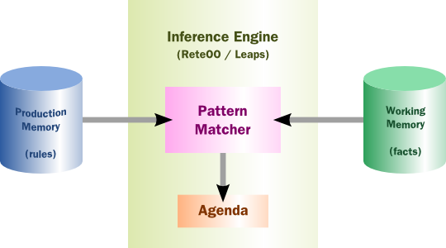
Drools as a Production Rule System (3)

Slide 8
Rules executions algorithms
Rete
ReteOO
PHREAK
Leaps

Slide 9
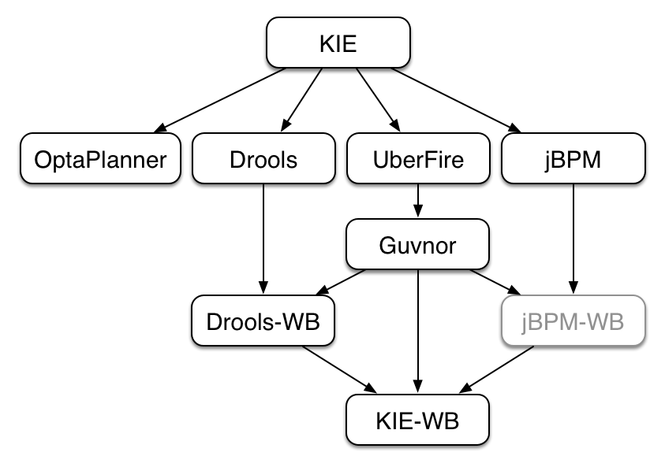
KIE – Knowledge Is Everything

Slide 10
Knowledge representation in Drools
insert(new Fact())

Slide 11
Drools rule
rule "Hello World"
when
m : Message( status == Message.HELLO, myMessage : message )
then
System.out.println( myMessage );
m.setMessage( "Goodbye cruel world" );
m.setStatus( Message.GOODBYE );
update( m );
end

Slide 12
Left Hand Side (LHS)
when
condition 1
condition 2

Slide 13
Left Hand Side (conditions)
when
f : Fact ( confirmed == true)
vehicle : Vehicle (noOfWheels > 2)
eval ()

Slide 14
Right Hand Side (RHS)
then
insert(fact)
insertLogical(fact)
update(fact)
retract(fact)
modify ( <fact-expression> ) {
<expression>
[ , <expression> ]
}
some Java

Slide 15
How to start in practice? (1)
<dependencyManagement>
<dependencies>
<dependency>
<groupId>org.drools</groupId>
<artifactId>drools-bom</artifactId>
<type>pom</type>
<version>6.0.1.Final</version>
<scope>import</scope>
</dependency>
</dependencies>
</dependencyManagement>

Slide 16
How to start in practice? (2)
<dependencies>
<dependency>
<groupId>org.kie</groupId>
<artifactId>kie-api</artifactId>
</dependency>
<dependency>
<groupId>org.drools</groupId>
<artifactId>drools-compiler</artifactId>
</dependency>
</dependencies>

Slide 17
Simplest possible kmodule.xml
<kmodule
xmlns:xsi="http://www.w3.org/2001/XMLSchema-instance"
xmlns="http://jboss.org/kie/6.0.0/kmodule" />

Slide 18
KIE base
KieServices kieServices = KieServices.Factory.get();
KieContainer kieContainer = kieServices.getKieClasspathContainer();
KieBase kieBase = kieContainer.getKieBase();

Slide 19
Stateful session
KieSession session = kieBase.newKieSession();
session.insert(new ChestPain(true));

Slide 20
Fire!
session.fireAllRules();

Slide 21
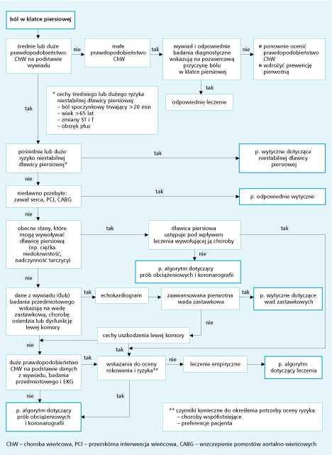
Postępowanie w przewlekłej stabilnej dławicy piersiowej

Slide 22
Execution control
Agenda – defines an order of rules execution
Salience
Agenda groups
Activation groups
Rule flow groups

Slide 23
Truth Maintenance
Insertions – putting fact into working memory
Logical insertions – just firing the rules that are activated by fact
Retraction – removing fact from memory, might also activate some rules
Modification – to activate rules it must be done explicitly from API or in RHS
Objects equality – equals() and hashCode()

Slide 24
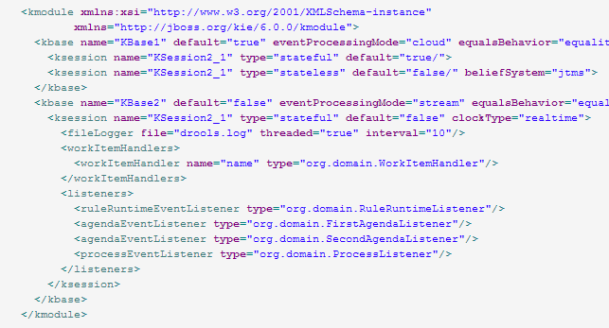
kmodule.xml

Slide 25
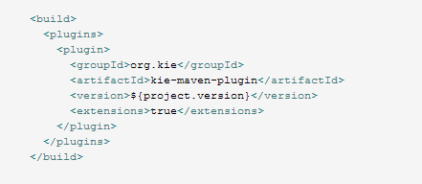
kie-maven-plugin

Slide 26

KieLogger

Slide 27
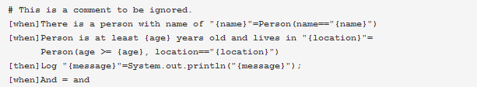
Domain Specific Languages

Slide 28
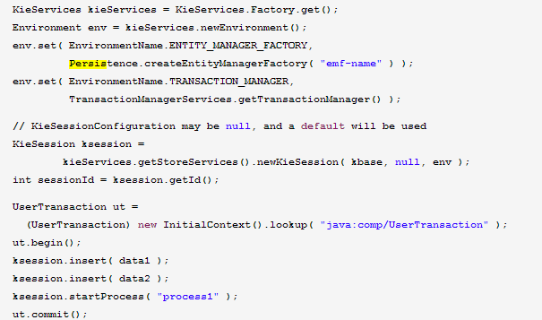
Persistence framework integration

Slide 29
Adventages of rule engine
Declarative programming
Logic and data separation
Speed and Scalability
Centralization of Knowledge
Tool Integration
Explanation facility
Understandable rules

Slide 30
When to use, when not to
The problem is too fiddly for traditional code
The problem is beyond any obvious algorithmic solution
The logic changes often
Domain experts are readily available and nontechnical
Rules engines are not really intended to handle workflow or process executions nor are workflow engines or process management tools designed to do rules. Use the right tool for the job. Sure, a pair of pliers can be used as a hammering tool in a pinch, but that's not what it's designed for.

Slide 31
JBoss Drools example of expert system, or develop your own House, M.D.
Thank you for your attention!
Any questions?
by Przemek Różycki

Slide 32
Links and references
This presentation and examples
https://github.com/rozz/drools-presentation-and-examples/tree/master-drools-6-jug
Drools documentation
http://www.jboss.org/drools/documentation
https://community.jboss.org/wiki/JBossRules
Komercyjne Droolsy RedHata
http://www.redhat.com/products/jbossenterprisemiddleware/business-rules/
by Przemek Różycki

