Slide 1

JBoss Drools example of expert system, or develop your own House, M.D.
Przemek Różycki
Cybercom Poland

Slide 2
Knowledge Representation and Reasoning (KRR)
KRR is about how we represent our knowledge in symbolic form, i.e. how we describe something.
Reasoning is about how we go about the act of thinking using this knowledge.

Slide 3
Knowledge representation in Drools
insert(new Fact())

Slide 4
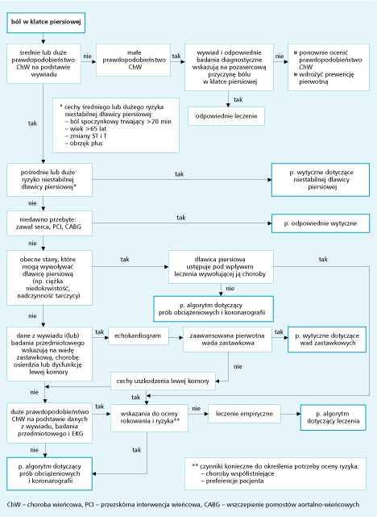
Postępowanie w przewlekłej stabilnej dławicy piersiowej

Slide 5
Drools rule
rule "Hello World"
when
m : Message( status == Message.HELLO, myMessage : message )
then
System.out.println( myMessage );
m.setMessage( "Goodbye cruel world" );
m.setStatus( Message.GOODBYE );
update( m );
end

Slide 6
Left Hand Side
when
condition 1
condition 2

Slide 7
Left Hand Side (conditions)
when
f : Fact ( confirmed == true)
vehicle : Vehicle (noOfWheels > 2)

