Slide 1
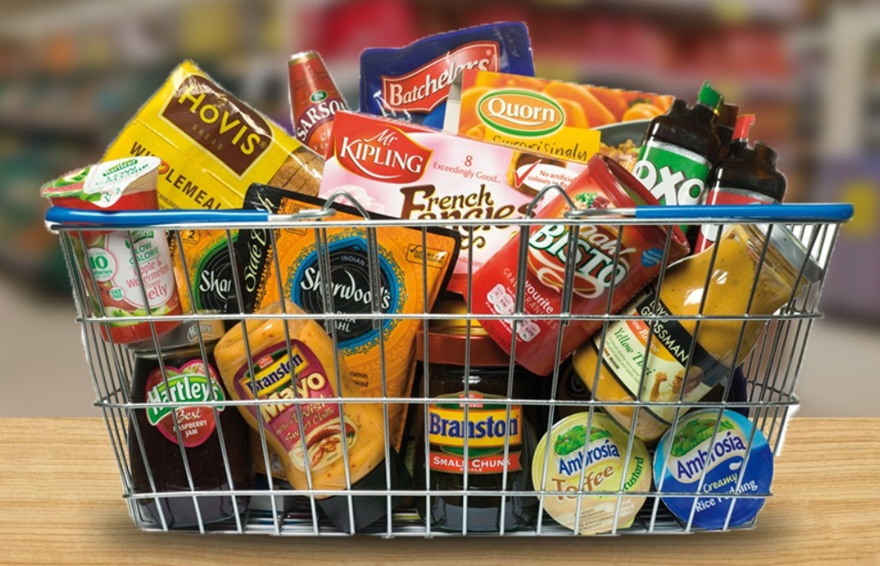
Store ITEM Demand Forecast
TIME SERIES

Slide 2
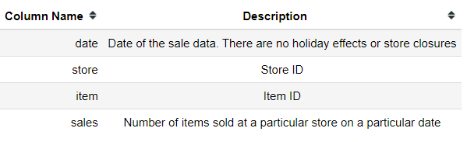
STORE-ITEM DATA SET
About Dataset
Dataset provides information about the number of items sold at a particular store on a particular date
Number of Stores = 10
Number of Items per store = 50
Dataset Description

Slide 3
Exploratory data analysis
Define Problem
Choose Right Tools
Collection of Data
Pre Profiling
Pre Processing of Data
Post Profiling
Ask Right Questions
Conclusion

Slide 4
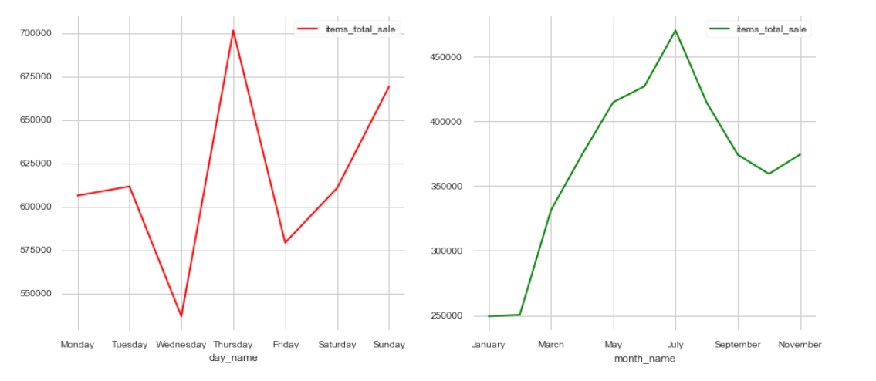
EDA – Sales from store are more in the month and day of ?

Slide 5
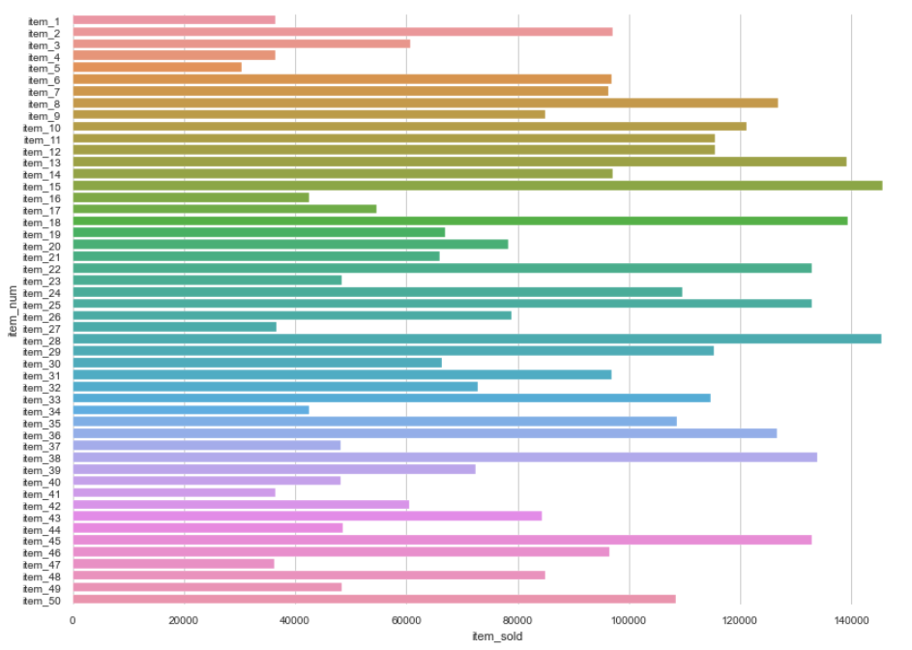
EDA – Which ITEM sold more from a store ?

Slide 6
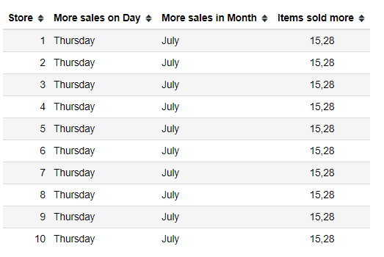
EDA – Summary

Slide 7
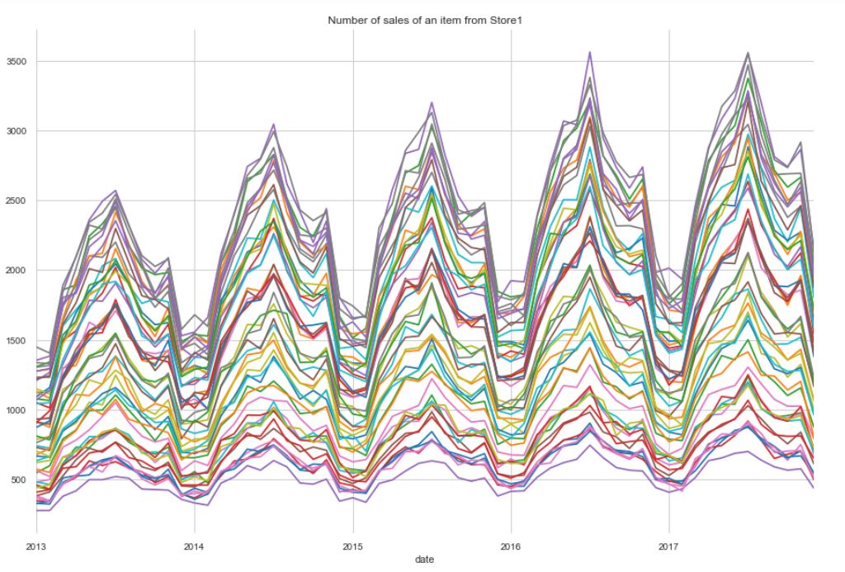
Item sales from Store-1

Slide 8
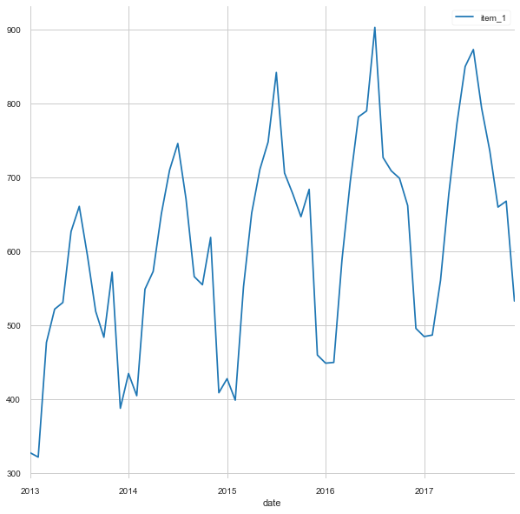
STORE-1 ITEM-1 SALEs TREND ( After Smoothing )

Slide 9
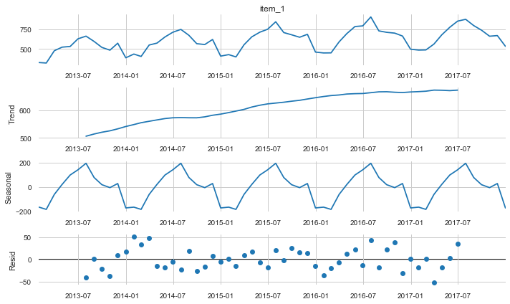
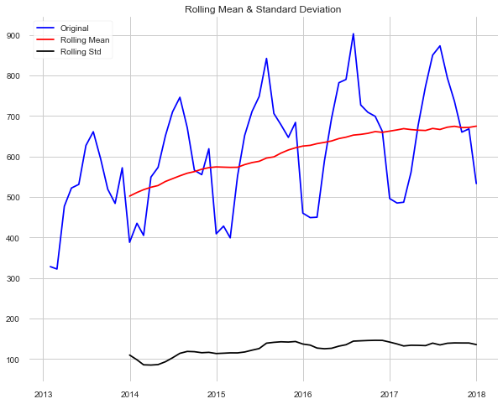
STATIONARITY CHECK & DECOMPOSITION
Augmented Dickey Fuller Test – Time Series is Stationary. But clearly Trend and seasonality is seen from decomposition
KPSS Test – Time Series is Non-Stationary
Augmented Dickey Fuller Test – Time Series is Stationary. But clearly Trend and seasonality is seen from decomposition
KPSS Test – Time Series is Non-Stationary

Slide 10
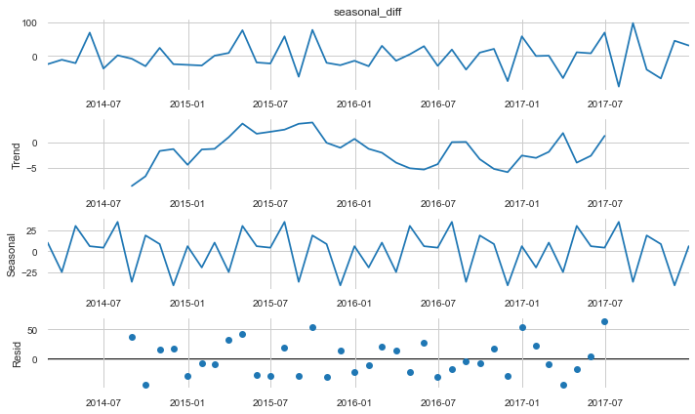
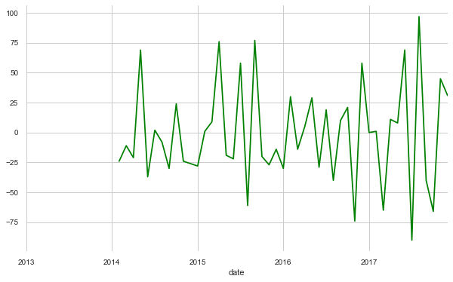
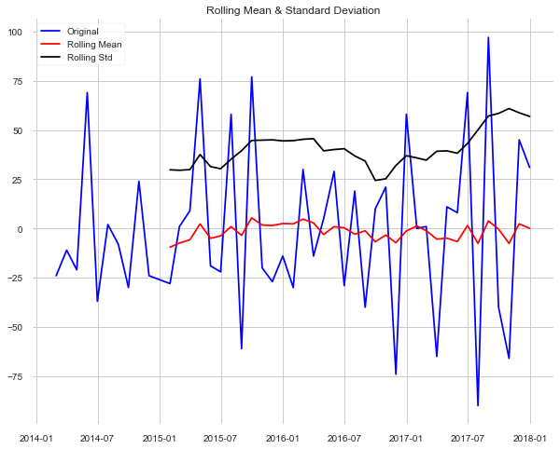
De-TREND (First diff) and DE-SEASONALITY (SEASONAL DIFF )
Augmented Dickey Fuller Test – Time Series is Stationary.
KPSS Test – Time Series is Stationary

Slide 11
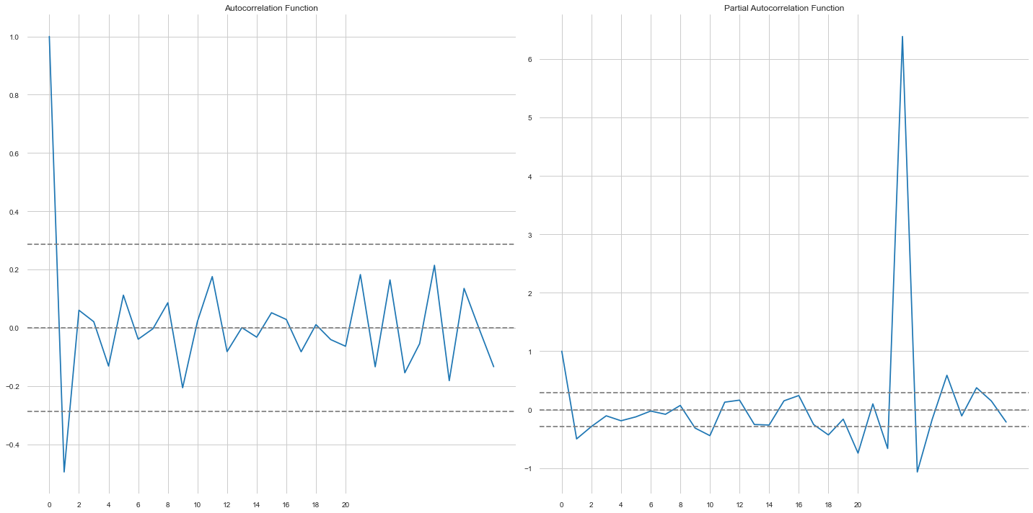
ACF and Pacf plots – p & q values

Slide 12
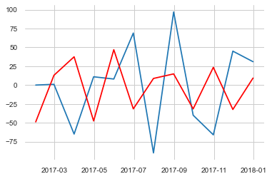
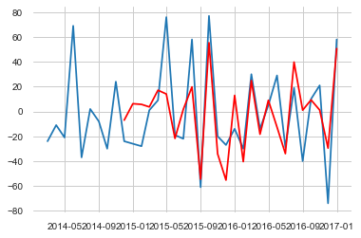
Auto regression (AR) Model

Slide 13
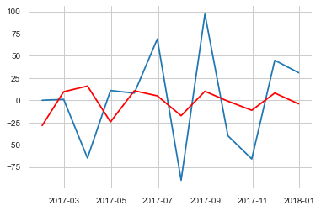
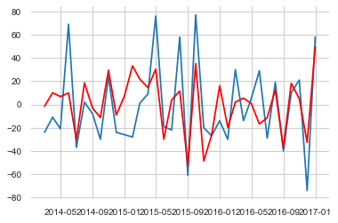
ARMA Model – Best Params (3,3)

Slide 14
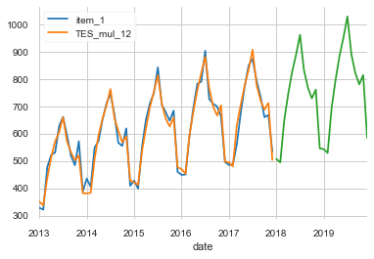
Holt’s-Winter Exponential smoot

Slide 15
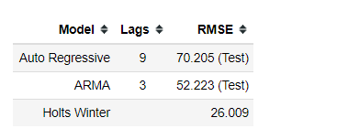
Model comparison
Holts Winter Exponential Smoothing has less RMSE compared to other models – so choosing Triple Exponential smoothing and applying it to all items and stores automatically and forecasting for sales for one year

Slide 16
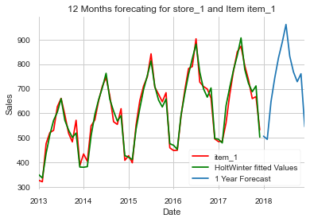
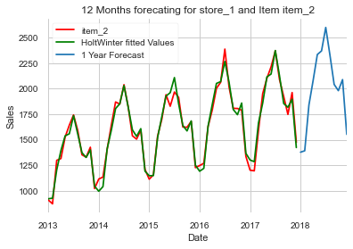
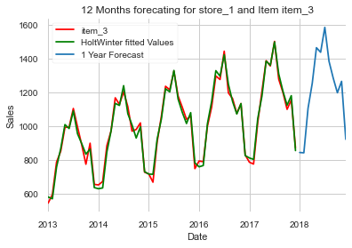
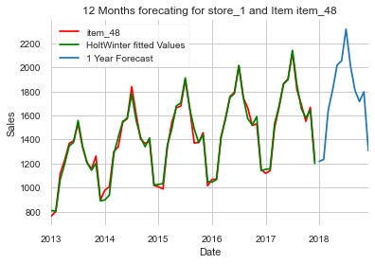
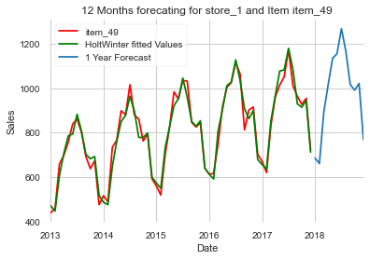
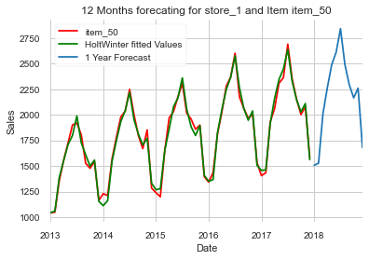
FORECAST for STORE-1 ITEMs

Slide 17

Thank you

