Slide 1
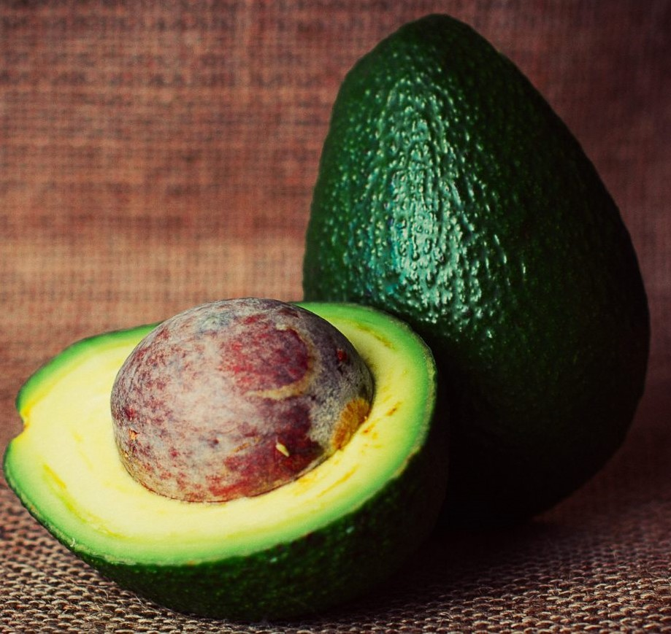
Avocado DatA SET
REGRESSION MODELS

Slide 2
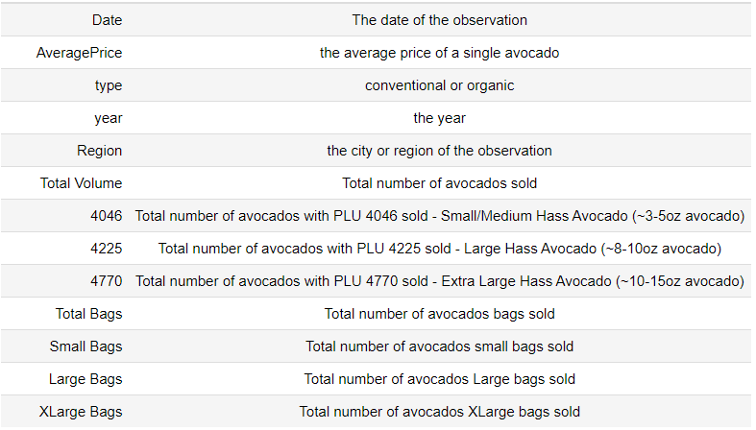
Avocado dataset
About Avocado:
An avocado is a bright green fruit with a large pit and dark leathery skin. They are also known as alligator pears or butter fruit.
Avocado Nutrition:
Avocados have a lot of calories
Avocados are high in fat
Avocados offer nearly 20 vitamins and minerals
Dataset Description:

Slide 3
Exploratory data analysis
Define Problem
Choose Right Tools
Collection of Data
Pre Profiling
Pre Processing of Data
Post Profiling
Ask Right Questions
Conclusion

Slide 4
DEFINE PROBLEM & choose right tools
Define Problem :
1. Which type of Avocados are sold more ?
2. Avocado Sales are more in which Product Lookup code (4046,4225,4770) ?
3. Average Price of an Avocado is more for which type ? Organic or Conventional ?
Choose Right Tools :
NumPy
Pandas
Seaborn
Matplotlib
Pandas Profiling
sklearn

Slide 5
DATA Collection
Load Data into pandas data frame avocado_df | pandas.read_csv(<source>)
Data Frame info avocado_df.info | 18249 rows 13 columns No missing values
Descriptive Statistics avocado_df.describe(include=‘all’) | Highest frequency of sales on a day is 108 Minimum Average Price of Avocado is 0.44 and Maximum is 3.2500 Total Volume,PLU-4046,PLU-4225,PLU-4770,Total Bags, Small Bags, Large Bags, XLarge Bags are Right Skewed Average Total Number of Avocados sold 107376, Min = 84 and Max = 62505646 Average Total Number of PLU-4046 Avocados sold 8645.3, Min = 0 and Max = 22743616 Average Total Number of PLU-4225 Avocados sold 29061.02, Min = 0 and Max = 20470572 Average Total Number of PLU-4770 Avocados sold 184.99, Min = 0 and Max = 2546439 Average Total Number of Bags sold 39743, Minimum = 0 and Maximum = 19373134 Average Total Number of PLU-4046 Bags sold 26362.82, Minimum = 0 and Maximum = 13384586 Average Total Number of PLU-4225 Bags sold 2647.71, Minimum = 0 and Maximum = 5719096 Total Number of PLU-4770 Bags Minimum bags sold = 0 and Maximum bags sold = 551693 conventional type Avocado transactions are high - 9126

Slide 6

Pre-profiling
High cardinality Date has a high cardinality: 169 distinct values region has a high cardinality: 54 distinct values
High correlation Total Volume is highly correlated with 4046, 4225, 4770 4225 is highly correlated with Total Volume and 3 other fields Total Bags is highly correlated with Small Bags, Large Bags
Uniform Date and region are uniformly distributed
Zeros 4046 has 242 (1.3%) zeros 4770 has 5497 (30.1%) zeros Large Bags has 2370 (13.0%) zeros XLarge Bags has 12048 (66.0%) zeros

Slide 7

Data processing & Post-profiling
Convert datatype of columns Total Volume, 4046, 4225, 4770, Total Bags, Small Bags, Large Bags,
XLarge Bags from float64 to int64
High cardinality Date has a high cardinality: 169 distinct values region has a high cardinality: 54 distinct values
High correlation Total Volume is highly correlated with 4046, 4225, 4770 4225 is highly correlated with Total Volume and 3 other fields Total Bags is highly correlated with Small Bags, Large Bags
Uniform Date and region are uniformly distributed
Zeros 4046 has 242 (1.3%) zeros 4770 has 5497 (30.1%) zeros Large Bags has 2370 (13.0%) zeros XLarge Bags has 12048 (66.0%) zeros

Slide 8
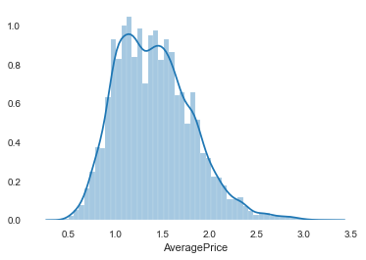
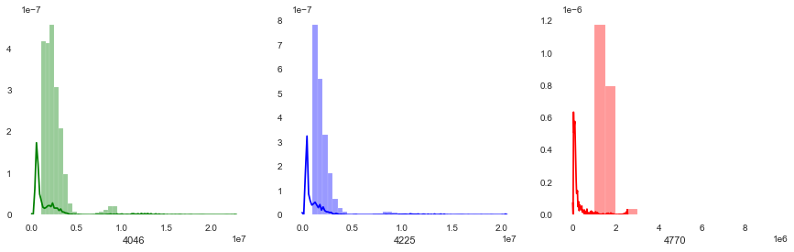
Average price & different Plu distribution
Average price is slightly right-skewed because organic avocados are high in price compared to conventional avocados
PLU-4225 Avocado are sold more than other types

Slide 9
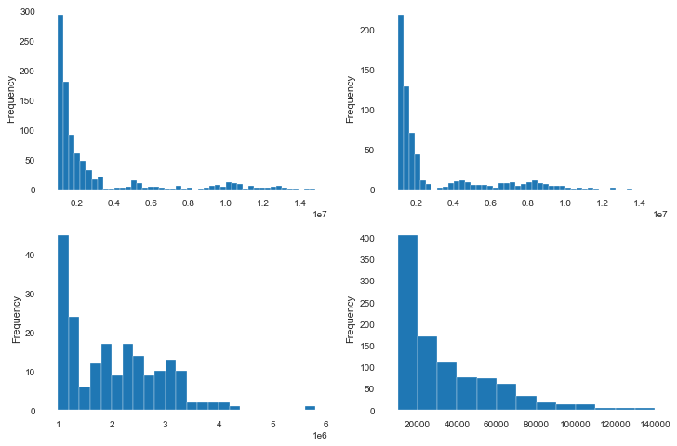
Avocado sold through bags - distribution
Total Bags
Small Bags
Large Bags
XLarge Bags
More number of avocados sold in small bags

Slide 10
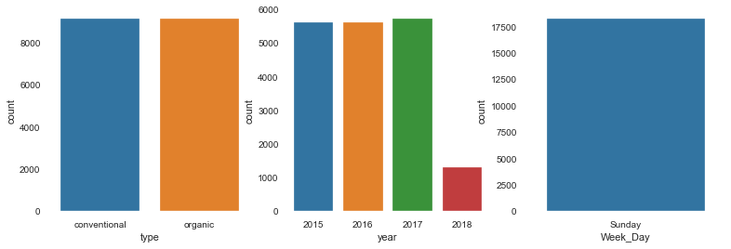
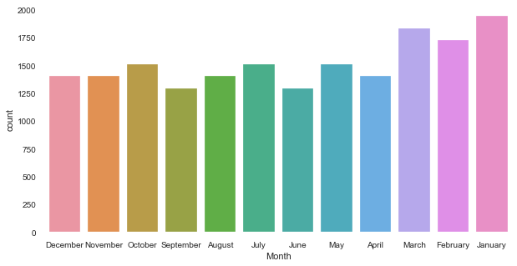
Avocado TRANSACTION STATS
Conventional type avocado sale transactions are more compared to organic type
More number of avocado sale transactions are seen in the year 2017
All avocado sale transactions happened only on Sunday
More number of avocado sale transactions are seen in the month of January

Slide 11
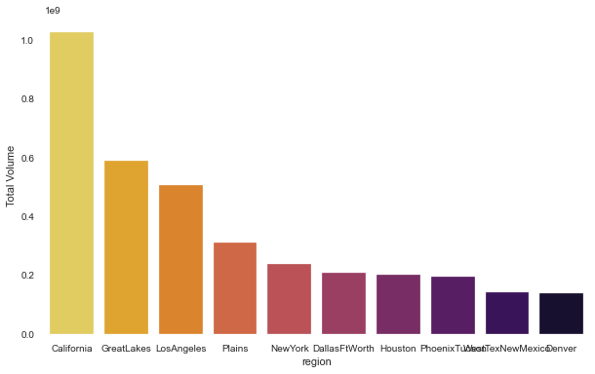
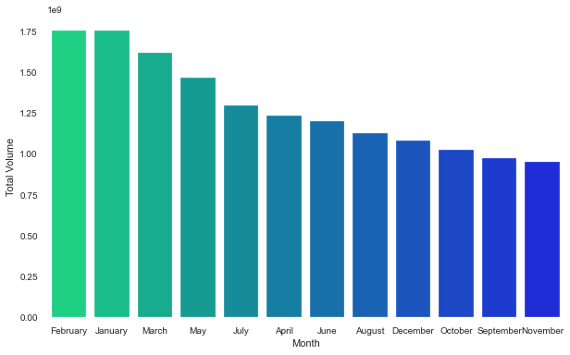
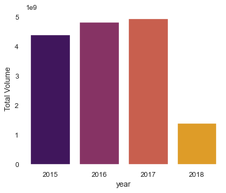
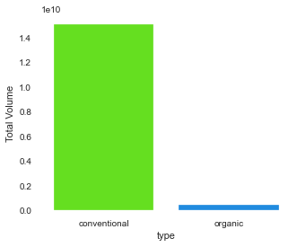
STATS for NUMBER of Avocados sold
More number of avocado’s sold are of type Conventional
More number of avocado’s sold in the year 2017
More number of avocado’s sold in the state of California
More number of avocado’s sold in the month of February

Slide 12
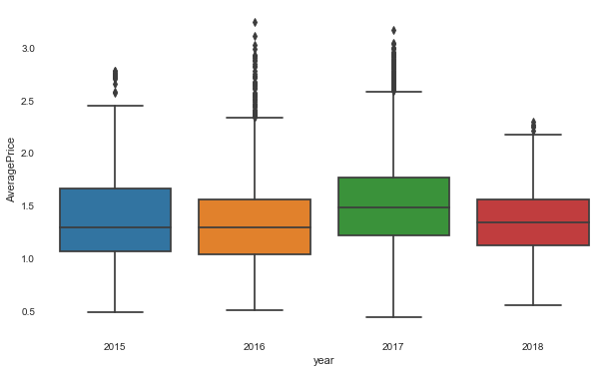
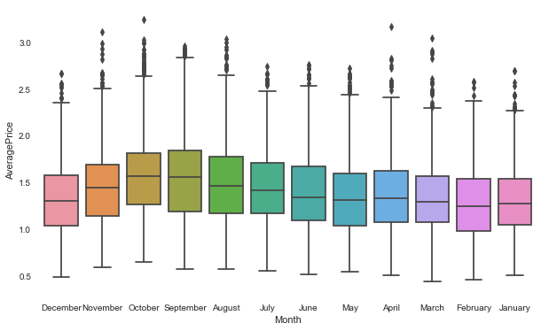
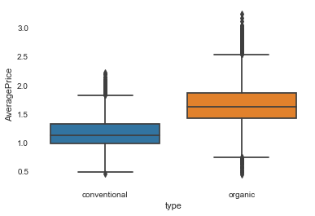
Avocado stats on Average price
Average price of an avocado is high in the month of October
Average price of an avocado is high in the year 2017
Average price of an avocado is high for Organic type

Slide 13
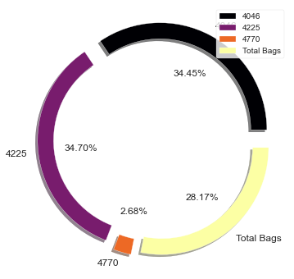
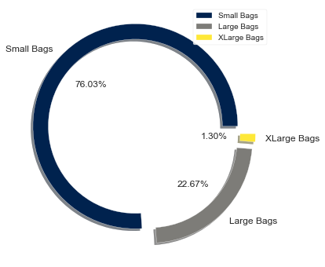
Avocado Volume & BAGS Percentage of distribution
PLU 4225 type avocados sold more around 34.70% of total number of avocados sold followed by PLU 4046
Around 76.03% Avocados are sold through Small Bags out of Avocados sold through all bags

Slide 14
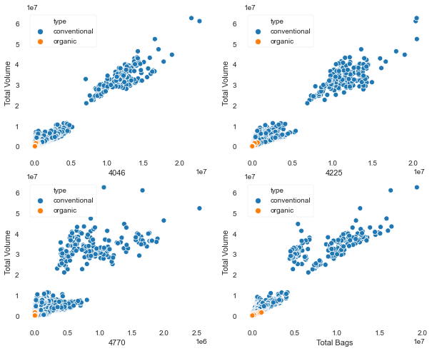
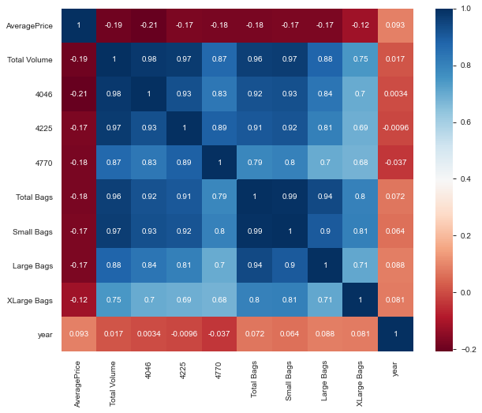
Multivariate Analysis

Slide 15
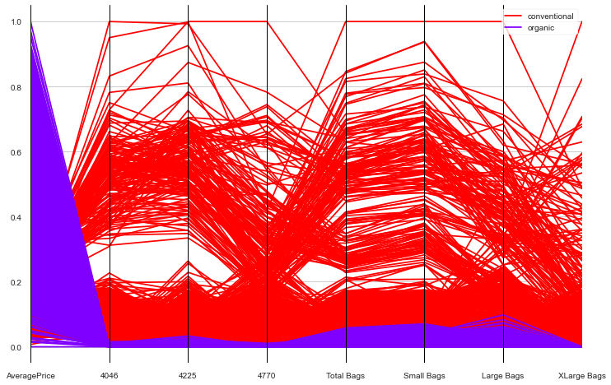
PARALLEL Coordinates
Conventional Type Avocados are sold more in number than Organic Type
Average Price of Organic Type Avocado is more than Conventional Type

Slide 16
Machine Learning MODEL
Objective
Assumptions
Train-Test Split & Standardization ( Scaling )
Linear Regression Model & Model Evaluation
Decision Tree Model & Model Evaluation
Random Forest & Model Evaluation
Choose the Best Fit Model

Slide 17
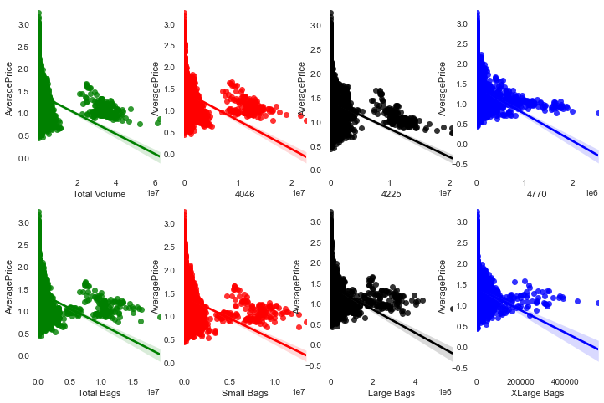
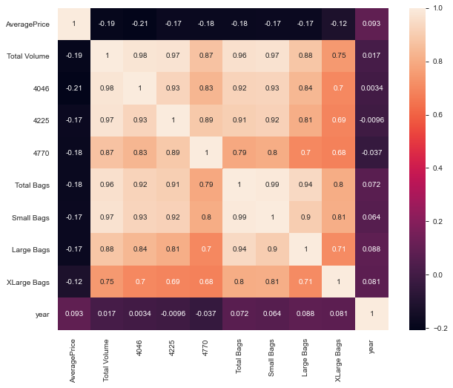
Objective & ASSUMPTIONS
Objective :
Build a regression model which predicts Average price of an Avocado
Supervised Learning Approach – Target variable is continuous – Regression Model
Assumptions :
Assumption-1 : Target Variable should be Normally distributed - True
Assumption-2 : Should have Linear relationship between Explanatory variables and Target variable - True
Assumption-3 : No Multicollinearity – Dropped Total Volume Column which has high correlation

Slide 18
Train-Test Split & Scaling
Train-Test Split :
Dataset is divided in the ratio of 80-20.Using 80% of data we train the model and remaining 20% of data is used to test the model
Best fit model will be selected using
Root Mean Square Error - Low RMSE is good
R-Squared ( Explained Variance ) - High R-squared is good
Adjusted R-square - High Adjusted R-squared is good
One-Hot Encoding:
Performed One Hot Encoding for the Categorical columns using get_dummies() method in python
Columns on which One Hot Encoding performed – type, region, Month
Standardization ( Scaling ) :
Performed StandardScaler ( Z-score ) fit & transform operation on all the columns to bring different scales onto a single scale

Slide 19
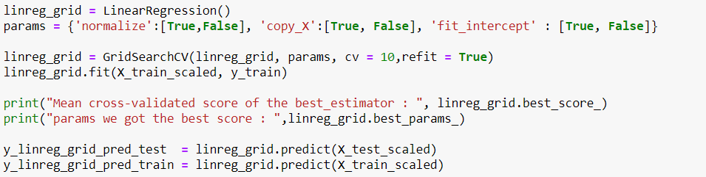







Linear Regression MODELS
Hyper Tuning using GridSeachCV

Slide 20
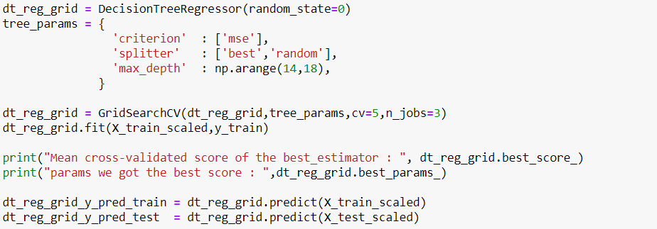







Decision Tree Regressor MODELS
Hyper Tuning using GridSeachCV

Slide 21
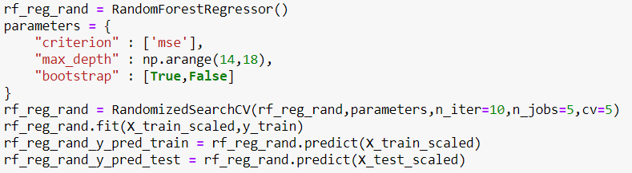







Random Forest Regressor Models
Hyper Tuning using RandomSeachCV

Slide 22
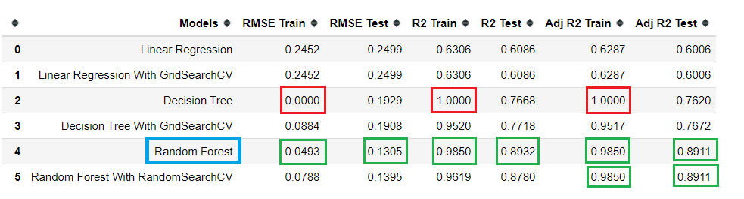
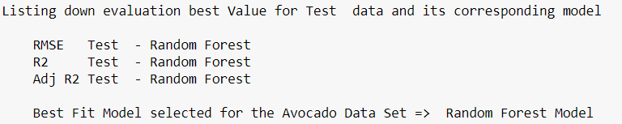
Choose Best FIT MODEL

Slide 23
Summary
Average Price of an Avocado is slightly right skewed but Normally Distributed
PLU 4225 Avocado Sales are more compared to other Product Lookup Codes
Avocado sales are more through small bags compared with other size of bags
Sale transactions of Avocado are more of type conventional
Sale transactions of Avocado are more in the year 2017
Transactions of Avocado Sales happened only on Sunday
Avocado Sale transactions are more in the month of January
More Number of Avocados sold in the month of February followed by January
More Number of Avocados sold in the state of California
More Number of Avocados sold in the year 2017
Conventional Type of Avocados are sold more than Organic Type
Average Price of an Avocado is more in the month of October
Average Price of an Avocado is more in the year of 2017
Average Price of an Organic type of Avocado is more than Conventional type
Sale Percentage of Total Volume of Avocados sold
PLU 4046 - 34.45%
PLU 4225 - 34.70%
PLU 4770 - 2.68%
Bags - 28.17%
Sale Percentage of Avocados sold in bags
Small Bags - 76.03%
Large Bags - 22.67%
XLarge Bags - 1.30%

Slide 24
Conclusion
Conventional Type of Avocados are sold more than Organic Type
4225 type Product Lookup Code Avocados are sold more than other products
Average Price of an Organic type Avocado is more than Conventional type Avocado

Slide 25


