Slide 1

Exploratory Data Analysis

Slide 2
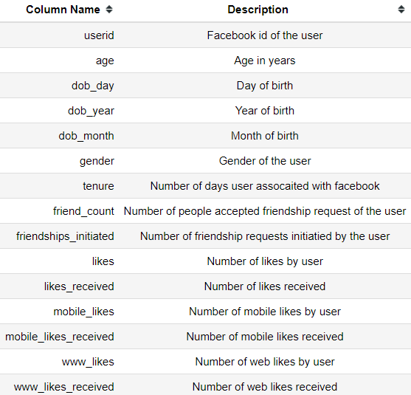
Facebook Data Set
About Facebook:
Facebook is an American online social media and social networking service based in Menlo Park, California and a flagship service of the namesake company Facebook, Inc.
It was founded by Mark Zuckerberg, along with fellow Harvard College students and roommates
Dataset Description

Slide 3
Exploratory Data Analysis
Define Problem
Choose Right Tools
Collection of Data
Pre Profiling
Pre Processing of Data
Post Profiling
Ask Right Questions
Conclusion

Slide 4
Define Problem & Choose Right Tools
Define Problem:
Which age group of users are more attracted towards Facebook ?
What mode of access users preferring ? web or mobile ?
Who has good networking ? Male or Female ?
Choose Right Tools:
Pandas
NumPy
Matplotlib
Seaborn
Pandas Profiling

Slide 5
Data Collection
Load Data into pandas data frame fb_df | pandas.read_csv(<source>)
Data Frame info fb_df.info | 99003 rows 15 columns Columns with ,missing values : gender & tenure
Descriptive Statistics fb_df.describe(include=‘all’) | minimum age 13 and maximum age is 113 age is right skewed [ mean(37 years) > median (28 years) ] users born in between 1900 - 2000 Male users are more in number highest tenure for a user on facebook is 3139 days highest friend count for a user is 4923 highest friendship requests initiated is 4144 highest number of likes is 25111 highest number of likes received is 261197 highest number of mobile likes is 25111 highest number of mobile likes received 138561 highest number of www likes 14865 highest number of www likes received 129953

Slide 6

Pre-Profiling
Observations:
friend_count has 1962 (2.0%) zeros friendships_initiated has 2997 (3.0%) zeros likes has 22308 (22.5%) zeros likes_received has 24428 (24.7%) zeros mobile_likes has 35056 (35.4%) zeros mobile_likes_received has 30003 (30.3%) zeros www_likes has 60999 (61.6%) zeros www_likes_received has 36864 (37.2%) zeros
dob_year is highly correlated with age likes_received is highly correlated with www_likes_recevied and mobile_likes_received
likes_received, www_likes_received, mobile_likes_recieved are highly skewed
userid has unique values

Slide 7
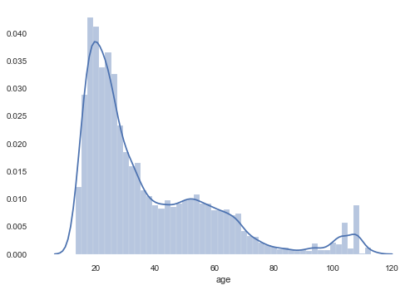
Pre-Processing of Data
Drop rows where age > 80 years
combine dob_day, dob_month and dob_year column and convert into datetime64[ns] type
Drop columns userid, dob_day, dob_month, dob_year
fill missing values in gender column with mode of that column 'male’
Drop duplicates

Slide 8

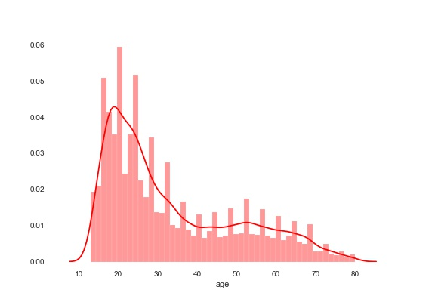
Post-Profiling
Observations:
friend_count has 1962 (2.0%) zeros friendships_initiated has 2997 (3.0%) zeros likes has 22308 (22.5%) zeros likes_received has 24428 (24.7%) zeros mobile_likes has 35056 (35.4%) zeros mobile_likes_received has 30003 (30.3%) zeros www_likes has 60999 (61.6%) zeros www_likes_received has 36864 (37.2%) zeros
likes_received is highly correlated with www_likes_recevied and mobile_likes_received
likes_received, www_likes_received, mobile_likes_recieved are highly skewed

Slide 9
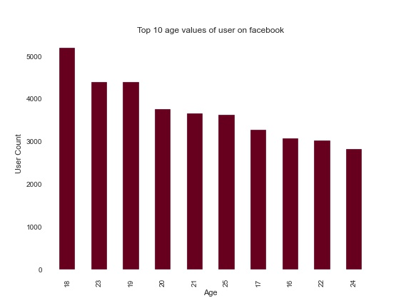
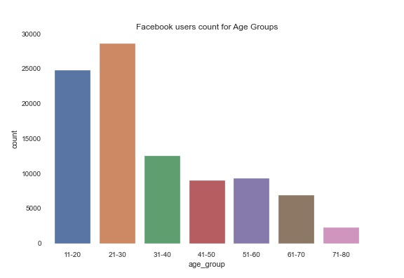
Which age group and age value of users are more on facebook ?
Facebook users are more in the age-group 21-30 years
Teenagers ( 18 years ) are more on Facebook

Slide 10
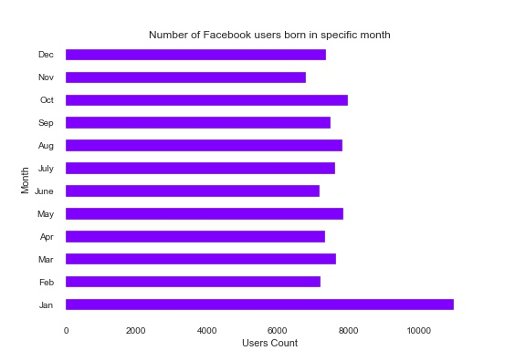
Month in which facebook users born most
More number of facebook users are born in the month of January

Slide 11
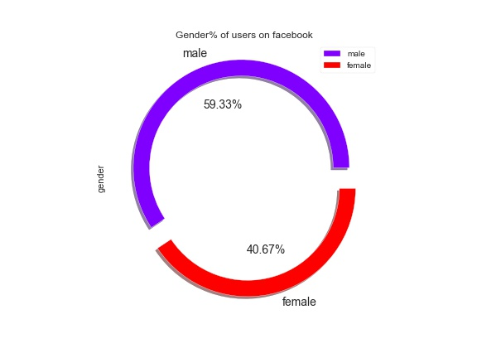
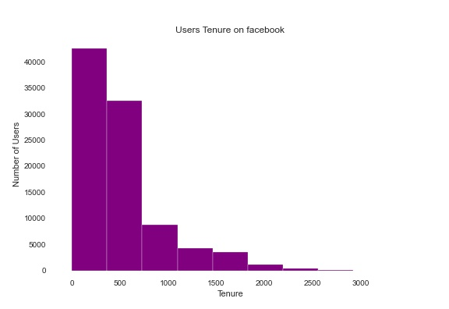
Which gender category of users are more on facebook ? What % of users started using facebook in last 2 years ?
Male users are more in number ( 55335 - 59.33% ) on facebook compared to Female users ( 37937 - 40.67% )
80% of users started their journey with facebook in last 2 years

Slide 12
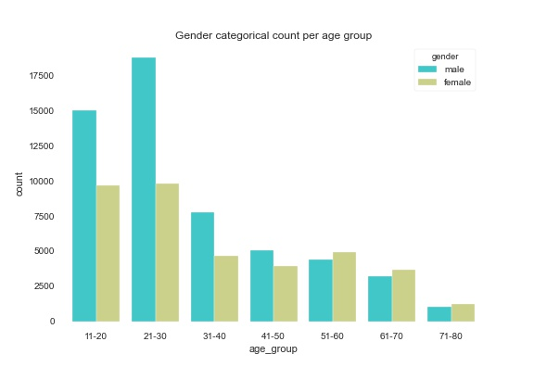
which age group have more number of male and female users ?
Male users of facebook are more in the age group 21-30
Female users of facebook are more in the age group 13-20

Slide 13
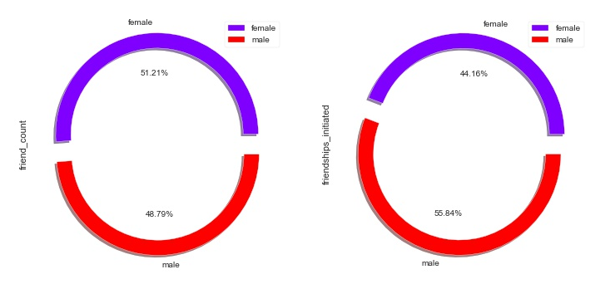
Who have more number of friends ? Male or Female ?
Female users on facebook have more friend count compared to Male users
Male users initiated more number of friendship requests than Female users

Slide 14
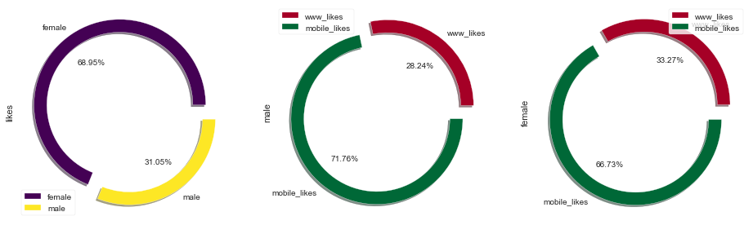
who have more likes ? Male or Female ? web or mobile ?
Female users - 68.95% of likes
within 68.95% likes, 33.27% of likes are from web and 66.73% are from mobile
Male users - 31.05% of likes
within 31.05% likes, 71.76% are from mobile and 28.24% are from web
Likes are more by Female users from mobile compared to male users

Slide 15
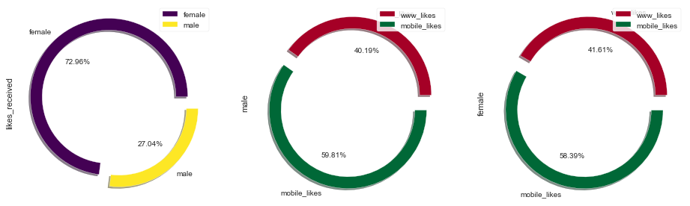
who have more likes_received ? Male or Female ? web or mobile ?
Female users received 72.96% of likes
within 72.96% likes, 41.61% of likes are from web and 58.39% are from mobile
Male users received 27.04% of likes
within 27.04% likes, 59.81% are from mobile and 40.19% are from web
Female users receive more likes from mobile compared to male users

Slide 16
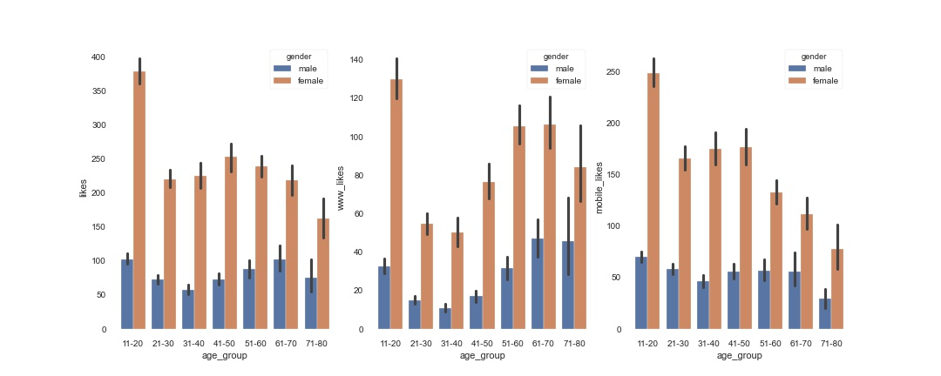
Which age group have more likes from which source ?
Likes are more from Female users age between 13-20 years - most of the likes are from mobile

Slide 17
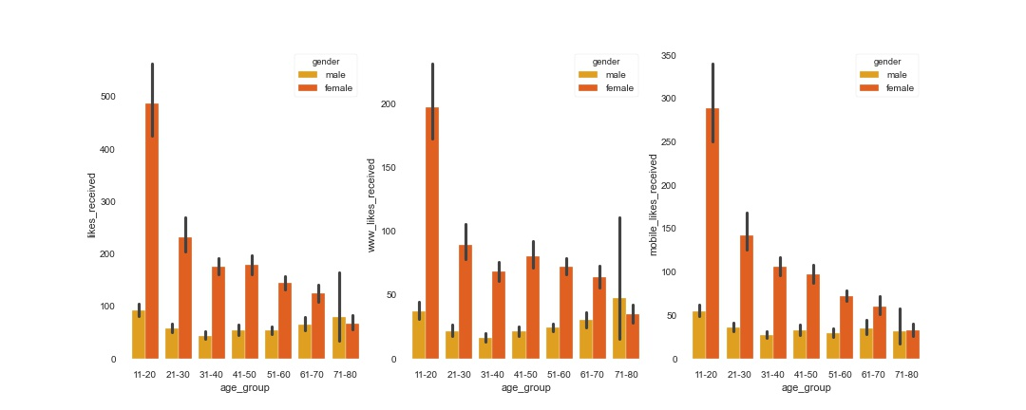
Which age group received more likes from which source
Female users with age between 13-20 years received more likes from mobile compared to web

Slide 18
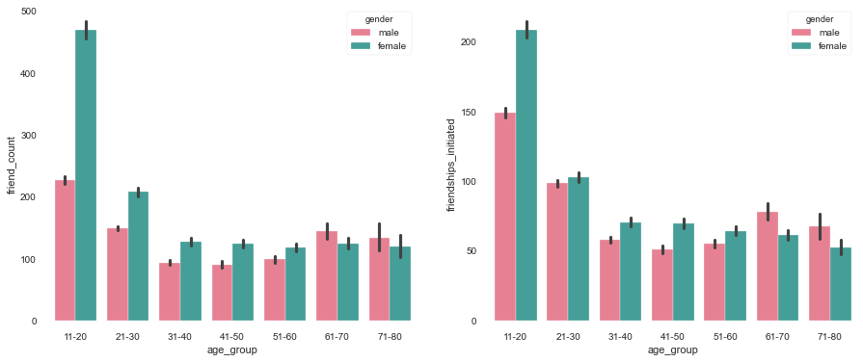
Which age group have more friends and initiated more friendships ?
Female users of age group 13-20 on facebook have more friend count and initiated more friendship requests

Slide 19
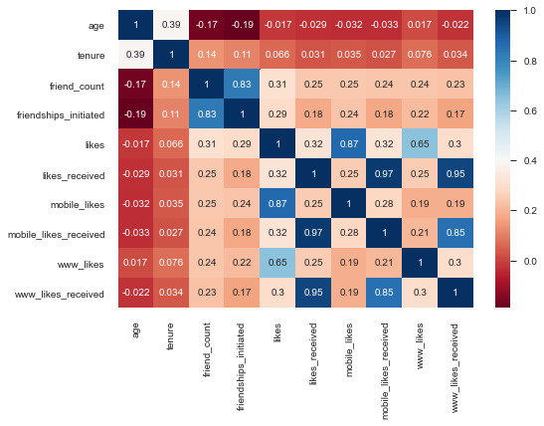
Correlation

Slide 20
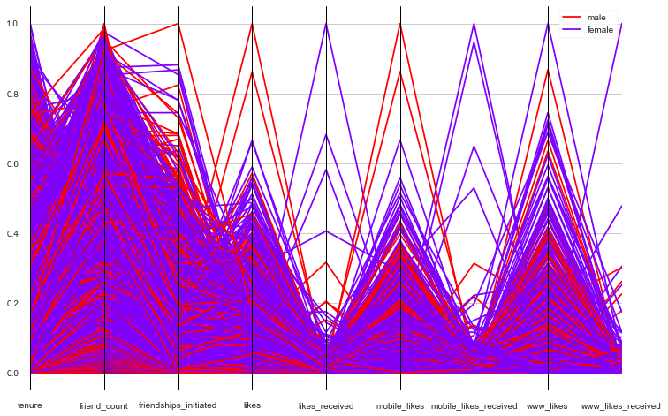
Parallel Coordinates Min-Max Scaling

Slide 21
Summary
Which age_group of users are more on facebook | 21-30 years
Facebook users born mostly in the month of | January
Which Gender category of users are more on facebook | Male(55335 - 59.33% )
Which age value has more number of users | 18 Years
Facebook users distribution is | Right Skewed
what percentage of users started using facebook in last two years | 80%
Which age_group have more number of Male and Female users | 21-30 Years
Which category of gender holds more friends | Female (51.21%)
Which category of gender initiated more friendship requests | Male (55.84%)
Which category of gender liked more posts on facebook | Female(68.95%)
Which category of gender liked more posts on facebook using mobile check-in | Male (71.76% of their likes are from mobile)
Which category of gender liked more posts on facebook using web check-in | Male (33.27% of their likes are from web)
Which category of gender received more likes on facebook | Female(72.96%)
Which category of gender received more likes on facebook using mobile check-in | Male (59.81% of their likes received are from mobile)
Which category of gender received more likes on facebook using web check-in | Male (41.61% of their likes received are from web)

Slide 22
Summary
Most liked posts are from which age group and gender category | Female ( 13-20 years )
Most web liked posts are from which age group and gender category | Female ( 13-20 years )
Most mobile liked posts are from which age group and gender category | Female ( 13-20 years )
Most received likes are from which age group and gender category | Female ( 13-20 years )
Most web received likes are from which age group and gender category | Female ( 13-20 years )
Most mobile received likes are from which age group and gender category | Female ( 13-20 years )
Which age group of gender holds more friend count | Female ( 13-20 years )
Which age group of gender initiated more friendship requests | Female ( 13-20 years )

Slide 23
Conclusion
Age Group 18-30 are more attracted towards the facebook
Most prefer mode of accessing facebook is through Mobile
Male users are more in Number but Female users are dominating in other aspects

Slide 24


