Slide 1
We are accounted poor citizens, the patricians good.
What authority surfeits on would relieve us: if they
would yield us but the superfluity, while it were
wholesome, we might guess they relieved us humanely;
but they think we are too dear: the leanness that
afflicts us, the object of our misery, is as an
inventory to particularise their abundance; our
sufferance is a gain to them Let us revenge this with
our pikes, ere we become rakes: for the gods know I
speak this in hunger for bread, not in thirst for revenge.
Texto original

Slide 2

We
are
accounted
poor
citizens
,
the
patricians
good
.
What
authority
surfeits
on
would
relieve
us
:
if
they
would
yield
us
but
the
superfluity
,
while
it
were
wholesome
,
we
might
guess
they
relieved
us
humanely
but
they
think
we
are
Token

Slide 3








We
are
accounted
poor
citizens
,
the
patricians
good
.
What
authority
surfeits
on
would
relieve
us
:
if
they
would
yield
us
but
the
superfluity
,
while
it
were
wholesome
,
we
might
guess
they
relieved
us
humanely
but
they
think
we
are

Slide 4
We
are
accounted
poor
citizens
,
the
patricians
good
.
What
authority
surfeits
on
would
relieve
us
:
if
they
yield
but
superfluity
while
it
were
wholesome
might
guess
relieved
humanely
but
think
Token sem repetição

Slide 5
6
12
18
24
30
0
We
surfeits
relieved
the
patricians
What
Token sem repetição
Vocabulario
Google – Sentence Piece
OpenAI – TikTok (GPT)
Tipicamente ~40K - 50k Tokens
1
7
13
19
25
31
authority
on
citizens
:
if
yield
2
might
14
20
26
32
8
but
relieve
it
were
.
3
15
21
27
are
9
guess
,
but
good
ed
4
10
16
22
accounted
28
would
us
humanely
they
shar*
able
5
11
17
23
29
poor
superfluity
while
think
wholesome
e

Slide 6
0
3
4
5
13
15
18
24
27
32
30
1
6
7
10
14
16
19
25
28
10
31
16
8
18
11
15
17
20
26
29
15
0
2
9
28
12
16
22
21
28
23
0
3
Texto codificado para Tokens

Slide 7
context
0
3
4
5
13
15
18
24
target
0
3
4
5
13
15
18
24
context
27
32
30
1
6
7
10
14
target
27
32
30
1
6
7
10
14

Slide 8
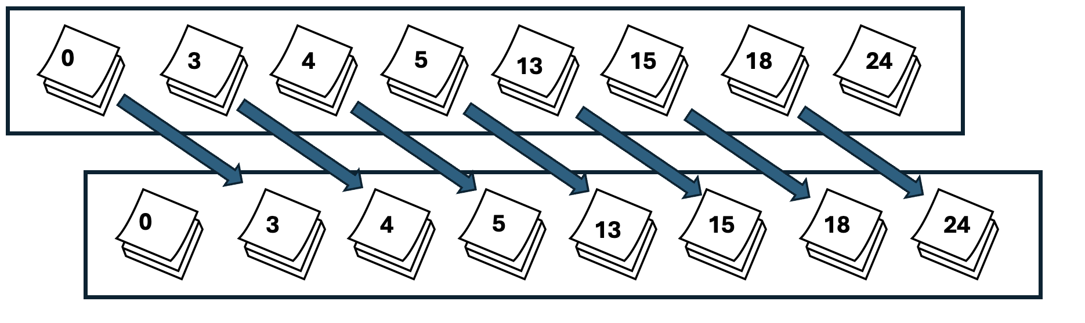
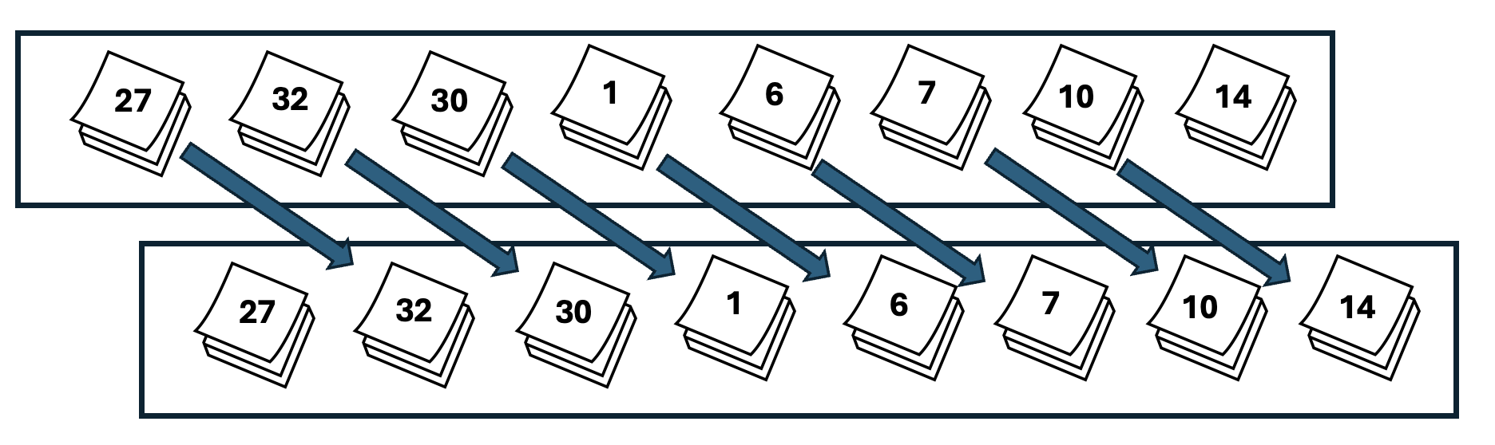
Block size = 8 (tamanho dos tokens na entrada)
Batch size = 4 (processamento praralelo)

Slide 9
0
3
4
5
13
15
18
24
3
4
5
13
15
18
24
27
27
32
30
1
6
7
10
14
32
30
1
6
7
10
14
16
16
19
25
28
10
31
16
8
19
25
28
10
31
16
8
18
18
11
15
17
20
26
29
15
11
15
17
20
26
29
15
0
Inputs
Targets

Slide 10
Vocabulary size
0
3
4
5
13
15
18
24
3
4
5
13
15
18
24
27
27
32
30
1
6
7
10
14
32
30
1
6
7
10
14
16
16
19
25
28
10
31
16
8
19
25
28
10
31
16
8
18
18
11
15
17
20
26
29
15
11
15
17
20
26
29
15
0
Inputs
Targets

Slide 11
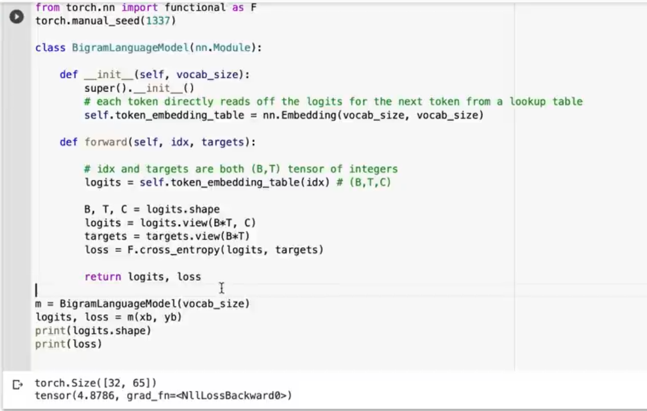
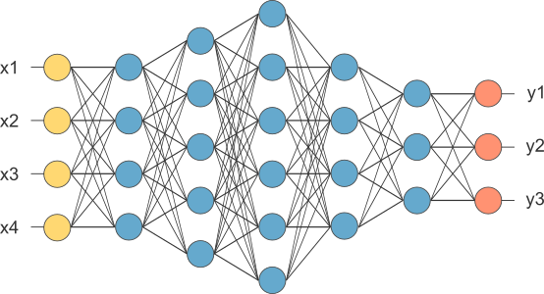
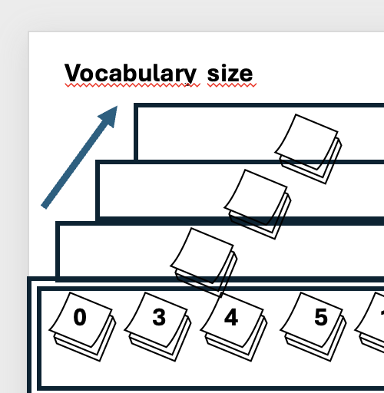
Cross entropy
Cross entropy is also considered a loss function. This loss function is nothing but the difference between the predicted probability distribution and the actual distribution, or true distribution.
Transforma um tensor de
4x8x65 para 32x65, que é
Necessário para a função
Cross_entropy
Para cada elemento de input, obtemos o target e calculamos a cross antropy, que é a probabilidade de um input estar gerando um target corretamente, comparado com todos os outros itens do vocabulário

Slide 12
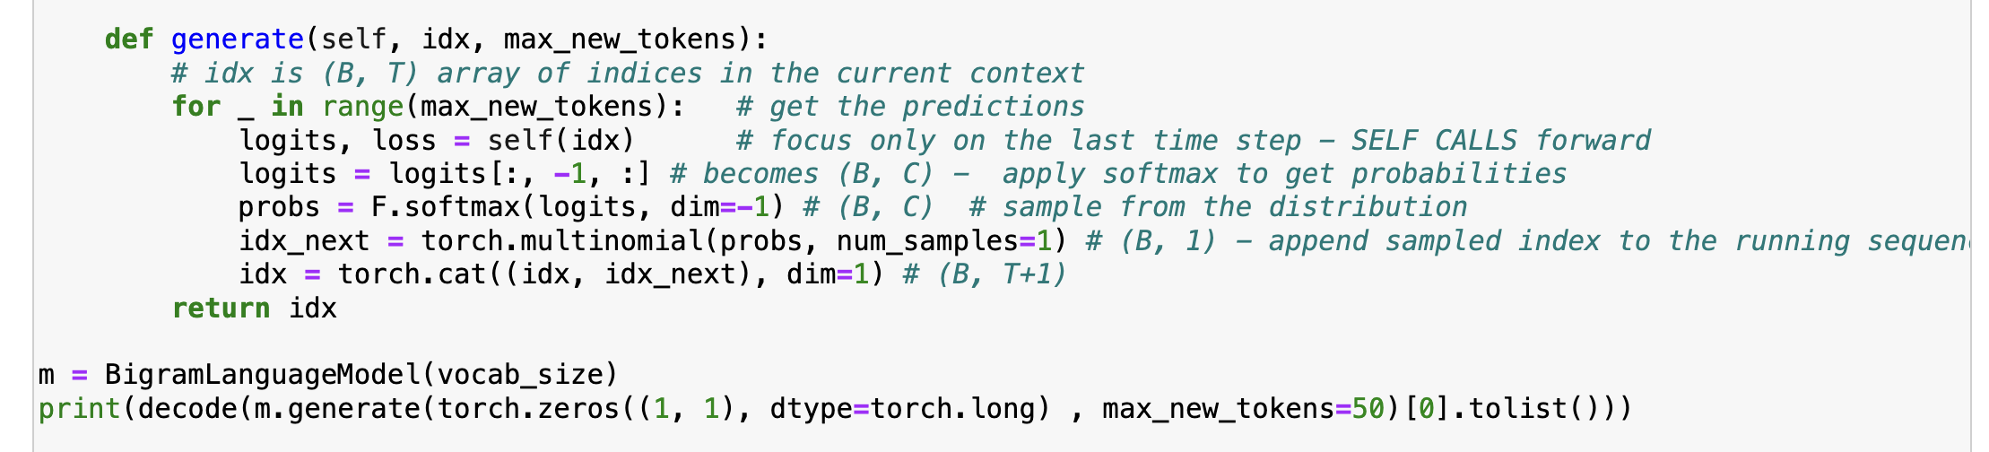
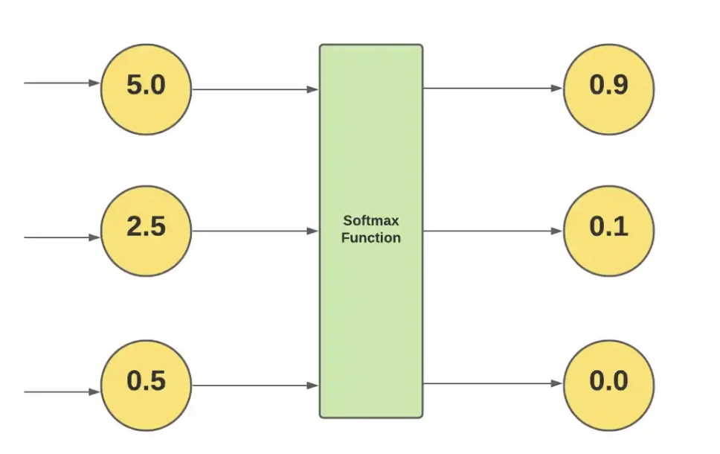
Softmax e multinomial
Softmax – A função softmax é uma função que converte um vetor de valores reais K em um vetor de valores reais K que
somam 1.
Multinomial – retorna elementos de um conjunto de probabilidades ordenados pelas maiores probabilidades
Segundo elemento é a maior “probabilidade”
Quantos elementos desejo

Slide 13
Softmax e multinomial
Self aciona forward
Softmax e multinomial
1
2
3
SKIcLT;AcELMoTbvZv C?nq-QE33:CJqkOKH-q;:la!oiywkHj
%
%
%
%
+
1
softmax
2
multinomial
3
Cat (concatena)
Transforma um array de próximas palavras em probabilidades, retorna o elemento de maior probabilidade e concatena com o resultado anterior

Slide 14
Optimizer

Slide 16
context
0
3
4
5
13
15
18
24
target
0
3
4
5
13
15
18
24
context
27
32
30
1
6
7
10
14
target
27
32
30
1
6
7
10
14

Slide 17
We
are
accounted
poor
citizens
,
the
patricians
good
.
What
authority
surfeits
on
would
relieve
us
:
if
they
would
yield
us
but
the
superfluity
,
while
it
were
wholesome
,
we
might
guess
they
relieved
us
humanely
but
they
think
we
are

