Slide 1
INTERNSHIP PROJECT
Enterprise Data
Reconciliation
Turning messy transaction logs into clear financial insights
Python • Pandas • Regex • SQLite • Matplotlib
Presented by: Gummadavelli Srija
Internship submission
ENTERPRISE DATA RECONCILIATION
1 / 5

Slide 2
Problem Statement
Enterprise transaction data is often large, unstructured, and inconsistent, making accurate financial reconciliation difficult.
Key challenges
Large Dataset
- Processing around 100,000 records efficiently requires optimized data operations.
2. Unstructured Logs
- Transaction details must be extracted from messy server logs using Regex.
3. Missing Weekend Exchange Rates
- Weekend transactions need appropriate exchange-rate matching to avoid losing records.
4. Historical Customer Records
- The latest customer record must be identified before matching transactions.
Goal: Build a clean, accurate, and unified dataset for financial analysis.

Slide 3
Project Solution
Python and Pandas: Process and clean large datasets efficiently.
Regex: Extract transaction details from unstructured server logs.
SQL Window Functions: Identify the latest customer records and filter active users.
Exchange-rate matching: Convert EUR transactions into USD and handle weekend dates appropriately.
Matplotlib / Seaborn: Visualize monthly revenue and the top five customers.
Expected outcome: A reconciled financial dataset and clear revenue insights.

Slide 4
01 / PROJECT OVERVIEW
What does the project do?
The goal is to combine messy business data and turn it into useful financial information.
WORKFLOW
MAIN OBJECTIVE
1
Find latest customers
Create one reliable view of transactions, customers, and USD revenue.
SQL window function
2
Read and clean logs
Regex + Pandas
The source data includes raw server logs, daily exchange rates, and customer history.
Convert and reconcile
3
Exchange rates + joins
4
Summarize results
TOOLS USED
Charts + tables
Python • Pandas • Regex • SQLite • Matplotlib / Seaborn
Result: a monthly revenue view and a top-customer summary.
ENTERPRISE DATA RECONCILIATION
2 / 5

Slide 5
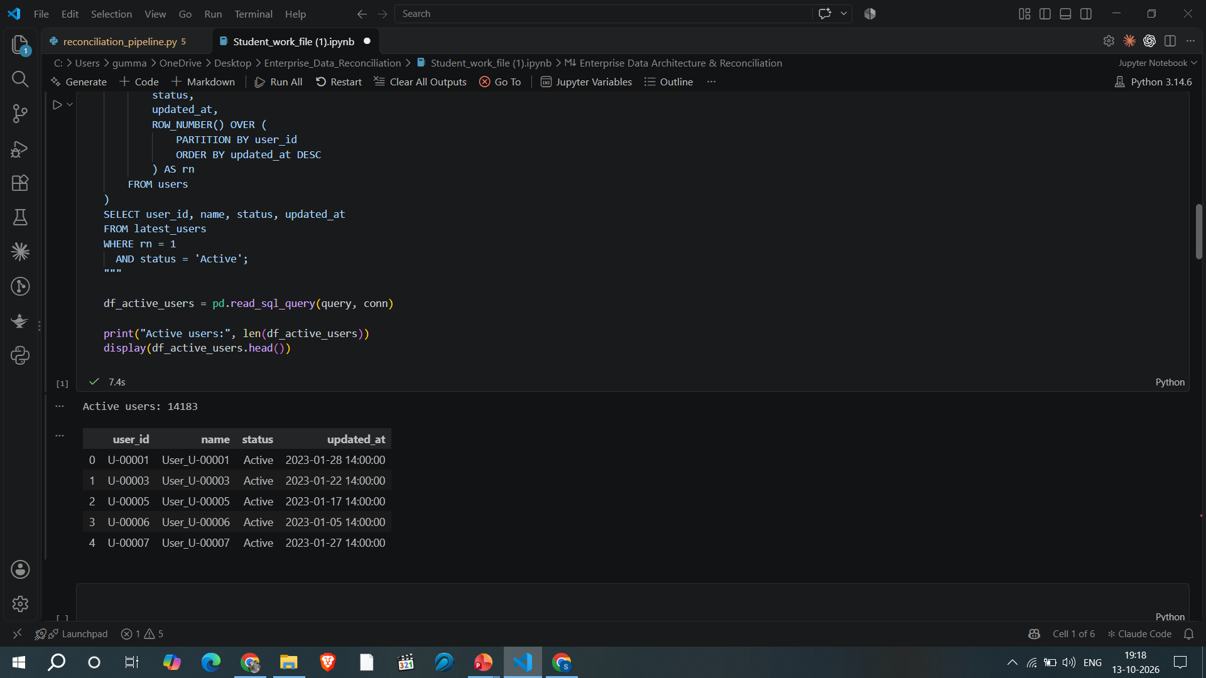
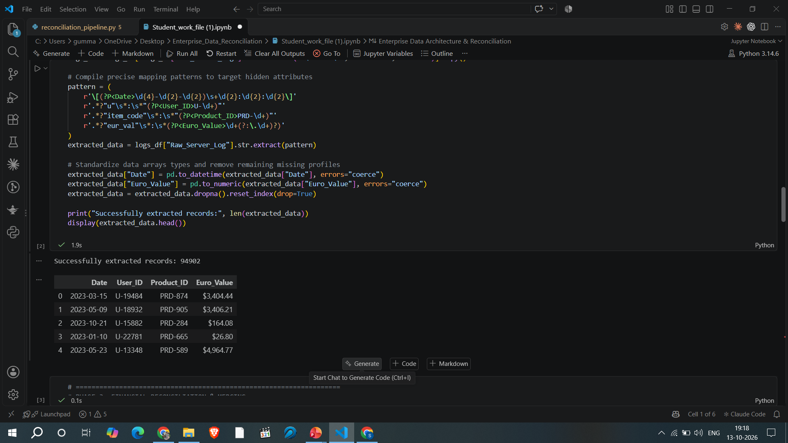
02 / DATA PREPARATION
Cleaning and extracting the source data
Screenshots from the notebook show the SQL and Regex steps.
PHASE 1 • SQL CUSTOMER HISTORY
PHASE 2 • REGEX LOG EXTRACTION
Selected the latest record per user and kept current Active users.
Extracted date, user, product, and euro amount from raw logs.
14,183 active users shown in output
94,902 records extracted
ENTERPRISE DATA RECONCILIATION
3 / 5

Slide 6
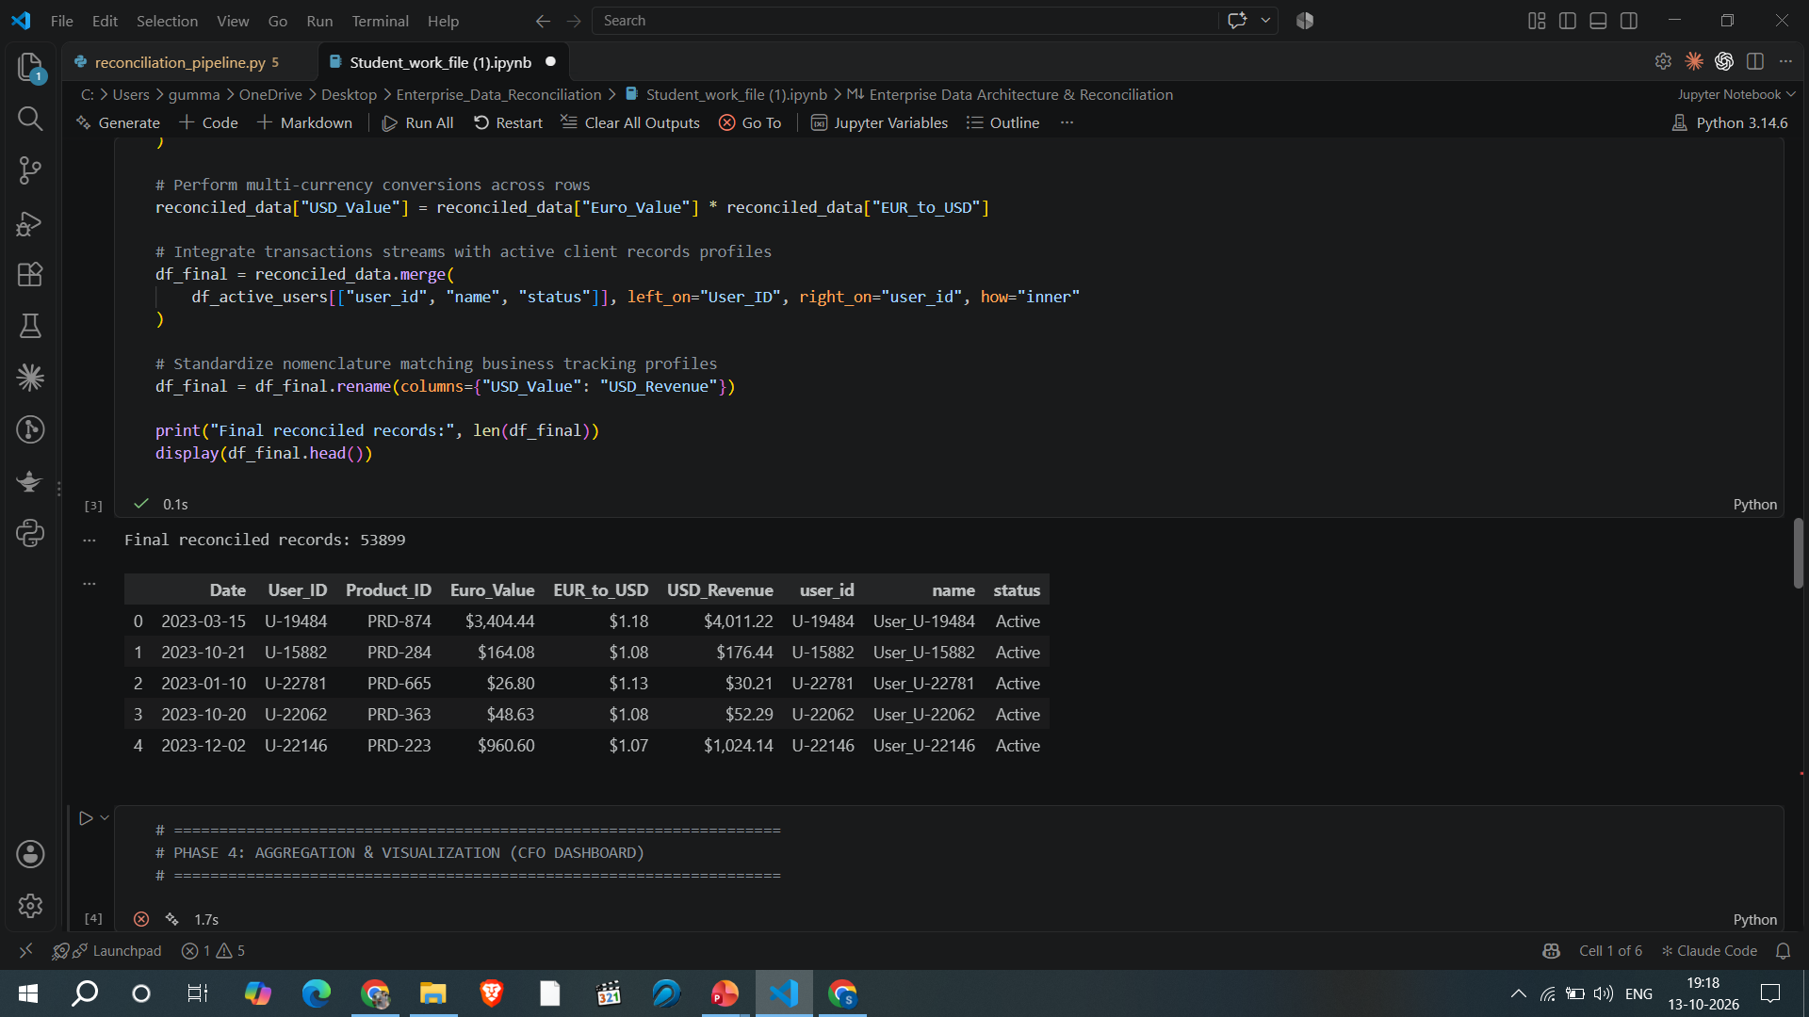
03 / FINANCIAL RECONCILIATION
Combining transactions, rates, and customers
The final table shows transaction values after currency conversion and customer matching.
KEY OUTPUT
53,899
final reconciled records
EUR values were converted to USD and matched with active customer records.
Note: confirm weekend exchange-rate matching in the final run.
ENTERPRISE DATA RECONCILIATION
4 / 5

Slide 7
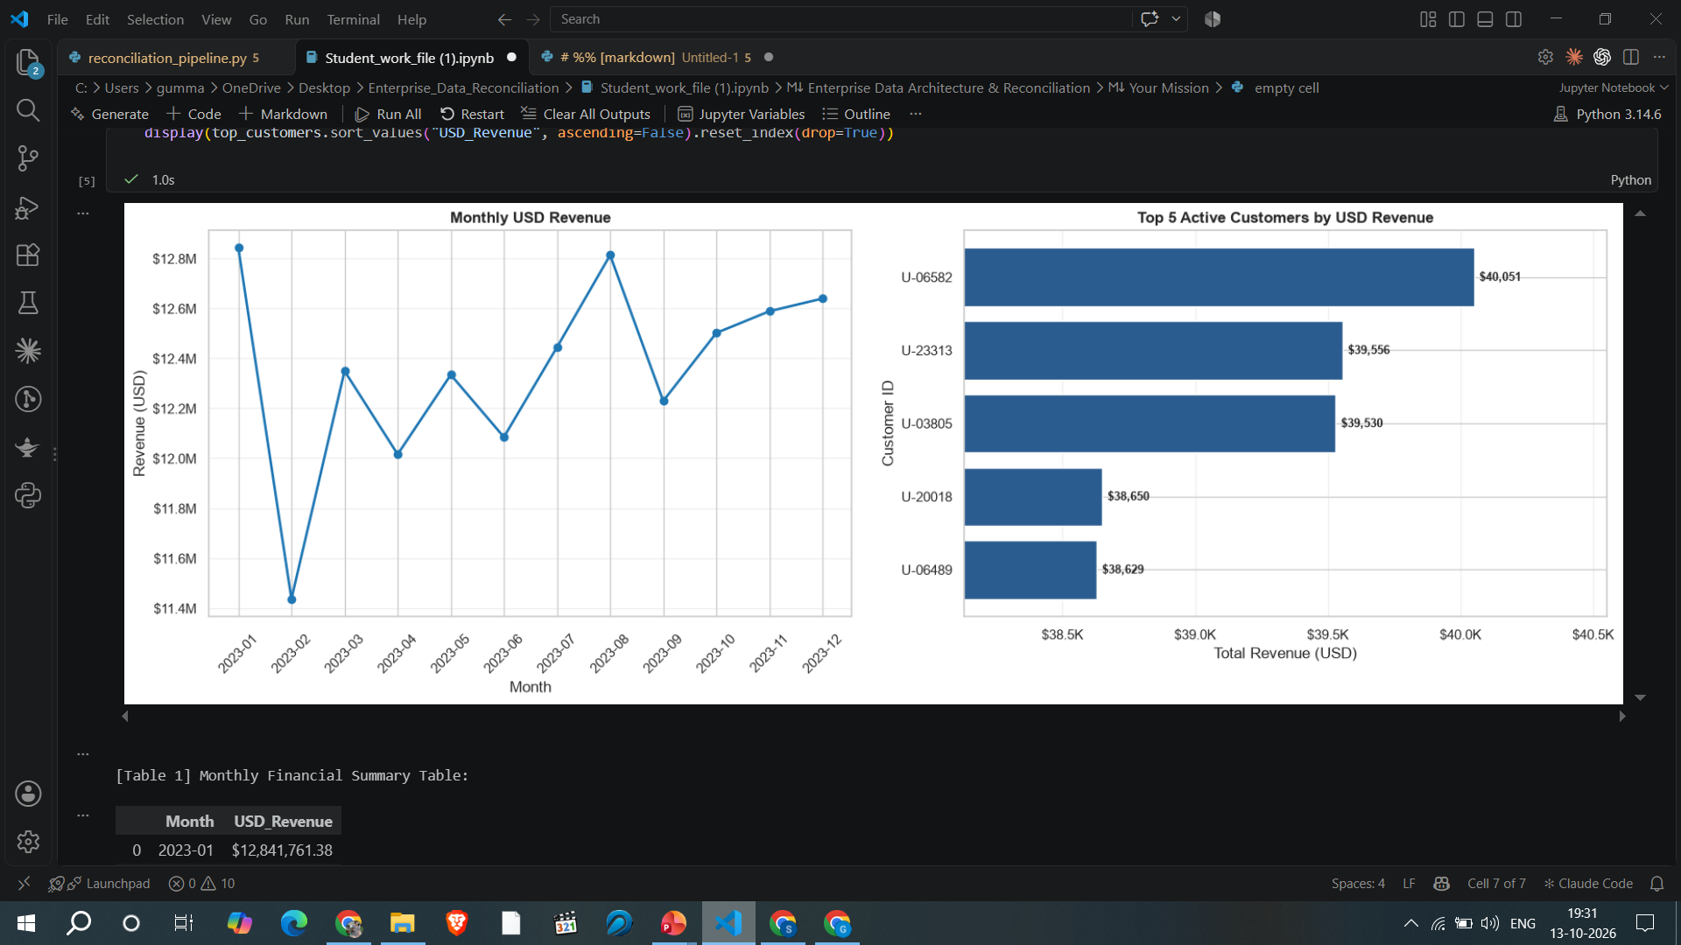
04 / RESULTS
CFO dashboard: clear financial insights
The dashboard summarizes monthly revenue and highlights the top five customers.
KEY TAKEAWAYS
• Automated data extraction
• Combined transaction and customer data
• Created revenue summaries
• Visualized trends for review
Monthly revenue chart + top-five customer chart
Thank you
ENTERPRISE DATA RECONCILIATION
5 / 5

