Slide 1
EduNexus
AI-Powered College Management Platform
https://edu-nexus.co.in

Slide 2
The Problem
• Manual attendance takes 5-10 minutes per class • Report generation takes weeks of manual work • At-risk students identified only after they fail • Parents only get updates at PTM meetings • One-size-fits-all dashboards frustrate users

Slide 3
The EduNexus Solution
✓ AI Face Recognition Attendance (30 seconds) ✓ Auto-generated Reports (minutes, not weeks) ✓ Predictive Analytics for At-Risk Students ✓ Real-time Parent Notifications ✓ 9 Role-Specific Dashboards

Slide 4
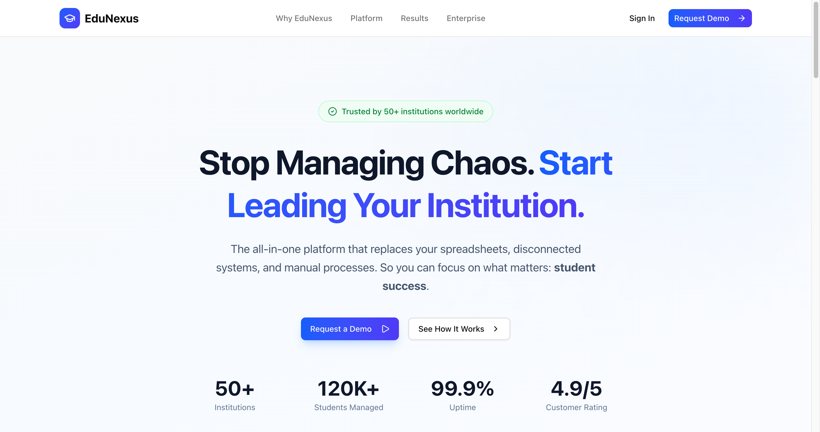
Modern, Intuitive Interface
https://edu-nexus.co.in

Slide 5
9 Role-Specific Dashboards
Platform Owner
Principal
HOD
Admin Staff
Teacher
Lab Assistant
Student
Parent
Alumni

Slide 6
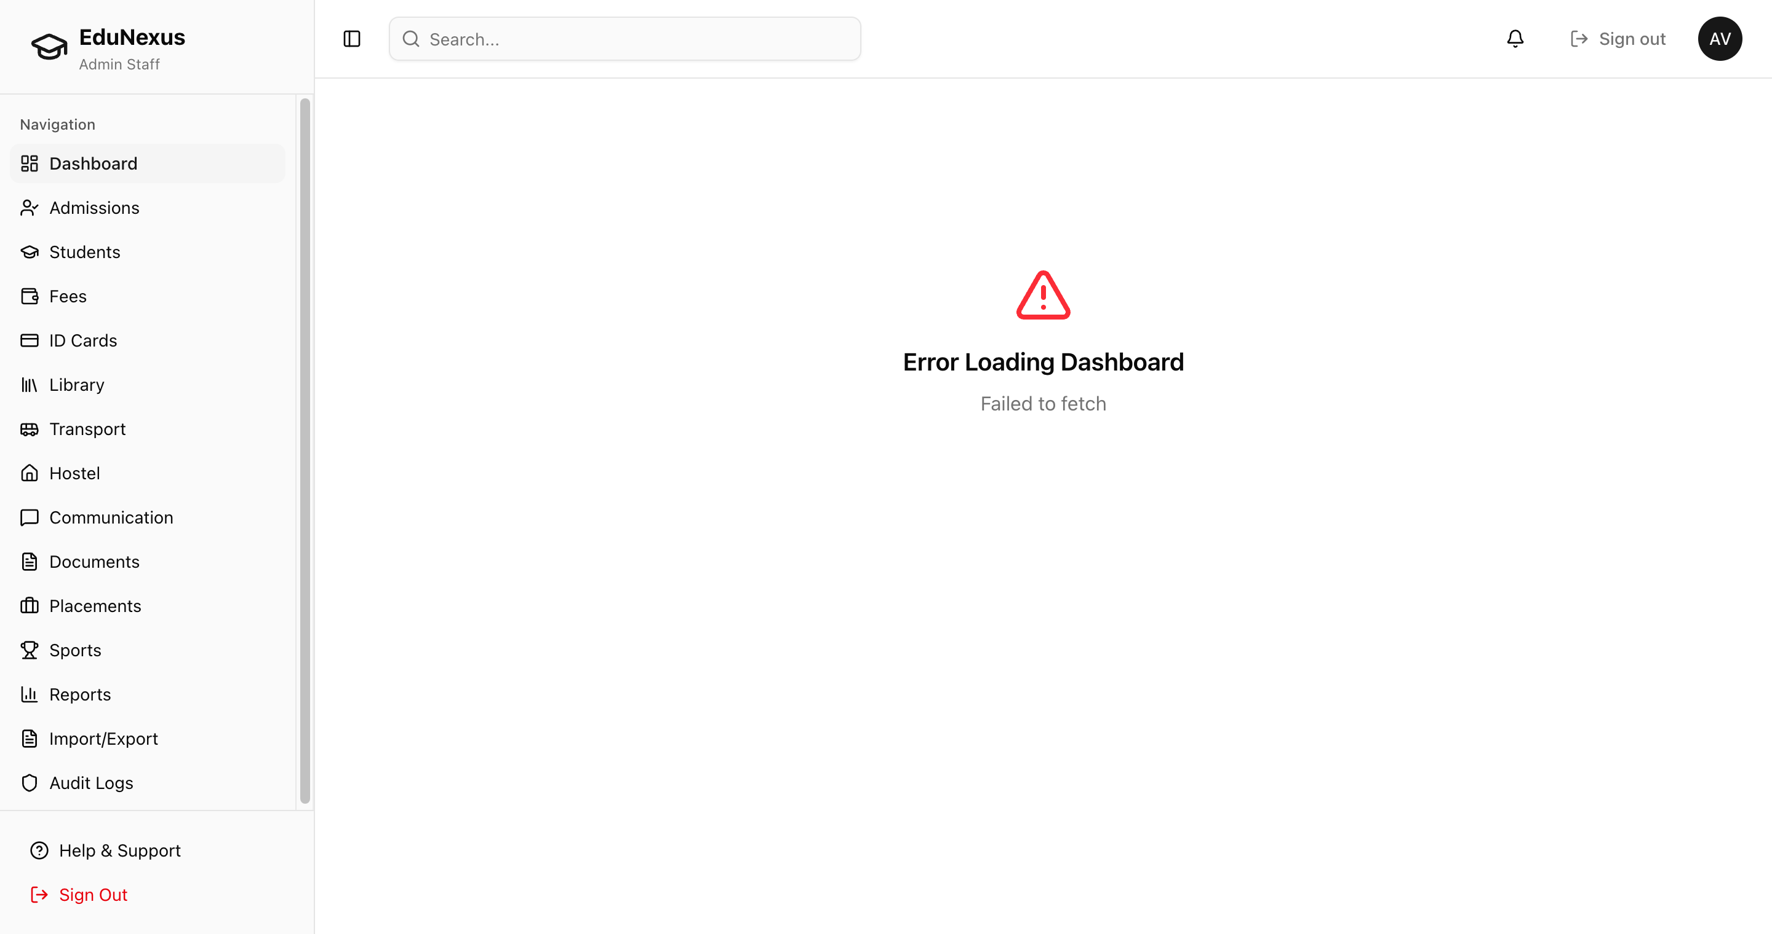
Admin Staff Dashboard
Login: admin@nexus-ec.edu

Slide 7
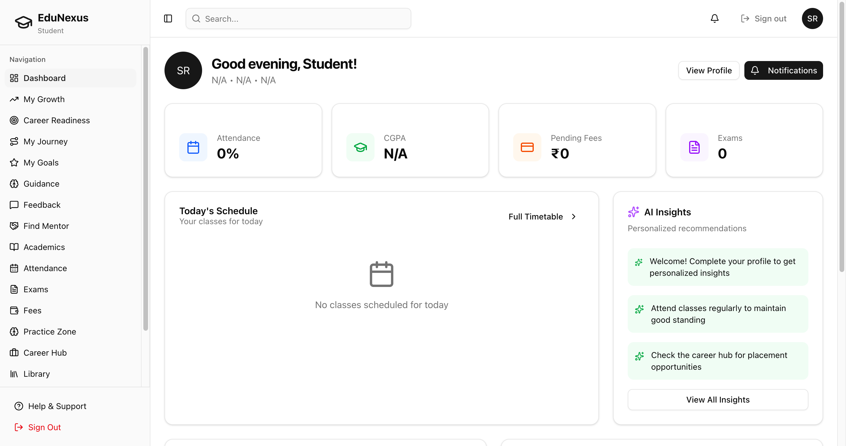
Student Dashboard
Login: student@nexus-ec.edu

Slide 8
AI-Powered Features
Face Recognition
Predictive Analytics
Attendance in 30 seconds with anti-spoofing
Identify at-risk students weeks ahead
Smart Reports
Career AI
Auto-generated accreditation reports
Personalized career path recommendations

Slide 9
Return on Investment
Metric
Before
After
Savings
Attendance Time
5-10 min/class
30 seconds
90%
Report Generation
Weeks
Minutes
95%
Fee Follow-ups
Manual calls
Auto-reminders
70%
Student Retention
Reactive
Predictive +15%
15%

Slide 10
Try the Live Demo
https://edu-nexus.co.in
Password: Nexus@1104
Platform Owner
admin@edunexus.io
Principal
principal@nexus-ec.edu
HOD
hod.cse@nexus-ec.edu
Admin Staff
admin@nexus-ec.edu
Teacher
teacher@nexus-ec.edu
Lab Assistant
lab@nexus-ec.edu
Student
student@nexus-ec.edu
Parent
parent@nexus-ec.edu
Alumni
alumni@nexus-ec.edu

Slide 11
Ready to Transform
Your Institution?
Schedule a personalized demo today
https://edu-nexus.co.in

