Slide 1
EduNexus
AI-First College Management Platform
"From Admission to Placement - One Intelligent Platform"
20+ Modules
8 Portals
AI Engine
6 Weeks Go-Live

Slide 2
Agenda
1. Executive Summary - ROI & Key Differentiators
2. The Problem We Solve - Pain Points by Persona
3. Our Solution - EduNexus Platform Overview
4. Persona-Wise Features & Benefits
5. Quality & Reliability Assurance
6. AI-Powered Capabilities
7. ROI & Time Savings Analysis
8. Implementation & Pricing

Slide 3
Executive Summary
One Platform. Complete Transformation.
EduNexus is an AI-First College Management Platform designed specifically for Indian Engineering Colleges. We unify all college operations - from admission to placement - in one intelligent system.
Traditional ERP | EduNexus
Generic modules | Student-centric design
Reactive reporting | Predictive AI insights
Desktop-only | Mobile-first PWA
6+ months implementation | 6 weeks to go live
Hidden costs | Rs 500/student/year - all inclusive
Quick ROI Snapshot
Metric | Impact
Fee Collection | +20%
Staff Time Saved | 40+ hrs/month
Placement Rate | +15-20%
Report Generation | 10x faster
Parent Satisfaction | +60%

Slide 4
The Problem We Solve
Pain Points Across the College
Persona | Pain Point | Impact
Principal | Fragmented systems, no unified view | Cannot make data-driven decisions
HOD | No real-time analytics | At-risk students identified too late
Admin Staff | Manual processes, paperwork | 40+ hours/month wasted
Teacher | Time on attendance & marks | Less time for teaching
Student | No career guidance | Lower placement rates
Parent | Disconnected from progress | Complaints, dissatisfaction

Slide 5
Admin Staff: Drowning in Paperwork
141 hours/month spent on repetitive tasks!
Task | Current Time | Frequency | Monthly Hrs
Fee collection & receipts | 2 hrs/day | Daily | 40 hrs
Attendance compilation | 1 hr/day | Daily | 20 hrs
Report generation | 4 hrs | Weekly | 16 hrs
Parent phone calls | 2 hrs/day | Daily | 40 hrs
Certificate processing | 30 min each | 50/month | 25 hrs
TOTAL |  |  | 141 hrs
That's almost one full-time employee's month spent on repetitive tasks!

Slide 6
Our Solution: EduNexus Platform
Layer | Components
8 Specialized Portals | Principal, HOD, Admin, Teacher, Lab Assistant, Student, Parent, Alumni
20+ Integrated Modules | Academic, Financial, Operations, Career, AI/ML, Communication
AI Engine | Score Prediction, Placement Prediction, Chatbot, Content Generation
Technology Stack | Next.js, NestJS, PostgreSQL, Redis, Python ML, AWS Mumbai
What Makes EduNexus Different
• Student-Centric Design - Built for engineering colleges, not adapted
• AI-First Architecture - Score Prediction, Placement Prediction, Smart Alerts
• Mobile-First Approach - Works seamlessly on any device
• Multi-Tenant Security - Complete data isolation per college
• Rapid Deployment - 6 weeks to go live, not 6 months

Slide 7
Persona-Wise Features & Time Savings
Role | Key Features | Time Saved | Key Value
Principal | Dashboard, Analytics, AICTE Reports | 10-15 hrs/mo | Strategic focus
HOD | Faculty Mgmt, Student Analytics | 15-20 hrs/mo | Better outcomes
Admin Staff | Fee Collection, Online Payments | 40-60 hrs/mo | Less paperwork
Teacher | Quick Attendance, Gradebook | 10-15 hrs/mo | More teaching
Lab Assistant | Lab Attendance, Equipment Tracker | 8-10 hrs/mo | Better tracking
Student | AI Dashboard, Career Hub, Chatbot | 5-10 hrs/mo | Self-service
Parent | Progress Tracking, Fee Payment | 5 hrs/mo | Peace of mind

Slide 8
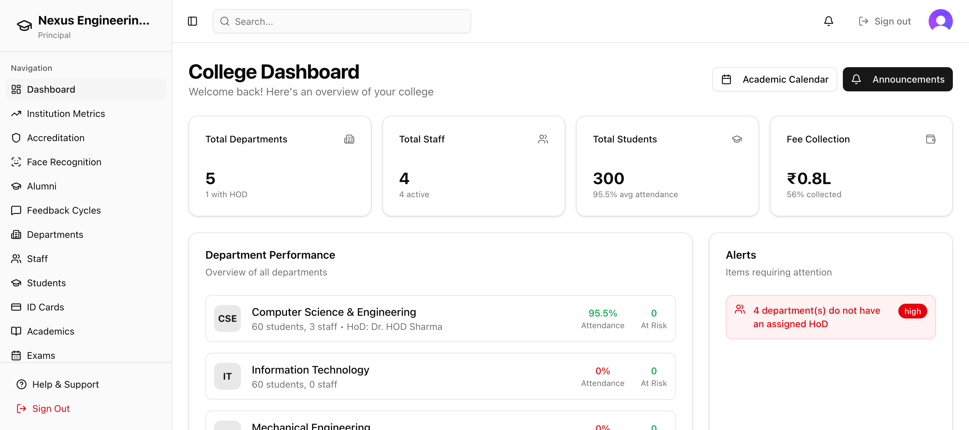
Principal Dashboard
Complete college overview at a glance
Departments • Students • Staff • Fees • Analytics • Reports - All in one view

Slide 9
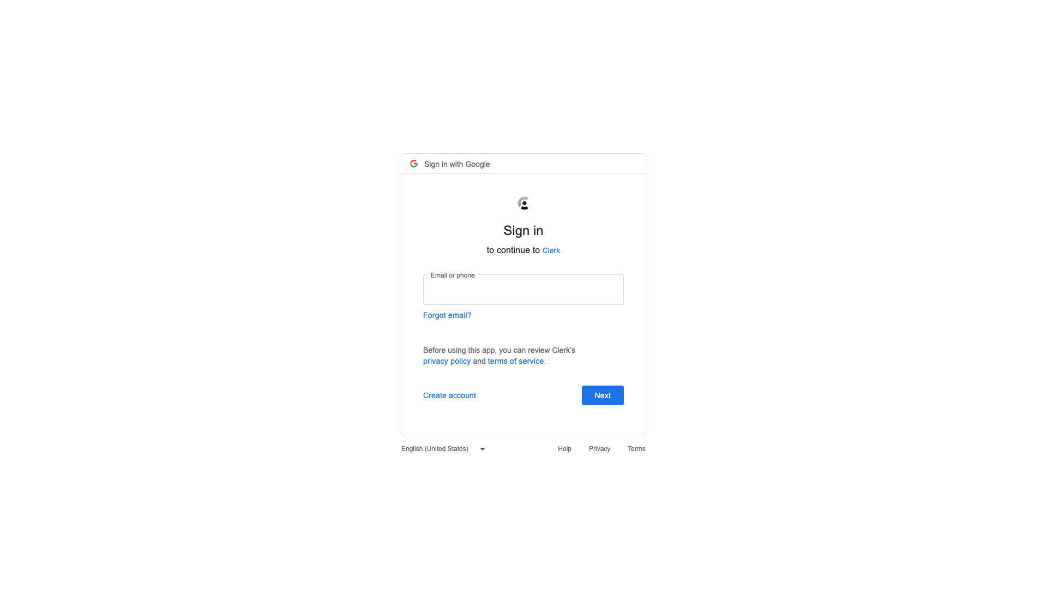
HOD Dashboard
Department-level management & analytics
Faculty Management • Student Performance • Curriculum • Batch Analytics

Slide 10
Admin Staff Dashboard
Streamlined operations & automation
Admissions • Fee Collection • Documents • Library • Transport - 120+ hours saved monthly

Slide 11
Teacher Dashboard
Focus on teaching, not paperwork
Quick Attendance • Gradebook • Assignments • Class Analytics - 10-15 hours saved monthly

Slide 12

Student Dashboard
Self-service portal with AI insights
AI Score Prediction • Career Hub • Placement Prep • 24/7 Chatbot Support

Slide 13
Parent Dashboard
Stay connected with child's progress
Attendance Tracking • Fee Payments • Academic Progress • Direct Communication

Slide 14
Admin Staff: Biggest Impact
120 hours saved per month!
Task | Before | After | Saved/Month
Fee collection & receipts | 40 hrs | 5 hrs | 35 hrs
Attendance compilation | 20 hrs | 1 hr | 19 hrs
Report generation | 16 hrs | 2 hrs | 14 hrs
Parent communication | 40 hrs | 8 hrs | 32 hrs
Certificate processing | 25 hrs | 5 hrs | 20 hrs
TOTAL | 141 hrs | 21 hrs | 120 hrs

Slide 15
Quality & Reliability Assurance
E2E Testing Verification
Performance & Security
Metric | Result
Total Personas Tested | 21 (7 roles x 3 colleges)
Test Scenarios | 100+ automated
404 Errors Found | 0
Access Denied Errors | 0
Tenant Isolation | Verified
Overall Status | PASS
Aspect | Status
Dashboard Load | < 3 seconds
API Response (p95) | < 200ms
Uptime SLA | 99.9%
Encryption | AES-256 + TLS 1.3
Data Location | AWS Mumbai (India)
Compliance | AICTE Ready

Slide 16
AI-Powered Capabilities
The Intelligence That Sets Us Apart
AI Feature | Description | Accuracy
Score Prediction | Predicts exam scores based on attendance, past performance | 85%+
Placement Prediction | Predicts placement probability and salary band | 80%+
Weak Topic ID | Identifies topics where student struggles | Personalized
AI Chatbot | 24/7 query resolution in English/Hindi | Instant
Content Generation | Sample papers, mock tests, study plans | AI-powered
Resume Builder | ATS-optimized resumes with AI suggestions | Professional
Traditional ERPs give you reports. EduNexus gives you predictions and recommendations.

Slide 17
ROI & Time Savings Analysis
Per-Persona Time Savings (5,000 Students)
Financial Impact (5,000 Students)
Persona | Monthly | Annual | Value
Principal | 10-15 hrs | 144 hrs | Strategic
HOD (5) | 75-100 hrs | 1,050 hrs | Rs 3.5L
Admin (15) | 600-900 hrs | 9,000 hrs | Rs 20L
Teachers (50) | 500-750 hrs | 7,500 hrs | Rs 15L
TOTAL | 1,265+ hrs | 18,774 hrs | Rs 40L+
Benefit | Annual
Fee Collection (+5%) | Rs 3.75 Cr
Staff Productivity | Rs 20.1 L
Placement Value | Rs 45 L
Compliance Savings | Rs 3 L
TOTAL RETURNS | Rs 4.44 Cr
Investment: Rs 25L | Returns: Rs 4.44 Cr | ROI: 1,677% | Payback: < 1 month

Slide 18
Implementation: 6 Weeks to Transform
Phase | Duration | Deliverables
Setup | Week 1-2 | Server provisioning, branding, configuration
Data Migration | Week 2-3 | Student, staff, fee, attendance data import
Training | Week 3-4 | Role-wise training sessions (recorded)
Pilot | Week 4-5 | Limited rollout with feedback collection
Launch | Week 5-6 | Full deployment with go-live support
Ongoing | Continuous | 24/7 support, monthly updates, optimization
SLA Commitments
Critical: 15 min response, 4 hr resolution | High: 1 hr response, 8 hr resolution | Medium: 4 hr response, 24 hr resolution

Slide 19
Simple, Transparent Pricing
Rs 500 / Student / Year
EVERYTHING INCLUDED
What's Included:
Volume Discounts:
✓ All 20+ Modules
✓ Email/SMS Integration
Students | Price | Annual
1-5,000 | Rs 500 | Rs 25L
5K-15K | Rs 450 (10% off) | Rs 45L
15K-30K | Rs 400 (20% off) | Rs 80L
30K+ | Custom | Contact us
✓ All 8 Portals
✓ 24/7 Support
✓ AI/ML Features
✓ Training & Onboarding
✓ Mobile Apps (PWA)
✓ Regular Updates

Slide 20
Next Steps
1
Schedule Demo
See EduNexus in action with your college data (60 min, Free)
2
Pilot Program
Free 30-day pilot with 100 students
3
Full Rollout
Go live in 6 weeks with complete support
Live Demo: http://15.206.243.177
Contact: sales@edunexus.in
Password: Nexus@1104
www.edunexus.in

Slide 21
Why Choose EduNexus?
✓ Student-Centric - Built for engineering colleges, not adapted
✓ AI-First - Predictions and recommendations, not just reports
✓ Mobile-First - Works on any device, anywhere
✓ All-Inclusive - One price, all features, no surprises
✓ India-Built - Data stays in India, AICTE compliant
✓ Rapid Deployment - Live in 6 weeks, not 6 months
✓ Proven ROI - 1,000%+ return on investment
"Your Students' Success is Our Mission"

