Slide 1


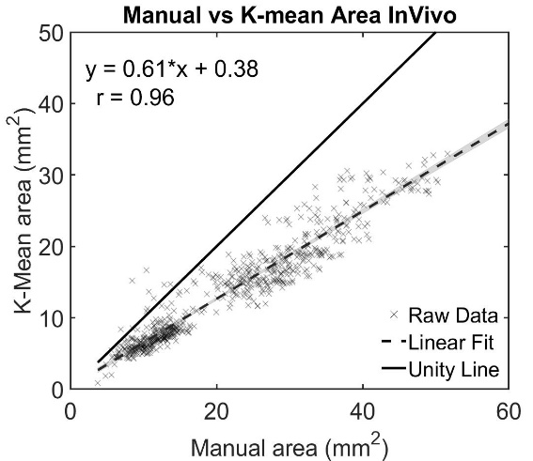
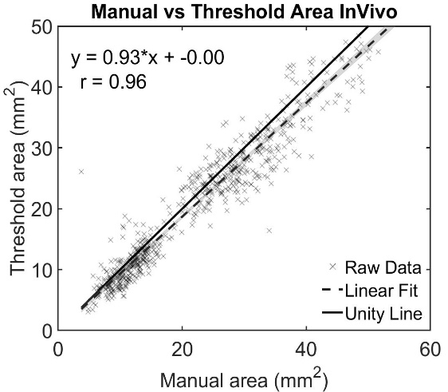
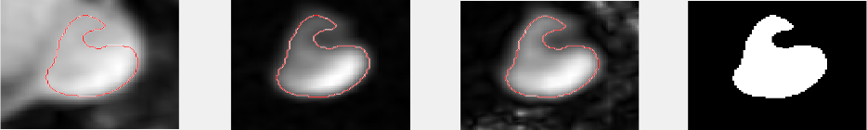
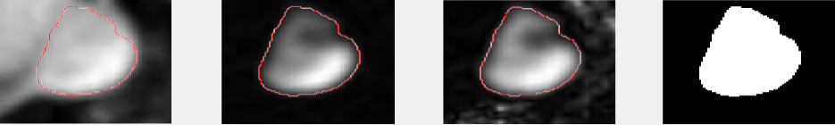
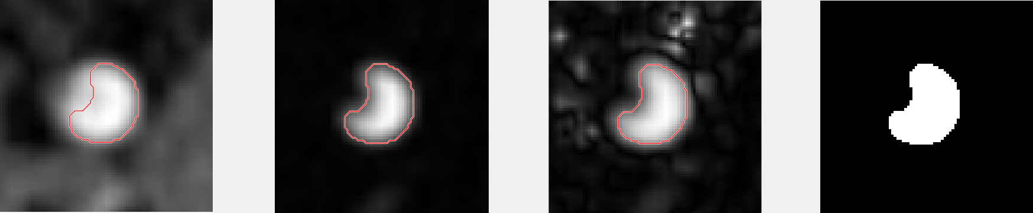
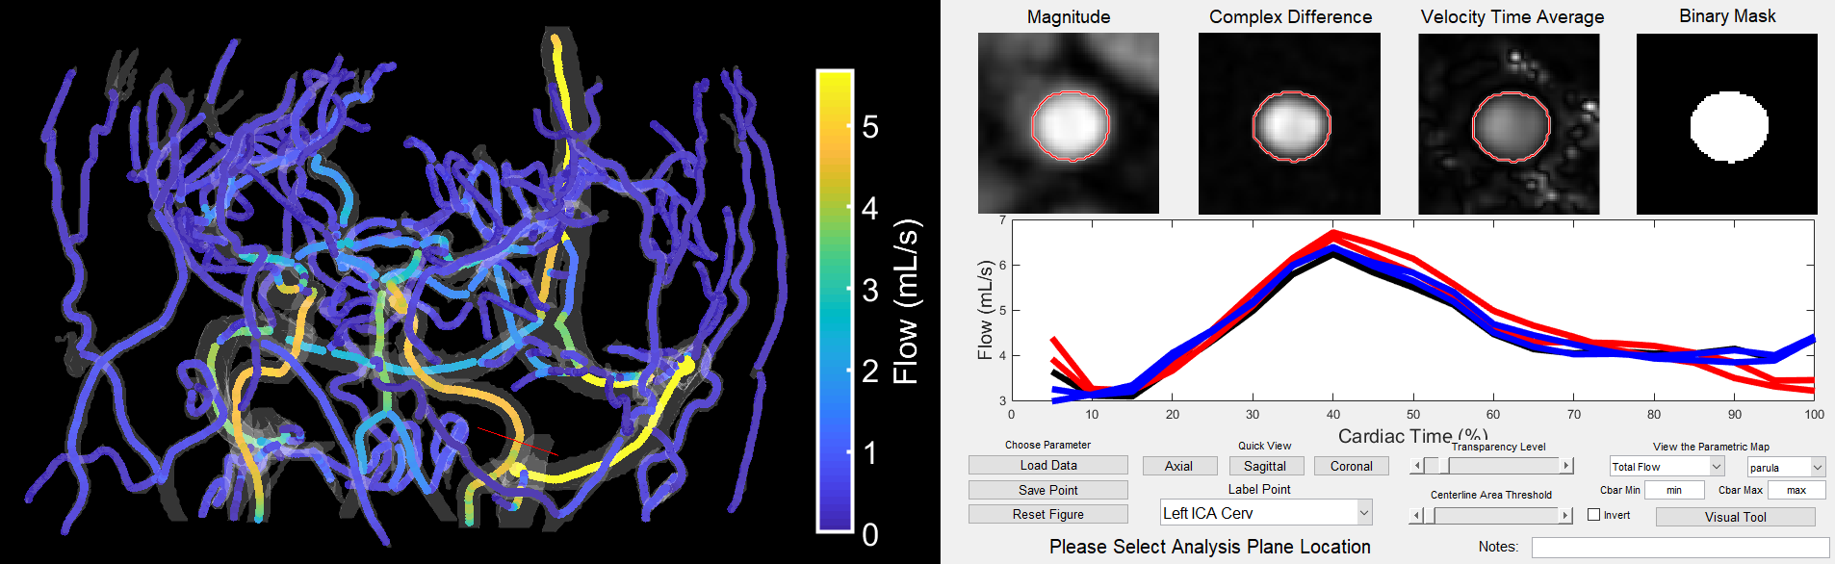
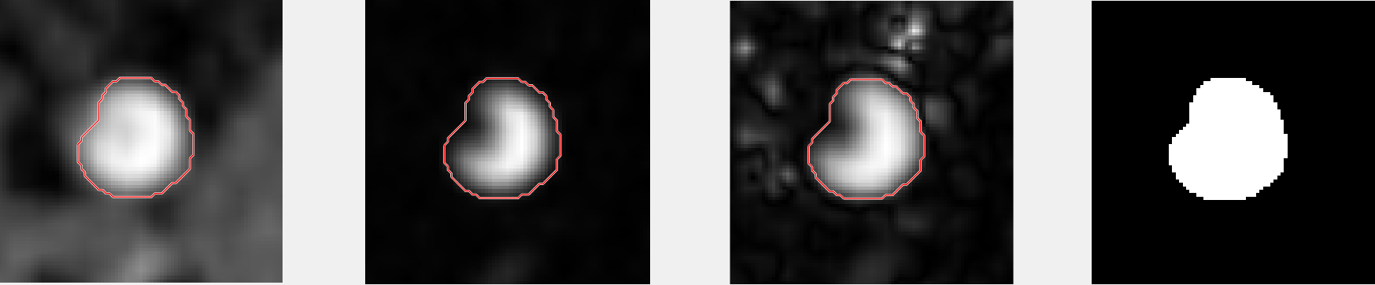
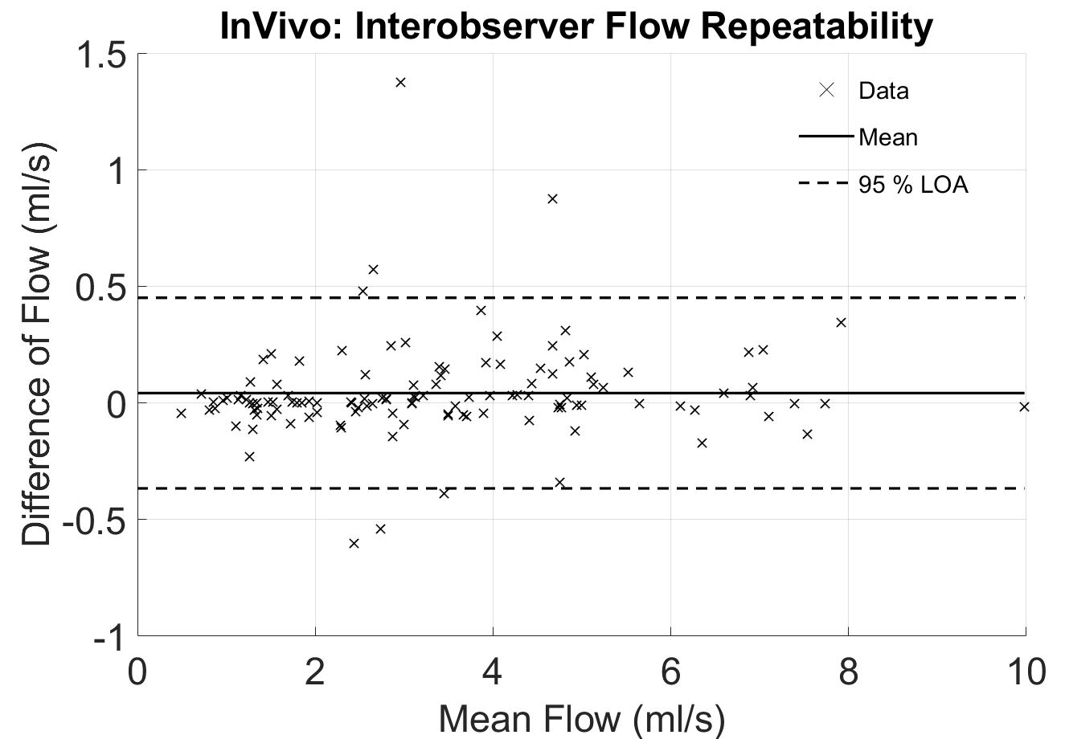
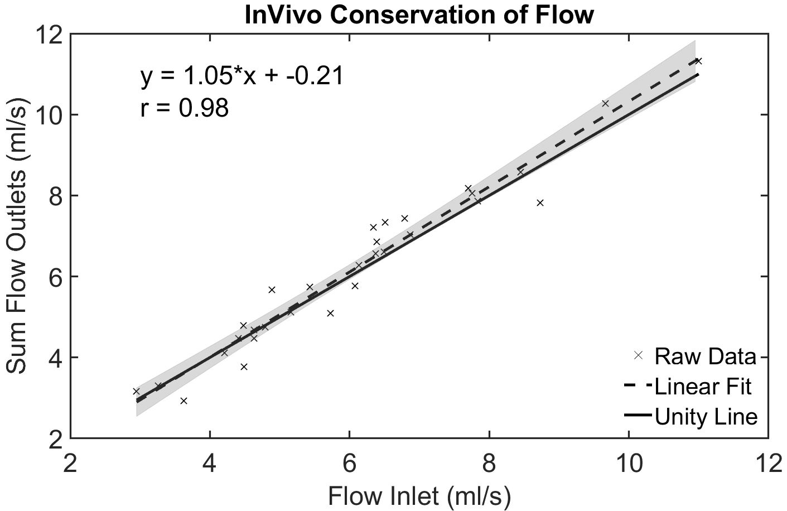
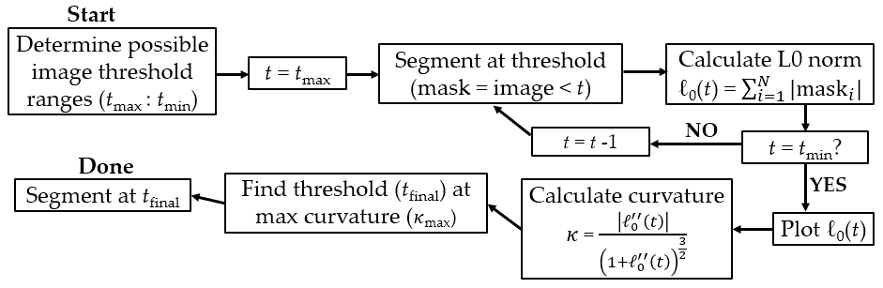
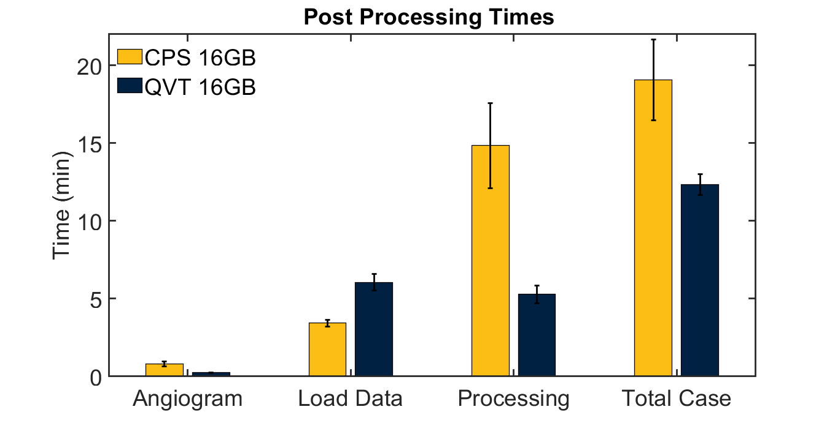
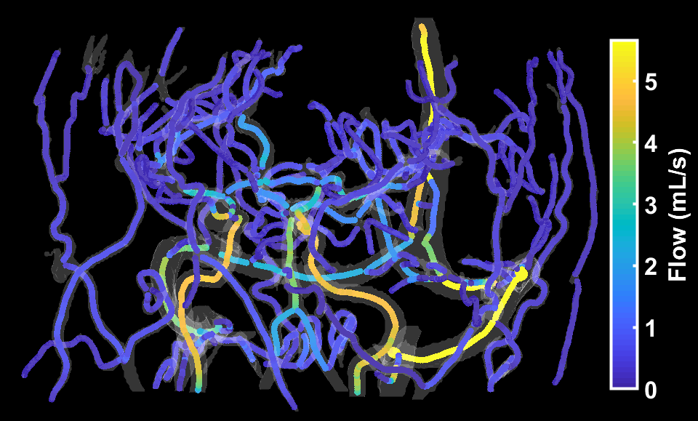
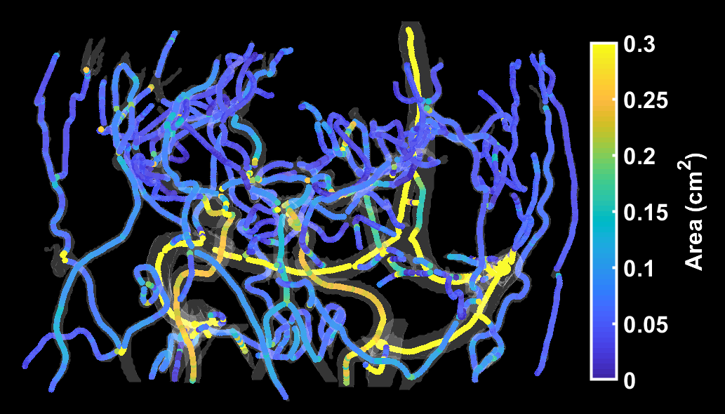
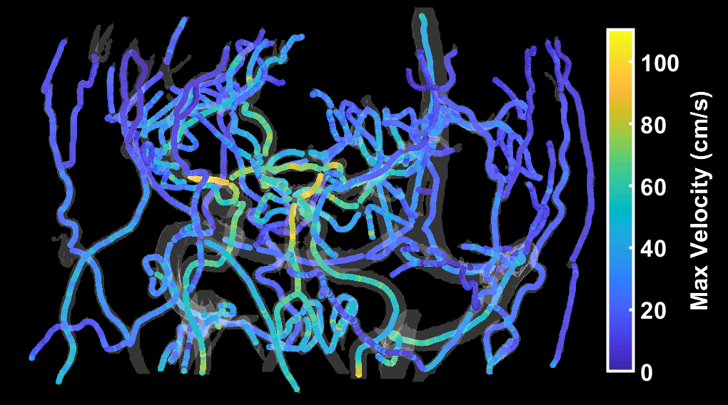
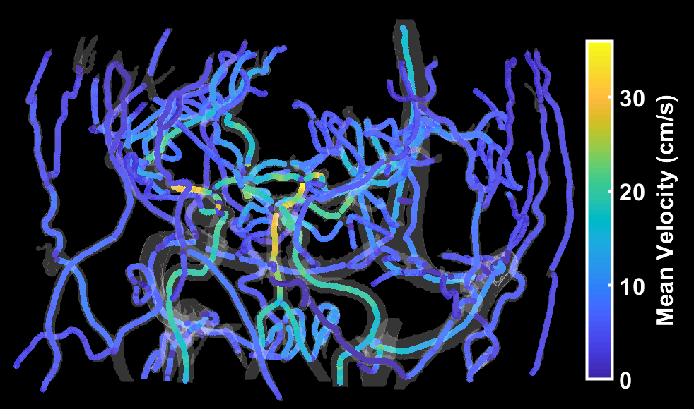
Automated Cranial 4D Flow MRI Analysis
Carson Hoffman¹, Grant Roberts¹, Sara Berman³, Laura Eisenmenger², and Oliver Wieben^{1,2}
Departments of ¹Medical Physics and ²Radiology, University of Wisconsin – Madison
³Alzheimer’s Disease Research Center, University of Wisconsin – Madison
Synopsis
Results
The purpose of this project is to develop a 4D flow post-processing analysis tool that includes an interactive visual interface, allowing for quick, easy, and repeatable hemodynamic analysis of large, complex 4D flow datasets.
Background
4D flow MRI non-invasively acquires time-resolved, 3D velocity maps in-vivo.
    Shows vascular anatomy and allows for calculations of blood flow parameters.
    However, detailed analysis requires long post-processing times.
Goal: Develop a quantitative velocity tool (QVT) that automates 4D flow post-processing
This improves upon an older cranial 4D flow centerline processing scheme (CPS)¹ by:
    Automating blood flow parameter calculation prior to vessel selection
    Creating an interactive 3D user interface with color-coding of flow parameters
    Improving automated segmentation
    Automating background phase correction
    Reducing memory requirements
    Allowing for reloading of pre-processed exams
A small in-vivo study will be performed to assess CPS and QVT segmentation performances, interobserver variabilities, number of missed vessels, and total time to process cases.
Threshold
k-means
Figure 4: Linear regression (correlation) plots of k-means-derived (CPS) segmented vessel areas and iterative threshold-based (QVT) areas versus ground-truth manual segmentation.
Magnitude
Regression (Figure 4) for both segmentation methods showed high correlation (R=0.96).
Threshold-based segmentation was more accurate compared to ground-truth manual segmentation (slope=0.93) than k-means segmentation (slope=0.61).
Examples of segmentation improvements are shown in Figure 5.
Number of missed vessels reduced from 16.2% to 3.8% when analyzed in QVT.
    MCA, PCA, and TS accounted for 25/26 missed vessels.
    Average local flow quantification errors were similar for CPS (2.8±2.6%) and QVT (2.9±2.2%).
Comp. Diff.
Methods
Transverse Sinus
Ten 4D flow brain scans were acquired on healthy volunteers.
    PC-VIPR² acquisition; field strength = 3T; volume = 22 cm³; spatial res. = 0.69 mm²; V_{ENC} = 80 cm/s; scan time = 7 min., retrospective cardiac gating (20 frames).
The QVT graphical interface (Figure 1) was developed in MATLAB18b (Mathworks, MA).
Blood flow parameters were automatically calculated across the vascular network and color-coded in the 3D interface (Figure 3).
Velocity
k-means
Int. Carotid Artery
Threshold
Binary Mask
Figure 5: Old k-means segmentation and new threshold segmentation in transverse sinus (top) and internal carotid artery (bottom).
Bland-Altman analysis of flow quantification between users showed a mean difference and 95% CIs of 0.042 [-0.37, 0.45] ml/s with the QVT (Figure 6).
Bias and CIs are greatly reduced when compared to old CPS -0.1 [-1.88,1.68] ml/s.
Internal consistency of flow was observed at vessel junctions for the QVT (Figure 7).
Figure 1: 4D flow post-processing tool with 3D interactive graphical user interface. As the user moves the cursor, the cross-sectional images and flow waveforms are updated in real-time.
A novel threshold-based vessel segmentation algorithm was developed (Figure 2).
Figure 2: Flowchart for threshold-based segmentation. This algorithm iterates through all possible thresholds and calculates L0-norm. The norm is plotted as a function of threshold, and the point of maximum curvature is the final threshold used.
Figure 6: Bland-Altman plot of inter-observer repeatability for QVT.
Figure 7: Linear regression plot of inlet and outlet flow at vessel junctions, namely ICA, ACA, MCA junction and SSS, SS, TS junctions. High correlation reflects internal flow consistency of QVT.
Flow analysis was completed in 13 locations: internal carotid arteries (ICA), basilar artery (BA), middle cerebral arteries (MCA), posterior cerebral arteries (PCA), straight sinus (SS), superior sagittal sinus (SSS), and transverse sinuses (TS).
K-means segmentation (CPS) and threshold-based segmentation (QVT) were compared to ground-truth manual segmentation at these vessel locations using correlation plots.
Number of missed vessels were counted for both tools.
Intra-observer variability of flow measures were calculated between two observers.
Local flow variations (standard deviation) along vessel were calculated for both tools to assess flow consistency. Conservation of flow at ICA, MCA, ACA and TS, SS, SSS junctions was assessed for the QVT only.
Angiogram and centerline generation times decreased from 48.6 s to 13.2 s.
Vessel selection and flow verification times decreased from 15.2 min to 5.0 min (1.17 min and 0.38 min per plane).
Memory requirements were greatly reduced.
Saved cases could be loaded into the tool in ~10 seconds.
Figure 8: Processing times for new and old tool with 16 GB machine.
Discussion
QVT provided improved angiograms, better centerline generation, quick vessel selection, automated background phase correction, easy visualization of quantitative parameters, and less computer memory requirements.
Robust analysis tools with high repeatability are extremely desirable for high-volume, long-term 4D flow studies.
    Both tools showed high user repeatability with a slight improvement for QVT.
    Local flow measurements at selected vessel locations were small (<3%).
    Flow was conserved at vessel junctions, indicating good internal consistency.
Additional users and cases will help further investigate repeatability between tools.
References
Figure 3: Quantitative parameters (area, flow, velocity) color-coded on automatically-generated centerlines.
[1] Schrauben, E. et al. JMRI 2015; 42:1458-64.
[2] Gu, T. et al. AJNR 2008; 26:743-749
[3] Johnson, KM. et al. MRM 2008; 60(6):1329-1336

