Slide 1


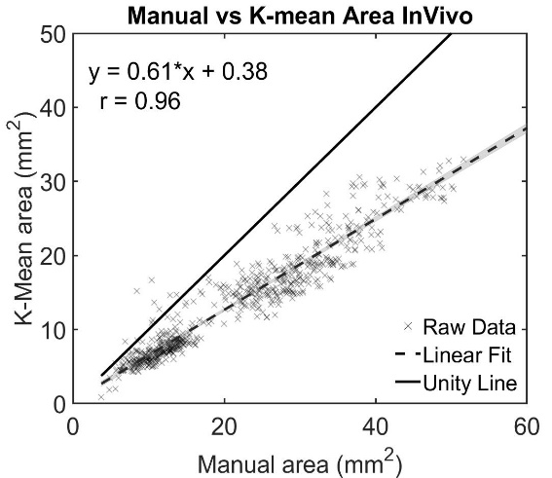
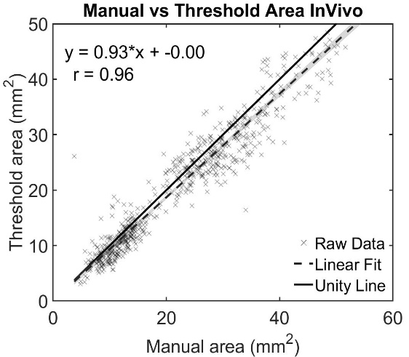
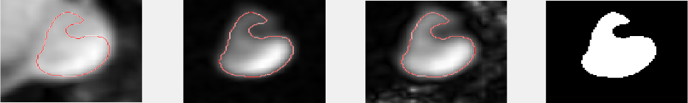
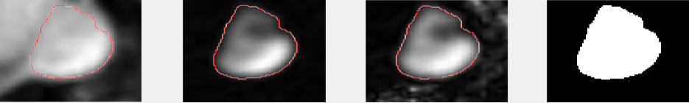
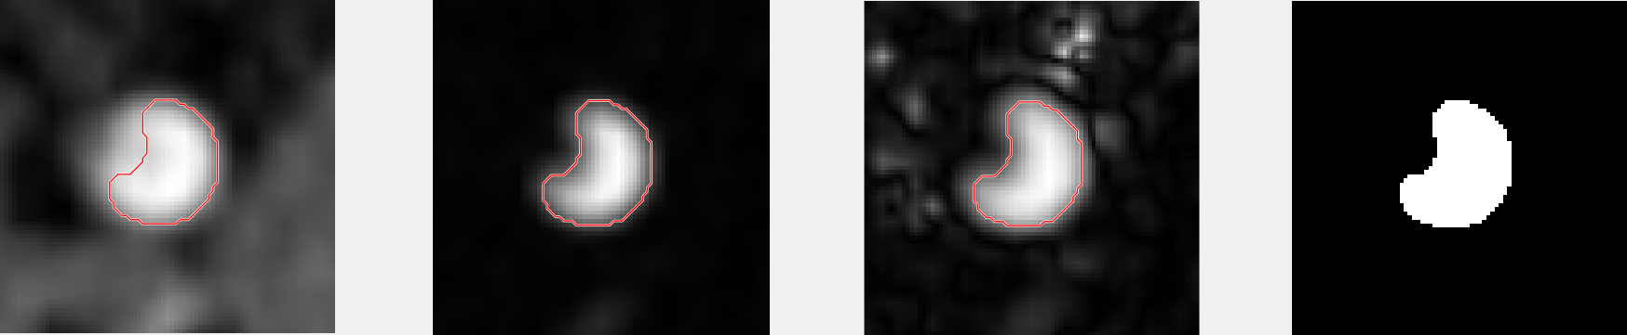
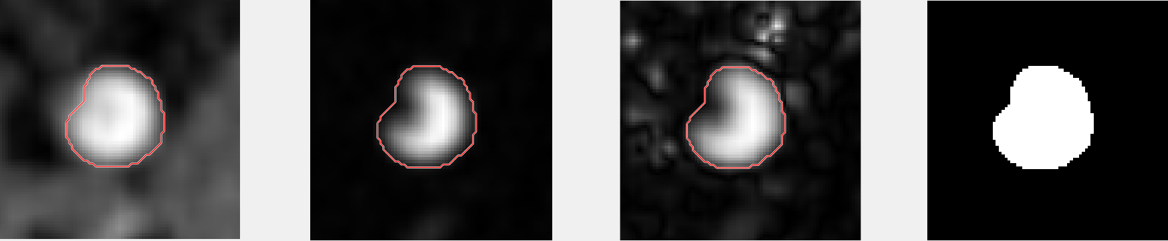
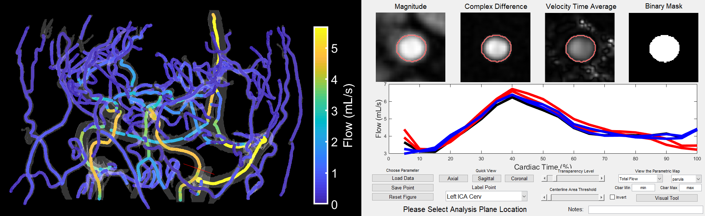
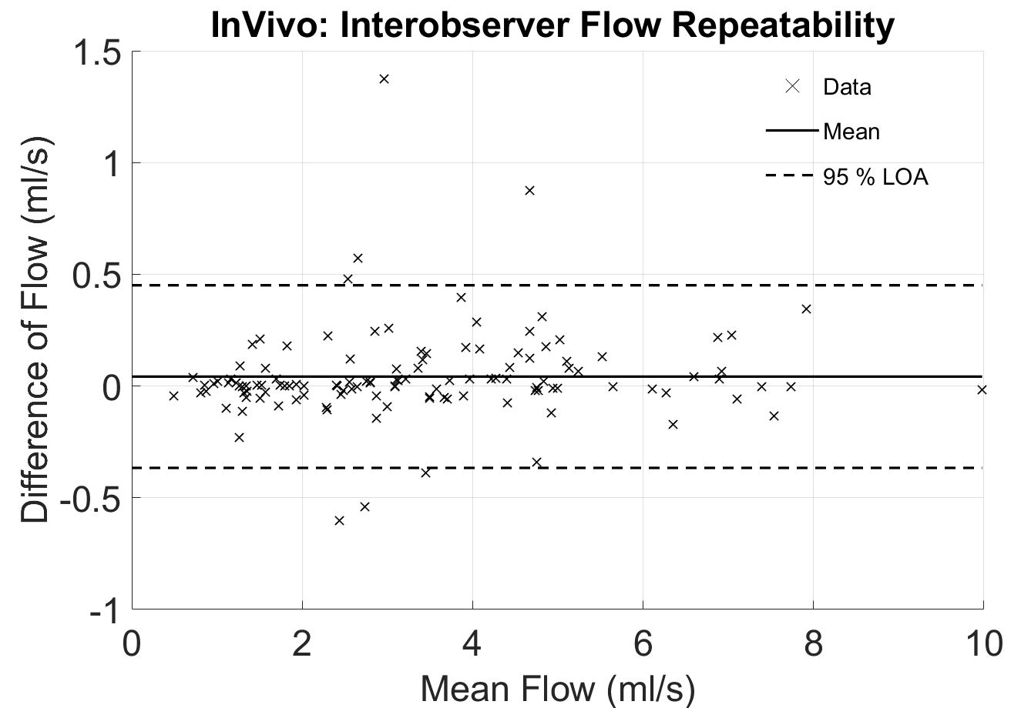
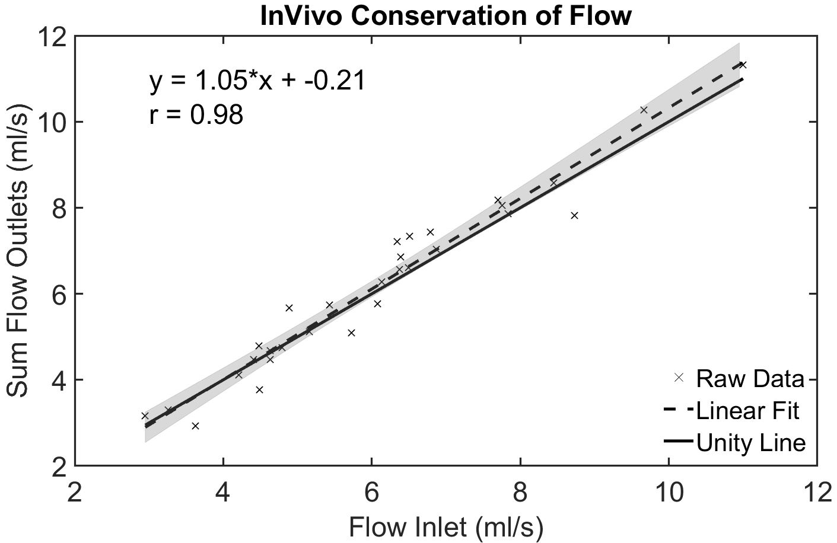
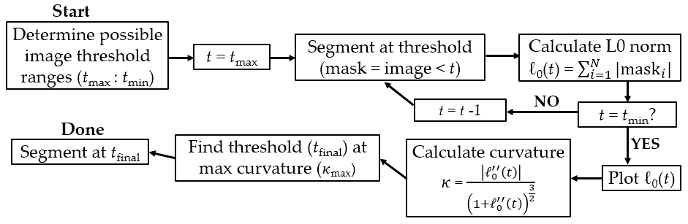
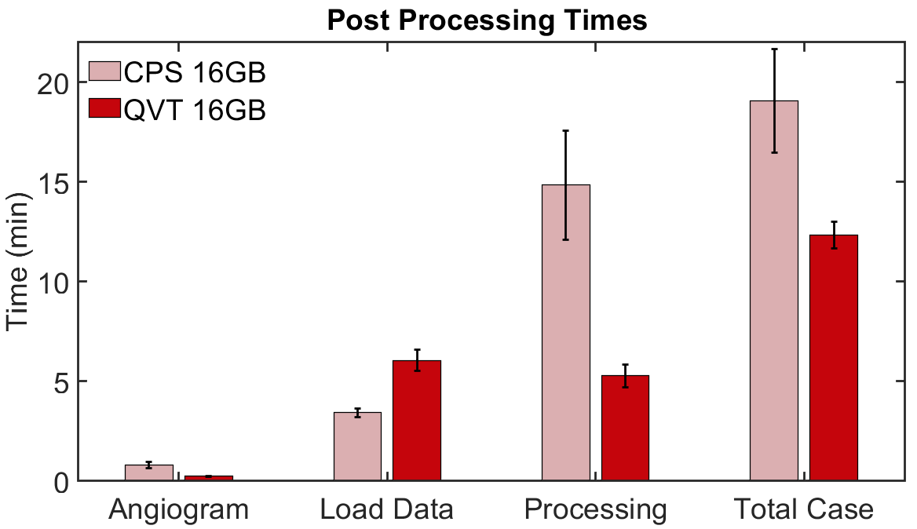
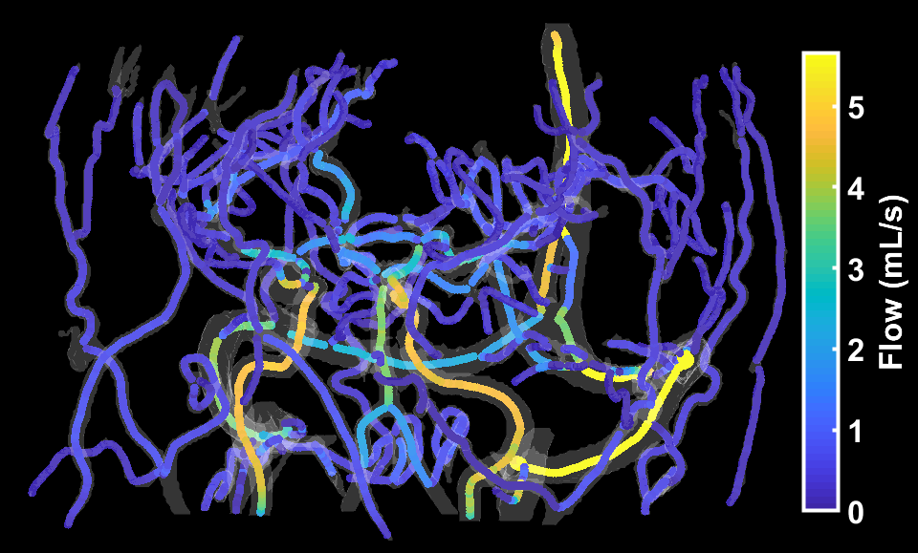
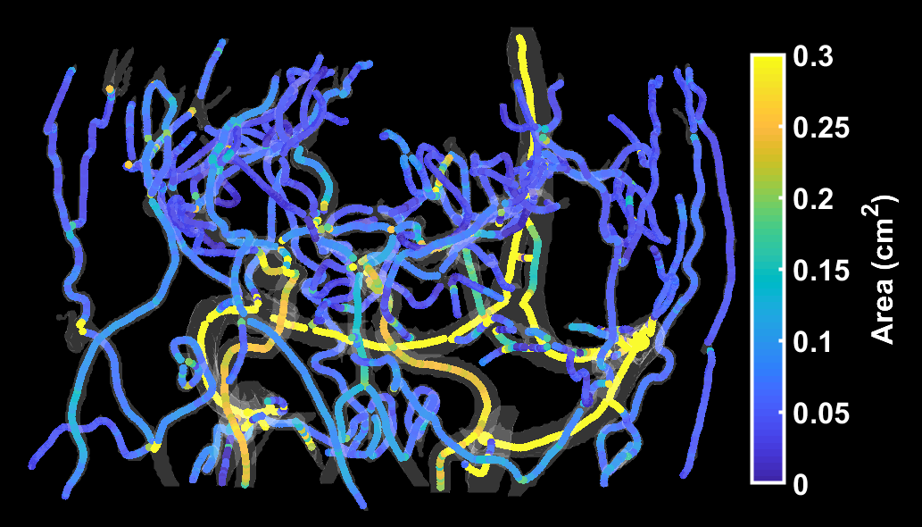
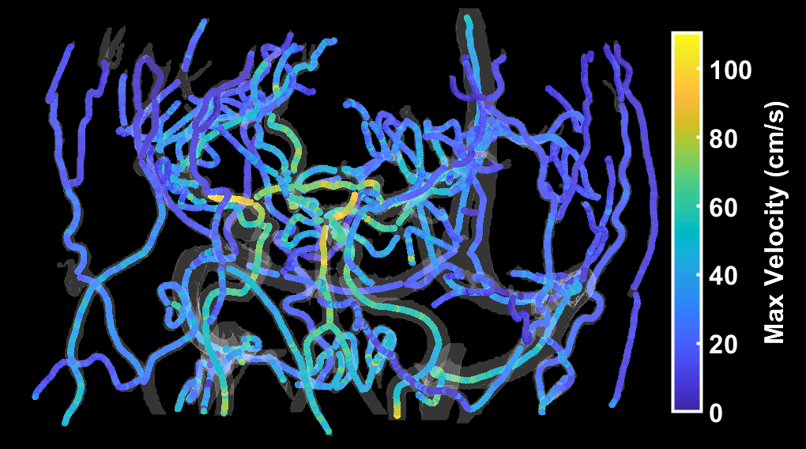
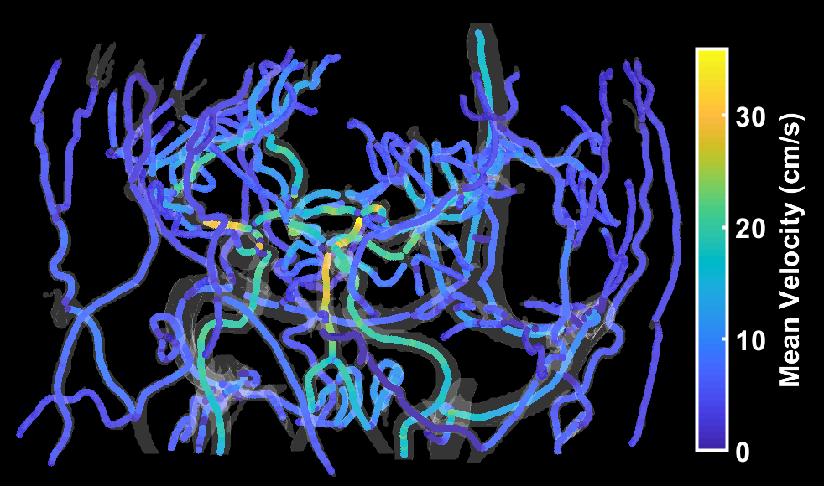
Automated Cranial 4D Flow MRI Analysis
Carson Hoffman¹, Grant Roberts¹, Sara Berman³, Laura Eisenmenger², and Oliver Wieben^{1,2}
Departments of ¹Medical Physics and ²Radiology, University of Wisconsin – Madison
³Alzheimer’s Disease Research Center, University of Wisconsin – Madison
Synopsis
Results
To develop and validate a software tool for robust cerebrovascular analysis of 4D flow MRI data that includes:
    An interactive visual interface
    Quick and robust automated and reproducible hemodynamic analysis
Background
4D flow MRI acquires in-vivo, time-resolved, volumetric data of velocity vectors.
    Allows for qualitative and quantitative analysis of anatomy and hemodynamics
    Post-processing can be time consuming
A previously-established cranial 4D flow centerline processing scheme (CPS)¹ allowed:
    Repeatable quantitative analysis
    Automated segmentation
    Quick post processing times (~15 min)
    Analysis of +1000 cranial cases
Purpose: Develop a quantitative velocity tool (QVT) that improves 4D flow post-processing:
    Fully automated quantitative flow computations for all vessels (~3000 locations)
      Anatomical: vessel segmentation
      Functional: blood velocity, flow, pulsatility index, etc.
    Interactive 3D user interface
      Visualization of color-coded flow parameters
      Easy vessel selection
    Reduce memory requirements and post-processing times (~5 min)
Figure 4: Linear regression (correlation) plots of k-means-derived (CPS) segmented vessel areas and iterative threshold-based (QVT) areas versus ground-truth manual segmentation.
Threshold
k-means
Magnitude
Regression (Figure 4) for both segmentation methods showed high correlation (R=0.96).
Threshold-based segmentation was more accurate compared to manual segmentation (slope=0.93) than k-means segmentation (slope=0.61).
Examples of segmentation improvements are shown in Figure 5.
Number of missed vessels reduced from 16.2% to 3.8% when analyzed in QVT.
    MCA, PCA, and TS accounted for 25/26 missed vessels.
    Average variance of flow along vessel segments was similar for CPS (2.8±2.6%) and QVT (2.9±2.2%).
Comp. Diff.
Methods
Transverse Sinus
An in-vivo study was performed to assess CPS and QVT segmentation performances, interobserver variabilities, vessel selection, and post processing times.
Ten 4D flow brain scans were acquired on healthy volunteers.
    PC-VIPR² acquisition: field strength = 3T; volume = 22 cm³; spatial res. = 0.69 mm²; V_{ENC} = 80 cm/s; scan time = 7 min.; retrospective cardiac gating (20 frames).
The QVT graphical interface (Figure 1) was developed in MATLAB18b (Mathworks, MA).
Velocity
k-means
Int. Carotid Artery
Threshold
Binary Mask
Figure 5: Old k-means segmentation and new threshold segmentation in transverse sinus (top) and internal carotid artery (bottom).
Bland-Altman analysis of flow quantification between users showed a mean difference and 95% CIs of 0.042 [-0.37, 0.45] ml/s with the QVT (Figure 6).
Bias and CIs are reduced when compared to old CPS -0.1 [-1.88,1.68] ml/s.
Internal consistency of flow was observed at vessel junctions for the QVT (Figure 7).
Figure 1: 4D flow post-processing tool with 3D interactive graphical user interface. As the user moves the cursor, the cross-sectional images and flow waveforms are updated in real-time.
A threshold-based vessel segmentation algorithm was developed (Figure 2).
Automated calculations of blood flow parameters were completed across the vascular network and color-coded in the 3D interface (Figure 3).
Figure 2: Flowchart for threshold-based segmentation. This algorithm iterates through all possible thresholds and calculates L0-norm. The norm is plotted as a function of threshold, and the point of maximum curvature is the final threshold used.
Figure 6: Bland-Altman plot of inter-observer repeatability for QVT.
Figure 7: Linear regression plot of inlet and outlet flow at vessel junctions (ICA, ACA, MCA and SSS, SS, TS junctions). High correlation reflects good internal flow consistency with the QVT.
Angiogram and centerline generation times decreased from 48.6 s to 13.2 s.
Automated data loading and processing increased from 3.4 min to 6 min
Processing times (vessel selection and flow validation) decreased from 15.2 min to 5.0 min (1.17 min and 0.38 min per plane).
Memory requirements were reduced from ~6GB to ~1GB
Flow analysis was completed in 13 locations: internal carotid arteries (ICA), basilar artery (BA), middle cerebral arteries (MCA), posterior cerebral arteries (PCA), straight sinus (SS), superior sagittal sinus (SSS), and transverse sinuses (TS).
Automated vessel segmentation methods were evaluated against a manual segmentation:
    K-means segmentation (CPS) and threshold-based segmentation (QVT)
Number of missed (non-selectable) vessels were counted for both tools.
Intra-observer variability of flow was calculated between two observers with QVT.
Conservation of flow at ICA, MCA, ACA and TS, SS, SSS junctions was assessed with QVT.
Figure 8: Processing times for new and old tool with 16 GB machine.
Discussion
Robust analysis tools with high repeatability are extremely desirable for high-volume, long-term 4D flow studies.
Both tools showed high user repeatability, small local flow measurement variations (<3%), and quick processing times.
However, we confirmed that the QVT provided improved angiograms, quicker vessel selection, easier visualization, reduced computer memory requirements, and faster processing times.
    Due to these improvements, we suggest utilizing the QVT moving forward.
To further verify these findings, more extensive repeatability and flow consistency testing should be performed.
References
Figure 3: Quantitative parameters (area, flow, velocity) color-coded on automatically-generated centerlines.
[1] Schrauben, E. et al. JMRI 2015; 42:1458-64. [2] Gu, T. et al. AJNR 2008; 26:743-749

