Slide 1
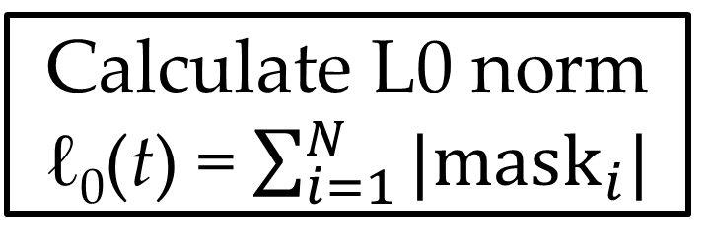
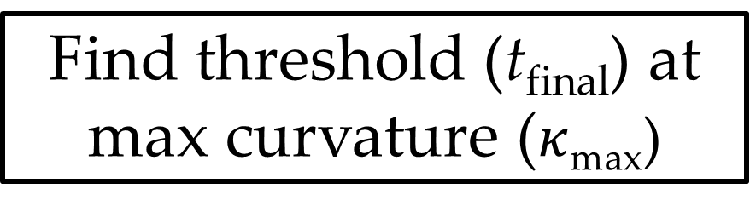
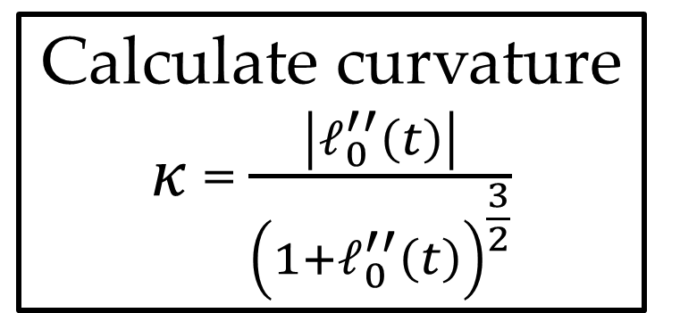
Start
Determine possible image threshold ranges (t_{max} : t_{min})
Segment at threshold (mask = image < t)
Calculate L0 norm ℓ₀(t) = $\sum_{i=1}^{N}{|mask_{i}|}$
t = t_{max}
NO
t = t -1
t = t_{min}?
Done
Find threshold (t_{final}) at max curvature ($κ$_{max})
YES
Segment at t_{final}
Calculate curvature $κ$ = $\frac{\left|ℓ_{0}^{′′}\left(t\right)\right|}{{\left(1+ℓ_{0}^{′′}\left(t\right)\right)}^{\frac{3}{2}}}$
Plot ℓ₀(t)

