Slide 1


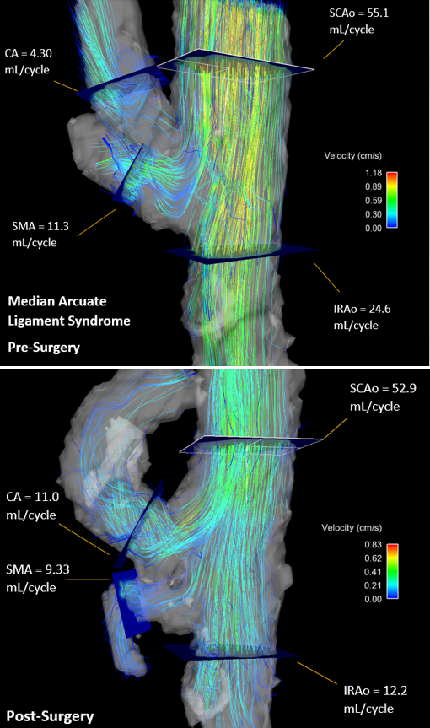
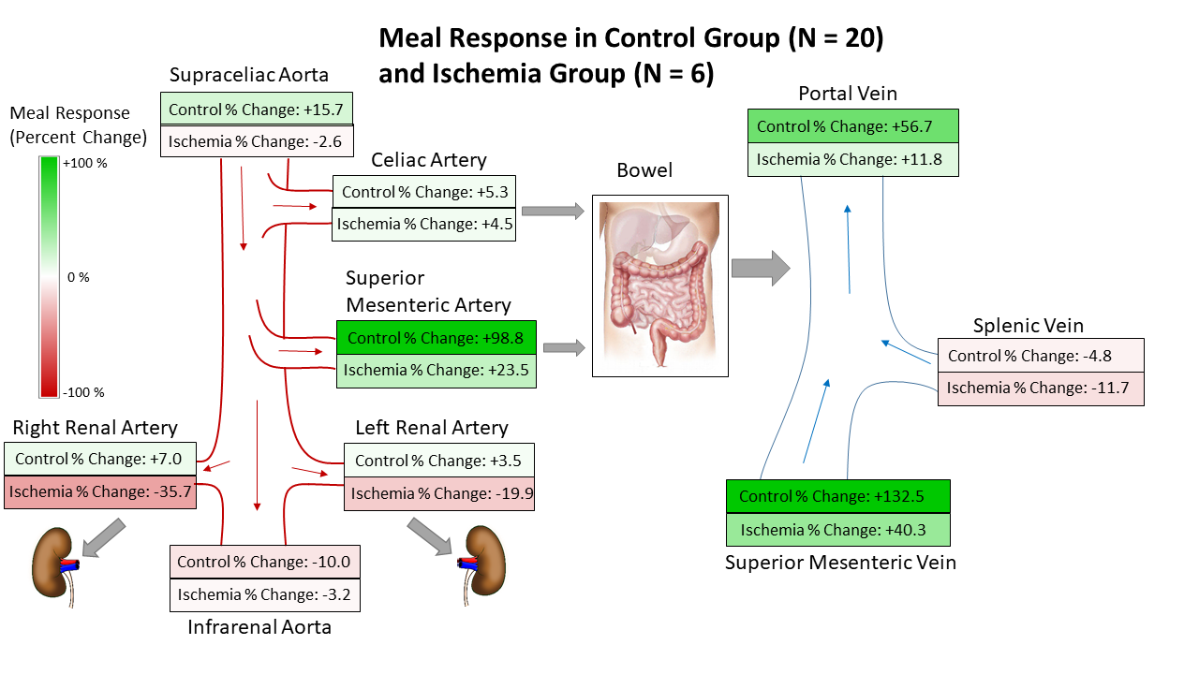
Non-Invasive Assessment of Mesenteric Hemodynamics with 4D flow MRI
G. Roberts¹, A. Roldán-Alzate², C.J. Francois², and O. Wieben^{1,2}
Departments of ¹Medical Physics and ²Radiology, University of Wisconsin - Madison
SYNOPSIS
METHODS cont.
RESULTS cont.
This study investigates the use of 4D flow MRI to non-invasively assess the hemodynamics of mesenteric circulation in both healthy patients and patients with chronic mesenteric ischemia.
Flow analysis was conducted in 6 arterial and 3 portal vessel segments.
Arterial vessels: supraceliac aorta (SCAo), infrarenal aorta (IRAo), superior mesenteric artery (SMA), celiac artery (CA), right renal artery (RRA), and left renal artery (LRA).
Portal Vessels: portal vein (PV), splenic vein (SV), and superior mesenteric vein (SMV).
After flow analysis, the clinical diagnosis for each patient was provided and the suspected ischemia group was further subcategorized into 2 groups.
Ischemia (positive diagnosis of ischemia)
Negative Diagnosis
INTRODUCTION
Chronic mesenteric ischemia (CMI) is a disease caused by inadequate blood flow to the intestines.
In healthy individuals, an increase in mesenteric blood flow is observed within minutes after a meal. In patients with CMI, this meal response is compromised.
Around 90% of cases are the result of atherosclerosis.
Rare conditions such as median arcuate ligament syndrome (MALS) and aortic dissection may also result in CMI¹.
Due to collateral circulation, patients may not experience symptoms until 2 or 3 major mesenteric vessels are involved¹.
Typical symptoms include:
Severe postprandial abdominal pain after a meal
Weight loss
Nausea/Vomiting
Fear of eating
If left untreated, CMI can result in life-threatening acute ischemia and bowel infarction.
Functional assessment of mesenteric flow has been traditionally accomplished with invasive interventional angiography and duplex sonography.
4D flow MRI has previously been proposed to anatomically and functionally evaluate mesenteric vasculature².
RESULTS
Figure 3: Patient diagnosed with MALS. Images are shown before a) and after b) median arcuate ligament release surgery. Image a) clearly shows disturbed flow due to pinching of the CA. Image b) shows greatly improved flow after surgery (flow increase of 156%).
 | Average Percent Change in Flow after Meal Challenge
Vessel | CONTROL (N = 20) | NEGATIVE DIAGNOSIS (N = 15) | ISCHEMIA (N = 6)
SCAo | 15.0 ± 14.8 | 30.1 ± 30.1 | -2.57 ± 12.1
IRAo | -9.5 ± 27.0 | 26.5 ± 71.2 | -3.16 ± 27.1
LRA | 3.4 ± 15.4 | 8.46 ± 34.6 | -19.9 ± 26.1
RRA | 6.6 ± 17.5 | 7.71 ± 31.3 | -35.7 ± 37.1
SMA | 94.1 ± 80.7 | 105.6 ± 141.1 | 23.5 ± 32.7
CA | 5.0 ± 52.3 | -9.09 ± 25.6 | 4.52 ± 8.52
SMV | 125.8 ± 80.2 | 252.8 ± 267.8 | 40.3 ± 55.6
SV | -4.5 ± 32.3 | -0.55 ± 38.2 | -11.7 ± 19.4
PV | 53.9 ± 47.9 | 118.0 ± 150.8 | 11.8 ± 30.9
METHODS
DISCUSSION & CONCLUSION
21 patients with a suspicion of mesenteric ischemia, referred from vascular surgery, were imaged on 1.5T and 3.0T scanners (Signa Excite, GE Healthcare, Waukesha, WI).
Average age: 49.2 years [21 – 86 years]
20 healthy volunteers
Average age: 44.4 years [19 – 73 years]
Hemodynamic parameters were measured before and after a meal challenge. All patients received two scans.
The first scan was performed after 5 hours of fasting.
The second scan was performed 20 minutes after ingestion of 574 mL of EnSure Plus (Abbott Laboratories, Columbus, OH).
The ischemia group showed lower flow values than the control group in the supraceliac aorta (SCAo) and splenic vein (SV).
Most likely due to globally compromised cardiovascular health.
The ischemia group showed a stunted flow response after a meal challenge, particularly in the SCAo, SMA, SMV, and PV.
Most likely due to the intrinsic pathology preventing mesenteric vessels from fulfilling demand for increased blood flow to the abdomen.
Flow visualization can further aid in diagnosis (Figure 4).
This study demonstrates the feasibility of using 4D flow MRI to non-invasively and comprehensively assess the functional response of to a meal challenge in patients with suspicion of chronic mesenteric ischemia.
Table 1: Average percent change of blood flow in response to a meal challenge is shown for all three cohorts for each vessel. The negative diagnosis group and ischemia group were compared to the control data set using a t-test. Yellow indicates statistical significance (p < 0.05).
4D PC MR data were acquired using 5-point PC-VIPR acquisition^{3,4} with cardiac and respiratory gating.
Complete volumetric coverage of the abdomen was acquired.
32x32x24 cm spherical, 1.25 mm isotropic resolution
3D vessel segmentation was performed semi-automatically using Mimics (Materialize, Leuven, Belgium).
Flow visualization and flow analysis plane placement was accomplished in EnSight (ANSYS, Canonsburg, PA) as seen in Figure 1.
Magnitude and velocity vector data from these 9 planes were exported and analyzed in a customized software package that allowed for manual vessel segmentation over all frames of the cardiac cycle.
REFERENCES
Wilkins LR, Stone JR. Chronic mesenteric ischemia. Tech Vasc Interv Radiol. 2015;18(1):31-37. doi:10.1053/j.tvir.2014.12.005
Roldan-Alzate A, Frydrychowicz A, Said A, et al. Impaired regulation of portal venous flow in response to a meal challenge as quantified by 4D flow MRI. J Magn Reson Imaging. 2015;42(4):1009-1017. doi:10.1002/jmri.24886
Gu T, Korosec FR, Block WF, et al. PC VIPR: A high-speed 3D phase-contrast method for flow quantification and high-resolution angiography. Am J Neuroradiol. 2005;26(4):743-749. doi:26/4/743
Johnson KM, Lum DP, Turski PA, et al. Improved 3D Phase Contrast MRI with Off-resonance Corrected Dual Echo VIPR. Magn Reson Med. 2008;60(6):1329-1336. doi:10.1002/mrm.21763.Improved
Figure 2: Comparison of meal challenge response between the control group and the ischemia group.
ACKNOWLEDGEMENTS
We acknowledge GE Healthcare for their assistance and support.

Slide 2
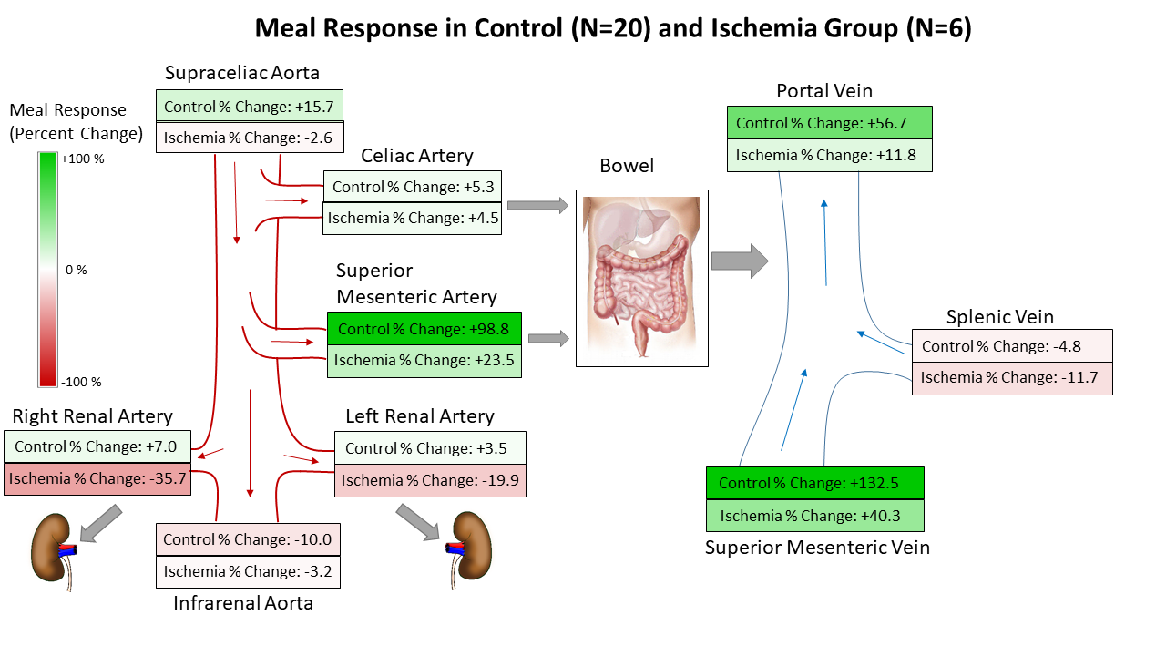
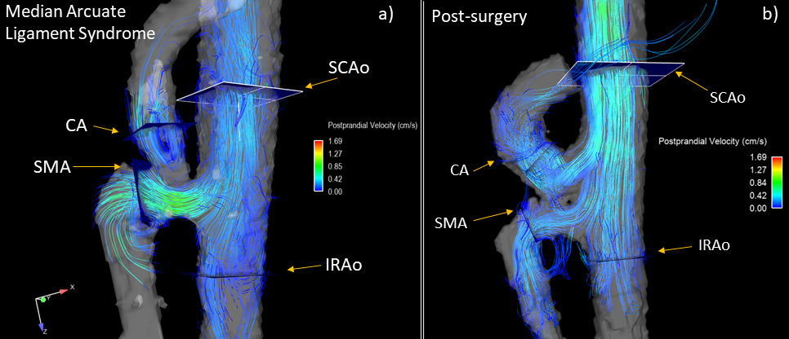
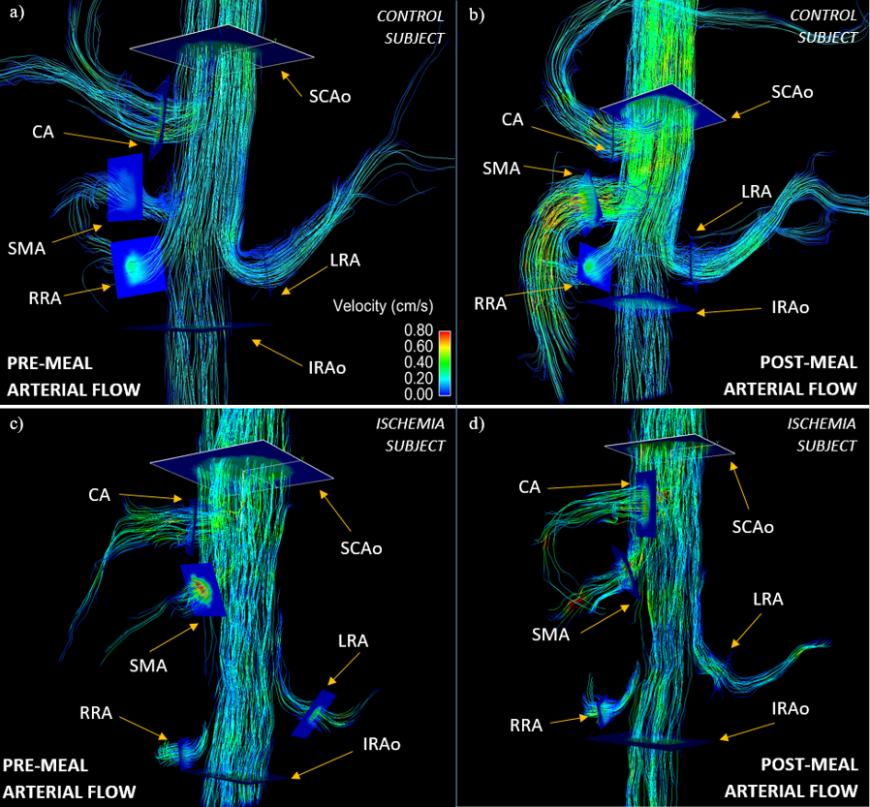
Non-Invasive Assessment of Mesenteric Hemodynamics with 4D flow MRI
G. Roberts¹, A. Roldán-Alzate², C.J. Francois², and O. Wieben^{1,2}
Departments of ¹Medical Physics and ²Radiology, University of Wisconsin - Madison
SYNOPSIS
RESULTS cont.
This study investigates the use of 4D flow MRI to non-invasively assess the hemodynamics of mesenteric circulation in both healthy patients and patients with chronic mesenteric ischemia.
INTRODUCTION
Chronic mesenteric ischemia (CMI) is a disease caused by inadequate blood flow to the intestines.
In healthy individuals, an increase in mesenteric blood flow is observed only minutes after ingestion of a meal. In patients with CMI, this meal response is compromised.
Around 90% of cases are the result of atherosclerosis. Rare conditions such as median arcuate ligament syndrome (MALS) and aortic dissection may also result in CMI¹.
Due to collateral circulation, patients may not experience symptoms until 2 or 3 major mesenteric vessels are involved¹.
Typical symptoms include:
Severe postprandial abdominal pain, weight loss, nausea, vomiting, and fear of food.
If left untreated, CMI can result in life-threatening acute ischemia and bowel infarction.
Functional assessment of mesenteric flow has been traditionally accomplished with invasive interventional angiography and duplex sonography.
4D flow MRI has previously been proposed to anatomically and functionally evaluate mesenteric vasculature².
Figure 2: Comparison of meal challenge response between the control group and the ischemia group.
METHODS
21 patients with suspicion of CMI (referred from vascular surgery) were imaged on 1.5T and 3.0T scanners (Signa Excite, GE Healthcare, Waukesha, WI). Average age: 48.3 years [21 – 86 years].
20 healthy volunteers were also imaged. Average age: 44.4 years [19 – 73 years].
Hemodynamic parameters were measured before and after a meal challenge. All patients received 2 scans. The first scan was performed after 5 hours of fasting. The second scan was performed 20 minutes after ingestion of 574 mL of EnSure Plus (Abbott Laboratories, Columbus, OH).
4D PC MR data were acquired using 5-point PC-VIPR acquisition^{3,4} with cardiac and respiratory gating.
Complete volumetric coverage of the abdomen was acquired: 32x32x24 cm spherical, 1.25 mm isotropic res.
3D vessel segmentation was semi-automatically performed using Mimics (Materialize, Leuven, Belgium).
Flow visualization and flow analysis plane placement was accomplished in EnSight (ANSYS, Canonsburg, PA) as seen in Figure 1.
Table 1: Average percent change of blood flow in response to a meal challenge is shown for all three cohorts for each vessel. The negative diagnosis group and ischemia group were compared to the control data set using a t-test. Yellow indicates statistical significance (p < 0.05).
One subject with MALS was studied before and after median arcuate ligament release surgery.
Flow analysis was conducted in 6 arterial and 3 portal vessel segments.
Arterial vessels:
Supraceliac aorta (SCAo)
Infrarenal aorta (IRAo)
Superior mesenteric artery (SMA)
Celiac artery (CA)
Right renal artery (RRA)
Left renal artery (LRA)
Portal Vessels:
Portal vein (PV)
Splenic vein (SV)
Superior mesenteric vein (SMV)
Figure 3: Patient diagnosed with MALS. Images are shown before a) and after b) median arcuate ligament release surgery. Image b) shows greatly improved flow after surgery (CA flow increase of 156%).
DISCUSSION & CONCLUSION
Magnitude and velocity vector data were exported and analyzed in a customized software package that allowed for manual vessel segmentation over all frames of the cardiac cycle.
After flow analysis, the clinical diagnosis for each patient was provided and the suspected ischemia group was further subcategorized into 2 groups.
Ischemia (positive diagnosis of ischemia)
Negative Diagnosis
The ischemia group showed lower flow values than the control group in the supraceliac aorta (SCAo) and splenic vein (SV). This is most likely due to globally compromised cardiovascular health.
The ischemia group showed a stunted flow response after a meal challenge, particularly in the SCAo, SMA, SMV, and PV. This is most likely due to the intrinsic pathology preventing mesenteric vessels from fulfilling demand for increased blood flow to the abdomen.
Visualization can further aid in diagnosis by identifying patient-specific pathology (Figure 3).
This study demonstrates the feasibility of using 4D flow MRI to non-invasively and comprehensively assess the functional response of to a meal challenge in patients with suspicion of chronic mesenteric ischemia.
Figure 1: 4D arterial flow MRI streamline images for a control subject (figures a and b) and an ischemia subject (figures c and d) both before (figures a and c) and after a meal challenge (figures b and d).
REFERENCES
RESULTS
Wilkins LR, Stone JR. Chronic mesenteric ischemia. Tech Vasc Interv Radiol. 2015;18(1):31-37.doi:10.1053/j.tvir.2014.12.005
Roldan-Alzate A, Frydrychowicz A, Said A, et al. Impaired regulation of portal venous flow in response to a meal challenge as quantified by 4D flow MRI. J Magn Reson Imaging. 2015;42(4):1009-1017. doi:10.1002/jmri.24886
Gu T, Korosec FR, Block WF, et al. PC VIPR: A high-speed 3D phase-contrast method for flow quantification and high-resolution angiography. Am J Neuroradiol. 2005;26(4):743-749. doi:26/4/743
Johnson KM, Lum DP, Turski PA, et al. Improved 3D Phase Contrast MRI with Off-resonance Corrected Dual Echo VIPR. Magn Reson Med. 2008;60(6):1329-1336. doi:10.1002/mrm.21763.Improved
4D flow data were successfully obtained for all 82 flow scans.
Flow changes between pre- and post-meal are shown in Figure 2 and Table 1.
Cross comparing the flow difference between the control group and the ischemic group show a statistically significant difference in the SCAo (p=0.022), SMA (p=0.003), SMV (p=0.008), and PV (p=0.018).
There was no statistically significant difference in flow difference between the negative diagnosis group and the control group.
ACKNOWLEDGEMENTS
We gratefully acknowledge GE Healthcare for their assistance and support.

