Slide 1


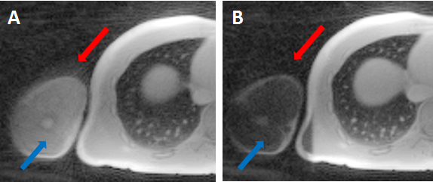
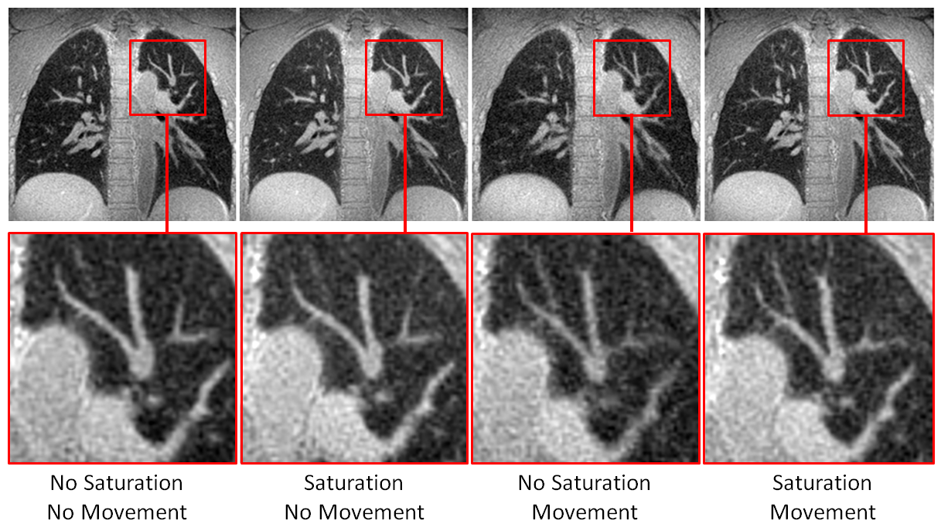
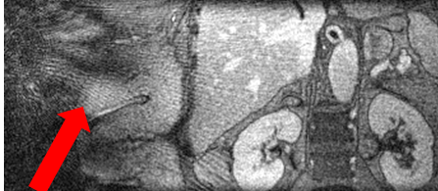
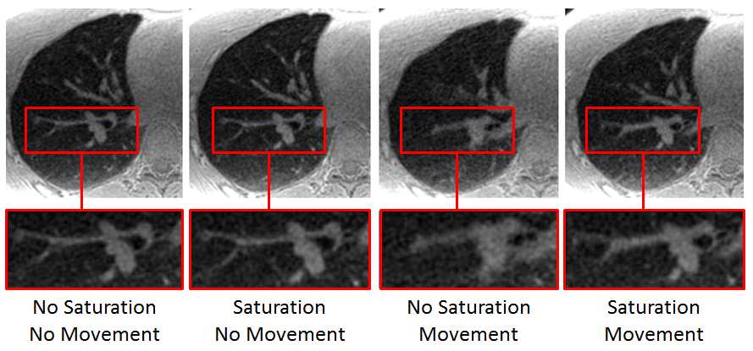
Artifact Reduction in 3D Radial Imaging with Outer Volume Saturation Pulses
J. Macdonald¹, O. Wieben^{1,2}, S.K. Nagle², and K.M. Johnson¹
Departments of ¹Medical Physics and ²Radiology, University of Wisconsin - Madison
STUDY OBJECTIVE
RESULTS
RESULTS cont.
To assess the effectiveness of outer volume spatial saturation pulses in 3D radial imaging as a means to improve apparent SNR by suppressing streaking artifacts from anatomy outside of the imaging volume of interest.
Outer volume saturation pulses proved to be effective at suppressing most tissue signal in the arms and reducing corresponding streaking artifacts (Figure 2).
Coronal views also showed improvement in image quality with outer volume saturation in the cases with motion (Figure 4).
BACKGROUND
Undersampling artifacts and data inconsistencies in radial imaging manifest as relatively benign, incoherent streaking artifacts in high contrast images¹.
In regions with naturally low signal, such as the lungs, streaking artifacts can lead to decreased apparent SNR and errors in derived parameter maps.
Anatomy outside of the imaging volume of interest can be a source of streaking artifacts (Figure 1).
Figure 2: Logarithmic grayscale images of subject 2 moving their arms with (A) no saturation pulses and (B) saturation every 80 TRs. The red arrow shows streaking artifacts from the surface of the arm. The blue arrow shows effective suppression of most tissue in the arms. Some tissue saturation is also apparent on the edge of the torso, but fat is not completely suppressed.
Figure 4: Coronal slices of the lung in subject 3 under all 4 imaging conditions. The red box identifies an area where effect of the saturation bands on the SNR of the lung vasculature is especially noticeable.
The image rankings performed for each subjects by the radiologist are shown in Table 1.
 | No Saturation No Movement | Saturation No Movement | No Saturation Movement | Saturation Movement
Subject 1 | 2 | 1 | 4 | 3
Subject 2 | 1 | 2 | 4 | 3
Subject 3 | 1 | 2 | 4 | 3
Subject 4 | 4 | 2 | 3 | 1
Mean Score | 2 | 1.75 | 3.75 | 2.5
Std. Dev. | 1.41 | 0.5 | 0.5 | 1
DISCUSSION & CONCLUSION
Saturation pulses were effective at reducing streaking artifacts from the arms outside of the image volume of interest.
Outer volume saturation improved image quality and SNR in cases with outer volume motion, but had minimal impact on cases with no motion.
The scan time penalty of the saturation pulses was minimal, increasing the scan duration by only 13 s (5%).
The short T1 of fat allowed for regrowth between successive saturation pulses and resulted in considerable signal relative to the rest of the tissue in the arm, as shown in Figure 2.
This suggests the need for either fat suppression or more frequent saturation, both of which would increase SAR, which is already near the allowable limit.
SAR minimized suppression pulses could substantially increase the efficacy of saturation, which is ~60% with the 257 ms spacing between pulses.
Given the small increase in scan time and improvement in image quality, these saturation pulses are worth implementing in 3D radial acquisitions if the extra SAR can be tolerated, especially in cases with motion.
Figure 1: Coronal abdominal slice of a subject displaying prominent streaking artifacts (red arrow) originating at the arms outside of the imaging volume of interest and continuing into the body, reducing apparent SNR in this region.
Outer volume suppression may reduce streaking artifacts originating outside of the imaging volume of interest and improve apparent SNR.
METHODS
Table 1: Radiologist scoring on image quality from best (1) to worst (4) for the four different acquisitions in each subject.
Four healthy volunteers were imaged on a 3.0 T scanner (Discovery MR750, GE Healthcare, Waukesha, WI) with a 32 channel torso coil.
The lungs were imaged due to their naturally low signal and susceptibility to SNR loss from streaking artifacts.
Respiratory gated imaging was performed with a 3D radial ultrashort echo time (UTE) sequence²: TR/TE = 2.9/0.1 ms, FA = 4°, spatial resolution = 1.25 mm isotropic, 40,000 projections, axial slab excitation with 30 cm FOV of interest.
Two successive quadratic phase 90° saturation pulses (TR = 12.6 ms, BW = 12.5 kHz, PW = 10 ms) were played to the right and left of the field of view of interest to provide outer volume saturation on the arms.
Saturation pulses were played every 80 TRs, the minimum time allowable to stay below SAR limitations.
Each subject was scanned with and without outer volume saturation bands.
Scan times were 3:54 (min:sec) without saturation and 4:07 with saturation.
Scans were repeated with each volunteer instructed to move their upper arms throughout the duration of the scan, introducing increased artifacts from motion.
An experienced cardiothoracic radiologist ranked the images by overall image quality for each subject from best to worst (1=best, 4=worst).
Axial slices through the lung showed comparable results between images with and without saturation when no motion was present. There was a noticeable improvement in the images with saturation when motion was present (Figure 3).
REFERENCES
[1] Block WF, Barger AV, Mistretta CA. Vastly Undersampled Isotropic Projection Imaging. Proceedings from the International Society of Magnetic Resonance in Medicine. 2000; 8: 161.
[2] Johnson KM, Fain SB, Shiebler ML, Nagle S. Optimized 3D Echo Time Pulmonary MRI. Magnetic Resonance in Medicine. 2013; 70(5): 1241-1250.
Figure 3: Axial slices of the lung in subject 2 under all four imaging conditions. The red box identifies an area where the effect of the saturation bands on the SNR of the lung vasculature is especially noticeable.
ACKNOWLEDGEMENTS
We gratefully acknowledge GE Healthcare for their assistance and support.

