Slide 1
Table 1: Average Preprandial Volumetric Flow Rates (mL/min/kg)
 | SCAo | IRAo | LRA | RRA | SMA | CA | SMV | SV | PV
Control | 48.2 ± 17.6 | 15.5 ± 7.81 | 5.00 ± 3.40 | 4.85 ± 2.42 | 5.97 ± 3.15 | 11.8 ± 7.88 | 6.61 ± 2.66 | 6.52 ± 4.18 | 14.1 ± 5.57
CMI- | 44.6 ± 15.6 | 16.5 ± 6.50 | 6.40 ± 2.73 | 6.18 ± 2.99 | 8.04 ± 4.35 | 6.72 ± 3.54 | 6.89 ± 4.14 | 6.46 ± 3.63 | 13.5 ± 4.40
CMI+ | 36.5 ± 10.4 | 19.1 ± 3.88 | 6.68 ± 8.44 | 6.01 ± 6.37 | 7.59 ± 3.13 | 7.80 ± 3.51 | 10.7 ± 3.64 | 5.21 ± 1.89 | 17.7 ± 5.71
Volumetric flow rates are expressed as mean ± 1 standard deviation. Bold indicates statistical significance (p < 0.05) compared to controls. Underline indicates statistical significance (p < 0.05) between CMI and Neg. Diag. group. SCAo = supraceliac aorta, IRAo = infrarenal aorta, LRA = left renal artery, RRA = right renal artery, SMA = superior mesenteric artery, CA = celiac artery, SMV = superior mesenteric vein, SV = splenic vein, and PV = portal vein.

Slide 2
Table 2: Average Postprandial Volumetric Flow Rates (mL/min/kg)
 | SCAo | IRAo | LRA | RRA | SMA | CA | SMV | SV | PV
Control | 55.3 ± 19.9 | 14.0 ± 6.15 | 4.94 ± 2.91 | 5.21 ± 2.72 | 11.1 ± 5.00 | 11.0 ± 7.00 | 14.2 ± 4.56 | 5.80 ± 2.52 | 20.6 ± 5.91
CMI- | 54.2 ± 22.3 | 19.3 ± 6.93 | 6.33 ± 2.74 | 6.33 ± 3.70 | 12.5 ± 6.40 | 7.00 ± 4.42 | 16.7 ± 7.23 | 5.94 ± 3.85 | 23.1 ± 6.56
CMI+ | 35.3 ± 11.3 | 18.6 ± 7.00 | 6.37 ± 9.29 | 3.82 ± 4.18 | 9.37 ± 4.52 | 8.17 ± 3.96 | 15.5 ± 8.60 | 4.46 ± 1.67 | 20.8 ± 10.3
Volumetric flow rates are expressed as mean ± 1 standard deviation. Bold indicates statistical significance (p < 0.05) compared to controls. Underline indicates statistical significance (p < 0.05) between the CMI- and CMI+ group. SCAo = supraceliac aorta, IRAo = infrarenal aorta, LRA = left renal artery, RRA = right renal artery, SMA = superior mesenteric artery, CA = celiac artery, SMV = superior mesenteric vein, SV = splenic vein, and PV = portal vein.

Slide 3
Table 3: Average Percent Change in Flow (%)
 | SCAo | IRAo | LRA | RRA | SMA | CA | SMV | SV | PV
Control | 15.7 ± 14.8 | -7.03 ± 24.4 | 3.58 ± 15.4 | 6.97 ± 17.5 | 98.8 ± 80.7 | -3.73 ± 18.9 | 132 ± 80.7 | -4.76 ± 32.3 | 56.7 ± 47.9
CMI- | 21.1 ± 16.6 | 13.0 ± 31.1 | 2.03 ± 21.0 | -0.950 ± 19.0 | 62.7 ± 66.5 | 0.930 ± 35.6 | 178 ± 147 | -3.77 ± 36.0 | 72.1 ± 50.4
CMI+ | -2.57 ± 12.1 | -3.16 ± 27.1 | -19.9 ± 26.1 | -35.7 ± 37.1 | 23.5 ± 32.7 | 4.52 ± 8.53 | 40.3 ± 55.6 | -11.7 ± 19.4 | 11.7 ± 30.9
Percent change values are expressed as mean ± 1 standard deviation. Bold indicates statistical significance (p < 0.05) compared to controls. Underline indicates statistical significance (p < 0.05) between the CMI- and CMI+ group. SCAo = supraceliac aorta, IRAo = infrarenal aorta, LRA = left renal artery, RRA = right renal artery, SMA = superior mesenteric artery, CA = celiac artery, SMV = superior mesenteric vein, SV = splenic vein, and PV = portal vein.

Slide 4
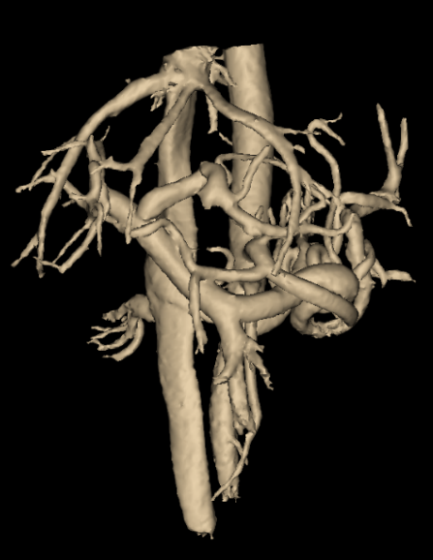
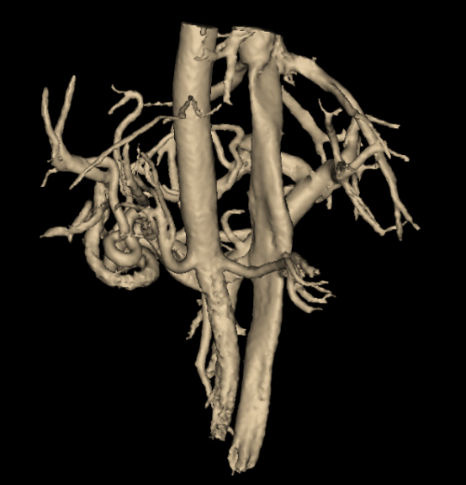
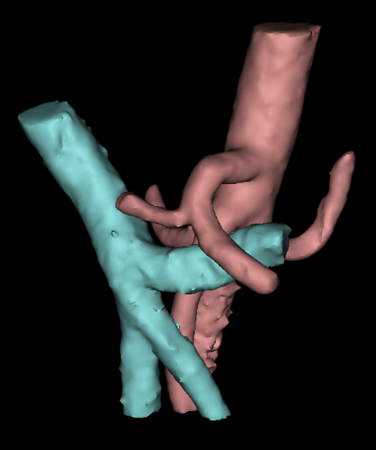
a)
b)
c)

Slide 5
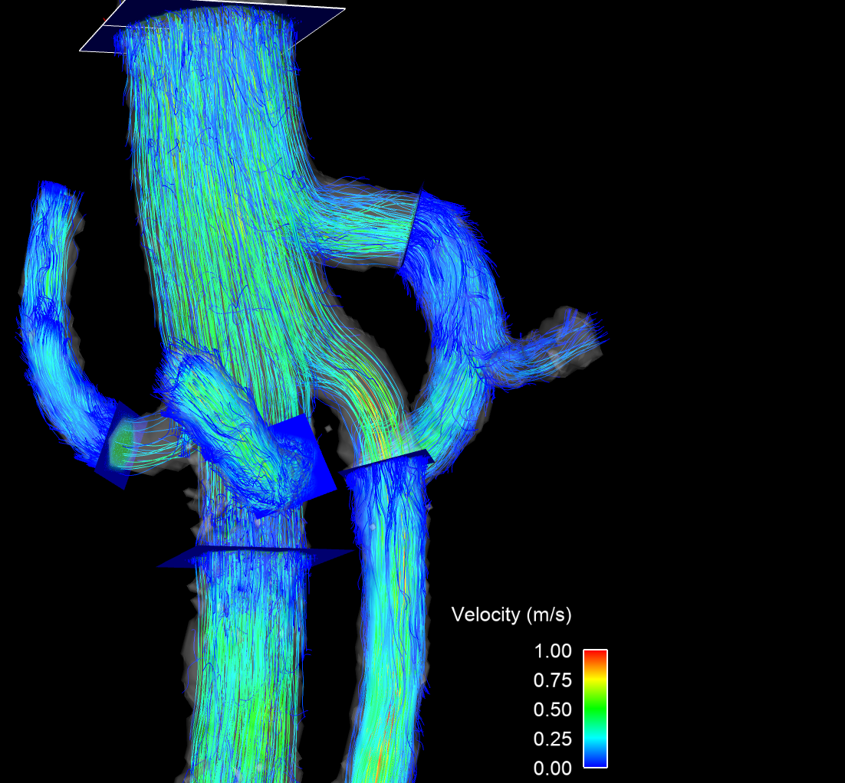
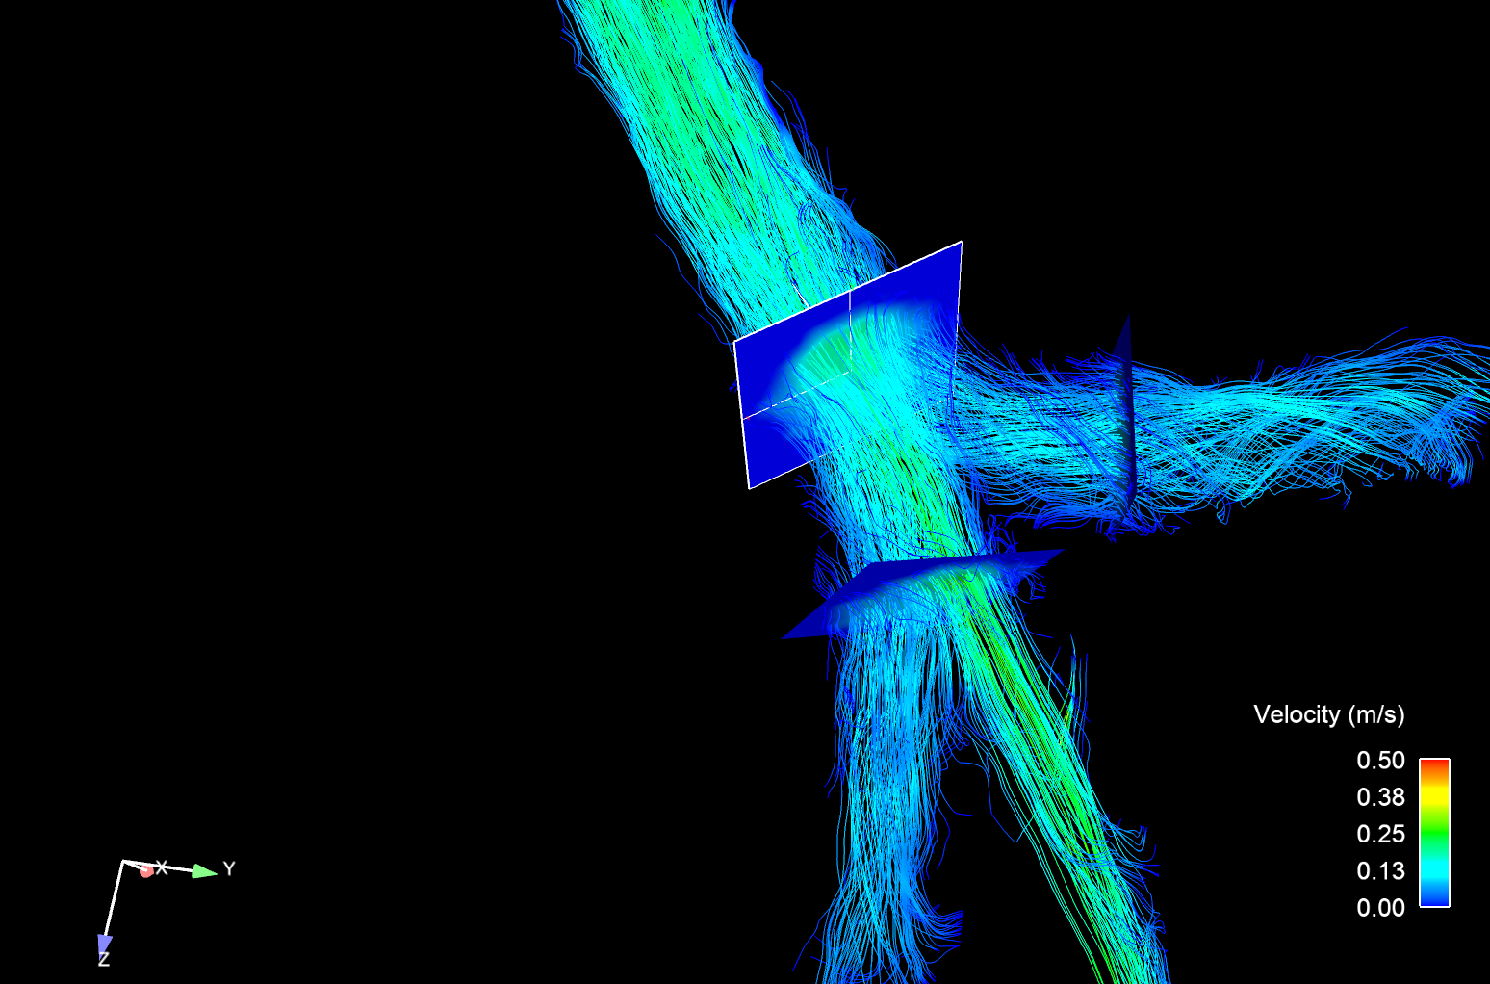
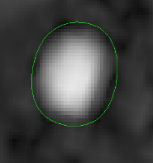
a)
b)
SCAo
PV
SV
ROI
LRA
CA
SMA
RRA
SMV
IRAo

Slide 8
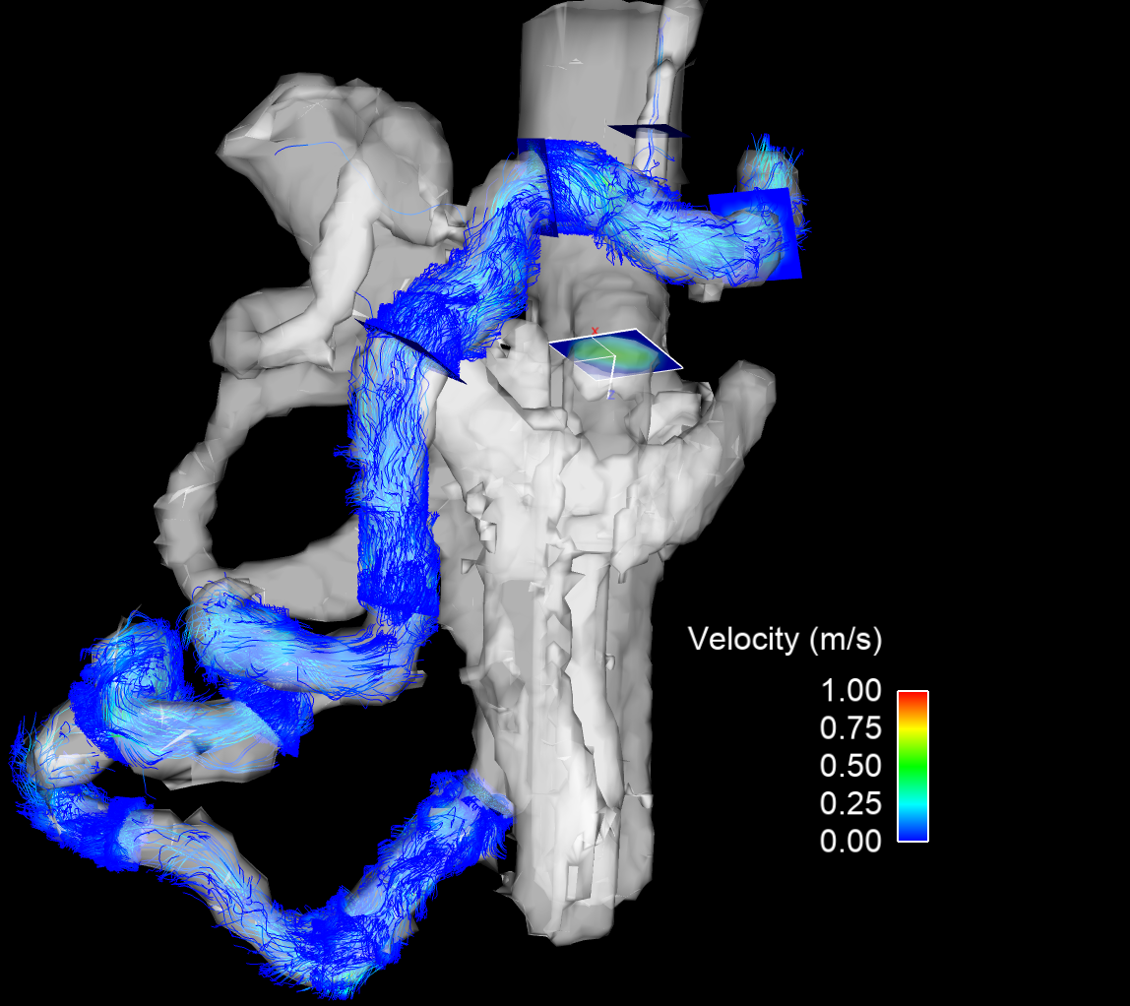
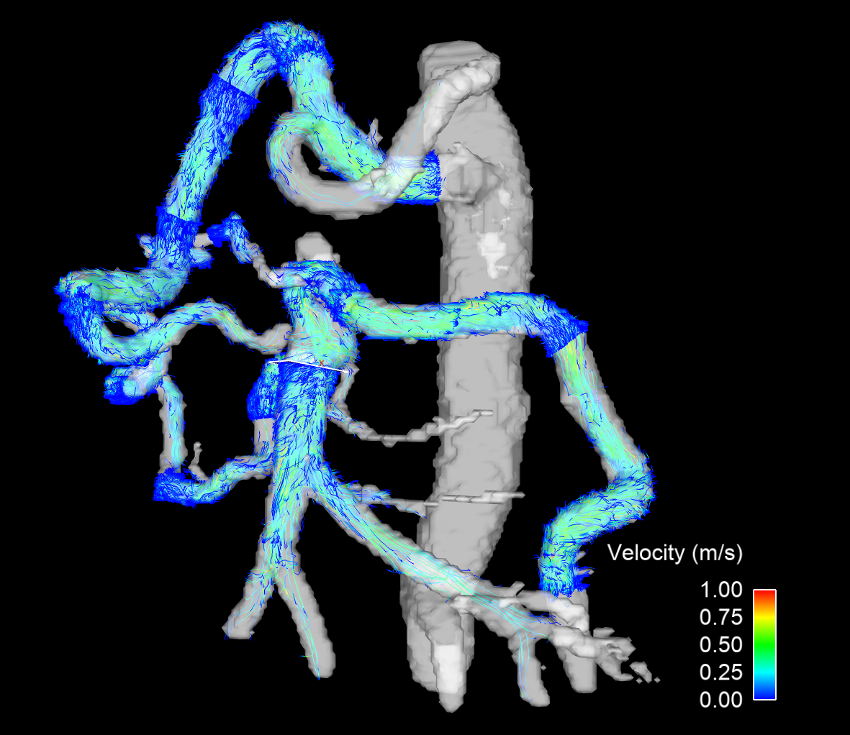
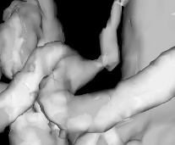
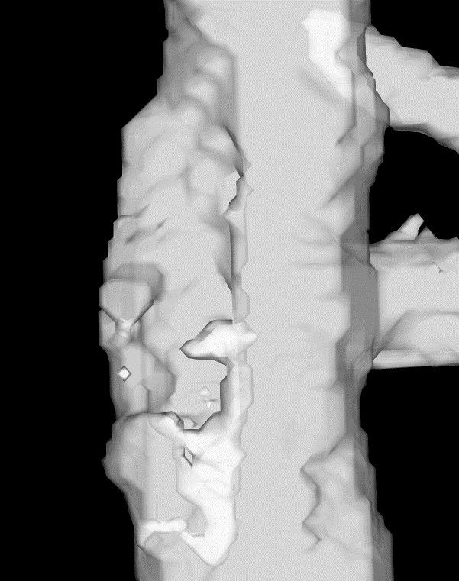
a)
b)
GDA
CA
GDA
Pancreatico-duodenal Arcade
CA Compression
Splenic Artery
Aortic Narrowing
SMA
SMA Occlusion
Distal SMA
Arc of Riolan
IMA

