Slide 1
Lecture 2: Computer representation, data classes and Matlab fundamentals
MP574
Jan 24, 2018

Slide 2
Objectives
How computers work with data
Number representation and data classes
Data storage
Complex number representation
How matlab works
Create matrices and perform basic operations
Basic image display

Slide 3
Number Representation
IEEE-754 standard
Matlab defaults to ‘double’ (double precision floating point)
Most real numbers are not computable
This would require infinite precision and unlimited memory

Slide 4
Data Classes
Matlab Syntax
logical, (u)int8, (u)int16, (u)int32, single, double
C Syntax
char, char, short, int, float, double
Byte Count (1 Byte = 8 bits)
1,1, 2, 4, 4, 8
Medical images are often shorts

Slide 5
Integers
Uint8 range 0 to 255
[1 1 1 1 1 1 1 1]
2⁷+2⁶+2⁵+2⁴+2³+2²+2¹+2⁰=255
[0 0 0 0 0 0 0 1]
2⁰=1
Int8 range -128 to 127
Two’s complement used when signed

Slide 6
Two’s Complement
Initial bit can be considered a sign bit, but it isn’t that easy
0 is positive, 1 is negative
Unsigned:[1 0 0 1]=9
Signed:[1 0 0 1]=-7
Algorithm:[1 0 0 1]
Complement:[0 1 1 0]
Add 1:[0 1 1 1]=-7
Remember minus sign

Slide 7

Memory Storage (integers)
Big endian vs little endian
Little endian
Least significant to most significant
X86 (intel)
Big endian
Most significant to least significant
PPC, SPARC, network

Slide 8
Integer Storage Ambiguities
Using 4 bit atomic size
Unsigned:[1 1 1 1 1 1 1 0]=254
(two’s complement) Signed:[1 1 1 1 1 1 1 0]=-2
Big Endian:[1 1 1 1 1 1 1 0]
English spoken system
Little Endian:[1 1 1 0 1 1 1 1]
Reversed byte order
Wraparound at the ends of the storage

Slide 9
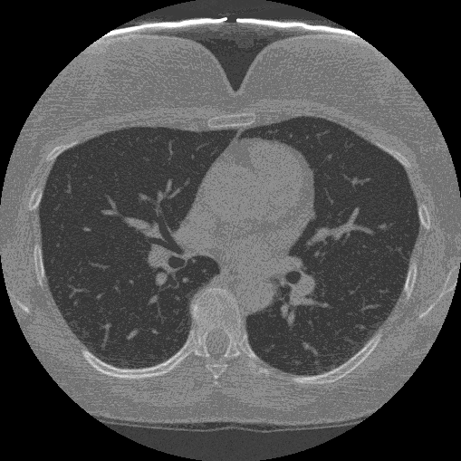
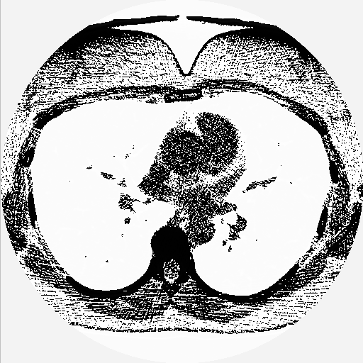
Signed status

Slide 10
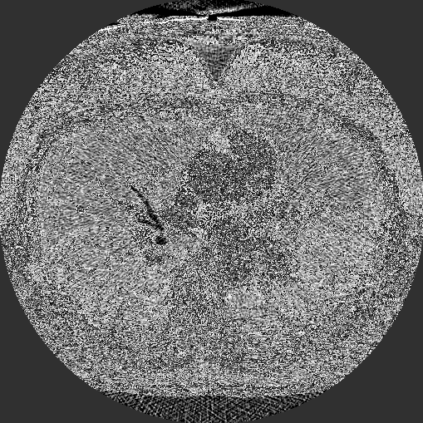
Byte swap

Slide 11
Why use integers?
Pros
Small memory and storage
“Fast” computationally
Well defined by IEEE
Cons
Using only integers is very limiting
Wraparound for mathematical operations

Slide 12
Single and Double precision
X=(-1)^{s}•(1+f)•2e
s=sign (1=negative, 0=positive)
f=mantissa 0≤f<1
e=exponent (bias 127 or 1023)
Scientific notation
1.126x10³

Slide 13
Floating point representation
X=(-1)^{s}•(1+f)•2e
5.126*10³ rather than:
51.26*10² or 0.5126*10⁴
Is called normalization
Floating point numbers directly represent some integers
http://steve.hollasch.net/cgindex/coding/ieeefloat.html

Slide 14
Single precision
32 bit (4 bytes)
1 bit sign
23 bit mantissa
8 bit exponent (-127≤e≤128)
±~10^{-44.85} to ~10^{38.53}

Slide 15
Double precision
64 bit (8 bytes)
1 bit sign
52 bit mantissa
11 bit exponent (-1023≤e≤1024)
±~10^{-323.3} to ~10^{308.3}

Slide 16
Quick exercises
Bias (offset for exponent) of 4 in these examples
s:[0] f:[0 0 0] e:[0 0 0]
+ 1+0 * 2⁻⁴ = 1/16
Smallest positive number
s:[0] f:[1 1 1] e:[1 1 1]
+ 1+7/8* 2³ = 15
Largest number
s:[0] f:[1 1 0] e:[1 1 1]
+ 1+6/8* 2³ = 14
2nd largest number

Slide 17
Fundamental Resolution
Machine epsilon (eps)
Difference between 1 and smallest number >1
S:[0] f:[0 0 0] e:[1 0 0]
(1+0)=1
S:[0] f:[0 0 1] e:[1 0 0]
(1+2⁻³)=1.125
Fundamental resolution of 0.125 for this case

Slide 18
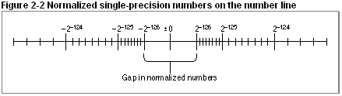
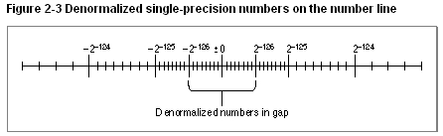
Floating point number line

Slide 19
Complex Data
Is really simple, just store 2 numbers, one for the real the other for imaginary

Slide 20
Matlab Operations
Matlab operates on matricies by default
A=[1 2 3; 4 5 6; 7 8 9];
B=[1 2; 3 4]+i*[4 3; 2 1];

Slide 21
Matlab Operators
A=[1,2;3,4]
A*A=[7,10;15,22]
A.*A=[1,4;9,16]
A+A=[2,4;6,8]

Slide 22
Matlab Operators
help '*’
Operators and special characters. Arithmetic operators.
plus - Plus +
uplus - Unary plus +
minus - Minus -
uminus - Unary minus -
mtimes - Matrix multiply *
times - Array multiply .*
mpower - Matrix power ^
power - Array power .^
mldivide - Backslash or left matrix divide \
mrdivide - Slash or right matrix divide /
ldivide - Left array divide .\
rdivide - Right array divide ./
kron - Kronecker tensor product kron

Slide 23
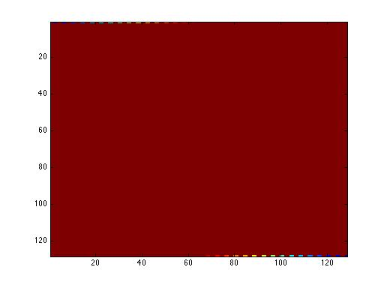
Image Display
A=magic(128);
figure();
image(A);

Slide 24
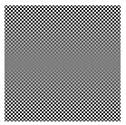
Image Display
A=magic(128);
figure();
imshow(A,[]);

Slide 25

Image Display
A=magic(128);
figure();
imshow(A);

Slide 26
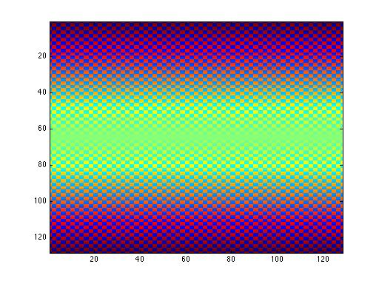
Image Display
A=magic(128);
figure();
imagesc(A);

Slide 27
Image Display
A=magic(128)+i*magic(128);
imagesc(A);
??? Error using ==> image
Error using ==> image
Image CData can not be complex..
Either use imag(), real(), angle(), or abs() to display components of the image

Slide 28
Take Home Points
Computers have a finite numerical precision
Different operations call for differing precision (i.e. Fourier transform operation vs. Image display)
Except for special math toolboxes
Matlab is a powerful toolbox for matrix operations including image processing
Idiosyncrasies of image display and complex number representation
Experiment with image display
GUI tools on the website: Volume viewer

