Slide 1
Lecture 4 Display Tools: MATLAB, Volume Viewer (MATLAB) and Image J/Fiji David Mummy mummy@wisc.edu
Medical Physics/Biomedical Engineering 574
1022 WIMR, 9:55-10:45 am, MWF Spring 2018

Slide 2
Outline
Matlab basics
Brief review of image header concept
Image i/o basics
Built-in image display tools in Matlab
Volume Viewer (custom Matlab GUI)
Imagescn (custom Matlab toolbox)
ImageJ and Fiji basics

Slide 3
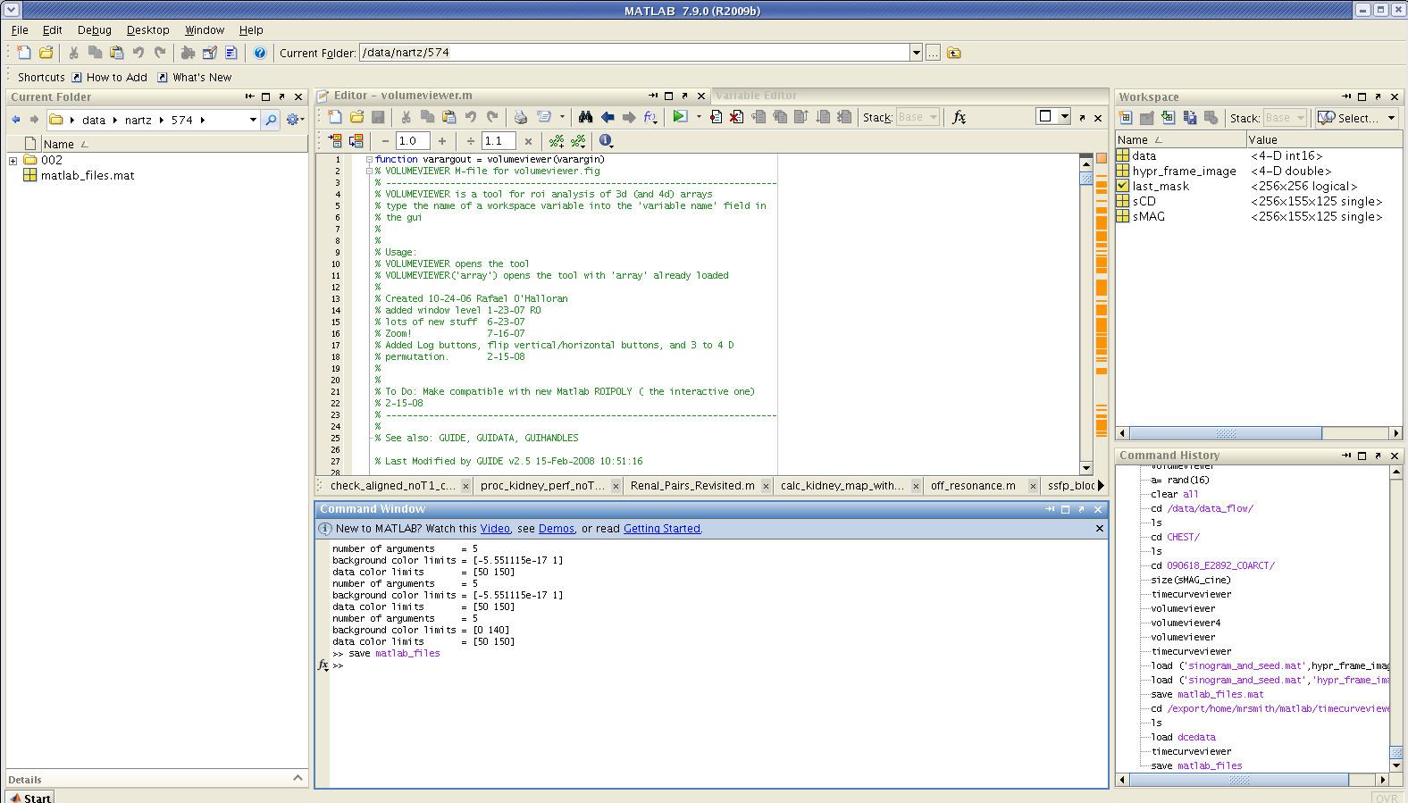
MATLAB – Does matrix manipulation well

Slide 4
A BRIEF LIST OF MATLAB COMMANDS
Commands Useful in Plotting.
Some Basic Commands (Note command syntax is case-sensitive!)
matlab loads the program matlab into your workspace.
quit quits matlab, returning you to the operating system.
exit same as quit.
who lists all of the variables in your matlab workspace.
whos list the variables and describes their matrix size.
clear deletes all matrices from active workspace.
clear x deletes the matrix x from active workspace.
... the ellipsis defining a line continuation is three
successive periods.
save saves all the matrices defined in the current
session into the file, matlab.mat.
load loads contents of matlab.mat into current workspace.
save filename saves the contents of workspace into
filename.mat
save filename x y z
saves the matrices x, y and z into the file titled
filename.mat.
load filename loads the contents of filename into current
workspace; the file can be a binary (.mat) file
or an ASCII file.
plot(x,y) creates an Cartesian plot of the vectors x & y.
plot(y) creates a plot of y vs. the numerical values of the
elements in the y-vector.
title('text') places a title at top of graphics plot.
xlabel('text') writes 'text' beneath the x-axis of a plot.
ylabel('text') writes 'text' beside the y-axis of a plot.
text(x,y,'text') writes 'text' at the location (x,y) .
hold on maintains the current plot in the graphics window
while executing subsequent plotting commands.
hold off turns OFF the 'hold on' option.
hist(x) creates a histogram. This differs from the bargraph
in that frequency is plotted on the vertical axis.
mesh(z) creates a surface in xyz space where z is a matrix
of the values of the function z(x,y). z can be
interpreted to be the height of the surface above
some xy reference plane.
surf(z) similar to mesh(z), only surface elements depict
the surface rather than a mesh grid.
contour(z) draws a contour map in xy space of the function
or surface z.
http://www-psych.nmsu.edu/~jkroger/lab/Manuals/MATLAB_commands.htm

Slide 5
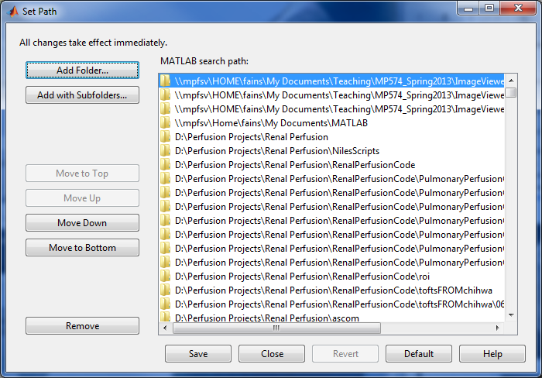
File:Set Path

Slide 6
A BRIEF LIST OF MATLAB COMMANDS cont.
Data Analysis Commands
max(x) returns the maximum value of the elements in a
vector or if x is a matrix, returns a row vector
whose elements are the maximum values from each
respective column of the matrix.
min (x) returns the minimum of x (see max(x) for details).
mean(x) returns the mean value of the elements of a vector
or if x is a matrix, returns a row vector whose
elements are the mean value of the elements from
each column of the matrix.
median(x) same as mean(x), only returns the median value.
sum(x) returns the sum of the elements of a vector or if x
is a matrix, returns the sum of the elements from
each respective column of the matrix.
prod(x) same as sum(x), only returns the product of
elements.
std(x) returns the standard deviation of the elements of a
vector or if x is a matrix, a row vector whose
elements are the standard deviations of each
column of the matrix.
sort(x) sorts the values in the vector x or the columns of
a matrix and places them in ascending order. Note
that this command will destroy any association that
may exist between the elements in a row of matrix x.
fliplr(x) reverses the order of a vector. If x is a matrix,
this reverse the order of the columns in the matrix.
flipud(x) reverses the order of a matrix in the sense of
exchanging or reversing the order of the matrix
rows. This will not reverse a row vector!
reshape(A,m,n) reshapes the matrix A into an mxn matrix
from element (1,1) working column-wise.
http://www-psych.nmsu.edu/~jkroger/lab/Manuals/MATLAB_commands.htm

Slide 7
A BRIEF LIST OF MATLAB COMMANDS cont.
SPECIAL MATRICES
ARRAY PRODUCTS
zeros(n) creates an nxn matrix whose elements are zero.
zeros(m,n) creates a m-row, n-column matrix of zeros.
ones(n) creates a n x n square matrix whose elements are 1's
ones(m,n)' creates a mxn matrix whose elements are 1's.
ones(A) creates an m x n matrix of 1's, where m and n are
based on the size of an existing matrix, A.
zeros(A) creates an mxn matrix of 0's, where m and n are
based on the size of the existing matrix, A.
eye(n) creates the nxn identity matrix with 1's on the
diagonal.
length(x) returns the number elements in a vector.
size(x) returns the size m(rows) and n(columns) of matrix x.
rand returns a random number between 0 and 1.
rand(A) returns a matrix of size A of random numbers.
Sometimes it is desired to simply multiply or divide each
element of an matrix by the corresponding element of another
matrix. These are called 'array operations" in 'matlab'. Array or
element-by-element operations are executed when the operator is
preceded by a '.' (period). Thus
a .* b multiplies each element of a by the respective
element of b
a ./ b divides each element of a by the respective element
of b
a .\ b divides each element of b by the respective element
of a
a .^ b raise each element of a by the respective b element
x' The transpose of a matrix is obtained by
interchanging the rows and columns. The 'matlab'
operator that creates the transpose is the single
quotation mark, '.
Miscellaneous Commands
TRANSPOSE OF A MATRIX

Slide 8
Raw Images vs. Image File Formats
“Raw” images have no header
Generally a linear array of bytes containing only the signal intensities
Most images (ex. JPEG, TIFF, DICOM) have extra data stored in the header
Image data structure and size
Image compression encoding
Acquisition parameters
Patient information (PHI – protected health information)
…more in Lecture 6
raw image file
image data
image file
header
image data

Slide 9

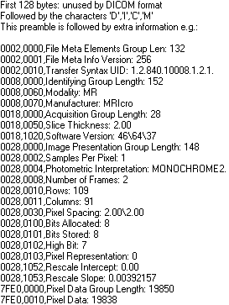
Image Header Example
*Digital Imaging and Communications in Medicine (DICOM)
http://www.sph.sc.edu/comd/rorden/dicom.html#header

Slide 10
Image Processing Tools in MATLAB
Import
Export
Get image information
View images
imshow
imagesc
volumeviewer
imagescn

Slide 11
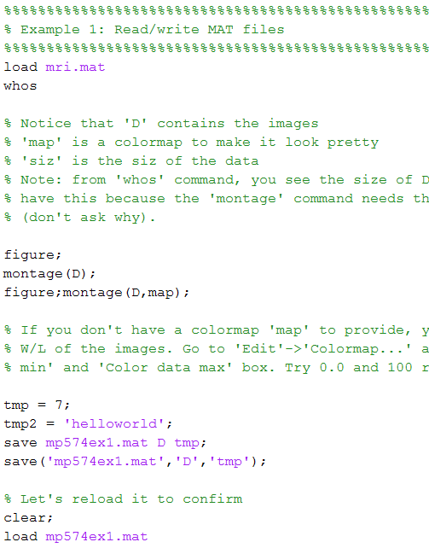
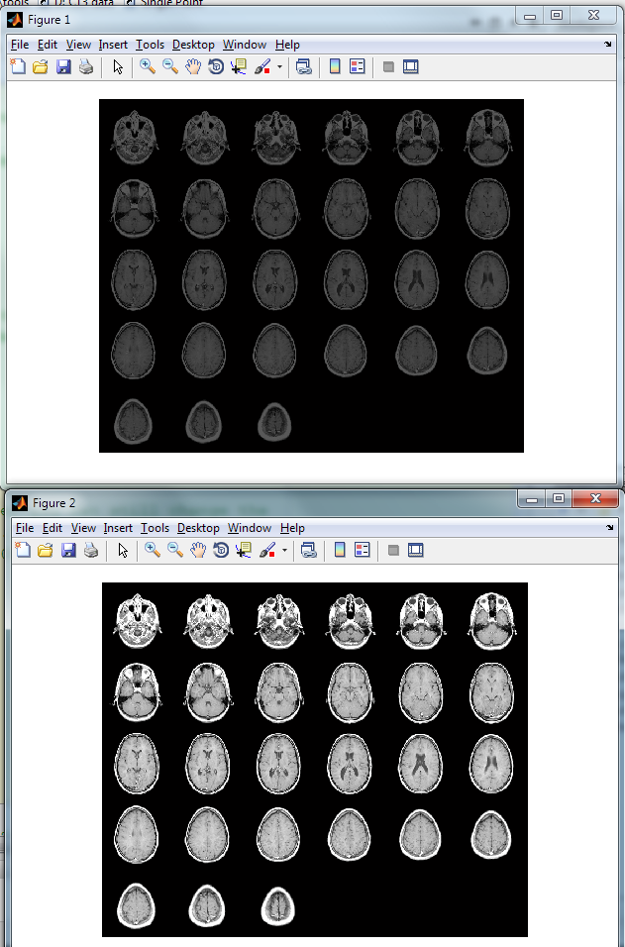
Import/Export MAT data (Example 1)

Slide 12
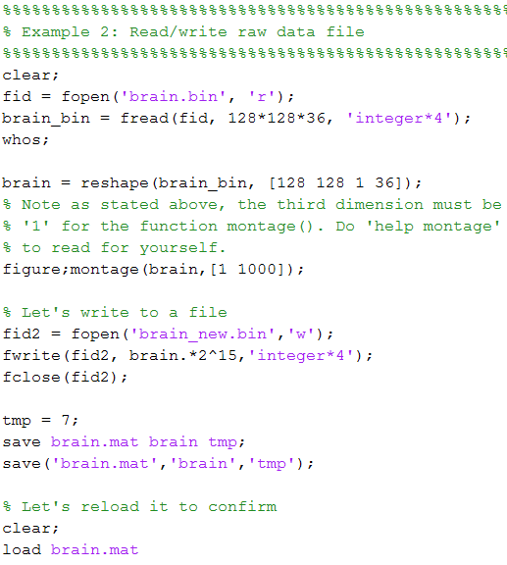
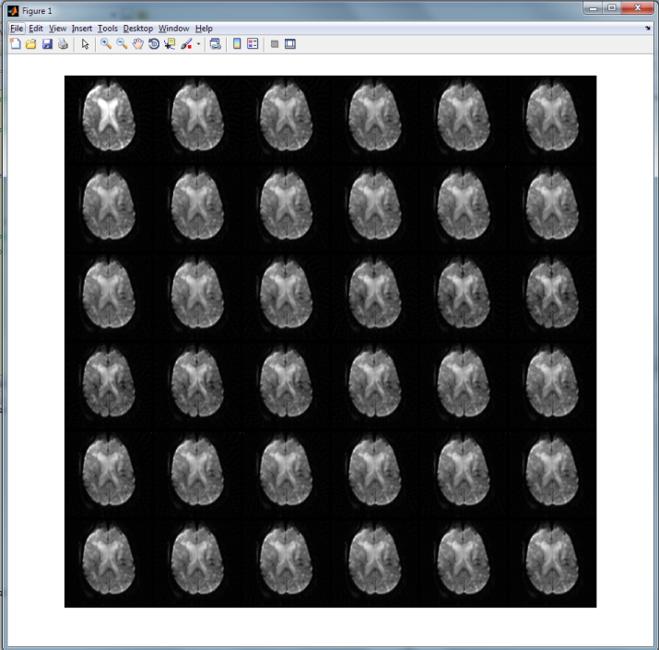
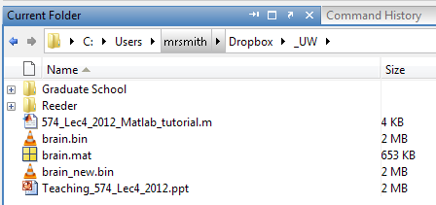
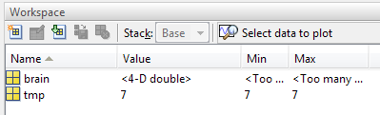
Import/Export raw data (Example 2)

Slide 13
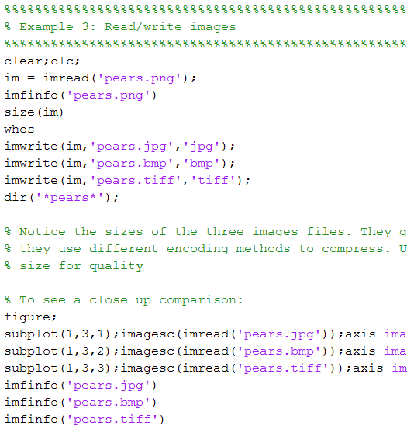
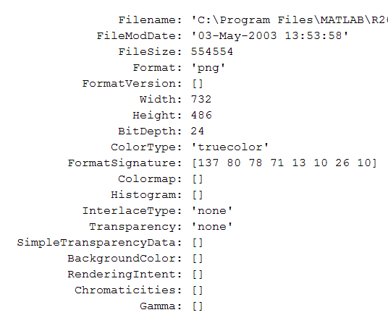
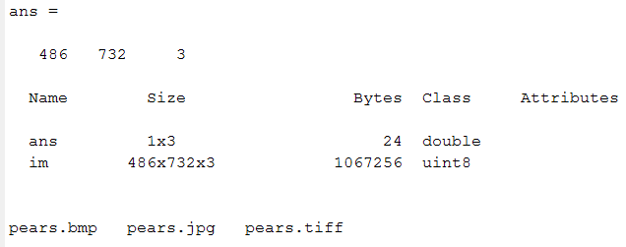
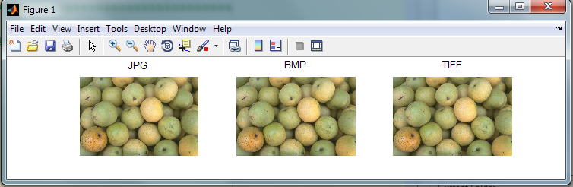
Import/Export image files (Example 3)

Slide 14
Image Info (Example 1-3)
For image files, use MATLAB function imfinfo displays info without reading into workspace (reads the header)
imfinfo(‘name.jpg’)
For dicom files, use MATLAB function dicominfo displays info without reading into workspace (reads the header)
dicominfo(‘name.dcm’)
Read image into workspace (see previous slides)
Once image is read into workspace
‘whos’ sees information about the data in your workspace
‘size(X)’ gives you the size of variable X
‘max(X)’ gives max value of 1D array X
‘max(max(X))’ or ‘max(X(:))’ gives max value of 2D array X

Slide 15
Image Processing Tools in MATLAB
Import
Export
Get image information
View images
imshow (Matlab)
imagesc (Matlab)
volumeviewer (custom GUI)
imagescn (custom toolbox)

Slide 16
Image Processing Tools in MATLAB
http://www.mathworks.com/help/toolbox/images/ref/f3-23960.html
LOTS OF FUNCTIONS!
Don’t waste time doing it yourself, there’s probably a function that does it for you!
However, they might not be perfect….performance, efficiency, etc
example: imshow scales image from 0 to 1, might not be desirable
Good to know how they work
Use ‘Help’ in Matlab, it’s wonderful documentation on how the functions work.

Slide 17
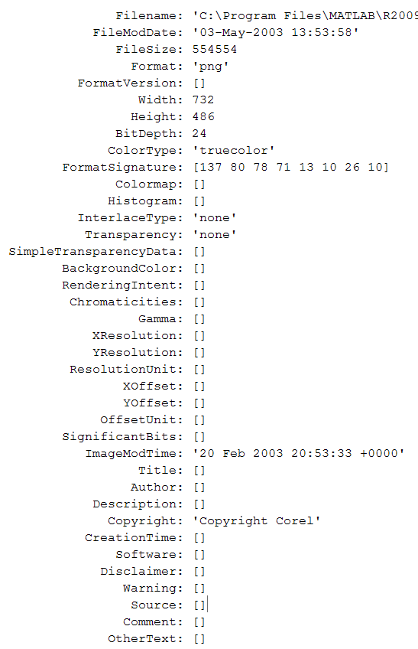
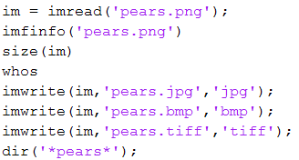

imread() and imfinfo()
(saw some of these already)
% reads in images of most filetypes
% Data concerning image size, compression, colormap read from the header
% data are 8 bit unsigned but note the 3 color channels, red, green, blue.

Slide 18
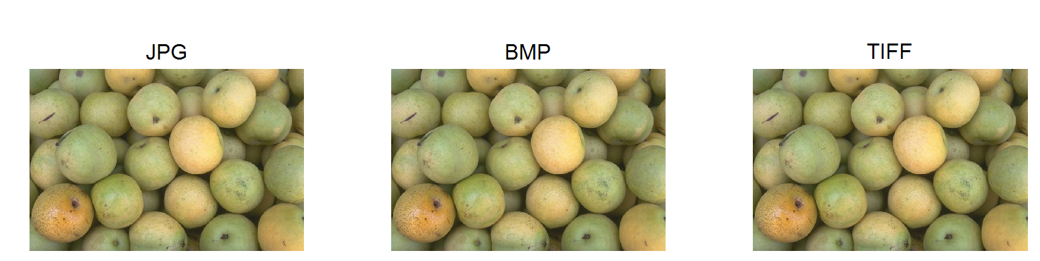
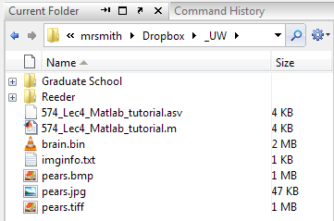
imwrite()
Can generate different image formats automatically

Slide 19
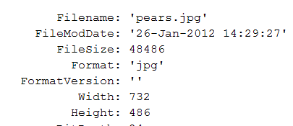
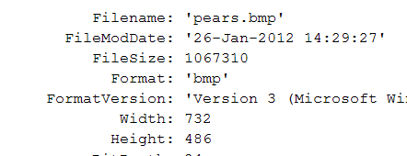
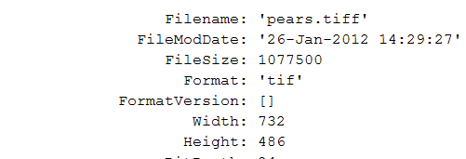
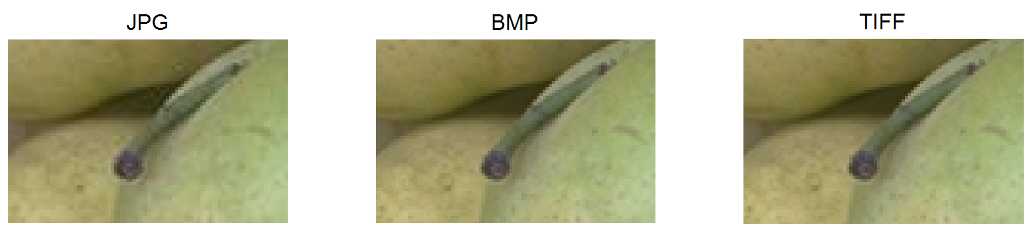
Consider compression ratios…
JPG
BMP
TIFF
Calculated Matrix Size
= 732 X 486 X 3 bytes = 1.07 MB

Slide 20
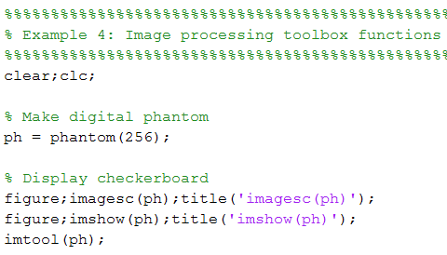
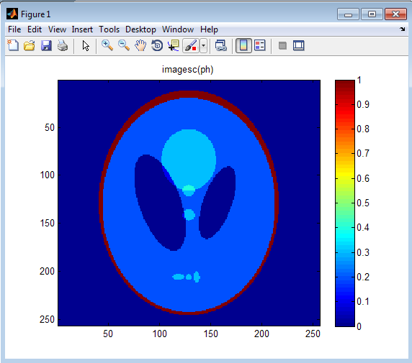
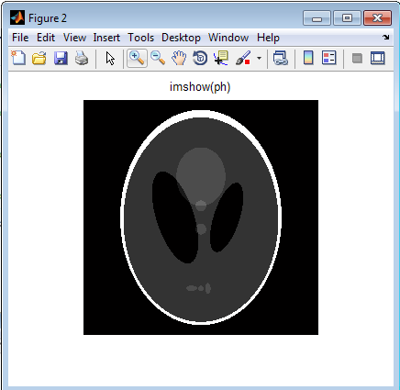
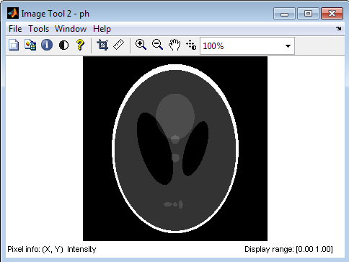
Display Tools in Matlab

Slide 21
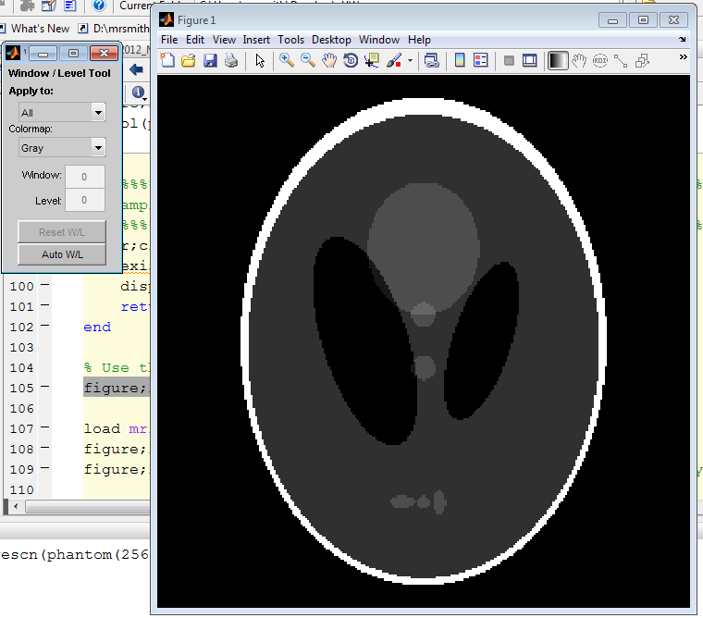
imagescn toolbox
Developed by NIH, but not supported
W/L
ROI
Distance
Movies
Point Measure
Image Rotation
Crop
imagesc tools

Slide 22
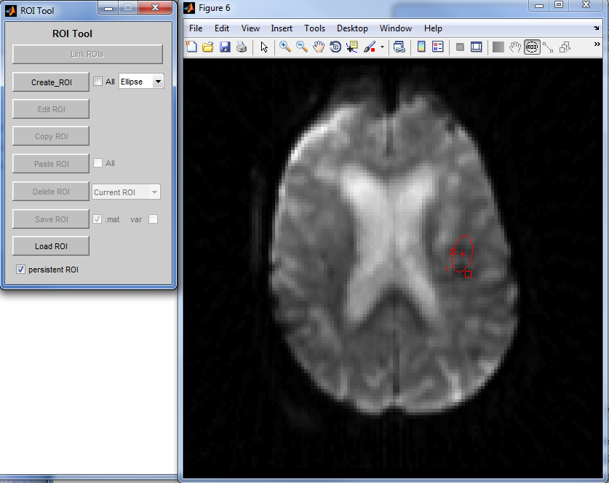
imagescn: Easy to Use Basic ROI Tools

Slide 23
All of these examples can be replicated line by line (Matlab R2016a) Tutorial for Volume Viewer and Image J on Learn@UW

Slide 24
Load into the workspace a single dicom image:
% load in a single image if the brain using dicomread %
brain2 = dicomread('brain__5’);
% Alternatively if you reshape brain_bin %
brain3 = reshape(brain_bin,128, 128, 36);
% one can then load in the matrix as a time series in volume viewer as a matrix, for example: %
brain3(:, : , :)
% This is a time series of contrast perfusion in the brain %

Slide 25
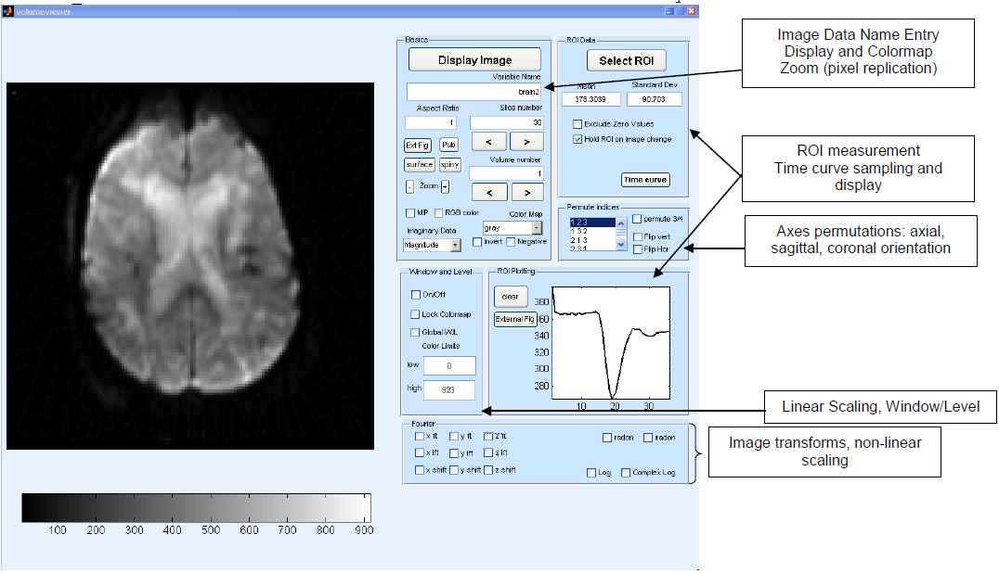
Volume Viewer: Matlab GUI
Developed by Dr. Rafael O’Halloran

Slide 26
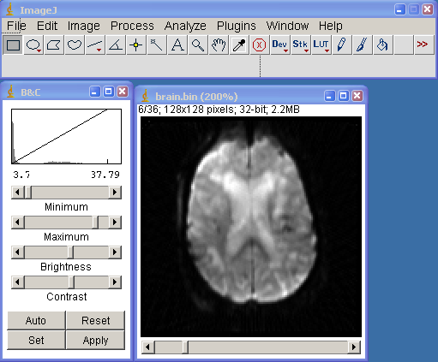
ImageJ/Fiji (http://fiji.sc/): Stand Alone Windows/Mac Program from NIH
Unique from the rest of this presentation b/c it’s NOT Matlab based
Functionality
Window and Level
ROI measurement
ROI measurement through image series
Plot line profile
Play as a movie
Rotate & Zoom images
Mathematical operations on images
Apply filters
Fourier Transform
And the list goes on….

Slide 27
Assignment
ImageJ/Fiji, volumeviewer, and imagescn
See tutorial for ImageJ/Fiji and volumeviewer on Learn@UW
“Brain” image data set: 2D dynamic perfusion MR images
imginfo text file describes file size and data types
brain binary file on Learn@UW
Links to software sites online:
https://www.slicer.org
https://imagej.net/Welcome
http://www.itksnap.org/pmwiki/pmwiki.php

