Slide 1
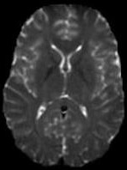
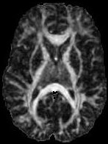
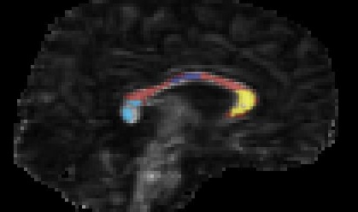
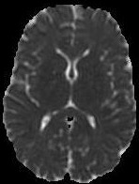
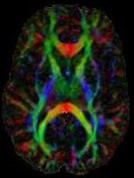
Analysis of DTI Data –
ROI Methods
MP/NTP 651

Slide 2
Data Analysis Design
What is the Question/Objective?
What do we Know?
  Patient history
  Disease specific
HYPOTHESIS?
Global versus Regional?
  What Region?
Samples
  Population distribution attributes (age, handedness, gender, etc)
  How many?

Slide 3
Diffusion Tensor MRI:
Measures
FA is NOT Enough!
Mean, Axial, Radial Diffusivities
Scanner Variations
  Co-vary for Scanner
  Harmonization
DTI is not adequate model in many cases
  Advanced DWI methods – NODDI, diffusion kurtosis

Slide 4
Diffusion Tensor MRI:
Strategies for Data Analysis
Analysis Design Considerations
Global Histograms
Regions of Interest
Atlas-based Templates
Tractography
Voxel-Based

Slide 5
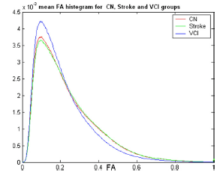
DTI Histogram Analysis
Whole Brain Example –
Vascular Cognitive Impairment
Simple to Perform
Very high SNR
Global Characterization
Whole Brain - No Regional Specificity
Tissue Specific Regions – Better Specificity
Voxel Dimensions can influence
Zhou et al. J Neurol Sci 2008

Slide 6
DTI ROI Analysis
Regional Hypotheses – Predict where
Most Specific/Targeted Approach
Regional Averaging: Increased SNR / Limited Local Anatomic Specificity
Requires Expert / Algorithm for Labeling
Disadvantages:
  Manual ROIs Tedious
  Limited Intra- and Inter- Observer Performance

Slide 7
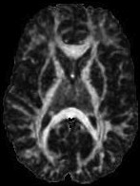
Requires Anatomic Specificity
Apples versus apples
Genu versus genu
Splenium versus splenium
PLIC versus PLIC

Slide 8
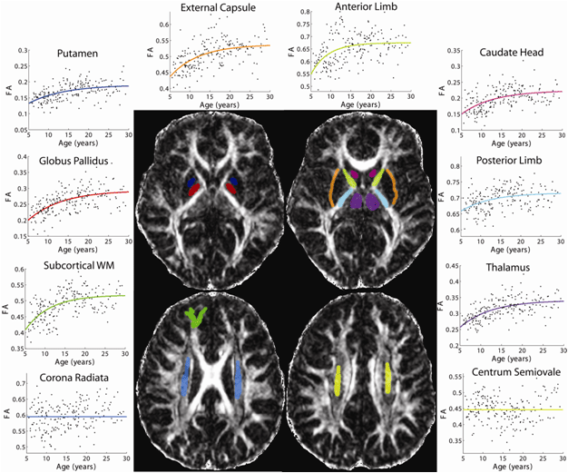
ROI Analysis
4646 manually placed ROIs – 23 regions in 202 subjects !
ROIs by
Lindsay Walker
Lebel et al,
Neuroimage 2008
Courtesy
Christian Beaulieu –
Alberta

Slide 9
DTI of Corpus Callosum in Autism
Corpus Callosum in Autism:
  Anisotropy reduced
  Mean diffusivity increased
  Volume decreased
 | Control |  | Autism
 | mean | std dev | mean | std dev
MD | 0.579 | 0.024 | 0.552 | 0.037 | p < 0.001
FA | 0.807 | 0.023 | 0.833 | 0.037 | p < 0.001
Alexander et al. Neuroimage 2007

Slide 10
DTI of Corpus Callosum Effect Sizes
 | Control | - Autism
 | Mean Difference | Standard Deviation
MD | -0.027 | 0.030
FA | 0.026 | 0.030
Effect Size
Diff/StD
Effect sizes are usually small in DTI
Alexander et al. Neuroimage 2007

Slide 11
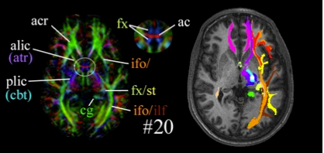
Template-Based ROIs
Spatially Normalize Anatomical Template to Native DTI Data
Requires Accurate Nonlinear (e.g., Diffeomorphic) Normalization
Misregistration – quantitative errors
Automated
S. Mori, S. Wakana, L.M. Nagae-Poetscher, and P.C.M. van Zijl, MRI Atlas of Human White Matter, Elsevier, B.V., Amsterdam, 2005; ISBN:0-444-51741-3

Slide 12
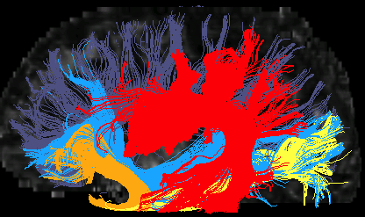
DTI Tractography Analysis
Tract Specific Analysis (objective in many cases)
Similar to ROI analyses
Requires Skill with Tractography Tools
Time-consuming
Sensitive to DTI Errors
Sensitive to Crossing WM Tracts
  HARDI, QBI, DSI, etc.
How to weight tract trunk versus branches?
What to do with Erroneous Tracts
  May throw away important data

Slide 13
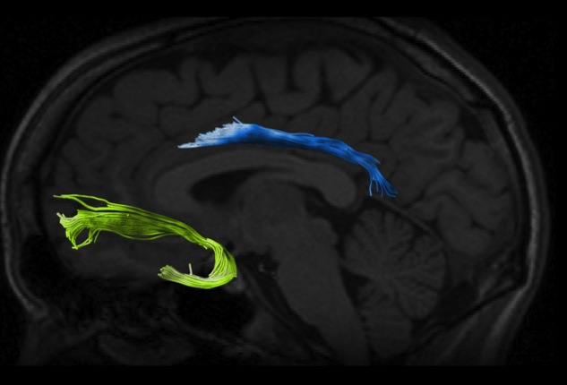
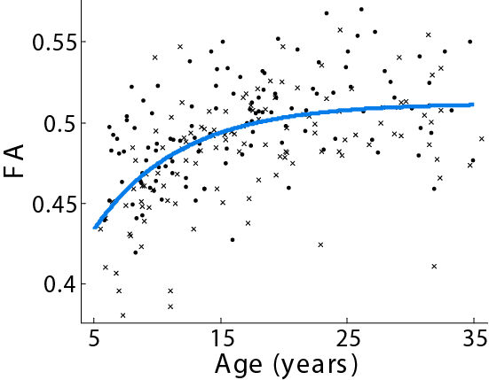
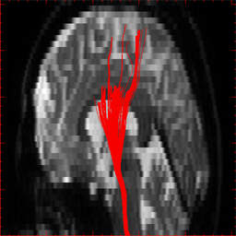
Tractography-Based Analysis
Cingulum
Lebel et al, Neuroimage 2008
Courtesy Christian Beaulieu - Alberta
Medulla
Pons
Midbrain
0.8
100
0.7
90
0.6
T₂ (ms) ( )
Fractional anisotropy ( )
80
0.5
0.4
70
Courtesy Susumu Mori – Johns Hopkins
0.3
60
-10
0
10
20
30
Distance (rostral-caudal) (mm)

Slide 14
Spatial Normalization
J Mu et al. Sci Rep 2017

Slide 15
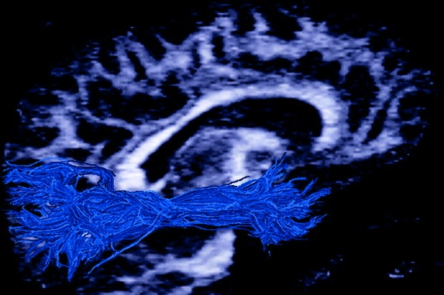
Inferior Longitudinal Fasciculus

