Slide 1
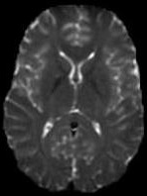
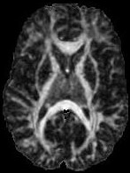
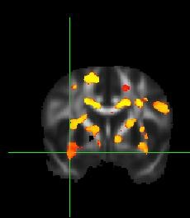
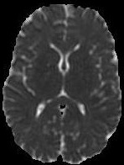
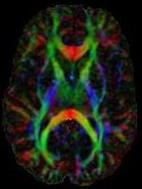
Analysis of DTI Data
MP/NTP 651

Slide 2
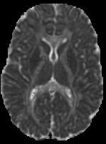
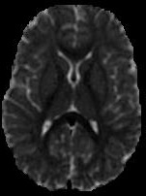
Diffusion Tensor Imaging
Basser et al. (1994)
Non-invasive imaging technique for estimating the diffusion properties of water in biological tissues
Highly sensitive to differences in tissue microstructure
Diffusion in white matter is anisotropic (varies with direction)
T2W
Structure
Fractional
Anisotropy
(‘White Matter’)
Mean
Diffusion
(1/Density)
Orientation
of White
Matter
Perpendicular Diffusivity
(‘Myelin’)
Parallel Diffusivity
(‘Axons’)

Slide 3
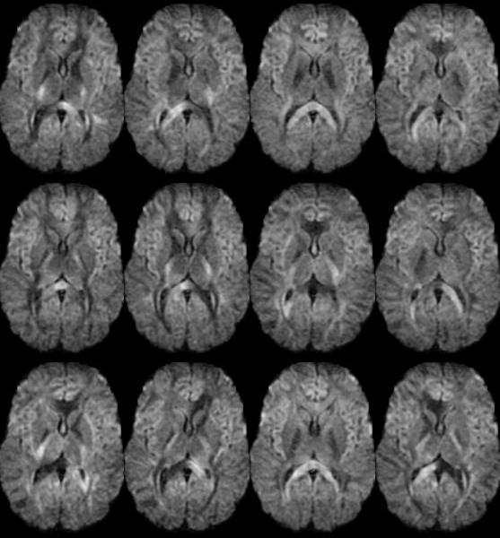
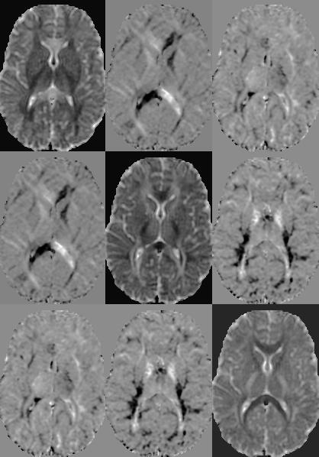


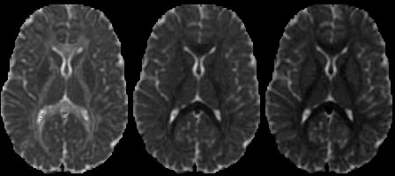
DTI Processing
Diffusion Tensor
DW images
Eigenvalues
MD
FA

Slide 4
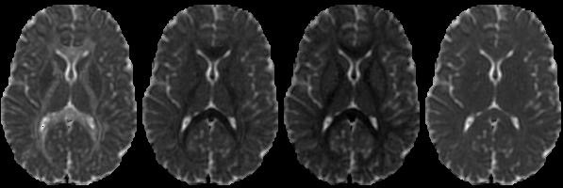
Diffusion Eigenvalues
Three Eigenvalues of Diffusion Tensor
  Major, Medium, Minor – λ1, λ2, λ3 (L1,L2,L3 in FSL)
  Da = Axial Diffusivity = λ1 ~ axonal degeneration
  Dr = Radial Diffusivity = (λ2 + λ3)/2 ~ myelination
Mean Diffusivity
  Magnitude of Diffusion
  Inversely related to tissue density
[mm²/s]
Major Medium Minor MD

Slide 5
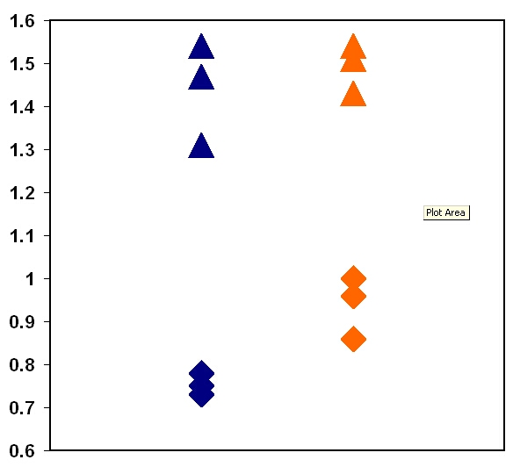
Diffusivity Measures
Role of Myelin
_{AD}
ADC (x 10⁻³ mm²/sec)
_{RD}
Myelinated
Unmyelinated

Slide 6
Fractional Anisotropy
  Variance of diffusivity with direction
  Normalized between 0 and 1
  Ubiquitous measure of microstructure
  Extremely sensitive
  Low specificity

Slide 7
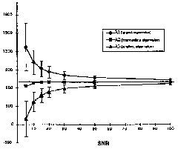
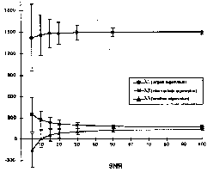
Low SNR Biases DTI
Diffusivity
Diffusivity
SNR
SNR
SNR = Signal to Noise Ratio
Adapted from Pierpaoli et al.
MRM 1996

Slide 8
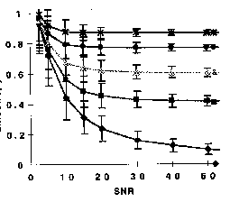
DTI & SNR
Low SNR:
Biased FA, eigenvalues
Increase variance
FA
SNR
Low SNR:
resolution < 1.5mm, long TE, high b-values, poor coil sensitivity
Adapted from Pierpaoli et al.
MRM 1996

Slide 9
Variance Across Studies - FA
Reported DTI values inconsistent!
Genu of Corpus Callosum
19 Published Studies (N >=8)
Std Dev: 0.1
Range: 0.36 (2004)

Slide 10
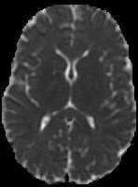
DTI Histograms

Slide 11
Caveat: Anisotropy has low specificity
↓Anisotropy
DEMYELINATION
AXONAL LOSS AND GLIOSIS
H
H
H
H
H
O
H
H
H
O
H
H
H
H
H
H
O
O
H
H
H
H
O
NORMAL
O
O
O
O
H
H
H
H
H
H
H
H
O
O
H
H
O
O
H
H
H
H
H
H
O
H
H
H
H
O
O
O
O
O
H
H
H
H
H
H
H
H
O
H
H
O
O
H
H
O
H
H
O
H
H
O
H
H
O
O
H
H
H
H
O
O
O
VASOGENIC EDEMA
CELLULAR INFILTRATION
MIXED
Courtesy AS Field

Slide 12
Why DTI?
Diffusion is EXTREMELY SENSITIVE to tissue changes/differences at the microstructural level
  Myelination
  Axon damage/loss
  Cell Proliferation / Density
  Inflammation / Edema
  Ischemia
  WM Organization
  Development & Aging
Caveat – non-specific
Diffusion = Membrane/Barrier Spacings
a priori knowledge

