Slide 1
Statistical Testing
Compare individuals or groups
General Linear Model
Group Comparison
  e.g., FA of Disease vs Control
Individual Differences Comparison
  E.g., FA versus Continuous Variable (Age, Cognitive Ability)
Multiple Comparisons
  False positive rate for multiple tests

Slide 2
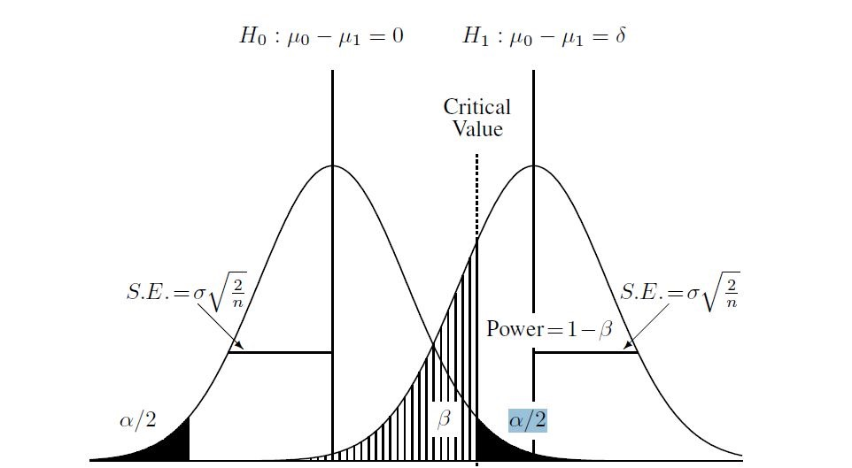
Statistical Testing
0 δ
α = failure to accept null hypothesis (Type 1 error - false positive rate)
= failure to reject null hypothesis (Type 2 error - false negative rate)
δ = effect size n = sample size

Slide 3
Statistical Power
0 δ
1-β = Power (typically 80-90%)
δ = effect size n = sample size α = Type 1 error rate

Slide 4
Multiple Comparisons
Significance level
  Typical α < 0.05
  Likelihood of a false-positive result
Repeated testing – increases probability of false positives
  100 tests – 5 false positives – even if there are no differences
False positives increase with number of tests
  Single region - 1 test
  Voxel-based – thousands of tests – Nx x Ny x Nz (limited to brain)
Multiple Comparisons Corrections
  Bonferroni – α/N
    ROI testing (small N)
  Familywise Error Rate, False Discovery Rate
  Cluster Correction
    Threshold Free Cluster Enhancement

Slide 5
t-test
Two-sample t-test
Alternate Hypothesis: the group means are significantly different
More stable for larger sample sizes
  Estimate means & standard dev
  Degrees of Freedom – n1+n2-2
Significance level
  Typical α < 0.05
  Likelihood of false-positive
Probability
  p<α – significant differences
Standard error

Slide 6
Statistical Testing in FSL (voxelwise)
Randomise
  https://fsl.fmrib.ox.ac.uk/fsl/fslwiki/Randomise/UserGuide
Two-Sample T-test
  randomise -i TwoSamp4D -o TwoSampT -d design.mat -t design.con -m mask –T
  -d design matrix input (1 or -1 for each person)
  -t t contrast file
  -m mask file
  -T threshold free cluster enhancement option – multiple comparisons correction

Slide 7
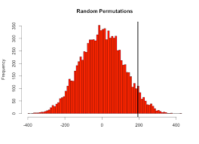
Permutation Testing
Repeated shuffling of samples (typically 1000’s iterations)
Group 1: A B C D E F G H Group 2: M N O P Q R S T
Sample 1:
Group 1: CTDOMFRQ Group 2: BNEGHPAS
Sample 2:
Group 1: QNECBRSM Group 2: ADTFPGHO
Sample 3:
…
Generate Statistics from Resampled Data
Observation
p-value
More robust than parametric testing

