Slide 1
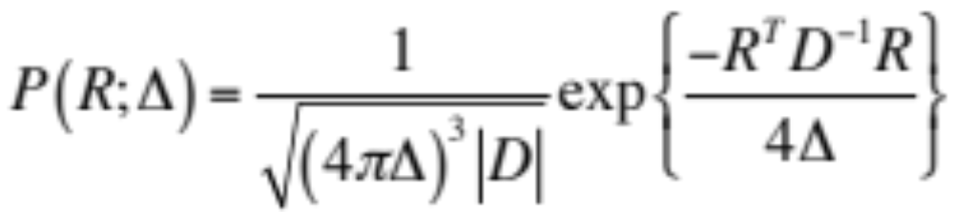

The Diffusion Tensor Model
z
z
ε₁, λ₁
ε₂, λ₂
y
y
ε₃, λ₃
x
x
Diffusion Propogator:
Zero-Mean 3D Multivariate Normal

Slide 2
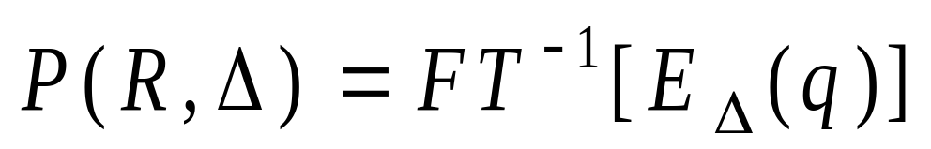
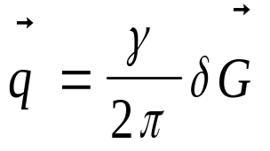
Q-space :
Fourier Mapping for Diffusion
The probability distribution function (also called diffusion propagator), P(R), is related to the q-space signal attenuation, E(q), by the Fourier relationship.
R: spin dynamic displacement q: diffusion weighting
R
r’
r
PT Callaghan Prin MR Microscopy
Wedeen VJ et al. MRM 2005
Courtesy YC Wu
Diffusion MRI - Alexander
Notes:
The probability density function is related to the q-space signal attenuation by the Fourier relationship.
And having the reciprocal FT variables: R and q.
R is the spin dynamic displacement.
q is the diffusion weighting and is proportional to the diffusion weighting gradients.

Slide 3
Diffusion Spectrum Imaging (DSI)
3D q-space sampling on clinical MRI scanner
→ yields diffusion probability distribution function (PDF)
No assumptions of diffusion distribution
Resolve intravoxel crossing fiber using orientation distribution function (ODF)
Typically 3D Cartesian Sampling
Courtesy YC Wu
Diffusion MRI - Alexander
Wedeen VJ et al. MRM 2005
Notes:
Introduction,
Diffusion spectrum imaging bases on no assumptions of diffusion distribution.
It yields probability density function which is the diffusion function.
(The PDF describes the probability of a spin having the dynamic displacement.)
The orientation distribution function (ODF) derived from PDF can resolve intravoxel crossing fibers.
There are several groups using ODF for tractography.
(Jennifer S. W. Campbell et al. McConnel Brain Imaging Center, McGill University)

Slide 4
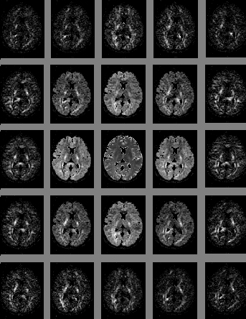
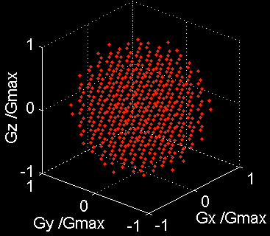
DSI: q-Space Acquisition
q_{y}
Spherically truncated
Cartesian lattice
q_{x}

Slide 5
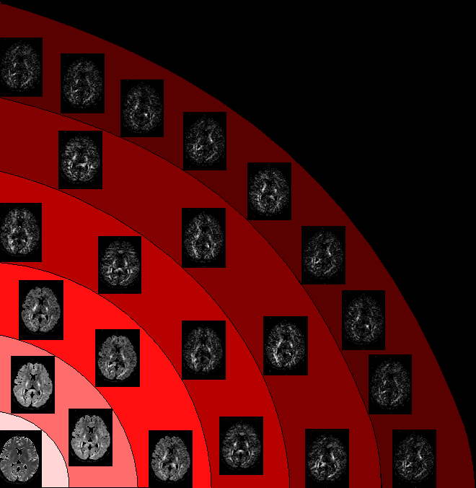
HYDI – Hybrid Diffusion Imaging
qθ
qr
DW: 0 375 1500 3375 6000 9375 s/mm²
qr
Adapted from Wu et. al. NI 2007

Slide 6
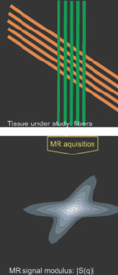
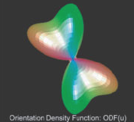
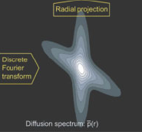
Diffusion Spectrum Imaging
Wedeen et al. MRM 2005

Slide 7
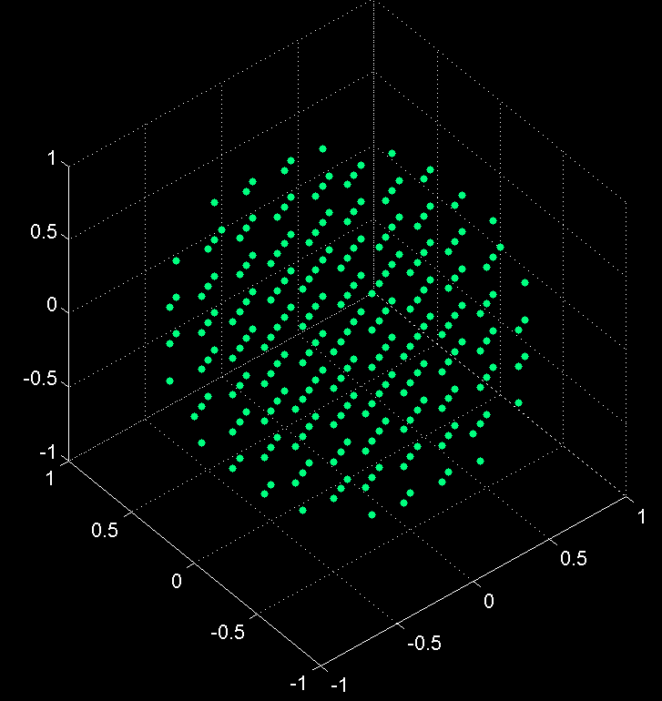
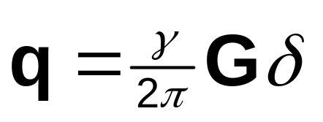
Diffusion Spectrum Imaging
9x9x9 Cartesian q-space lattice with spherical apodization
Max DW 17,000 s/mm^2 *
515 images
* Possible to do at lower b-values (3000-5000 s/mm^2)
DSI Tools:
DSI Studio; DiPy
Wedeen et al. MRM 2005

Slide 8
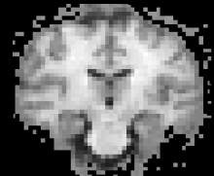
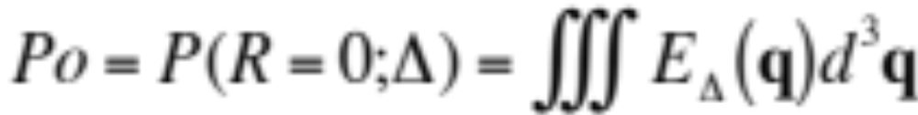
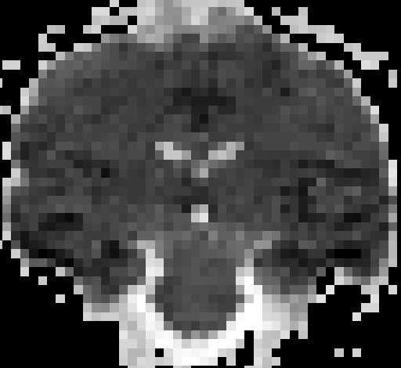
PDF Measures
Zero Displacement Probability:
Probability of no diffusion motion - restricted
Mean Squared Displacement:
Measures from Assaf et al. MRM 2000

Slide 9
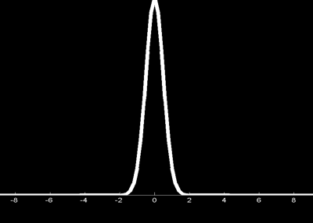
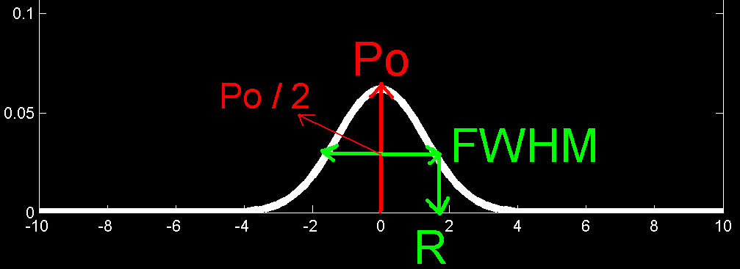
PDF Measures
Q space: S(q)
Probability density function: P(R)
FT
RMS of R: size of PDF
Variance of R: anisotropy measure
Assaf Y. et al. MRM 2002, 2004
Notes:
This a brief review of PDF measures that we defined.
The zero displacement probability.
The FWHM. ( or the displacement profile provide the directional information of PDF.)
The displacements that gives the same probability.
The RMS of these displacements describes the size of the diffusion function.
The variance of these displacement may be an anisotropy measure.

Slide 10
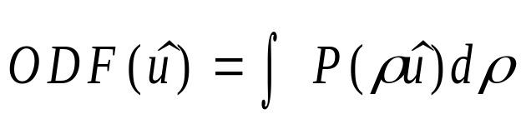
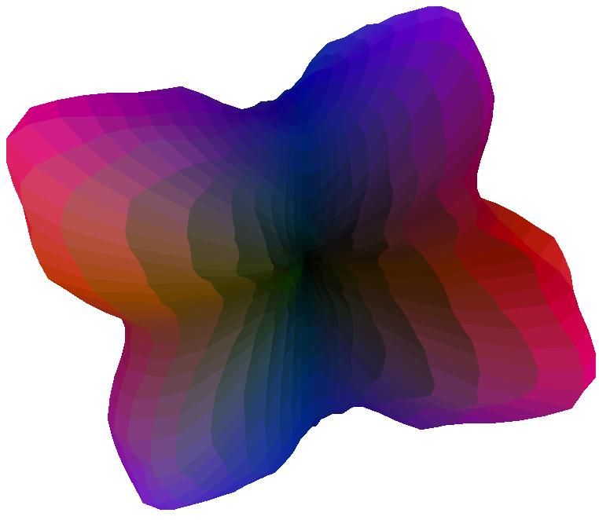
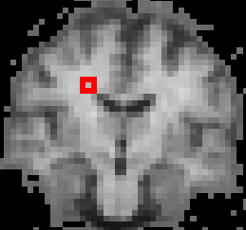
PDF Measures:
Orientation Distribution Function (ODF)
ODF:
the radial projection of the PDF
Courtesy YC Wu
Diffusion MRI - Alexander
Notes:
The well known orientation distribution function,ODF, is the radial projection of the PDF.
It describes the directional information of the diffusion function.

Slide 11
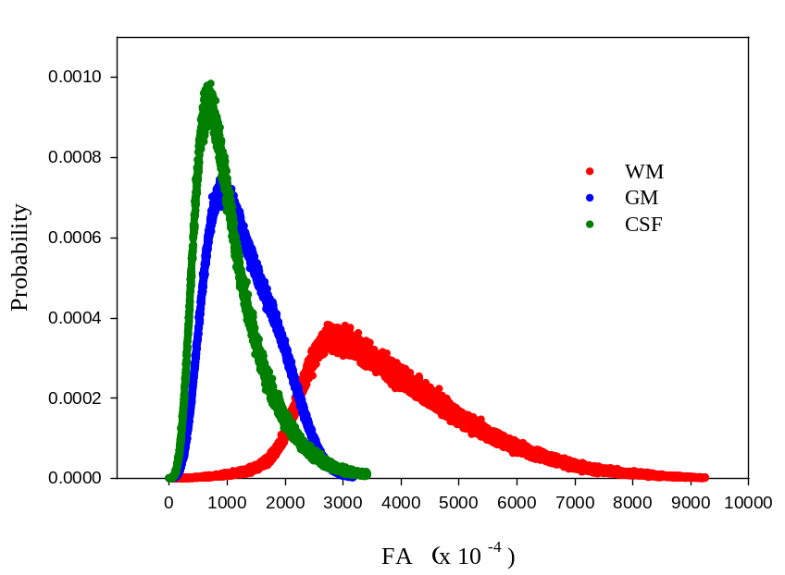
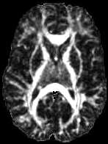
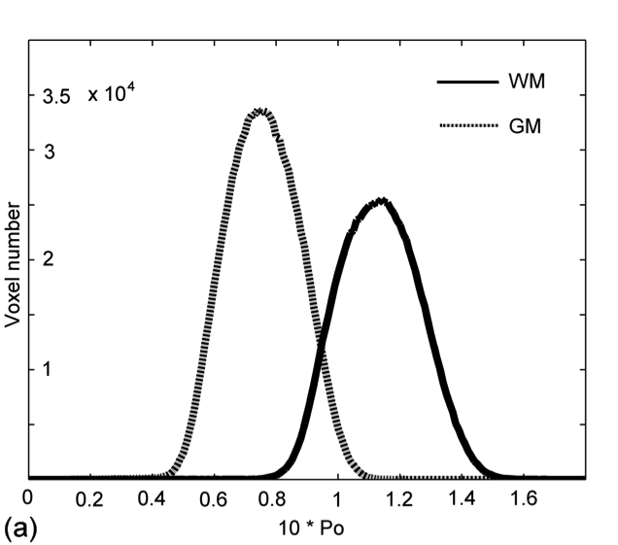
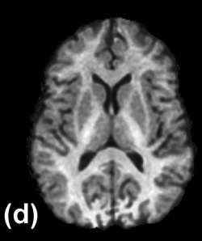
FA
Po
Zero Displacement Probability

Slide 12
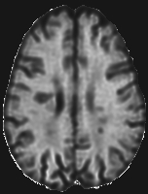
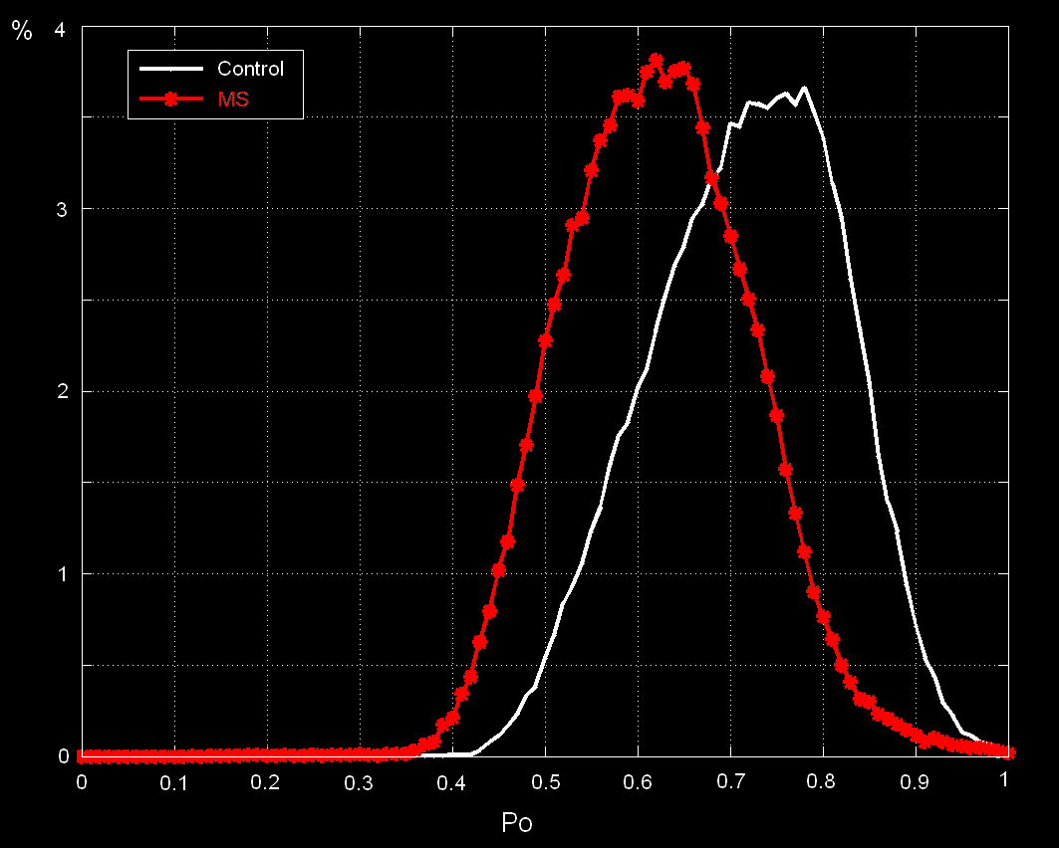
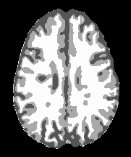
DSI: MS
NAWM Po decreased in MS
NAWM
Courtesy YC Wu

Slide 13
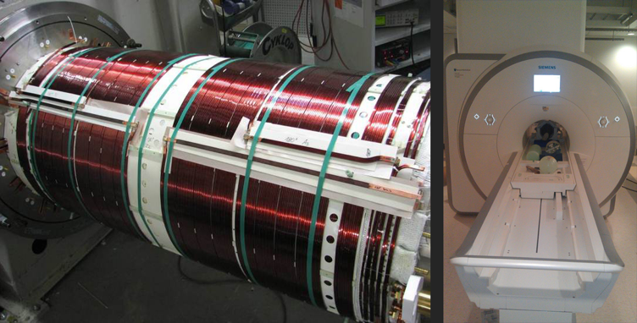
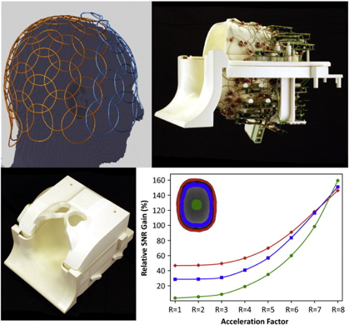
MGH Human Connectome Scanner
b = (γδG)²(Δ−δ/3)
Typical Max Gradient Strength, G (40-50 mT/m)
MGH Scanner Max Gradient (300 mT/m)
64 Channel Head Coil
Setsompop Neuroimge 2013

Slide 14
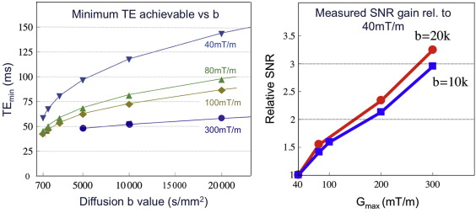
MGH Human Connectome Scanner
Typical Max Gradient Strength, G (40-50 mT/m)
MGH Scanner Max Gradient (300 mT/m)
Setsompop Neuroimge 2013

Slide 15
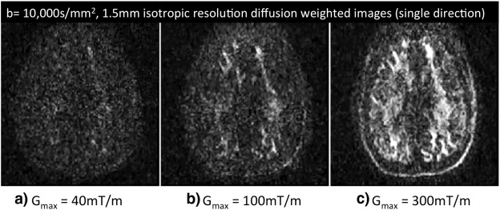
MGH Human Connectome Scanner
TE~120ms
TE~75ms
TE~50ms
Advanced
S=So exp(-TE/T2)
Setsompop Neuroimge 2013

Slide 16
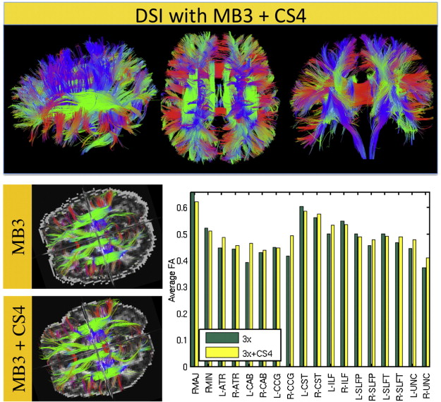
MGH Human Connectome Scanner – 4 Min DSI w/ Compressed Sensing
Setsompop Neuroimge 2013

