Slide 1
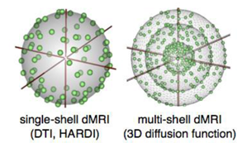
Multi-Shell (Multiple b-value) DWI
Figure from Brainlife.io

Slide 2
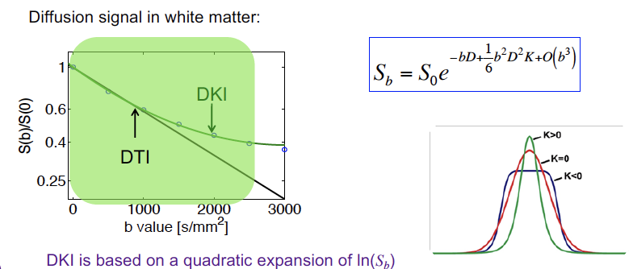
Non-Gaussian Diffusion: Diffusion Kurtosis
)
ln(
E Fieremans, NYU

Slide 3
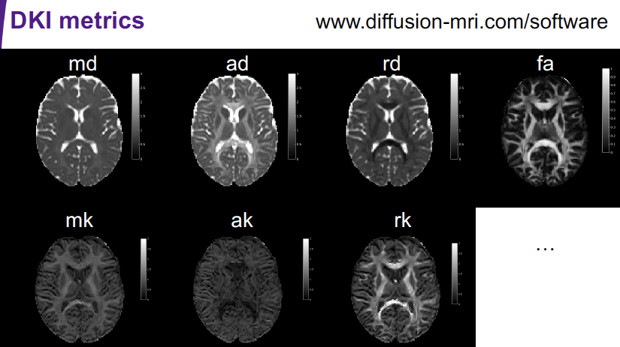
Non-Gaussian Diffusion: Diffusion Kurtosis
E Fieremans, NYU

Slide 4
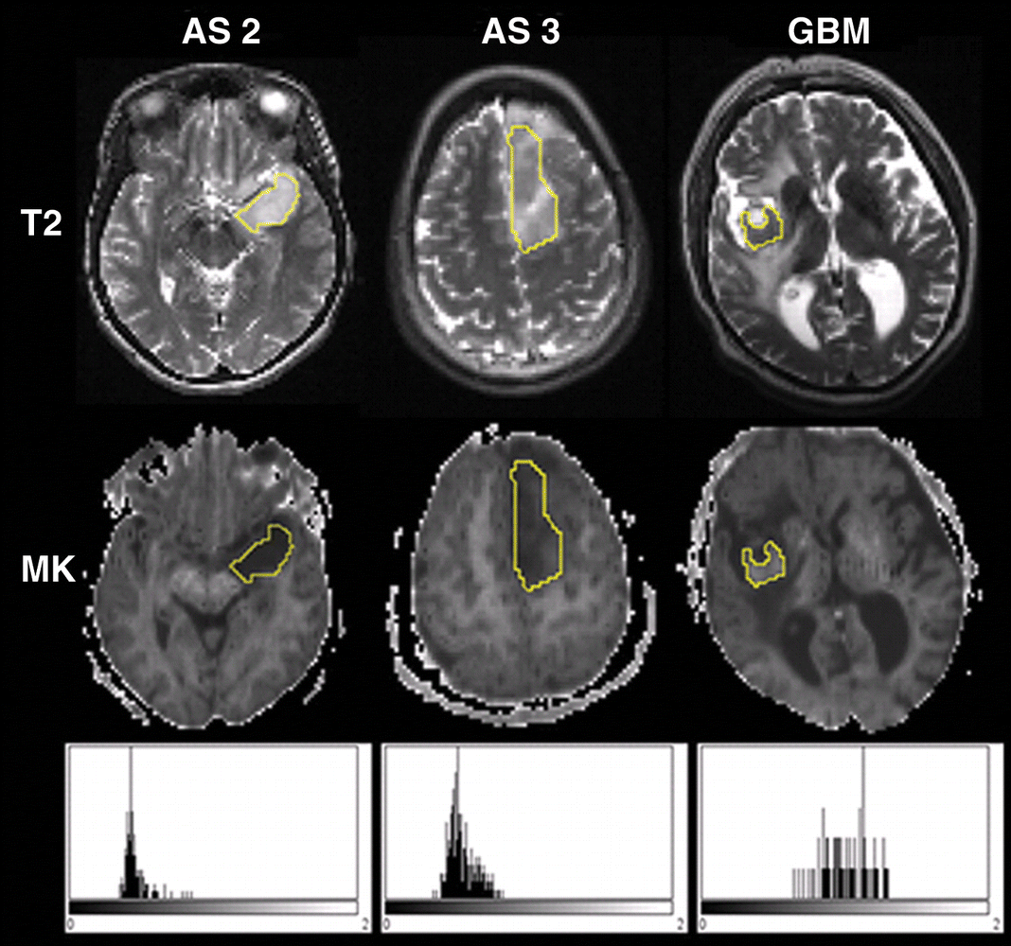
Diffusion Kurtosis – Cancer Staging
Tumor grade
Related to
Kurtosis –
Microstructural
complexity
histograms
MK
Steven et al. AJNR 2014

Slide 5
Model Based Diffusion Methods
Model DWI signal using biological assumptions
NODDI: Neurite Orientation Dispersion and Density Imaging - Zhang et al.
CHARMED: Combined Hindered and Restricted Diffusion - Assaf et al.
DBSI: Diffusion Basis Spectrum Imaging -
Wang and Song

Slide 6
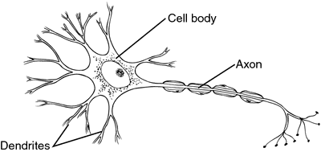
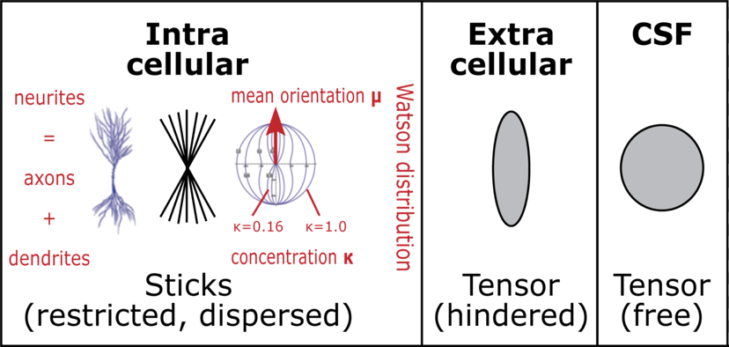
Neurite Orientation Dispersion and Density Imaging (NODDI)
Neurite: Any projection from neuron:
Axons and Dendrites
Multi- b-value DWI method
Zhang et al. Neuroimage 2012
Model (3 Compartments):
  Free water (CSF): Volume Fraction (Viso)
  Neurite (Intracellular): Density (Vic) and Dispersion (OD)
  Extracellular
Neurite: completely
restricted perpendicular
diffusion
phd thesis –
M.Kleinnijenhuis

Slide 7
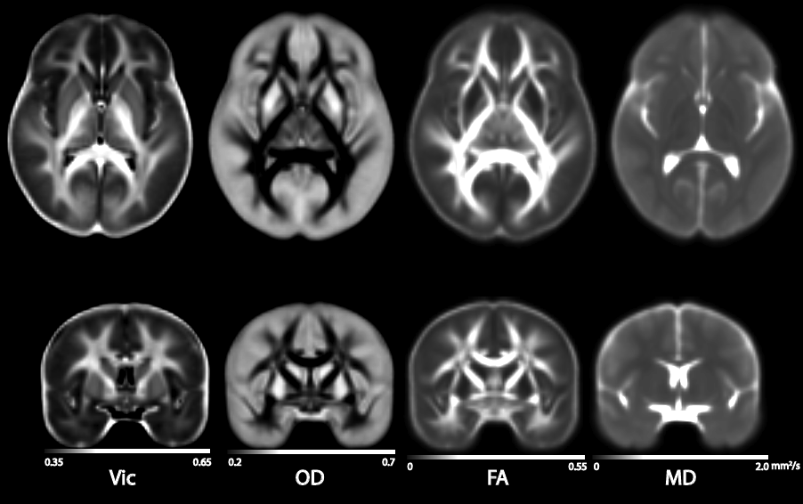
NODDI Maps (Multisubject Averaged)
Neurite
Density
Orientation
Dispersion
Fractional
Anisotropy
Mean
Diffusivity
Neurite Density has been proposed as a marker of neuronal density

