Slide 1
Lab - Overview
Basics of UNIX, the Terminal, and Filesystem
  Using the terminal
  Filesystem and Paths
  Basic commands on the terminal
  Practice examples
Note: NO FORMAL LAB REPORT IS DUE FOR THIS LAB

Slide 2
Assignment/Homework
Due Sept. 17, 2020
No formal lab report due for Today’s lab.
Please complete and submit the Lab 1 Worksheet (available through Canvas). The lab report is due Sept 17, 2020.
Please remember to also complete the Assignment for Lab 2 BEFORE the lab on Tuesday, Sept. 24, 2019. This directions for this assignment are posted on Canvas. DO NOT SUBMIT YOUR MRI SAFETY SCREENING FORM

Slide 3
Getting Started: Basic UNIX

Slide 4
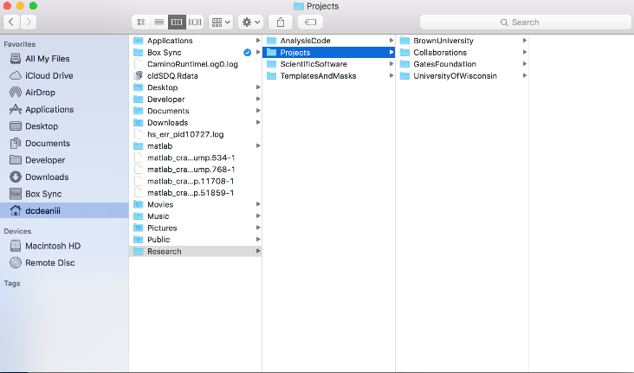
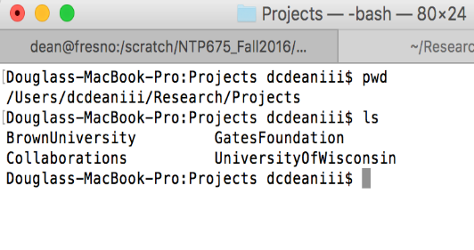
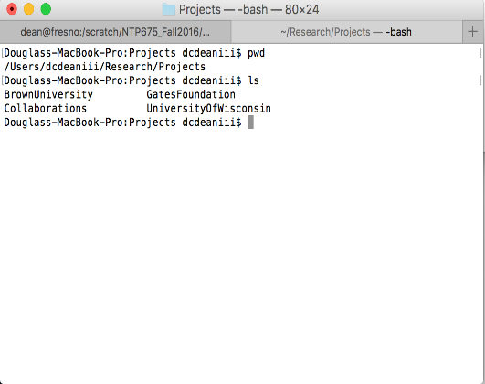
Lab 1: Introduction to Unix
Unix is a command line interface operating system
Instead of “pointing and clicking” with a mouse, with Unix, you type commands into a terminal to run specific processes

Slide 5
Terminal 101
What is a terminal?
  Text-based, command line interface
  Basic navigator for using the network/computer and accessing the files, programs, and software necessary for research
Instead of “pointing and clicking” with a mouse, you type commands into a terminal to run specific processes
Learning the command line takes practice, but as you become more proficient, it will allow you to be quicker and more efficient when processing and analyzing data.
Many of the software packages that will be used throughout the class (AFNI, FSL, MRTRIX) were developed to be used with the command line….we will use it throughout the course.

Slide 6
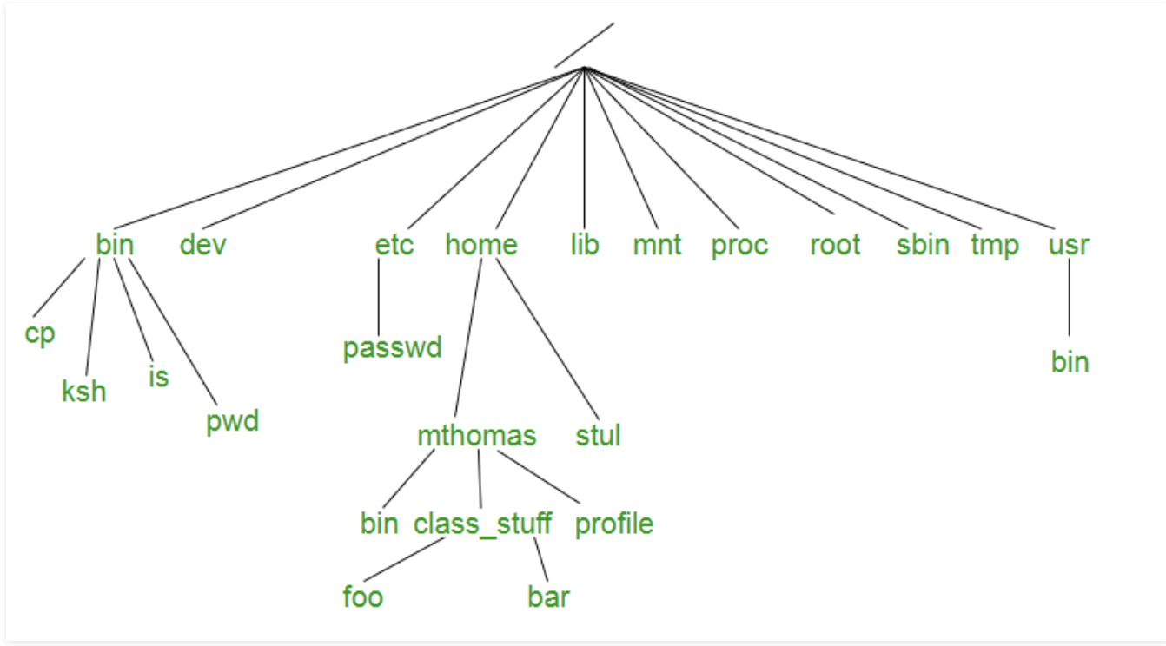
Filesystem and Directory Structure
Like other Operating Systems (e.g. macOS or Windows), Unix organizes files and folders into a directory structure.
Understanding this directory structure and being able to navigate the directory structure via the Terminal will be important.
Files in Unix System are organized into multi-level hierarchy structure known as a directory tree.
Example of a Directory Structure
geeksforgeeks.org

Slide 7
Filesystem and Directory Structure
At the very top of the file system is a directory called “root” which is represented by a “/”.
All other folder and files are “descendants” of root.
root

Slide 8
Navigating the Filesystem
Navigating the directory structure is analogous to “pointing and clicking” on a folder on your Desktop or Documents folder and seeing what’s inside.
The difference, is that we need to use the Terminal, and therefore commands for doing this. NO MOUSE!
The following commands will be used to navigate the filesystem:
    cd – ’c’hange ‘d’irectory
    ls – list (e.g. list contents of current folder/directory)
    pwd – print working directory (e.g. show your current location in the filesystem)

Slide 9
Navigating the Filesystem
Try it out!
  Open your terminal within your virtual machine
  Try typing the following commands:
    Type pwd into the terminal and note the output.
    Type ls into the terminal and note the output.
    Type cd ~/Desktop followed by ls. How did the output change?
    Type cd .. followed by pwd. How did the output change? What do you think this command did?
cd, pwd, and ls are only 3 commands that you will likely use all the time.
But there are many, many others…

Slide 10
Basic UNIX Commands Review
Command | Description
ls <file> | List contents of directory
mkdir <new_directory> | Make a new directory
cd <path> | Change directory to ‘path’
pwd | Print current directory location
cp <file1> <file2> | Copy ‘file1’ and call it ‘file2’
rm <file(s)> | Remove files
rmdir <empty_directory> | Remove directory
cat <file> | Concatenate file
mv <file1> <file2> | Move or rename ‘file1’ to ‘file2’
ssh –Y username@server | Log into ‘server’
gedit <file> | Open and edit file (text or csv)

Slide 11
Basic UNIX Commands
Try it out!
  Try typing the following commands:
    Navigate to your Desktop directory by typing cd ~/Desktop
    Type ls and note the output.
    Use the mkdir command to create a new directory called “Test” on your Desktop.
    Type ls. How did the output change?
    Delete ‘Test’ using the rmdir command by typing rmdir Test. Type ls. How did the output change?
Becoming comfortable with the the command line and directory structure does take practice.
You can practice these skills with many tutorials that are openly available online.
We list a few of these tutorials at the end of this lab and highly recommend you completing these to practice using the Terminal

Slide 12
Other Useful UNIX commands
If you need quick help with the usage and available options of a command, simply type the command name followed by ‘ --help’ into the command line
  Ex: rm --help
    This will list the usage and options available for the command ‘rm’
  The web may also be useful in finding help with commands
A great way to create and view a text file is using the application Gedit, a simple text editor.
  To open and edit a text file or comma-separated file:
    gedit subjects.txt

Slide 13
Useful UNIX tips & tricks
‘Tab’ completion – hitting the ‘Tab’ key after typing the beginning of a file or directory will auto-complete filename or directory name up until the point where it is ambiguous.
Pressing ‘Tab’ twice will list options starting with the text you already typed.
Try it Out!
  Navigate to your Desktop directory by typing cd ~/Desktop
  Create 4 new directories, ‘Apple’, ‘Test’, ‘Test1’, ‘Tiger’ using the command mkdir
  Navigate to the ‘Apple’ directory. Type cd A and then press ‘Tab’. What happened? Go back to the Desktop with cd ..
  Navigate to the ‘Tiger’ directory. Type cd T and then press ‘Tab’. What happens? What happens if you press ‘Tab’ two consecutive times. What happens? Add ‘i’ to your command and press ‘Tab’ two times. What happens this time? Go back to the Desktop with cd ..
  Navigate to the ‘Test1’ directory. Type cd T and press ‘Tab’ two consecutive times. What happens? Add ‘e’ to your command and press ‘Tab’ two times. What happens this time? Add ‘st’ to your command and press ‘Tab’ two times. What happens this time?
  Navigate back to the Desktop and remove the 4 directories that you created.

Slide 14
Useful UNIX tips & tricks
Wild cards: You can use symbols (“wildcards”) to have the UNIX shell expand the list to multiple files or directories.
  * - everything
  ? - one character
E.g.:
  ls * - lists all files and directories
  ls f* - lists all files and directories starting with ’f’
  ls fMRI_Lab? – lists all files and directories starting with ’fMRI_Lab’ and containing a single character following this string. (e.g. it will show fMRI_Lab1, fMRI_Lab2, but not fMRI_Lab10)
  cd f*1 – will change into the directory starting with ‘f’ and ending with ‘1’. (N.B.: If more than one directory or file match this pattern, you will get an error, since the ‘cd’ command expects only one argument.)

Slide 15
Useful UNIX tips & tricks
↑ <up arrow>, ↓ <down arrow>:
  Goes to the previously used commands
Ctrl–A – go to the beginning of the line
Ctrl–E – go to the end of the line

Slide 16
Filesystem Paths
A “path” refers to the location of the file on the filesystem. For example: /home/neuro/Desktop refers to the “path” of the Desktop folder on the Virtualbox virtual machine.
The path /home/neuro/Desktop/Document.docx is the path to a Word Document called “Document.docx” on the Desktop
A path is made up of two parts: the directory and filename. In the example: /home/neuro/Desktop/Document.docx
  The directory of this path is: /home/neuro/Desktop
  The filename of this path is: Document.docx

Slide 17
Filesystem Paths
Your home directory refers to the location: /home/neuro
By default, this is the path that you are initially at when you first open a Terminal.
UNIX provides a shortcut for your “home” directory:
  ~ – can be used as a shortcut to your home directory
  Therefore, you can navigate to your home directory two ways:
    cd /home/neuro
    cd ~
    These two commands are equivalent. The ~ is nice as it can help save typing.
  Try these out in the Terminal to verify that they are equivalent
The concept of a filesystem path is very important and will come up frequently throughout the class. Please ask any questions about this.

Slide 18
Copying and Moving Files
Just like how you can move or copy files into a folder, UNIX offers commands for copying and moving files from the Terminal:
    cp – Copy
    mv – Move
The syntax for these commands are similar. You need to specify a “path” for the file that you’re trying to copy and a path for the location you want to copy or move the file to.
    cp <file that you want to copy> < path to where you want to copy >
    mv <file that you want to move> < path to where you want to move >
Just as their names refer, main difference between these commands are that copy will make a copy of the file, while move moves the file directly. A good way to think of this is copy/paste vs. cut/paste.

Slide 19
Copying and Moving Files
Try it out!
  Create an empty text file inside the Documents folder called “welcome.txt” (e.g. touch ~/Documents/welcome.txt)
  Copy this file to a directory that you create on your home directory
    First, make a new directory/folder inside your home directory:
      mkdir ~/Test
    Copy the welcome.txt file to this new directory:
      cp /home/neuro/Documents/welcome.txt /home/neuro/Test/
      Or
      cp ~/Documents/welcome.txt ~/Test/
    Navigate to this new directory on your home directory and list its contents to verify that welcome.txt is inside.
      cd /home/neuro/Test/
      ls

Slide 20
Copying and Moving Files
Try it out!
  Now, navigate back to your home directory:
    cd ~
  Create a new directory, lets call it Move:
    mkdir ~/Move
  Now move welcome.txt from the directory Test to Move:
    mv ~/Test/welcome.txt ~/Move/
    NOTE: We did not specify a filename at the end of the move command. If you would like to rename the file, you can specify a different filename with the command
  Navigate to Test to verify that welcome.txt is no longer there
      cd ~/Test/
      ls
  Navigate to Move to verify that welcome.txt is now in this location
      cd ~/Move/
      ls

Slide 21
Copying and Moving Files
You can also copy a folder to a new location using the same cp command, with one subtle difference. You should include the syntax ‘-r’ before specifying the paths to your image.
For example, if I wanted to copy the folder Test into the folder Move, we could use the following command:
  cp ~/Test ~/Move/
The ‘-r’ option refers to copy recursively and copies all of the contents of a folder or directory

Slide 22
Print and Concatenate Files
Another frequently used command is the cat command. This command has multiple purposes:
  Displaying files
  Combining copies of files into one
  Creating new files.
  Copying files
The following link describes these functions very well:
  https://askubuntu.com/questions/642942/what-is-cat-used-for
Here we will try out the first purpose, displaying the contents of a file:
  Navigate to the Move directory inside your home directory:
    cd ~/Move
  Display the contents of welcome.txt:
    cat welcome.txt

Slide 23
Remember…
We want to emphasize again, that becoming comfortable and proficient using the command line takes a lot of practice.
We don’t expect you to be perfect using the Terminal initially, but we hope that as you move through the class, these concepts will become a little easier.
The next two slides contains a few links that have different tutorials and exercises for practicing and learning the command line. WE HIGHLY RECOMMEND GOING THROUGH ONE OR MORE OF THESE TO PRACTICE

Slide 24
Basic UNIX tutorial
Again, we want to emphasize that becoming proficient using the Terminal takes a lot of practice.
The UNIX Tutorial for Beginners website contains explanations of basic UNIX commands commonly used to navigate the terminal: http://www.ee.surrey.ac.uk/Teaching/Unix/
For our purposes, follow these instructions on what you need to know for each embedded link on the web page:
  Introduction to the UNIX Operating System
    Skip ‘Starting an UNIX terminal’
  Tutorial One
    Cover all
  Tutorial Two
    Ignore ‘less’, ‘head’, ‘tail’, and Section 2.5
  Tutorial Three
    Skip all
  Tutorial Four
    Skip Section 4.3
  Stop after Tutorial Four
  Ignore the ‘%’ sign in front of each command, as this does not appear on our command lines

Slide 25
HIGHLY RECOMMENDED
It is highly recommended that you take the time to go through this tutorial on your own time:
https://www.codecademy.com/learn/learn-the-command-line
This will give you practice in using the terminal/command line, which will be a major part of the course. The only way to get better at the terminal is by practicing using it. This tutorial will help give you that practice.
Additional tutorials are provided:
https://www.vikingcodeschool.com/web-development-basics/a-command-line-crash-course
https://ryanstutorials.net/linuxtutorial/commandline.php
https://www.davidbaumgold.com/tutorials/command-line/

