Slide 1
SQL Server Reporting Services: Develop & Deploy Reports
Anil Desai
http://AnilDesai.net

Slide 2






Speaker Information
Anil Desai
Independent Consultant (Austin, TX)
Author of several SQL Server books
Certification
Training
Instructor, “Implementing and Managing SQL Server 2005” (Keystone Learning)
Info: http://AnilDesai.net or Anil@AnilDesai.net

Slide 3
Administering Reporting Services
Administration Overview
Reporting Services Architecture
Installing and Configuring Reporting Services
Administering Reporting Services
Managing Reports and Data Sources
Advanced Administration
Configuring Report Execution and Caching
Creating Snapshots and Report History
Managing Subscriptions
Managing Report Security

Slide 4
Reporting Services Architecture
Features and components of Reporting Services

Slide 5
Reporting Life Cycle
Report Authoring
Report Delivery
Report Management

Slide 6
Reporting Services Features
Part of the SQL Server Platform
XML-based Report Files (.rdl)
Report Development
Visual report design
Business Intelligence Development Studio (BIDS)
Report Builder 2.0 / 3.0
Report Features
Grouping
Sorting
Filtering
Drill-Down and Drill-Through
Charting

Slide 7
Reporting Services Features
Report Types
Table, Matrix, Charts, etc.
Report output:
Report Viewer (web site)
Page-based (HTML, TIFF, PDF)
Application integration (Web / Windows Forms)
Exports:
Microsoft Excel
Text files (CSV, TSV)
Adobe PDF
XML

Slide 8
Reporting Services Features
Application Programming Interface (API)
Report Viewer control for Windows Forms
Report Viewer control for ASP.NET
Web Services API / SOAP Support
Custom Application Development
Web and Windows Forms Report Viewer controls
SSRS 2008+ uses its own web server (no IIS)
Deployment Methods:
Native mode
SharePoint-integrated mode
Server farm (distributed) configuration

Slide 9
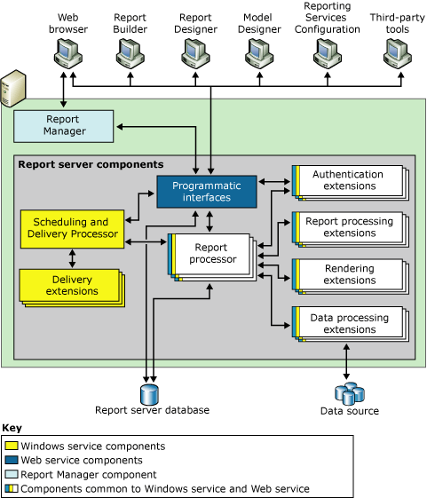
Reporting Services Architecture
From SQL Server Books Online

Slide 10
SSRS 2008 R2: New Features
Report Part Gallery
Shared data sources
Text rotation (for long column headers)
Mapping and spatial data visualization
New Platform Features / Tools
Self-Service Business Intelligence
Master Data Management
SharePoint 2010 Support
PowerPivot for Excel 2010

Slide 11
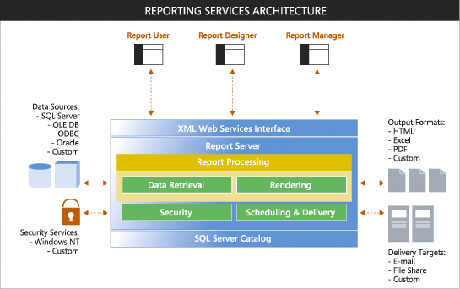
Reporting Services Architecture
From www.microsoft.com/sql

Slide 12
Reporting Services Components
SQL Server Reporting Services Service
Report Manager Web Site
Reporting Creation
SQL Report Builder 2.0
Visual Studio 2008 Report Designer
Databases:
ReportServer:
Report definitions, security settings, etc.
ReportServerTempDB:
Cached data and user session information

Slide 13
Installing Reporting Services
Part of the SQL Server Setup Process
Deployment Modes
Native mode
SharePoint Integrated mode
Native Mode with SharePoint Web Parts
Verifying the installation
Event Viewer: Application Log
Options in RSReportServer.config file

Slide 14
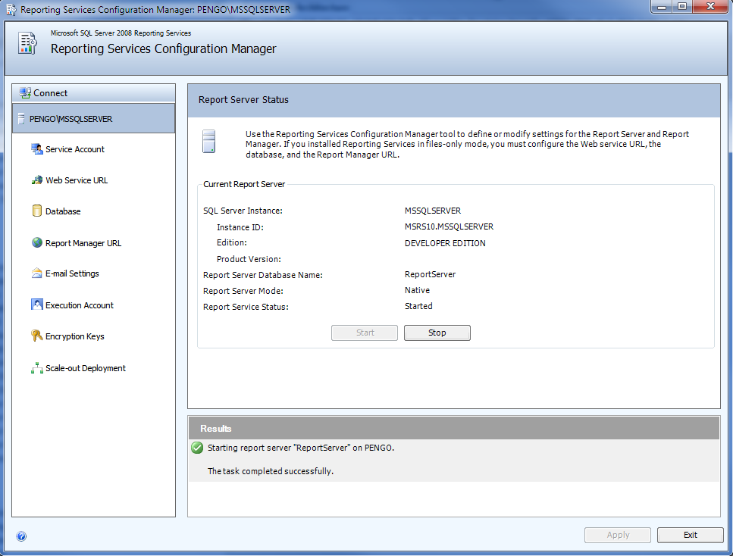
Configuring Reporting Services

Slide 15
Administration Methods
SQL Server Management Studio
Server Type: “Reporting Services”
Microsoft Visual Studio 2008 SP1
Can deploy reports and data sources
Can choose server and folder names for deployment
Command-line options
RS.exe
RSConfig.exe

Slide 16
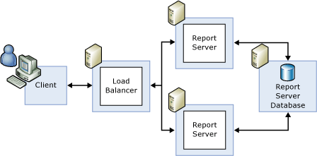
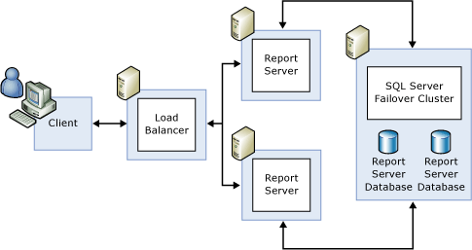
Scale-Out Deployments

Slide 17
Managing Reports
Working with report items and defining data access methods

Slide 18
Report Manager Web Site
Primary administration method
Configure site settings
Manage reports and data sources
Security configuration
View reports
Connecting to the Report Manager Web Site
Requires a DHTML-compatible browser
Default: http://ComputerName/reports

Slide 19
Understanding Reports
Report Definition Language (.rdl)
XML-based report files
Contains report layout and other details
Data sources
Queries / stored procedure calls
Parameters
Reports can be deployed or uploaded
Can be organized in folders

Slide 20
Deploying Reports
Using Visual Studio
Deploy a single report or data source
Deploy the entire project
Project Deployment options:
OverwriteDataSources
TargetDataSourceFolder
TargetReportFolder
TargetServerURL
Uploading Reports
.RDL files can be uploaded through the web site
Can overwrite a current report to retain all settings

Slide 21
Developing SSRS Reports
Review of modules and resources for more information

Slide 22
Using the Report Wizard
Report Wizard Goals:
Provides a quick way to create basic reports
Defines a data connection and query
Includes formatting and grouping options
Creates a new RDL file
Launching the Report Wizard:
New Project → Report Server Project Wizard
Add Item → Report Wizard

Slide 23
Report Wizard Steps
Define Data Source
Design Query / Create Datasets
Choose Report Type
Define Report Layout
Choose Report Formatting
Deploy Report

Slide 24
Creating Data Sources
Access data sources using Reporting Services

Slide 25
Understanding Data Sources
Specifies connection information for reporting data
Supported Data Sources:
Any OLEDB / ODBC-compliant data source
Relational
SQL Server
Oracle
MS Access
OLAP / Multi-Dimensional
SQL Server Analysis Services
XML, Excel, CSV, TSV, etc.

Slide 26
Creating Data Sources
Data Source Details
Data source type
Connection options
Security credentials
Private Data Sources (Report-specific)
Stored within the report (.RDL) file
Shared Data Sources
Defined at the Project / Server level
Can be used across multiple reports
Useful for development/production environments

Slide 27
Creating Datasets
Specifying information to be included in a report

Slide 28
Dataset Details
Identifies data to be used for report generation
Can have many different datasets per report
Requires a data source (shared or embedded)
Fields are available for use in reports
Dataset Options
Query (Text or Stored Procedure)
Fields
Data Options
Parameters
Filters

Slide 29
Query Designer
Query Designer Features
Visual creation of joins
Can access tables, views, and functions
Column names and aliases
Query sorting and filtering options
Query results
Screen sections
Diagram Pane
Grid Pane
SQL Pane
Result Pane

Slide 30
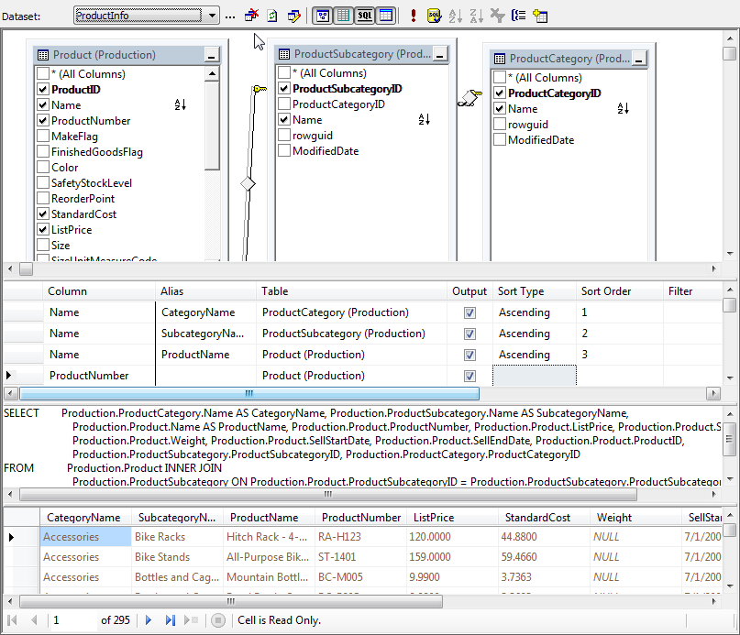
Query Designer Example

Slide 31
Creating a Dataset
Report Requirements:
AdventureWorks Products by Category Report
Retrieve information about Categories, Subcategories, and Products
Tables:
Production.ProductCategory
Production.ProductSubcategory
Production.Product

Slide 32
Report Design: Layout
Creating and laying out new reports

Slide 33
Report Layout
Report
Page Header
Page Footer
Body (Report Area)
Table Regions
Header
Detail
Footer
Groups
Page breaks
Summaries / Totals

Slide 34
Report Items (Toolbox)
Data Output
Layout / Formatting
Chart
SubReports
Table
Matrix
List
Textbox
Line
Rectangle
Image
Data visualization
Drill-through
Complex Reports
Dashboards

Slide 35
Report Layout: Demonstration
Report Requirements:
Show a list of all products by Category / Subcategory
Drill-down, sorting, and grouping are not required
Report Components:
Page Header
Report Title
Page Number
Report Data (Table)

Slide 36
Deploying and Viewing Reports
Publishing reports to the Reporting Services web site

Slide 37
Publishing Reports
Project Properties:
OverwriteDataSources
TargetDataSourceFolder
TargetReportFolder
TargetServerURL
Deployment Options
Entire Project
Single report / data source item

Slide 38
Viewing Reports
Interacting with Reports
Exporting Data

Slide 39
Report Design: Adding Interactivity
Sorting, Grouping, and Drill-Down

Slide 40
Interactive Sorting
Query Sorting
Useful for setting a “default” sort order
Use an ORDER BY clause in the dataset query
Table-Level Sorting
Default sort order specified in the “Sorting” tab
Interactive Sorting
Data is sorted during report generation
Sorted values are used for report output
Can use a field or complex sort expression
May be dependent on grouping scope

Slide 41
Grouping and Drill-Down
Grouping
Helps to logically organize data
Can create sub-totals in group footer
Drill-Down
Group visibility can be dynamically-controlled by other columns/values
Report exports are based on the current view

Slide 42
Grouping Example
Region
North America
Sub-Region
U.S.
Canada
Mexico
Details
Sales (YTD)
Sales (Monthly)
Sales (YTD)

Slide 43
Understanding Expressions
Statements used to specify values
Can be used in table cells
Expression Editor
Supports Intellisense
Uses Visual Basic-style syntax
Examples:
Globals!ReportName
Globals!PageNumber
Sum(Fields!SalesTotal.Value, “Sales")
CountDistinct(Fields!ProductCategory)
Fields!Employee.LastName + “,” + Fields!Employee.FirstName +

Slide 44
Expression Options
Constants
Globals
Parameters
Fields
Based on context
Report Name
Page information
Execution Time
From report settings
From datasets

Slide 45
Expression Options (cont’d.)
Datasets
Operators
Common Functions
Dataset column values
Single Values: May include “First” or “Sum”
Arithmetic
Comparisons
String functions
Aggregates
Financial
Type Conversions
Text
Date/Time
Math
Program Flow (IIF, Choose, Switch)

Slide 46
Filtering Report Data
Using Parameters to filter reporting data

Slide 47
Filtering Options
Dataset / Query Level
Uses parameter variables to restrict data returned
Can also use stored procedure variables
Report Parameters
Determined at report run-time
Useful when users will be frequently changing settings
Object Filtering
Filter options for tables, charts, etc.

Slide 48
Dataset Filtering
Can improve performance by minimizing data returned
Best used when filtering details are known before report generation
Implemented using query parameters
Variables: @StartDate, @EndDate
Query:
SELECT * FROM Sales
WHERE TransactionDate
BETWEEN @StartDate AND @EndDate

Slide 49
Reporting Parameters
Evaluated at report run-time
Report Parameter Options:
Data Types
Prompt Options
Allow blank / null; Multi-value
Available Values
Non-Queried or From Query
Default values:
Non-Queried or From Query
Cascading Parameters

Slide 50
Report Design: Adding Charts
Adding data visualization through Chart objects

Slide 51
Chart Types
Understanding Charts
Can be based on any dataset
Display and options are based on chart type
Chart Features
X- and Y-Axis Labels
Legends
3-D Effects
Filters

Slide 52
Chart Types
Column
Bar
Area
Line
Pie Chart
Doughnut
Scatter
Bubble
Stock
Spatial (R2)
Sparklines (R2)
Mapping (R2)

Slide 53
Designing Charts
Designing Charts:
Data Fields
Series Fields
Category Fields
Chart Example: AdventureWorks Sales Data
Requirement: Show sales by region and date in a variety of different ways

Slide 54
Report Design: Using Subreports
Accessing related data with Subreports

Slide 55
Understanding Subreports
Embedded Reports
May be related to the “parent” report
Purposes
Master / Detail view of data
Flexible layout and display options
Dashboards
Drill-Through (using hyperlinks)
Complex Reporting

Slide 56
Advanced Report Administration

Slide 57
Configuring Report Execution and Caching
Specifying how and when reports are run

Slide 58
Report Execution Process
Data is retrieved from data source(s)
Data is stored in ReportServerTempDB
Report is Executed
Results are provided to user or services

Slide 59
Report Execution Options
Always run this report with the most recent data
Enable caching
Expired based on number of minutes
Expired based on a schedule
Render report from a snapshot
Report Execution timeouts
System Default
Specified number of seconds
None

Slide 60
Understanding Report Caching
Cache is created when a report is first run
Stores a copy of data in ReportServerTempDB
Can reduce impact on production performance
Data may be out-of-date
Expires after a pre-defined amount of time
Data source security settings must be configured

Slide 61
Caching and Report Parameters
Query Parameters
Each combination of parameter values results in a separate stored database
Can use a large amount of disk space
Report Parameters
Creates a single cached instance of the report

Slide 62
Understanding Schedules
Events are executed by SQL Server Agent service
Schedule Types
Report-Specific Schedules
Shared Schedules
Defined at the system level
Tips:
Keep track of time zones
Use shared schedules whenever possible to allow centralized management
Distribute reporting processing workload over time

Slide 63
Creating Snapshots and Report History
Creating point-in-time views of data and storing them for later review

Slide 64
Understanding Snapshots
Point-in-time view of the contents of a report
Data never changes
Report parameters must be defined before running the snapshot
Usually created on a schedule
End-of-month or end-of-year reports
Scheduling
Report-specific schedule
Shared schedule

Slide 65
Report History
Used to maintain snapshot copies over time
Often used for auditing or historical reference
Scheduling:
Store all snapshots
Use a report-specific schedule
Use a shared schedule
Options:
Keep an unlimited number of snapshots
Limit the number of copies of report history

Slide 66
Managing Subscriptions
Getting data to users when and how they want it

Slide 67
Report Delivery Options
E-Mail
Uses SMTP server defined in Reporting Services Configuration tool
Can send report as attachment
Can send a link to the report
File Share
Stores the output of a report to a file share
Requires a shared folder accessible via UNC
Example: \\ReportServer\MarketingReports

Slide 68
Report Delivery Options
Output file types
XML
Comma-separated values (CSV) – text file
TIFF image files
Web Archive
Adobe Acrobat (PDF)
Microsoft Excel (XLS)
File Share Only
Web Page (HTML)
Web Archive

Slide 69
Subscription Types
Snapshot-Based Subscriptions
Notification is sent whenever a snapshot is created
Schedule-Based Subscriptions
Uses a custom schedule (e.g., daily, monthly, etc.)
Can have start and stop dates
Data-Driven Subscriptions
Report recipients are defined by a query
Table and query must be created manually
Useful when managing large or very dynamic lists of recipients

Slide 70
Managing Report Security
Configuring system-level and report-level permissions

Slide 71
Reporting Services Security
Hierarchical Security Model
Folders can be used for logical organization
Items inherit permissions
Security Layers
System-Level Role Definitions
Site-wide Security
Item-Level Role Definitions

Slide 72
Managing Security
Role-Based system
Roles are sets of permissions/capabilities
Users can be assigned to multiple roles
Based on Windows Authentication
Provides for centralized security management
May use Active Directory users and groups
Other authentication can be developed

Slide 73
Security Roles
Roles include collections of tasks
Pre-Defined Roles:
Browser
Content Manager
My Reports
Publisher
Report Builder

Slide 74
Creating Custom Roles
Available Tasks:
Consume Reports
Create linked reports
Manage all subscriptions
Manage data sources
Manage folders
Manage individual subscriptions
Manage models
Manage report history
Manage reports
Manage resources
Set security for individual items
View data sources
View folders
View models
View reports
View resources

Slide 75
Linked Reports
Creates a “virtual report”
Uses the same report definition (.rdl) as the parent report, but with independent settings
Purpose / Benefits
Can setup different sets of permissions
Can setup different sets of parameters

Slide 76
Reporting Services Security Best Practices
Give users minimal permissions
Implement “defense-in-depth”
Regularly review permissions
Delegate security review responsibilities
Make security reviews a part of your overall process
Ensure that Windows groups and users are properly defined

Slide 77
Course Summary
Resources for more information

Slide 78
For Further Information
AnilDesai.net
Presentation slides
SQL Server-focused articles
Sample code from presentations
ReportingServicesGuru.com
Course: “Administering Reporting Services”
Online forums and news
Microsoft Resources:
SQL Server Web Site: www.microsoft.com/sql
Reporting Site: http://www.microsoft.com/sqlserver/2008/en/us/reporting.aspx
Microsoft Developer Network: msdn.microsoft.com
Microsoft TechNet: technet.microsoft.com
SQL Server 2008 R2 Reporting Services Forums
SQL Server Product Samples: http://msftrsprodsamples.codeplex.com/

