Slide 1
SQL Server 2012 Analysis Services (Tabular Model ) Sheema.P

Slide 2
Agenda
2012 BI Semantic Model
BI Semantic Model Architecture
Analysis Services in Tabular Mode
Tabular Project Development
Comparing the Design Approaches
Comparing Tabular Vs Multidimensional Features
Security
Summary

Slide 3
2012 BI Semantic Model
There was UDM, now there is BISM
Business Intelligence Semantic Model
Only one BI data modeling tool
Divided in two flavors
Tabular
Multidimensional
Now there are two modeling techniques under a single technology

Slide 4









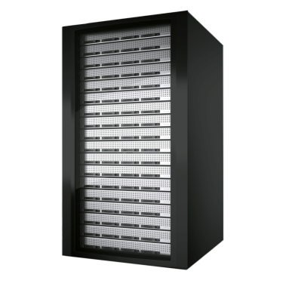

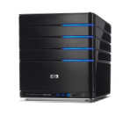
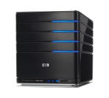




One Model for all End User Experiences
Client Tools
Analytics, Reports, Scorecards,
Dashboards, Custom Apps
BI Semantic Model
Data model
Personal BI
Team BI
Organizational BI
PowerPivot for Excel
PowerPivot for SharePoint
Analysis Services
Business logic
and queries
Data access
Data Sources
Databases, LOB Applications, OData Feeds,
Spreadsheets, Text Files
Simplicity
Richness
Scalability

Slide 5













BISM Architecture
Third-party
applications
Reporting
Services
Excel
PowerPivot
SharePoint
Insights
BI Semantic Model
Data model
Multi-
dimensional
Tabular
Business logic
and queries
MDX
DAX
Data access
ROLAP
MOLAP
VertiPaq
Direct
Query
Databases
LOB Applications
Files
OData Feeds
Cloud Services

Slide 6
BI Semantic Model Deliverables
Flexibility
Tabular and multidimensional modeling experiences
DAX and MDX for business logic and queries
Cached and pass through storage modes
Choice of end-user BI tools
Richness
Rich data modeling capabilities
Sophisticated business logic using DAX and MDX
Fine-grained security row and cell level
Enterprise capabilities and features
Hierarchies
KPIs
Perspectives
Semi-additive measures
Scalability
In-Memory for high performance, MOLAP for mission critical scale
DirectQuery and ROLAP for pass through access to data sources
State-of-the-art compression algorithms
Scales to the largest of enterprise servers
Notes:
‹#›

Slide 7
Tabular Mode : Introduction
Super-duper fast xVelocity in-memory engine
Based on the relational data model
Amazing compression ratio of tables
Programmed with the new DAX language
When compared with OLAP
Much faster
Easier to learn and use

Slide 8
Tabular Mode: Column Storage Layout
ID | Name | Address | City | State
1 | Bob | … | … | …
2 | Sue | … | … | …
3 | Ann | … | … | …
4 | Jim | … | … | …
5 | Liz | … | … | …
6 | Dave | … | … | …
7 | Sue | … | … | …
8 | Bob | … | … | …
9 | Jim | … | … | …
ID
1
2
3
4
5
6
7
8
9
State
…
…
…
…
…
…
…
…
…
Name
Bob
Sue
Ann
Jim
Liz
Dave
Sue
Bob
Jim
City
…
…
…
…
…
…
…
…
…
Address
…
…
…
…
…
…
…
…
…
Tables are stored “column-wise” with all values from a single column stored in a single block

Slide 9
Tabular Project Development
NEW TABULAR DESIGN FEATURES
Diagram view
Calculation area
Active/inactive relationships
Marking date tables and columns
Sorting a column by a different column
Multi-level hierarchies
Column and measure format properties
Table, column and measure descriptions
Key Performance Indicators (KPIs)
Perspectives
Reporting properties
Table partitions
Security roles, including row-level security
In-Memory (cached) and DirectQuery (passthrough) query modes
Notes:
This slide lists the new features available for developing tabular models. Do not attempt to describe in detail what each feature is designed to achieve, as they will be covered in both the demonstration and hands-on lab.

Slide 10
Tabular Project Development
DEVELOPMENT WORKFLOW
Create a tabular project
Import data to create tables
Define table relationships
Enhance the model with calculated columns, hierarchies, measures, KPIs and perspectives
Hide tables, columns and measures from the client tools
Define table partitions
Define roles
Deploy the project to SSAS
Notes:
This slide defines a general methodology for developing a tabular project.

Slide 11
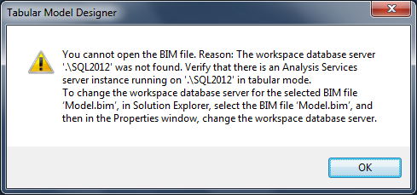
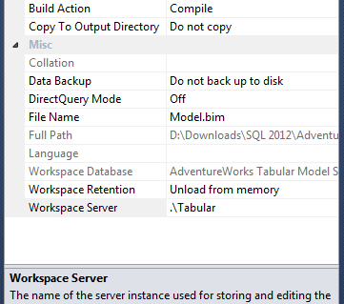
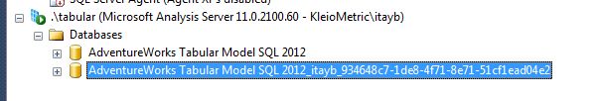
Workspace Database
Created during model authoring using SSDT.
Disappeared automatically when closing the project
The workspace database resides in-memory Workspace DB

Slide 12
Tabular Project Development
MANAGING TABULAR DATABASES
Tabular databases can be managed in SQL Server Management Studio (SSMS)
Capabilities include:
Restoring from PowerPivot workbooks
Managing connection strings
Adding and managing table partitions
Adding and managing roles
Processing the database, its tables and table partitions
Scripting the database, specific objects and commands
Notes:
Once deployed to a SSAS instance in tabular mode, the administrator can work with the listed features.

Slide 13
Tabular Project Development
CONFIGURING DIRECTQUERY
Similar to multidimensional models, tabular models can cache data or passthrough to the data source
For cached mode use the In-Memory query mode
For passthrough use the DirectQuery query mode
The In-Memory query mode requires processing to update data
The DirectQuery query mode:
Retrieves query results from the data source
Can perform very well when querying data source tables using the new columnstore index
Notes:
DirectQuery is explained in this slide.

Slide 14
Process Tabular Model Database, Table, Partition
To process a database
Mode | Description
Process Default | Detects the process state of database objects, and performs processing necessary to deliver unprocessed or partially processed objects to a fully processed state. Data for empty tables and partitions is loaded; hierarchies, calculated columns, and relationships are built or rebuilt (recalculated).
Process Full | Processes a database and all the objects that it contains. When Process Full is run for an object that has already been processed, Analysis Services drops all data in the object, and then processes the object. This kind of processing is required when a structural change has been made to an object. This option requires the most resources.
Process Clear | Removes all data from database objects.
Process Recalc | Updates and recalculates hierarchies, relationships, and calculated columns

Slide 15
Process Tabular Model Database, Table, or Partition
To process a Table
Mode | Description
Process Default | Detects the process state of a table object, and performs processing necessary to deliver unprocessed or partially processed objects to a fully processed state. Data for empty tables and partitions is loaded; hierarchies, calculated columns, and relationships are built or rebuilt (recalculated).
Process Full | Processes a table object and all the objects that it contains. When Process Full is run for an object that has already been processed, Analysis Services drops all data in the object, and then processes the object. This kind of processing is required when a structural change has been made to an object. This option requires the most resources.
Process Data | Load data into a table without rebuilding hierarchies or relationships or recalculating calculated columns and measures.
Process Clear | Removes all data from a table and any table partitions.
Process Defrag | Defragments the auxiliary table indexes.

Slide 16
Process Tabular Model Database, Table, or Partition
To process one or more partitions
Mode | Description
Process Default | Detects the process state of a partition object, and performs processing necessary to deliver unprocessed or partially processed partition objects to a fully processed state. Data for empty tables and partitions is loaded; hierarchies, calculated columns, and relationships are built or rebuilt (recalculated).
Process Full | Processes a partition object and all the objects that it contains. When Process Full is run for an object that has already been processed, Analysis Services drops all data in the object, and then processes the object. This kind of processing is required when a structural change has been made to an object.
Process Data | Load data into a partition or a table without rebuilding hierarchies or relationships or recalculating calculated columns and measures.
Process Clear | Removes all data from a partition.
Process Add | Incrementally update partition with new data.

Slide 17
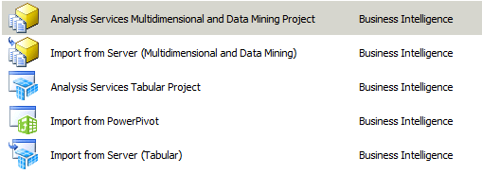
Comparing the Design Approaches
The model developer needs to select the appropriate development approach
Note: Migration between the design approaches is not supported

Slide 18
Comparing the Design Approaches Contd..
It could depend on the requirements for each layer:
Data model
Business logic
Data access and storage
The model developer will need to consider the following:
Supported capabilities and features
Scalability and performance
Available skills
Development time
Maintenance effort

Slide 19
Data Model
Tabular
Familiar model, easier to build, faster time to solution
Advanced concepts (parent-child, many-to-many) not available natively in the model… need calculations to simulate these
Easy to wrap a model over a raw database or warehouse for reporting & analytics
Multidimensional
Sophisticated model, higher learning curve
Advanced concepts baked into the model and optimized (parent-child, many-to-many, attribute relationships, key vs. name, etc.)
Ideally suited for OLAP type apps (e.g. planning, budgeting, forecasting) that need the power of the multidimensional model

Slide 20
Business Logic
DAX
Based on Excel formulas and relational concepts – easy to get started
Complex solutions require steeper learning curve – row/filter context, Calculate, etc.
Calculated columns enable new scenarios, however no named sets or calc members
MDX
Based on understanding of multidimensional concepts – higher initial learning curve
Complex solutions require steeper learning curve – CurrentMember, overwrite semantics, etc.
Ideally suited for apps that need the power of multidimensional calculations – assignments, calc members

Slide 21
Data Access and Storage
VertiPaq
In-memory column store… typical 10x compression
Brute force memory scans… high performance by default… no tuning required
Basic paging support… data volume mostly limited to physical memory
DirectQuery
Passes through DAX queries & calculations… fully exploits backend database capabilities
No support for MDX queries… no support for data sources other than SQL Server
MOLAP
Disk based store… typical 3x compression
Disk scans with in-memory subcube caching… aggregation tuning required
Extensive paging support… data volumes can scale to multiple terabytes
ROLAP
Passes through fact table requests… not recommended for large dimension tables
Supports most relational data sources… no support for aggregations except SQL Server indexed views

Slide 22
Comparing Tabular Vs Multidimensional Features
Features |  | TABULAR | MULTIDIMENSIONAL
 | Actions
 | Aggregations
 | Calculated Measures
 | Custom Assemblies
 | Custom Roll ups
 | Distinct Count
 | KPIs
 | Linked Objects
Via DAX
Not Available
Available

Slide 23
Comparing Tabular Vs Multidimensional Features Contd..
Features |  | TABULAR | MULTIDIMENSIONAL
 | Write back
 | Translations
 | Partitions
 | Perspectives
 | User Defined Hierarchies
 | Parent Child Hierarchies
 | Drill Through
 | Many To Many
Via DAX
Not Available
Available

Slide 24
Comparing Tabular Vs Multidimensional Features Contd..
Client Tools |  | TABULAR | MULTIDIMENSIONAL
 | Power View
 | Excel
 | Performance Point
 | Reporting Services
Not Available
Available

Slide 25
Comparing Tabular Vs Multidimensional Features Contd..
Querying and Scripting Language |  | TABULAR | MULTIDIMENSIONAL
 | DAX
 | MDX
 | DMX
 | ASSL
 | XML/A
Not Available
Available

Slide 26
Comparing Tabular Vs Multidimensional : Hardware Considerations
Feature | Tabular | Multidimensional
RAM | Lots (64-128GB) | Some (16/32GB)
RAM Speed | Crucial | Important
Number of Cores | 4/8/16 | 4/8/16
Core Speed | Crucial | Less Important
Disk Speed | Not Important | Very Important
SSD Disk Usage | Not Important | Strongly Recommended
Network Speed | Important | Important
Concurrency | Not Decided | Good
Note: It is not recommended to install multiple instances, in different modes, on the same server

Slide 27
Tabular Model : Security
In Tabular model we implement row level security by granting access to rows in a table. In SQL Server Data Tools tabular project grant permission using DAX that filters rows in a table
Tabular model supports dynamic security
E.g. Employees should be able to see only their personal data. Implement dynamic security based on employee id or other dynamic criteria
Tabular model we cannot specify default value. If we want a default filter then need to configure in reporting tool

Slide 28
Summary
SQL Server 2012 introduced Business Intelligence Semantic Model (BISM) to support reporting and analysis needs
The BI Semantic Model delivers a single model for all user experiences, and also delivers choice , flexibility, richness and scalability
Multidimensional and Tabular provides complementary features and we can select which best suits ours needs
Tabular model provides readily accessible modeling experience with capabilities that will satisfy most reporting and analysis needs
Users are familiar with tables and relationships and can quickly learn to implement business logic using Excel DAX language
The in memory column oriented xVelocity engine provides extreme fast query responses for data sets that contain billions of records

Slide 29
Creating a simple Tabular Model Database
SQL Server Data Tools -> File-> New Project->Analysis Services Tabular Project
Go to Model menu, and then click Import from Data Source
Select Microsoft SQL Server, and then click Next
Give the name of the server and the Database Name
In Impersonation Information page, specify the credentials Analysis Services will use to connect to the data source when importing and processing data
Choose How to Import the Data (Select from a list of tables and views to choose or write your own query)
Select Tables and Views you want to import
Select one of the tables, and click Preview & Filter
Now import the selected tables and data and Close
Click on the Model menu, and point to Model View, and then click Diagram View.

Slide 30
If relationship is there between the tables automatically it would be visible in Diagram view if its not there you can manually add relationships. Click and hold on one of the columns in the table , then drag the cursor to another column in another table, and then release
Go back to the Data View. (click the Model menu, then point to Model View, and then click Data View)Create New Calculated Columns ( for e.g. select the Internet Sales table -> Add a New column -> In the formula bar, type the formula =[Sales Amount]-[Total Product Cost]
Rename the New Column
Create New Measures. On the toolbar, click the down-arrow next to the AutoSum (∑) button, and then select SUM OR COUNT OR DistinctCount etc.
Create Hierarchies. Go to Diagram View -> right-click any table, and then click Create Hierarchy. You can add columns to this hierarchy. Right-click any column, and point to Add to Hierarchy
Go to Solution Explorer -> Properties-> under Deployment Server, in the Server property, type the name of an Analysis Services instance running in Tabular mode
Right click Solution Explorer and Click Deploy

