Slide 1
Java Servlet Technology
Version 1.0
TCS Internal

Slide 2
Early days…
In the early days of the Web, the Internet was basically a glorified file-transfer system.
A client would request a file from a server and the server would deliver the file to the client.
The files requested by the client (browser) are of the type HTML (Hyper Text File Format) and the client knows how render these files.
TCS Internal

Slide 3
Dynamic content
The next evolutionary step was the design of interactive web pages and dynamic content.
Paradigms like CGI (Common Gateway Interface) made it possible to run small programs on the server.
The output of these programs are HTML files which are sent back to the client.
TCS Internal

Slide 4
Java Servlet Technology
Sun introduced Java Servlet, which is a small program written in Java and executed by the server.
Servlet is a compiled Java class that are executed and maintained by a Servlet container.
Servlet technology allows you to develop Java applications that generate web content.
TCS Internal

Slide 5
Servlet Container
A web server uses a separate module to load and run servlets.
This specialized module, which is dedicated to the servlet management, is called a servlet container, or servlet engine.
Implements life cycle methods, manages security etc.
TCS Internal

Slide 6
Servlet Access Model
Servlet Container
Client
HTTP request
Invokes Servlet
Other
Services
Servlet
Web Server
Gives response
Client readable response
Servlet
Servlet
TCS Internal

Slide 7
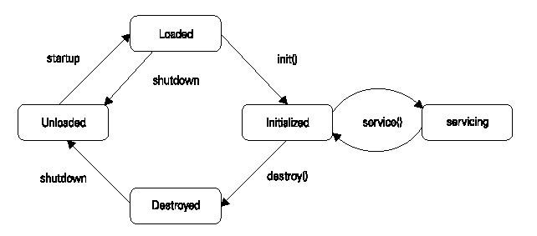
Servlet Life Cycle
TCS Internal
Notes:
‹#›
Loading is done by the web server, when the servlet is already not loaded in the container.
When servlet is no more used, it is destroyed.
On the other hand, if server is shout down, the servlet goes unloaded state.

Slide 8
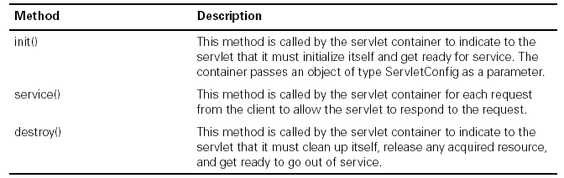
Lifecycle Methods
TCS Internal

Slide 9
Servlet API
javax.servlet
javax.servlet.http
The javax.servlet.Servlet interface
This is the central interface in the Servlet API.
Every servlet class must directly or indirectly implement this interface. It has five methods
init()
destroy()
service()
getServletConfig()
getServletInfo()
TCS Internal
Notes:
‹#›
The javax.servlet.http package contains several interfaces and classes that make it easier to build servlet that work with HTTP requests and responses.

Slide 10
Other Classes & Interfaces
javax.servlet.GenericServlet class
javax.servlet.ServletRequest interface
javax.servlet.ServletResponse interface
Javax.servlet.ServletConfig interface
Javax.servlet.ServletContext interface
javax.servlet.http.HttpServlet class
javax.servlet.http.HttpServletRequest
javax.servlet.http.HttpServletResponse interface
TCS Internal
Notes:
‹#›
Other interfaces/classes are :
SingleThreadModel – interface
Javax.servlet.ServletInputStream,ServletOutputStream,ServletException Classes
Javax.servlet.http.HttpSession

Slide 11

Sending HTTP Requests
TCS Internal

Slide 12
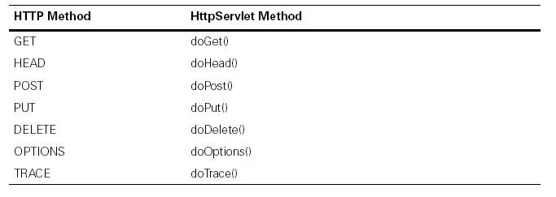
Handling HTTP Requests
TCS Internal

Slide 13

A HTML Form
TCS Internal

Slide 14
GET Vs POST
GET
Exposes data through browser URL
Browsers restrict the character size of query string to be 255 characters.
POST
Is more secured way of posting page data
No size restrictions as such.
TCS Internal
Notes:
‹#›
The length of the request URL should not exceed 255 characters. Since data is passed along with URL, the content should not exceed 255 characters.

Slide 15
Get Vs Post by Example
Either GET or POST
<html>
<body>
<form name="Form1“ method=“Get” action="http://localhost:8080/servlet/TestServlet">
<B>Credit Card Type:</B>
<select name=“ccType" size="1">
<option value=“Visa”>Visa</option>
<option value=“Master">Master</option>
</select>
<br><br>
<input type=submit value="Submit">
</form>
</body>
</html>
TCS Internal

Slide 16
Get Vs Post by Example (cont..)
In the HTTP GET Request, the URL sent from the browser to the server is -http://localhost:8080/servlet/TestServlet?ccType=Master
In the HTTP POST Request, the URL sent from the browser to the server is - http:/localhost:8080/servlet/TestServlet
TCS Internal
Notes:
‹#›
Using get method, the data is passed along URL.
Using post method, the data is passed separately. (not along with url).

Slide 17
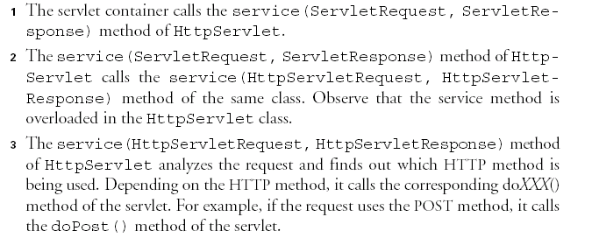
Sequence Of Events
TCS Internal

Slide 18
Guidelines to write a servlet
Make the class public.
Have the class extend GenericServlet or HttpServlet ???
Optionally have the class implement SingleThreadModel ???.
Optionally override the Servlet interface methods with your business implementation.
You should override a handling methods with your request/response logic.
TCS Internal
Notes:
‹#›
What is SingleThreadMode?
What is the difference between GenericServlet and HttpServlet?

Slide 19
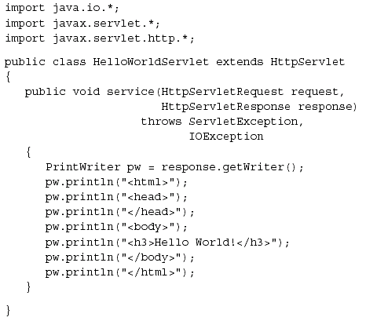
A Sample Servlet
TCS Internal

Slide 20
Analyzing the Request
You can use the HttpServletRequest interface associated with HTTP servlets to retrieve:
Session information ???
Remote user information???
HTTP meta information???
Path information and query (header)???
Http://localhost:9080/Testservlet/extra/info?val1=cool&val2=sth
Server & Port
Virtual Servlet mapping to actual servlet
Extra path info
Query String
TCS Internal

Slide 21
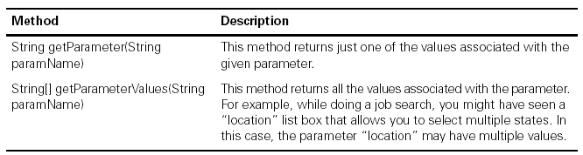
Analyzing the Request (cont..)
TCS Internal

Slide 22
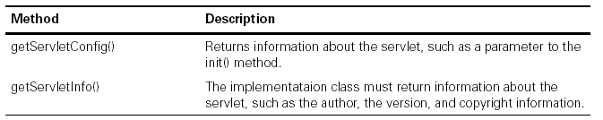
Other Methods of Request
TCS Internal

Slide 23
Important Interfaces in Servlet API
Interface | Description
Servlet | Declares life cycle methods for Servlet
ServletConfig | Allows Servlets to access Initialization Parameters
ServletContext | Gives Servlets the access to runtime their runtime environment details. Also enables to log events
TCS Internal

Slide 24
Important Interfaces in Servlet API (cont..)
Interface | Description
ServletRequest | Used to read the data from a client
ServletResponse | Used to send the data to a client
SingleThreadModel | Indicates that the servlet is thread safe
TCS Internal

Slide 25
Important Classes in Servlet API
Interface | Description
GenericServlet | Implements Servlet and ServletConfig interfaces.
ServletInputStream | Provides input stream for requests from a client.
ServletOutputStream | Provides an output stream for writing responses to a client
TCS Internal

Slide 26
Important interfaces in HttpServlet API
Interface | Description
HttpServletRequest | Enables to read the data from a client over HTTP.
HttpServletResponse | Enables to write the data to an HTTP response
HttpSession | Allows session data to be stored and retrieved
TCS Internal

Slide 27
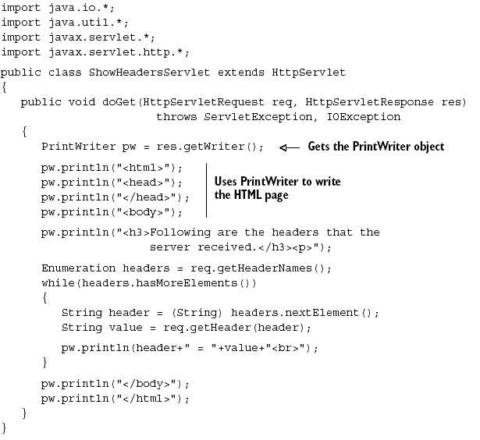
Sending the Response
TCS Internal

Slide 28
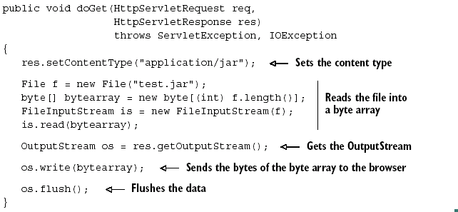
Sending the Response (cont..)
TCS Internal

Slide 29
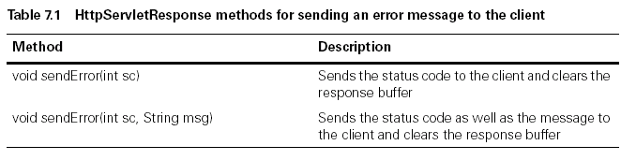
Error Handling
TCS Internal

Slide 30
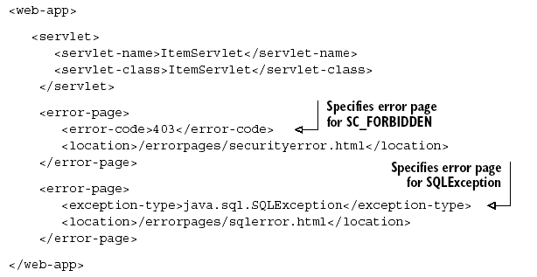
Declarative Error Handling
TCS Internal

Slide 31
Session Management
Cookies : uses header line of http response message
URL Rewriting:
encodeURL(String url);
encodeRedirectURL(String url);
Hidden Forms
Session Object
getSession(boolean create);
getSession();
TCS Internal
Notes:
‹#›
USING HTTP Session involves: retrieving session object associated with the request, add/delete NVPs, close/invalidate the session.

Slide 32
Session Management – Session object
Steps to use session objects:
1. Create/retrieve through Request object
getSession(boolean create);
getSession();
2. get/set values from session through HttpSession Interface:
Object getAttribute(key);
Void setAttribute(String key,Object val);
TCS Internal
Notes:
‹#›
USING HTTP Session involves: retrieving session object associated with the request, add/delete NVPs, close/invalidate the session.

Slide 33
Session Management – Session object (cont..)
3. Invalidate session:
It will be done by servlet container on time out.
How to define the timeout limit:
Declaring timeout in Web.xml
<web-app>
<session-config>
<session-timeout>30</session-timeout>
</session-config>
</web-app>
Time in minutes, <= 0 → never expires
TCS Internal
Notes:
‹#›
USING HTTP Session involves: retrieving session object associated with the request, add/delete NVPs, close/invalidate the session.

Slide 34
Session Management – Session object (cont..)
How to define the timeout limit (cont..):
setting the timeout through HttpSession interface:
void setMaxInactiveInterval(int seconds);
int getMaxInactiveInterval();
Time in seconds
<0 means session never expires
TCS Internal
Notes:
‹#›
USING HTTP Session involves: retrieving session object associated with the request, add/delete NVPs, close/invalidate the session.

Slide 35
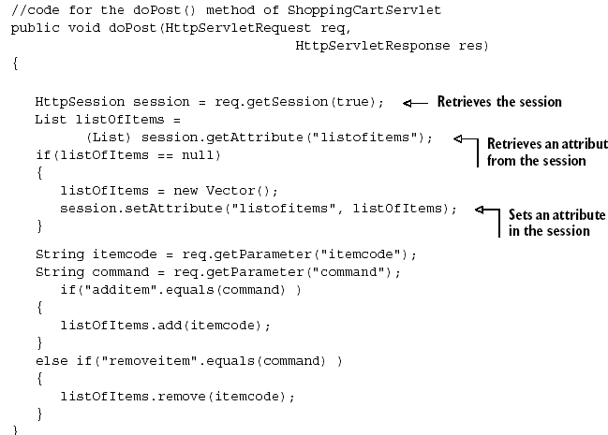
Session Management - example
TCS Internal

Slide 36
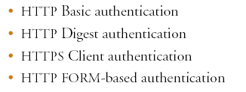
Servlet Security
TCS Internal
Notes:
‹#›
1. Basic Auth: Request for a resource on server, authentication check is performed, if not authenticated you get a 401 code back to browser and a browser pop up opens up prompting login info. Pop up window is non-customizable. Data is not encrypted in this mode. All browsers support this.
2. Digest Auth: similar to Basic but the password is sent encrypted. But only MS IE5 supports this. Many servlet containers don’t support this.
3. HTTPS: over SSL encrypted data using public-key cryptography. Safest but costly. Requires certificates.
4. Form based Auth: similar to Basic except that the login page is customizable html form instead of a browser window. Data is not encrypted. Should be used only when session is managed using cookies or HTTP session.

Slide 37
Servlet Security configuration
Web.xml
<web-app>
<login-config>
<auth-method>FORM/BASIC/DIGEST</auth-method>
<!– This info is specific to FORM based security →
<form-login-config>
<form-login-page>/login.jsp</form-login-page>
<form-error-page>/error.jsp</form-error-page>
</form-login-config>
</login-config>
</web-app>
TCS Internal
Notes:
‹#›
1. Basic Auth: Request for a resource on server, authentication check is performed, if not authenticated you get a 401 code back to browser and a browser pop up opens up prompting login info. Pop up window is non-customizable. Data is not encrypted in this mode. All browsers support this.
2. Digest Auth: similar to Basic but the password is sent encrypted. But only MS IE5 supports this. Many servlet containers don’t support this.
3. HTTPS: over SSL encrypted data using public-key cryptography. Safest but costly. Requires certificates.
4. Form based Auth: similar to Basic except that the login page is customizable html form instead of a browser window. Data is not encrypted. Should be used only when session is managed using cookies or HTTP session.

Slide 38
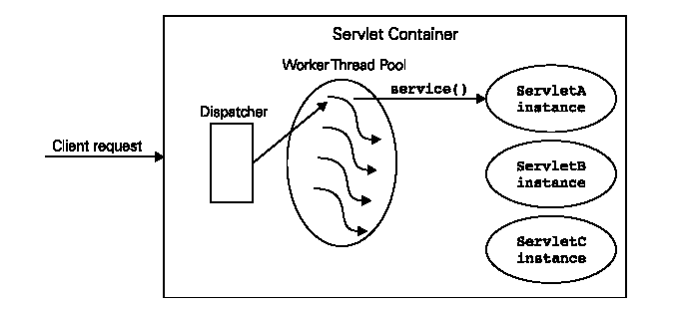
Thread Safe Servlets
TCS Internal
Notes:
‹#›
Needs explanation

Slide 39
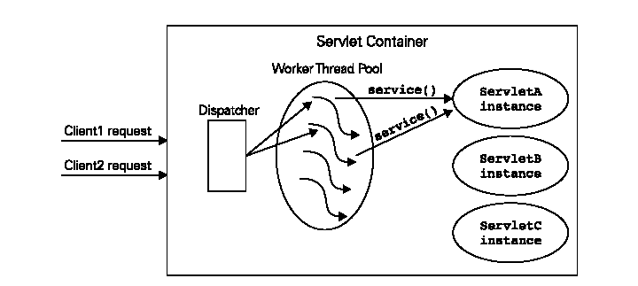
Concurrent Access
TCS Internal
Notes:
‹#›
Needs explanation

Slide 40
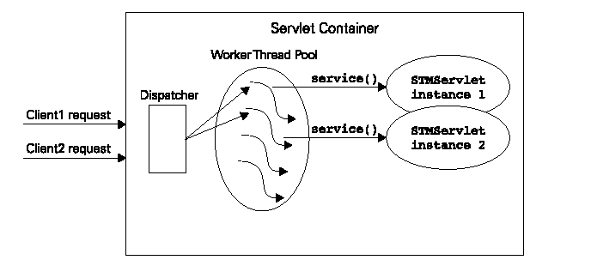
Single Threaded Model
TCS Internal
Notes:
‹#›
Needs explanation.

Slide 41
Sample Web-app structure
MyApp
source
Web Content
META-INF
WEB-INF
classes
config
tlds
TCS Internal
Notes:
‹#›
Needs explanation.

Slide 42
Reference
Stephanie Bodoff, et. al., The J2EE Tutorial, Sun Microsystems.
James Mc Govern, et. al., J2EE 1.4. Bible.
TCS Internal

Slide 43
Thank You
TCS Internal

