Slide 1
SQL Server 2012 Integration Services E3

Slide 2
Agenda
Need for a Data Warehouse
Architecting BI Solutions
SSIS - ETL Design Patterns
SQL 2012 Features
Partition Management
Package Management
Storage
Auditing & Logging
Security
Configuration
Performance Tuning
Troubleshooting
Using SSIS with PDW

Slide 3

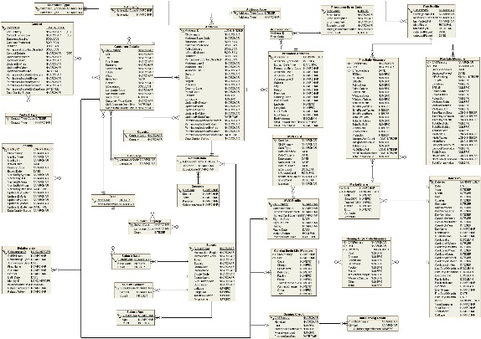

(A1 * B2)/100
A1 + B2
Notes:
Explain about Why Data Warehouse is required and what are the different problems in OLTP

Slide 4
Data Warehouse
Notes:
Talk about the Data Warehouse and how the OLTP problems are overcome here. Also mention about the Dimensional Modelling like Star Schema that is designed for DWH.

Slide 5
Why Data Warehouse
Problems with OLTP
Resource Contention
Data present in multiple sources in different formats
Historical Data Preservation
Users use own formulas
Users are not Technical for writing complex queries
Tools
Process used to load Data Warehouse – ETL (SSIS)
Dimensional Model – Star / Snow Flake Schema
Dimension and Fact Tables

Slide 6
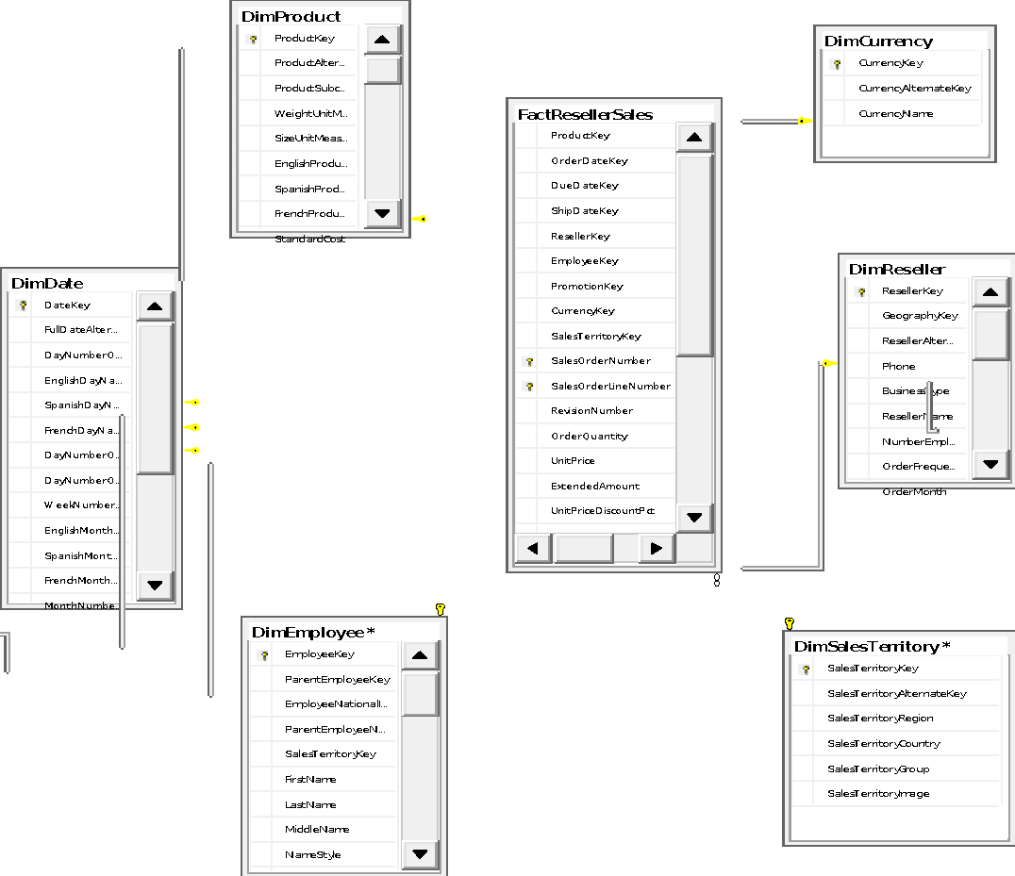
Dimension Modelling
Notes:
Describe about Fact Table and what does it contain and then Describe about the Dimension Tables and how it is related to the Fact Table

Slide 7
Characteristics – Fact and Dimension
Fact Table
Very Large Table with multiple records
Foreign Key to Dimension Tables
Fact Values called as Measures
Usually Additive and smaller values
Dimension Table
Smaller as compared to Fact Table
Primary keys are called as Surrogate Keys
Business or Natural Key
Columns for Grouping, Hierarchy, Sorting, Filtering

Slide 8
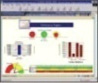










Enterprise BI Architecture
CDH
ETL
Source
Enterprise Data Warehouse
OLAP
BI Layer
Channel
Staging
Casinos
Data Marts
Hotels
Casino
Dashboards
CRM
Resort
Cubes
ETL
ETL
ETL
Consolidated and Validated Data
Internet & Intranet
Raw Data
Data Warehouse
CRM
Betting
Betting
Standard Reports
Future Systems
ERP
Survey Result
Adhoc Reports

Slide 9
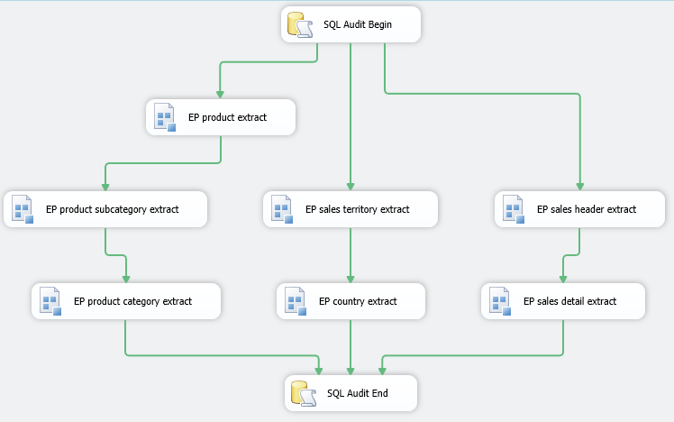
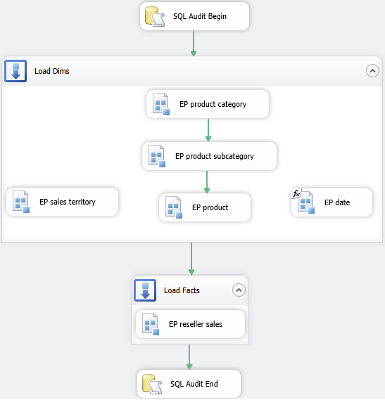
ETL Design Patterns
Master Extract Package
Master Transform Load Package
Notes:
Best Practice : Create a Snapshot of the Database before we load into the DWH for Error Recovery purpose.

Slide 10
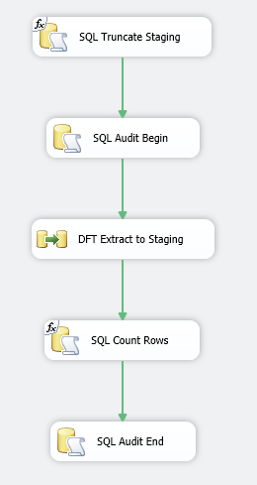
Extract Package
Truncate staging tables before extraction
Add a audit record to Audit table
Extract data from source and load to staging table
Count records extracted from source (staging)
Update the audit record

Slide 11
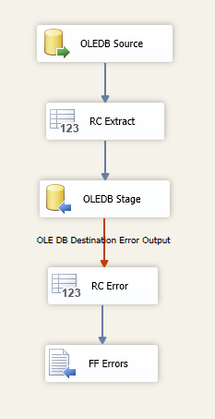
Extract Data Flow
Connect to the Source
Store the extracted row count in variable
Load extracted data into staging table
Store error row count in variable
Save error records

Slide 12
DEMO

Slide 13
Fact and Dimension – Load Patterns
Fact Table
Usually we do an Incremental Load of data from Source
Very Large Table with multiple records
Foreign Key to Dimension Tables
Fact Values called as Measures
Usually Additive and smaller values
Dimension Table
We do a Full Load of Dimension Table as the records are Smaller in nature
Existing Records can be updated/inserted based on Business Rules - SCD

Slide 14
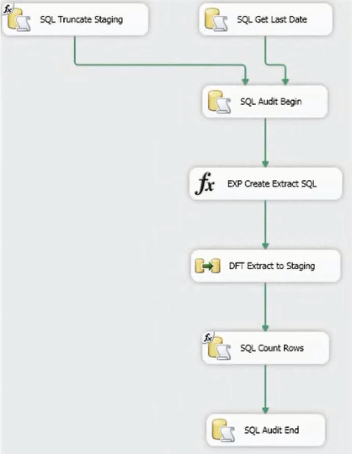
Extract and Load Fact Table
Lookup MaxDate in fact table and store in a Variable
Create a project parameter for initial load
Extract Incremental or Full Load based on Date

Slide 15
Slowly Changing Dimensions
Type 0
Load only new records.
Data does not change before and after load for existing records even though there is a change
Type 1
Data gets updated after loading
Type 2
Previous Record will be ended with a End Date.
New Record will be created after loading

Slide 16
DEMO
Notes:
Demo the Dimension Loading

Slide 17
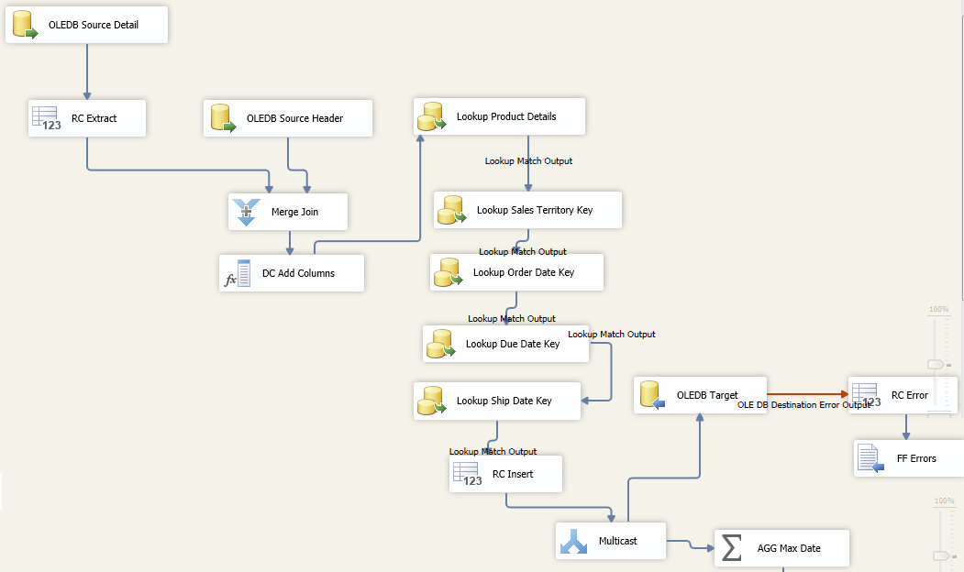
Load Pattern for Fact Table

Slide 18
DEMO
Notes:
Demo the Fact Loading Table (Reseller Sales Transform Load)

Slide 19
SQL Server 2012 Features

Slide 20





Upgrade Process - Step-by-Step
Visual Studio project/solution upgrade
Upgrade SSIS Packages with SSIS Package Upgrade Wizard
One wizard execution per project
Wizard upgrades all packages in project
Fix up connection strings in config files, data source files, expressions
If desired (to take advantage of new functionality)
Convert to project deployment model
Convert appropriate connections to project scope
Replace custom components with 2012 versions

Slide 21
Upgrade Results
Solution and projects convert
Packages upgraded
Format version 3 to version 6
Connection managers may require manual upgrade
Custom components convert if
devenv.exe.config contains assembly redirect
2012 component version is available
Take advantage of UI and usability improvements

Slide 22
Change Data Capture - How It Works
Enable it on the Source Database
Inserts, Updates, and Deletes are automatically tracked
Consume the changes

Slide 23


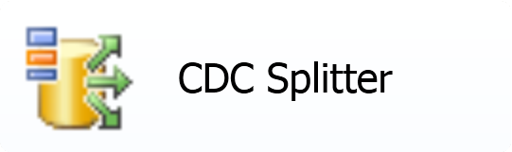
CDC Components for SSIS 2012
CDC Control Task
Retrieve and persist state
Use before and after your data flow
CDC Source
Reads change data from source table
CDC Splitter
Separate rows by operation type

Slide 24
Change Data Capture - Workflow
Initial Load
Incremental Load
Prepare database
Get last date
Read all from source
Read changes
Write to destination
Process changes
Record date
Save current date

Slide 25
CDC – Initial Load
Scenario 1: Active database
Mark Initial Load Start
Bulk load from source to destination
Mark Initial Load End
Scenario 2: Inactive database or using snapshot/flashback
Mark CDC start
Oracle – provide the System Change Number (SCN)
SQL – provide the Log Sequence Number (LSN) or snapshot name
CDC Control Task will use current value if none is provided
Bulk load data from source to destination

Slide 26
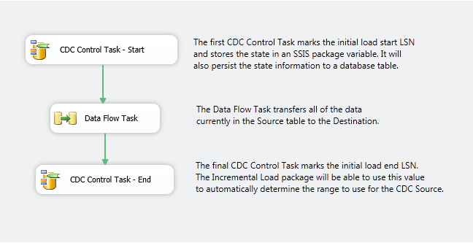
CDC – Initial Load
Notes:
When we run the package, all of the data currently in the Source table will be transferred to the Destination, and the initial CDC state markers will be created. If we select from the cdc_states table, we can see that there is now a “CDC_State” entry. Note, the state entry is an encoded string that is used by the CDC components – you should not have to edit or deal with it directly.

Slide 27
CDC – Incremental Load
Use CDC Control Task to get the processing range
Read from cdc_states table
Stored in package variable
Use CDC Source to read changes since last run
Process change rows
Use CDC Control Task to mark processing end

Slide 28
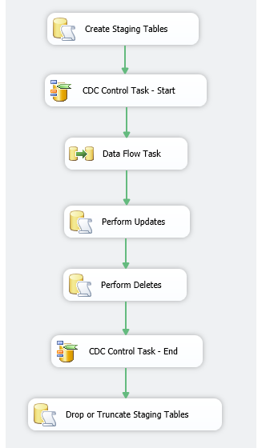
CDC – Incremental Load

Slide 29
CDC – Using the Reprocessing Indicator
Option in the CDC Source to include a reprocessing flag
Adds __$reprocessing column to data flow
Flag is set to True for rows that require special handling
Rows that overlap with initial load
Reprocessing a range after a failure

Slide 30
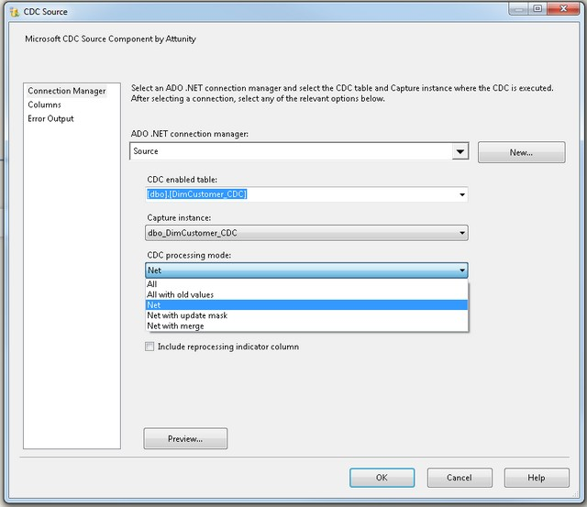
CDC – Processing Modes
All
All with Old Values
Net
Net with Update Mask
Net with Merge

Slide 31
CDC – Processing Modes All
Operation | Key | Name
Insert | 50 | Smith
Update | 50 | Smyth
Insert | 60 | Jones
Delete | 60 | Jones
Update | 10 | Williams
Delete | 20 | Martin

Slide 32
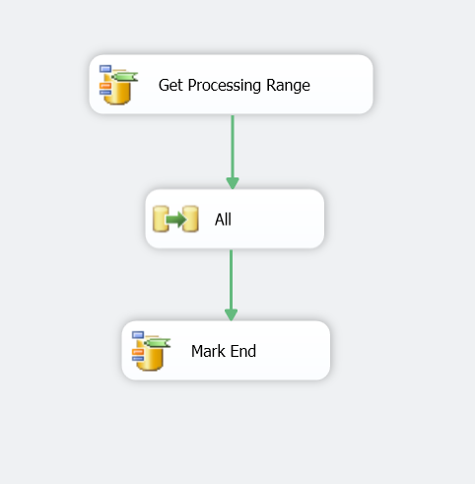
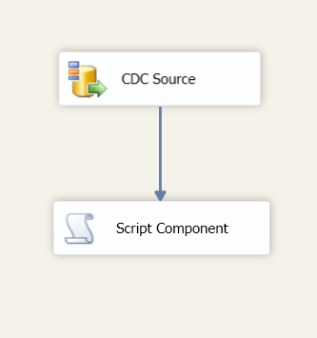
CDC – Processing Modes All
Control Flow
Data Flow

Slide 33
CDC – Processing Modes All with Old Values
Operation | __$update_mask | Key | Name
Insert | 0xFF | 50 | Smith
Update Old | 0x80 | 50 | Smith
Update | 0x80 | 50 | Smyth
Insert | 0xFF | 60 | Jones
Delete | 0xFF | 60 | Jones
Update Old | 0x80 | 10 | William
Update | 0x80 | 10 | Williams
Delete | 0xFF | 20 | Martin

Slide 34
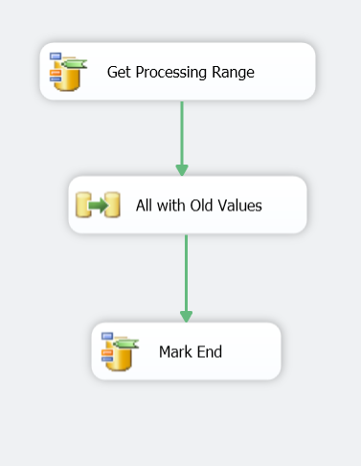
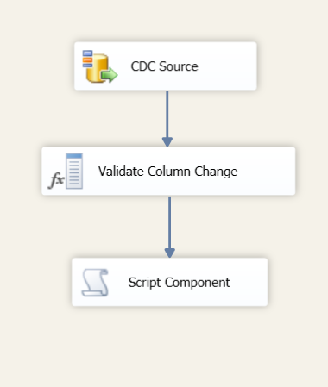
CDC – Processing Modes All with Old Values
Control Flow
Data Flow

Slide 35
CDC – Processing Mode Net
Operation | Key | Name
Insert | 50 | Smyth
Update | 10 | Williams
Delete | 20 | Martin

Slide 36
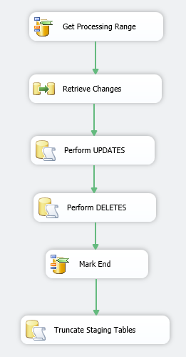
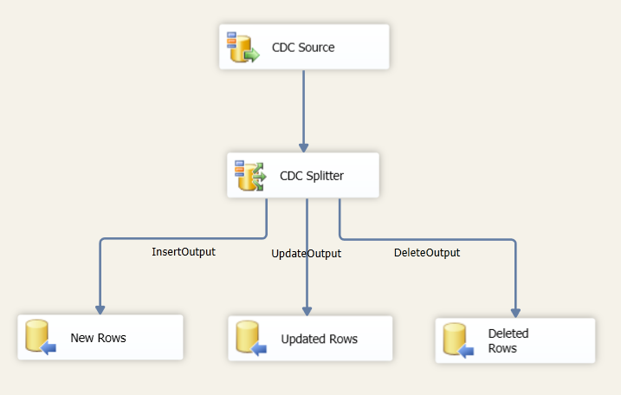
CDC – Processing Mode Net
Control Flow
Data Flow

Slide 37
CDC – Processing Mode Net with Update Mask
Operation | Key | __$Key_Changed | Name | __$Name_Changed
Insert | 50 | True | Smyth | True
Update | 10 | False | Williams | True
Delete | 20 | True | Martin | True

Slide 38
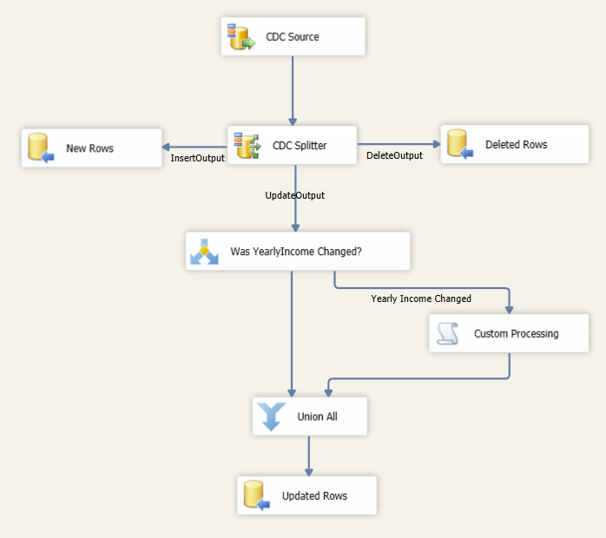
CDC – Processing Mode Net with Update Mask
Control Flow
Data Flow

Slide 39
CDC – Processing Mode Net with Merge
Operation | Key | Name
Update | 50 | Smyth
Update | 10 | Williams
Delete | 20 | Martin

Slide 40
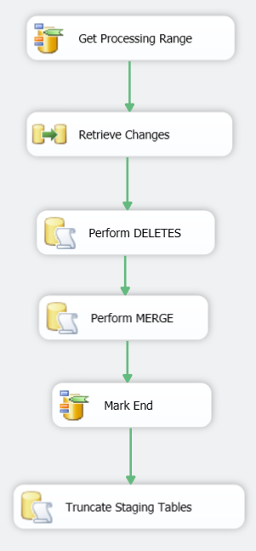
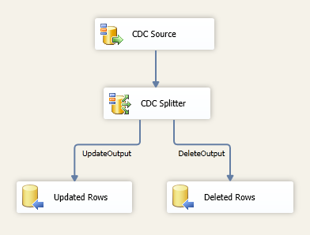
CDC – Processing Mode Net with Merge
Control Flow
Data Flow

Slide 41
Day 2

Slide 42
Agenda
Package Management
Storage
Auditing & Logging
Security
Configuration
Deployment
Performance Tuning
Troubleshooting
Best Practices
Partitioning
Column Store Index

Slide 43
New Pivot Transformation
The Pivot transformation makes a normalized data set into a less normalized but more compact version by pivoting the input data on a column value
E.g.
 | 2008 | 2009 | 2010
Mountain Tire | 5000 | 1000 | 4000
Road Tire Tube | 1200 | 1500 | 1700
Touring Tire | 200 | 3000 | NULL
Single row lists sales of the Product with Year shown as column names. Because not every product is sold every year , many columns may contain null values

Slide 44
Pivot Transformation – Sort and Duplicate Rows
To pivot data efficiently, the input data must be sorted on the pivot column
E.g. If a dataset is pivoted on a Name column but the names are not sorted, the output dataset could have more than one row for each customer, because a pivot occurs every time that the value in Name changes
The input data might contain duplicate rows, which will cause the Pivot transformation to fail
Duplicate rows means rows that have the same values in the set key columns and the pivot columns

Slide 45
Pivot Transformation – Options in dialog box
Configure the pivot operation by setting different options in the Pivot dialog box :
Pivot Key
Set Key
Pivot Value
Ignore un-matched Pivot Key values and report them after DataFlow execution
Generate pivot output columns from values
Generate Columns Now
Existing pivoted output columns

Slide 46
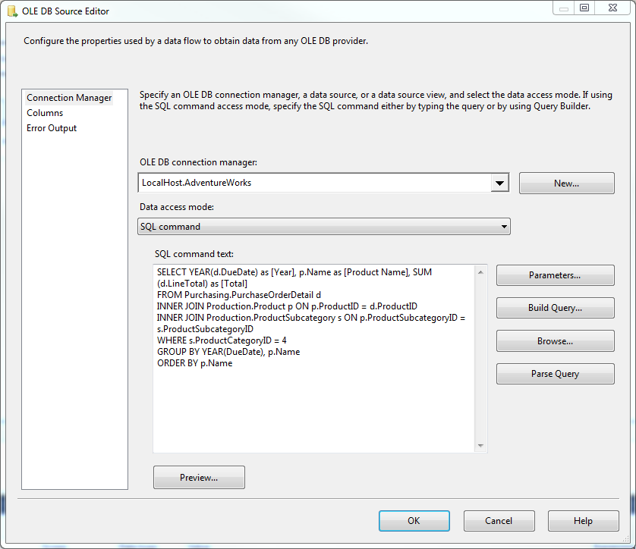
Pivot Transformation Contd…

Slide 47
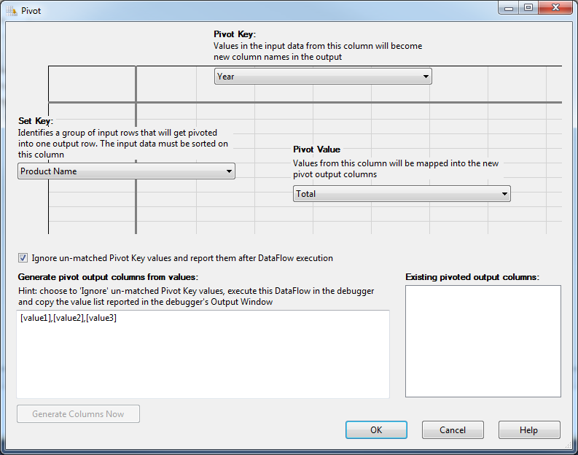

Pivot Transformation Contd..
Map the columns to the appropriate keys
Pivot Key –> Year
Set Key –> Product Name
Pivot Value –> Total

Slide 48
Pivot Transformation Contd…

Slide 49
DEMO
Notes:
Demo the Pivot Transformation Improvements in 2012

Slide 50
Reports for SSIS 2012
Standard reports are available in SQL Server Management Studio to monitor Integration Services projects deployed to the Integration Services server
Integration Services Dashboard report - Provides an overview of all the package executions on the SQL Server instance
Execution Information
Package Information
Connection Information
Package Detailed Information

Slide 51
Reports for SSIS 2012 Contd..
All Execution report - Displays a summary of all Integration Services executions that have been performed on the server
Can show executions that have started during a range of dates

Slide 52
Reports for SSIS 2012 Contd..
All Connections report - Provides the information for the connections that have failed, for executions that have occurred on the SQL Server instance
Shows the connection string, number of executions during which a connection failed, and the date when the connection last failed

Slide 53
Reports for SSIS 2012 Contd..
All Operations report - Provides the information for the connections that have failed, for executions that have occurred on the SQL Server instance
All Validations Report - Displays a summary of all Integration Services validations that have been performed on the server. Like status, start time, and end time
Custom Reports - Can add a custom report (.rdl file) to the SSISDB catalog node under the Integration Services Catalogs node in SQL Server Management Studio

Slide 54
DEMO
Notes:
Demo all the Reports that are available in SSIS 2012

Slide 55
Package Management - Deployment
Central store for
SSIS projects
Configuration settings
Logs
Access the SSISDB catalog in SQL Server Management Studio by connecting to the SQL Server Database Engine and then expanding the Integration Services Catalogs node in Object Explorer.
You access the SSISDB database in SQL Server Management Studio by expanding the Databases node in Object Explorer
You can Convert to Package Deployment Model
Manage the objects by calling stored procedures in the SSISDB database or by using the UI of the SSISDB catalog

Slide 56
Package Management - Projects
Earlier Version
Packages created under Project in Solution Explorer
Notion of project is gone once packages are deployed into Server. Common variables cannot be shared with these packages
Shared data sources, were not very useful, because they were only useful during development. Again, after deployment the concept was gone
SSIS 2012
Deploy entire Project into the SSIS Catalog
No more creation of Configurations
Project.params is available where you can define project parameters that will be available for every package in the project.
Shared Connection Manager deals with this problem, because connections now can remain persistent after deployment

Slide 57
Package Management - Parameters
SSIS Package Configuration is not there and it is now achieved using new feature called parameters
Parameters exist on 2 levels, project level and package level
Shared data sources, were not very useful, because they were only useful during development. Again, after deployment the concept was gone
project parameters are managed in de Project.params file
The Package parameters can be found in the Parameter tab in every package
New Fields
Sensitive determines whether you want the information to be encrypted or not.
Required on the other hand will indicate whether you want it to be obligated or not. If set to true, you must define a value for the package to run.

Slide 58
Package Management - Environments
You can create different physical environments to run your packages in different environments like Dev, Test and Production
It can also be used to set different filters for different business areas, so your environments may be something like Sales, Marketing, Finance
Under the Variables tab of your Environment Properties, we can define multiple variables and later on can link thee variables with the Project Parameters
Linking Environment Variables with Project Parameters makes the execution of your packages dynamic. This can be accomplished via the Configure button when right clicking on your project

Slide 59
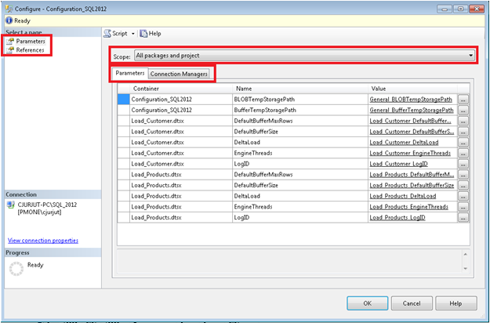
Package Management - Configuration

Slide 60
Package Management - Configuration
After a project has been deployed to the SSIS catalog, it is possible to configure it by right-clicking the project or one of the package entries and choosing “Configure…” from the context menu.
We can manages all parameters and connection managers on project and package scope.
For parameters the following information is provided:
container determines either the parameter is on project level or belongs to a package
name of the parameter and its current value
For connection managers the following information is provided:
connection string of the connection manager
initial catalog and the server name as single values
user name and password for authentication purposes
RetainSameConnection property

Slide 61
Package Management - Configuration
The value of above properties can be changed so that the changes can effect at both project and corresponding packages level
Under the reference section it is possible to assign environments to the project. These environments can be used to configure the values of the different properties.
The assignment of the environmental variables to parameters or connection manager properties can be done by choosing the Elipsis (…) button next to each of these values

Slide 62
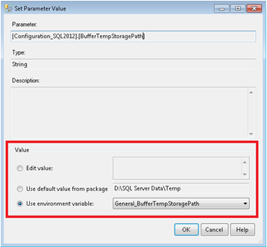
Package Management - Configuration

Slide 63
Package Management – Catalog Tables and SPs
Important SSISDB Catalog Tables
Environments
Environment_variables
Executables
Packages
Projects
Validations
We can use Integration Services stored procedures to add, remove, modify, or execute objects that are stored in the SSISDB catalog. Important SSISDB Catalog Stored Procedures are
deploy_project
move_project
create_environment
create_environment_variable
create_folder

Slide 64
SSIS - Package Performance
SSIS Data Flow moves data from source to destination by using the Buffer where data is stored in memory
Data flow engine requires buffer to store incoming data from source, do the necessary transformation in-memory if any, and upload it in the destination. The creation, allocation and management of buffer are done by SSIS Buffer Manager.
DefaultBufferSize – a DFT property which specifies maximum size for an individual buffer in bytes. By default its value is 10,485,760 bytes (10 MB). As this setting is configured consider that its upper bound is constrained by an internal SSIS parameter called MaxBufferSize which is set to 100 MB and cannot be changed.

Slide 65
SSIS - Package Performance
DefaultBufferMaxRows – a DFT property that specifies a maximum number of rows that can be held in an individual buffer. By default the value is set to 10,000, though this figure will be reduced if (based on row size estimates) the memory consumption would be greater than the DefaultBufferSize
MaxBufferSize – a SSIS internal parameter which cannot be changed, it dictates upper limit for the DefaultBufferSize property of DFT as discussed above. Its value is 100 MB.
MinBufferSize – a SSIS internal parameter which cannot be changed, it dictates lower limit for the DefaultBufferSize property of DFT as discussed above. Normally its value is 64 KB but it depends on operating system’s virtual memory allocation functionality so may differ from machine to machine

Slide 66
SSIS - Package Performance
SSIS Data Flow moves data from source to destination by using the Buffer where data is stored in memory
Non Blocking Transformations are Faster to process. Examples of Non Blocking Transformations are
Audit
Character Map
Copy Column
Conditional Split
Data Conversion
Derived Column
Multicast
RowCount

Slide 67
SSIS - Package Performance
Partially Blocking Transformations – Buffers will be waiting for Data to be loaded from another source as they are dependent upon the data from another source to load into the same Buffer. So all the subsequent tasks will be slow as they are waiting for these Transformations to be completed.
Merge
Merge Join
Data Mining
Term Lookup
Pivot
Union All
UnPivot

Slide 68
SSIS - Package Performance
Blocking Transformations – Buffers will be waiting until its all used up and operation is completed before passing the data to another task. These are the highest consumer of our server resources as they have to read every single record before generating the output.
Sort
Aggregate
Fuzzy Lookup
Fuzzy Grouping
Row Sampling
Term Extraction

Slide 69
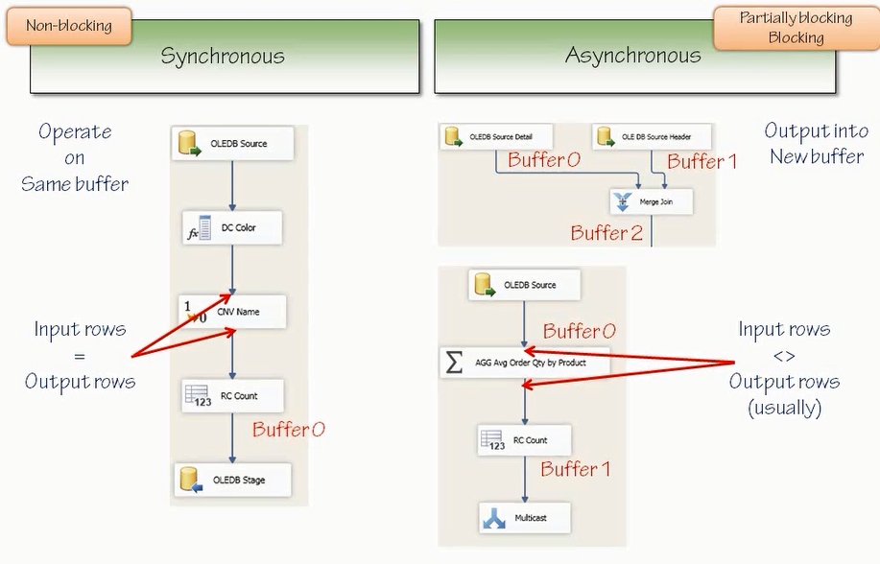
Synchronous vs Asynchronous Outputs

Slide 70
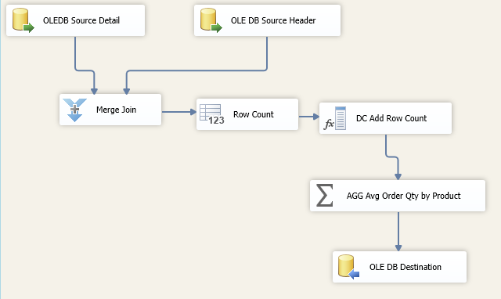
Execution Trees
Tree 3
Tree 2
Tree 1
Tree 0

Slide 71
DEMO
Notes:
Demo the Execution Trees and also the Buffer Pipeline along with the Buffer Size Tuning to see how the Tree is executing

Slide 72
SSIS – Best Practices

Slide 73
Data Flow Source– Best Practices
Retrieve only the columns you absolutely need • Write queries, don’t just use table objects • SELECT * queries are just as evil as anywhere else
Benefits • Less data from the source across the network • Less demand on memory and processor
Integration Services provides warnings about columns you don’t use • Don’t ignore those warnings just because package executes
Convert often degrade performance
Data types in source are often incompatible • Too easy to convert multiple times • Avoid converting more than once
Often read data from flat files as strings • Leave that way, unless performing calculations
If need to convert, do it…Once

Slide 74
Make use of Database– Best Practices
Tune queries
• Write efficient SQL code Goal: limit time to retrieve data Slow queries affect entire Data Flow Consider indexes too
Utilize Your Database Engine
• Do what you can in the database,
Use the SQL Command Option
• More efficient and less chatty with database • But tune the query!

Slide 75
Data Flow Transformations – Best Practices
Can be the worst performance offenders
Avoid asynchronous transformations
• Hold up the entire Data Flow • Perform the operation in database, if possible
Avoid Unnecessary Sorts
• Most inefficient operation in SSIS • Sort transformation is asynchronous • Sort in the database before inserting in Data
Can’t always avoid a Sort transformation
• Flat files Sort it once

Slide 76
Data Flow Transformations – Best Practices..Contd..
Enable Lookup Caching
Loads data set into memory
Reduces trips to database
But can eat up resources
Data Flow is blocked while cache is populated
Use Error Outputs
Redirect bad data to another data path
Bad rows fail some condition
Compare Different Designs
Test Data flow designed to see what works best

Slide 77
Tune for Bulk Loads– Best Practices
Can configure SQL Server and OLE DB destinations for bulk inserts Requires fewer round trips to databases Doesn’t log row operations
Considerations Indexes and Constrains
SQL Server recovery model

Slide 78
Data Flow Destination– Best Practices
Use Table Locks • Fastest writing to database tables • Available for OLE DB and SQL Server destination • Consider concurrency though
Use SQL Server Destinations • Fastest for SQL Server databases • Package must be executing on same server
Configure Batch and Commit Sizes • Number of rows in each batch and when commits • Default: single batch, commit after it • Maximum insert commit size • Rows per batch
Avoid per-Row Configurations

Slide 79
SSIS Engine– Best Practices
Packages perform many tasks, process massive data
• Adequate memory and CPU resources criteria, use 64 bit OS implementation
Spools to disk when low on memory
• Similar to windows paging • BufferTempStoragePath property
Default is to use Windows TEMP directory Change to use fast disk May cause deployment challenges
Control threads

Slide 80
Deployment and Management – Best Practices
Use the project deployment model

Slide 81
Security – Best Practices
Use the PackageProtection property
• DoNotSaveSensitiveData value is most secure
Use SQL Server roles when storing in MSDB
Use Windows NTfS security to secure file system files

Slide 82
Management – Best Practices
Keep you packages running well
• Monitor package performance regularly
Performance Monitor SQLServer:SSIsPipeIine object SQLServer:SSlSservice object
• Similar to what you see in Running Packages in Management Studio
• Monitor spooling with Buffers Spooled counter

Slide 83
Backup – Best Practices
Back up packages and files regularly
• SQL Server storage Back up SSIS Catalog Database for packages windows backup for support flies /
• File system Backup everything with windows backup
• Use SQL profiler to monitor and tune packages

Slide 84
Partitioning with example
Partitioned Table
Partition Scheme
Partition Column
Partition Function
Partition 1
Partition 2
Partition n
File Group 1
File Group 2
File Group n

Slide 85
Partition Function
CREATE TABLE USING Partition Scheme
CREATE PARTITION FUNCTION PfInternetSalesYear (TINYINT)
AS RANGE LEFT FOR VALUES (1, 2, 3, 4, 5, 6, 7, 8, 9);
GO
CREATE TABLE dbo.InternetSales
(
InternetSalesKey INT NOT NULL IDENTITY(1,1),
PcInternetSalesYear TINYINT NOT NULL,
CustomerDwKey INT NOT NULL,
ProductKey INT NOT NULL,
DateKey INT NOT NULL,
OrderQuantity SMALLINT NOT NULL DEFAULT 0,
SalesAmount MONEY NOT NULL DEFAULT 0,
UnitPrice MONEY NOT NULL DEFAULT 0,
DiscountAmount FLOAT NOT NULL DEFAULT 0,
CONSTRAINT PK_InternetSales
PRIMARY KEY (InternetSalesKey, PcInternetSalesYear)
)
ON PsInternetSalesYear(PcInternetSalesYear);
Partition Scheme
CREATE PARTITION SCHEME PsInternetSalesYear
AS PARTITION PfInternetSalesYear
ALL TO ([PRIMARY]);
INSERT DATA
INSERT INTO dbo.InternetSales
(PcInternetSalesYear, CustomerDwKey,
ProductKey, DateKey,
OrderQuantity, SalesAmount,
UnitPrice, DiscountAmount)
SELECT
CAST(SUBSTRING(CAST(FIS.OrderDateKey AS CHAR(8)), 3, 2)
AS TINYINT)
AS PcInternetSalesYear,
C.CustomerDwKey,
FIS.ProductKey, FIS.OrderDateKey,
FIS.OrderQuantity, FIS.SalesAmount,
FIS.UnitPrice, FIS.DiscountAmount
FROM AdventureWorksDW2012.dbo.FactInternetSales AS FIS
INNER JOIN dbo.Customers AS C
ON FIS.CustomerKey = C.CustomerKey
WHERE
CAST(SUBSTRING(CAST(FIS.OrderDateKey AS CHAR(8)), 3, 2) AS TINYINT) < 8;
CHECK PARTITIONS
SELECT
$PARTITION.PfInternetSalesYear(PcInternetSalesYear)
AS PartitionNumber,
COUNT(*) AS NumberOfRows
FROM dbo.InternetSales
GROUP BY
$PARTITION.PfInternetSalesYear(PcInternetSalesYear);

Slide 86
Partition Switching
Archive
(empty)
Partition 1
(data)
Partition 2
(data)
Partition 3
(empty)
Partition 4
(empty)
Staging
(data)
Load
Archive
(empty)
Partition 1
(data)
Partition 2
(data)
Partition 3
(data)
Partition 4
(empty)
Staging
(empty)
Switch

Slide 87
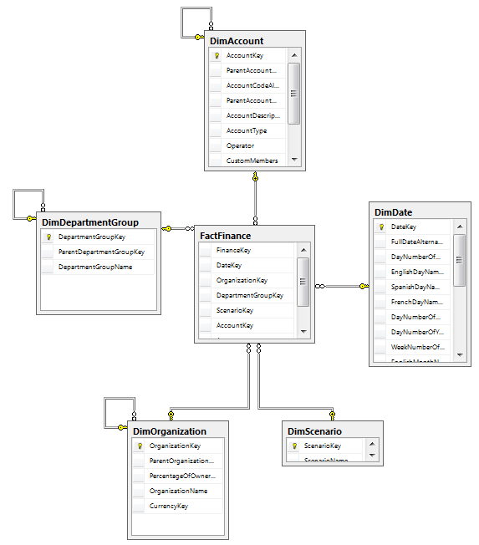
Columnstore Index – Improved Query performance
Columnstore indexes provide an easy way to significantly improve data warehouse and decision support query performance against very large data sets
Performance improvements for “typical” data warehouse queries from 10x to 100x
Ideal candidates include queries against star schemas that use filtering, aggregations and grouping against very large fact tables

Slide 88
What Happens When…
You need to execute high performance DW queries against very large data sets?
In SQL Server 2008 and SQL Server 2008 R2
OLAP (SSAS) MDX solution
ROLAP and T-SQL + intermediate summary tables, indexed views and aggregate tables
Inherently inflexible
In SQL Server 2012
You can create a columnstore index on a very large fact table referencing all columns with supporting data types
Utilizing T-SQL and core Database Engine functionality
Minimal query refactoring or intervention
Upon creating the columnstore index, your table becomes “read only” – but you can still use partitioning to switch in and out data OR drop/rebuild indexes periodically

Slide 89
How Are These Performance Gains Achieved?
Two complimentary technologies:
Storage
Data is stored in a compressed columnar data format (stored by column) instead of row store format (stored by row).
Columnar storage allows for less data to be accessed when only a sub-set of columns are referenced
Data density/selectivity determines how compression friendly a column is – example “State” / “City” / “Gender”
Translates to improved buffer pool memory usage
New “batch mode” execution
Data can then be processed in batches (1,000 row blocks) versus row-by-row
Depending on filtering and other factors, a query may also benefit by “segment elimination” - bypassing million row chunks (segments) of data, further reducing I/O

Slide 90
Column vs. Row Store
Row Store (Heap / B-Tree)
Column Store (values compressed)
ProductID
310
311
312
313
314
315
316
317
318
319
320
321
ProductID | OrderDate | Cost
310 | 20010701 | 2171.29
311 | 20010701 | 1912.15
312 | 20010702 | 2171.29
313 | 20010702 | 413.14
OrderDate
20010701
…
20010702
…
…
20010703
…
…
…
…
20010704
…
Cost
2171.29
1912.15
2171.29
413.14
333.42
1295.00
4233.14
641.22
24.95
64.32
1111.25
data page
1000
data page
2000
data page
2001
data page
2002
ProductID | OrderDate | Cost
314 | 20010701 | 333.42
315 | 20010701 | 1295.00
316 | 20010702 | 4233.14
317 | 20010702 | 641.22
data page
1001

Slide 91
Batch Mode
Allows processing of 1,000 row blocks as an alternative to single row-by-row operations
Enables additional algorithms that can reduce CPU overhead significantly
Batch mode “segment” is a partition broken into million row chunks with associated statistics used for Storage Engine filtering
Batch mode can work to further improve query performance of a columnstore index, but this mode isn’t always chosen:
Some operations aren’t enabled for batch mode:
E.g. outer joins to columnstore index table / joining strings / NOT IN / IN / EXISTS / scalar aggregates
Row mode might be used if there is SQL Server memory pressure or parallelism is unavailable
Confirm batch vs. row mode by looking at the graphical execution plan

Slide 92
Columnstore format + batch mode Variations
Performance gains can come from a combination of:
Columnstore indexing alone + traditional row mode in QP
Columnstore indexing + batch mode in QP
Columnstore indexing + hybrid of batch and traditional row mode in QP

Slide 93
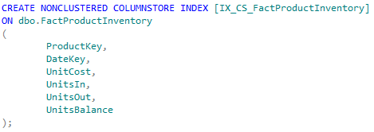
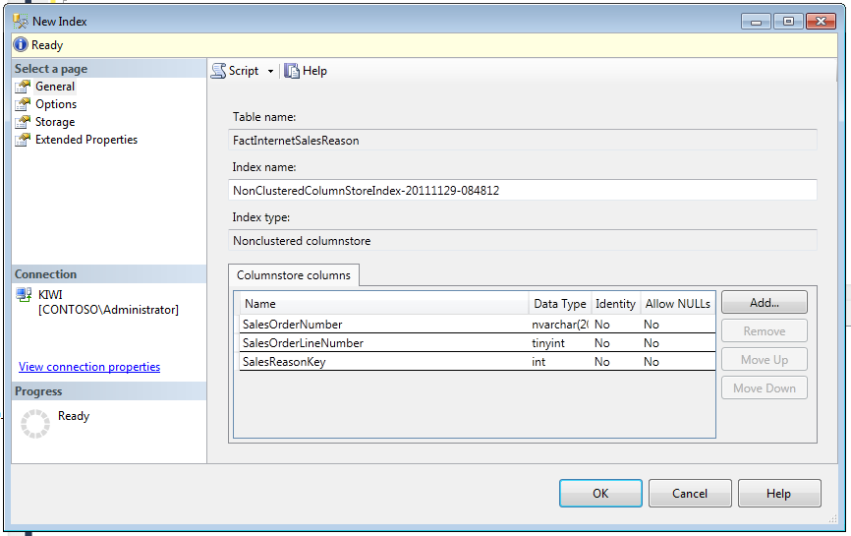
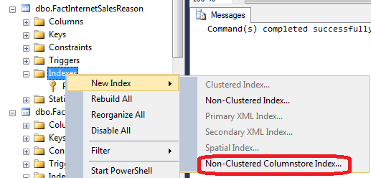
Creating a columnstore index
T-SQL
SSMS

Slide 94
Good Candidates for Columnstore Indexing
Table candidates:
Very large fact tables (for example – billions of rows)
Larger dimension tables (millions of rows) with compression friendly column data
If unsure, it is easy to create a columnstore index and test the impact on your query workload
Query candidates (against table with a columnstore index):
Scan versus seek (columnstore indexes don’t support seek operations)
Aggregated results far smaller than table size
Joins to smaller dimension tables
Filtering on fact / dimension tables – star schema pattern
Sub-set of columns (being selective in columns versus returning ALL columns)
Single-column joins between columnstore indexed table and other tables

Slide 95
Defining the Columnstore Index
Index type
Columnstore indexes are always non-clustered and non-unique
They cannot be created on views, indexed views, sparse columns
They cannot act as primary or foreign key constraints
Column selection
Unlike other index types, there are no “key columns”
Instead you choose the columns that you anticipate will be used in your queries
Up to 1,024 columns – and the ordering in your CREATE INDEX doesn’t matter
No concept of “INCLUDE”
No 900 byte index key size limit
Column ordering
Use of ASC or DESC sorting not allowed – as ordering is defined via columnstore compression algorithms

Slide 96
Supported Data Types
Supported data types
Char / nchar / varchar / nvarchar
(max) types, legacy LOB types and FILESTREAM are not supported
Decimal/numeric
Precision greater than 18 digits NOT supported
Tinyint, smallint, int, bigint
Float/real
Bit
Money, smallmoney
Date and time data types
Datetimeoffset with scale > 2 NOT supported

Slide 97
Maintaining Data in a Columnstore Index
Once built, the table becomes “read-only” and INSERT/UPDATE/DELETE/MERGE is no longer allowed
ALTER INDEX REBUILD / REORGANIZE not allowed
Other options are still supported:
Partition switches (IN and OUT)
Drop columnstore index / make modifications / add columnstore index
UNION ALL (but be sure to validate performance)

Slide 98
Limitations
Columnstore indexes cannot be used in conjunction with
Change Data Capture and Change Tracking
Filestream columns (supported columns from same table are supported)
Page, row and vardecimal storage compression
Replication
Sparse columns
Data type limitations
Binary / varbinary / ntext / text / image / varchar (max) / nvarchar (max) / uniqueidentifier / rowversion / sql_variant / decimal or numeric with precesion > 18 digits / CLR types / hierarchyid / xml / datetimeoffset with scale > 2
You can prevent a query from using the columnstore index using the IGNORE_NONCLUSTERED_COLUMNSTORE_INDEX query hint

Slide 99
Columnstore index - Summary
SQL Server 2012 offers significantly faster query performance for data warehouse and decision support scenarios
10x to 100x performance improvement depending on the schema and query
I/O reduction and memory savings through columnstore compressed storage
CPU reduction with batch versus row processing, further I/O reduction if segmentation elimination occurs
Easy to deploy and requires less management than some legacy ROLAP or OLAP methods
No need to create intermediate tables, aggregates, pre-processing and cubes
Interoperability with partitioning
For the best interactive end-user BI experience, consider Analysis Services, PowerPivot and Power View

Slide 100
Online Resources for common features of 2008 and 2012
Design Patterns
http://channel9.msdn.com/Events/TechEd/NorthAmerica/2010/BIE13-INT
Bringing Together SSIS, DQS, and MDS
http://channel9.msdn.com/Events/TechEd/NewZealand/TechEd-New-Zealand-2012/DBI301

Slide 101
Thank You

