Slide 1
LIFE EXPECTANCY (WHO)
Sai Manoj Chatrathi, Lokeshwar Reddy Gowkanapalli, Trivikram Gummaraj Shivakumar Sridevi, Anjani Sowmya Bollapragada

Slide 2
CONTENTS
Public Health Question
Literature Review Highlights
Data Description
Variable Description
Dataset Issues and Handling
Exploratory Data Analysis
Regression Models
Data Analysis
Shiny Application
Conclusion
Future Enhancements
References

Slide 3
PUBLIC HEALTH QUESTION
What are the key factors influencing life expectancy globally, and how do these factors differ between developed and developing countries over time?
Importance
Life expectancy is a crucial measure of a population’s overall health and well-being.
Understanding the various factors that contribute to life expectancy is vital for developing targeted public health policies and interventions.
This study is important as it identifies actionable areas for improving life expectancy, especially in developing nations, where healthcare resources may be limited and disparities are high.
Data Source: The dataset is obtained from Kaggle, sourced from the World Health Organization (WHO) and the United Nations (UN).

Slide 4
LITERATURE REVIEW HIGHLIGHTS
Previous Research: Studies have examined economic (income, GDP) & demographic factors (healthcare spending) impacting life expectancy
Identified Gaps: Limited focus on the impact of immunization coverage and predominance of cross-sectional studies; mixed-effects models for longitudinal analysis are rare.
Recent Advances: Notable healthcare improvements in developing countries over the past 15 years, influencing life expectancy trends.
Relevance of This Study: Integrates immunization and health-related factors and utilizes mixed-effects models for robust, longitudinal analysis of global data.

Slide 5
DATA DESCRIPTION
Variable | Description | Data Type
Country | Name of the country | String
Year | Year of the record | Integer
Status | Developed or Developing status of the Country | String
Life.expectancy | Life Expectancy in age | Float

Slide 6
DATA DESCRIPTION
Variable | Description | Data Type
Adult.Mortality | Adult mortality rates (probability of dying between 15 and 60 years per 1000 population) | Float
infant.deaths | Number of infant deaths per 1000 population | Integer
Alcohol | Alcohol consumption per capita | Float
percentage.expenditure | Expenditure on health as a percentage of GDP per capita | Float

Slide 7
DATA DESCRIPTION
Variable | Description | Data Type
Hepatitis.B | Hepatitis B immunization coverage among 1-year-olds (%) | Float
Measles | Number of reported cases per 1000 population | Integer
BMI | Average Body Mass Index of the entire population | Float
under.five.deaths | Number of under-five deaths per 1000 population | Integer

Slide 8
DATA DESCRIPTION
Variable | Description | Data Type
Polio | Polio immunization coverage among 1-year-olds (%) | Float
Total.expenditure | General government expenditure on health as a percentage of total government expenditure (%) | Float
Diphtheria | DTP3 immunization coverage among 1-year-olds (%) | Float
HIV/AIDS | Deaths per 1000 live births due to HIV/AIDS (0-4 years) | Integer

Slide 9
DATA DESCRIPTION
Variable | Description | Data Type
GDP | Gross Domestic Product per capita (USD) | Float
Population | Population of the Country | Integer
thinness..1.19.years | Prevalence of thinness among children and adolescents (ages 10-19) (%) | Float
thinness..5.9.years | Prevalence of thinness among children (ages 5-9) (%) | Float

Slide 10
DATA DESCRIPTION
Variable | Description | Data Type
Income.composition.of.resources | Human Development Index in terms of income composition of resources (0 to 1 index) | Float
Schooling | Number of years of schooling | Integer

Slide 11
VARIABLE DESCRIPTION
Primary Response Variable:
Predictor Variables:
Life Expectancy | The average number of years a person is expected to live, based on age-specific mortality rates
Economic Factors | Health Factors | Social Factors
Status, Income composition of resources, Total Expenditure, GDP | Adult Mortality, Infant Deaths, Alcohol Consumption, Measles Cases, BMI, Under Five Deaths, Polio Coverage, Diphtheria Coverage, HIV Prevalence, Thinness Factors | Schooling

Slide 12
VARIABLE DESCRIPTION
Rationale :
Economic variables | Health-related variables | Social Factors
Economic variables are critical as they reflect a country’s financial capability to invest in healthcare. | Health-related variables, including immunization and mortality rates, directly affect population health. | Social factors like schooling impact health literacy and access to care, influencing life expectancy.

Slide 13
VARIABLE DESCRIPTION
Confounding Variables and Their Impact :
Confounding Variables | Factors like population size, political stability, and healthcare infrastructure could confound the relationships between predictors and life expectancy.
Handling Confounders | The analysis accounted for potential confounders by employing mixed-effects models, which allow for random effects to capture unobserved variability among countries.

Slide 14
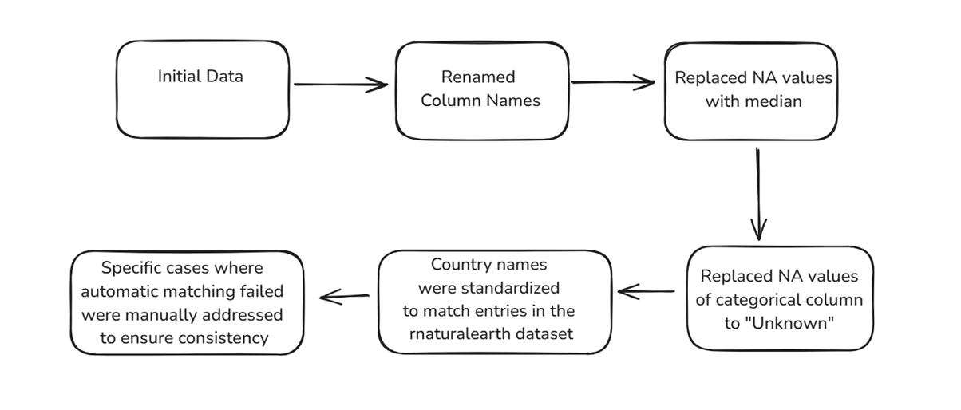
DATASET ISSUES AND HANDLING:

Slide 15
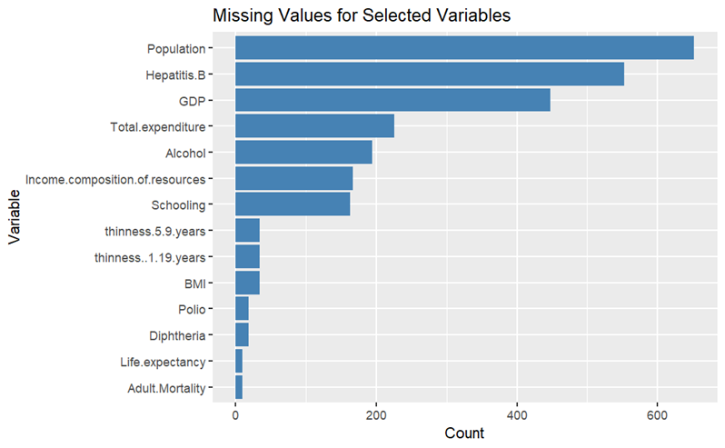



DATASET ISSUES AND HANDLING:

Slide 16
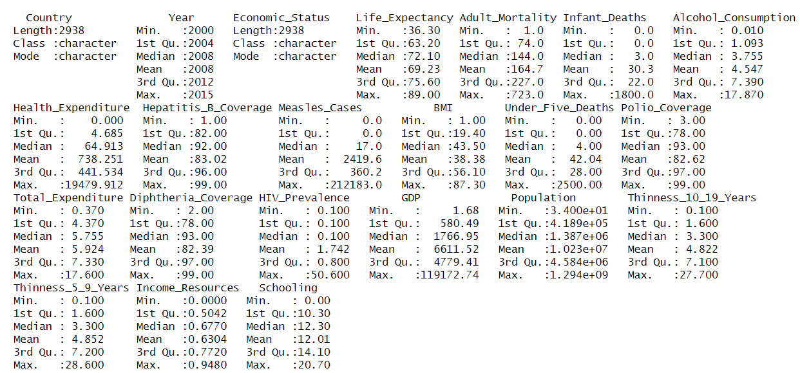
EXPLORATORY DATA ANALYSIS (EDA)
Conducted a summary of the data, including checking data types, identifying missing values, and ensuring consistency in variable formats

Slide 17
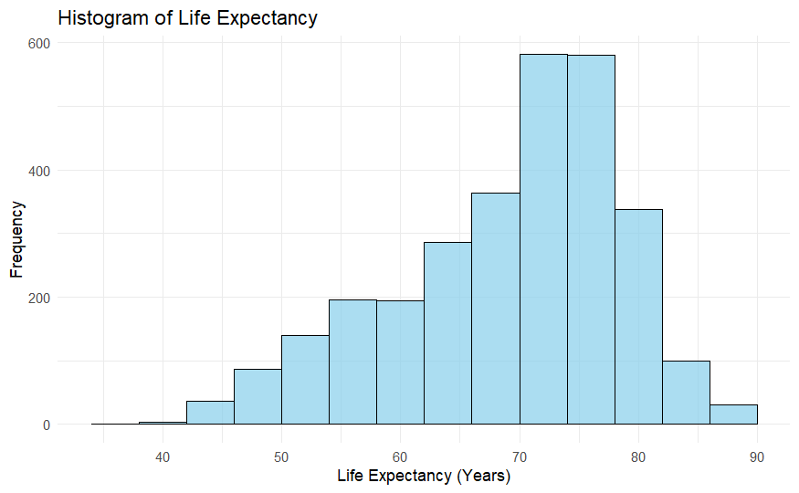
EXPLORATORY DATA ANALYSIS (EDA)

Slide 18
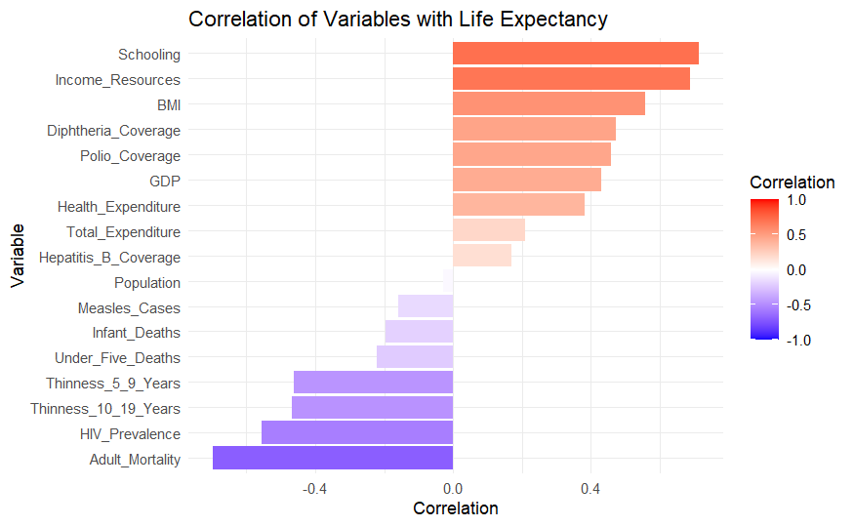
EXPLORATORY DATA ANALYSIS (EDA)

Slide 19
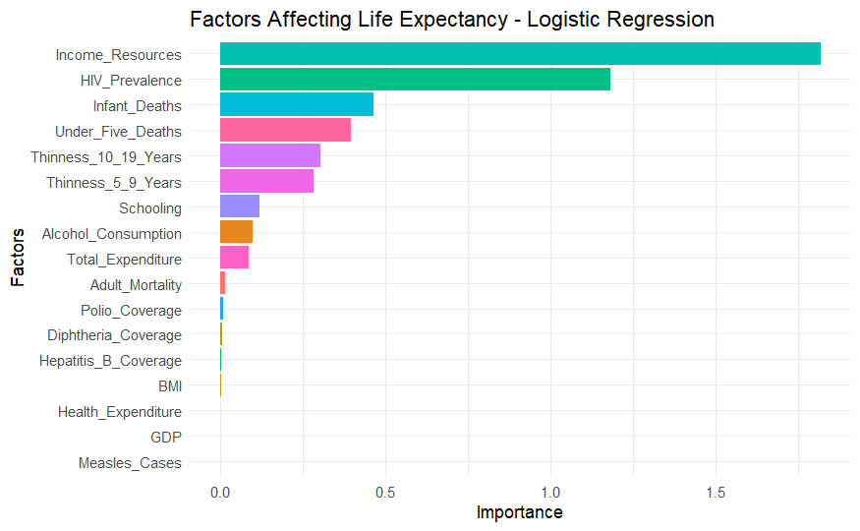
LOGISTIC REGRESSION

Slide 20
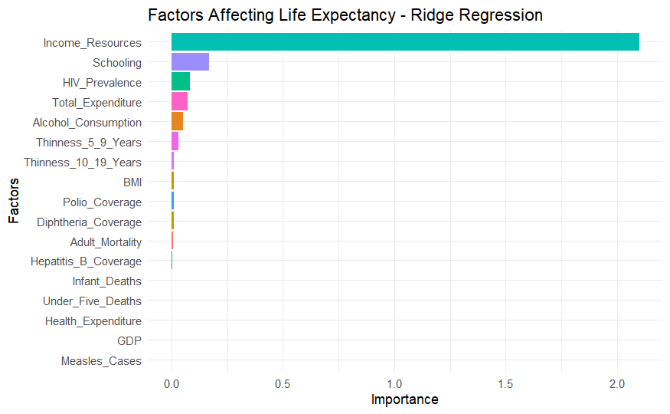
RIDGE REGRESSION

Slide 21
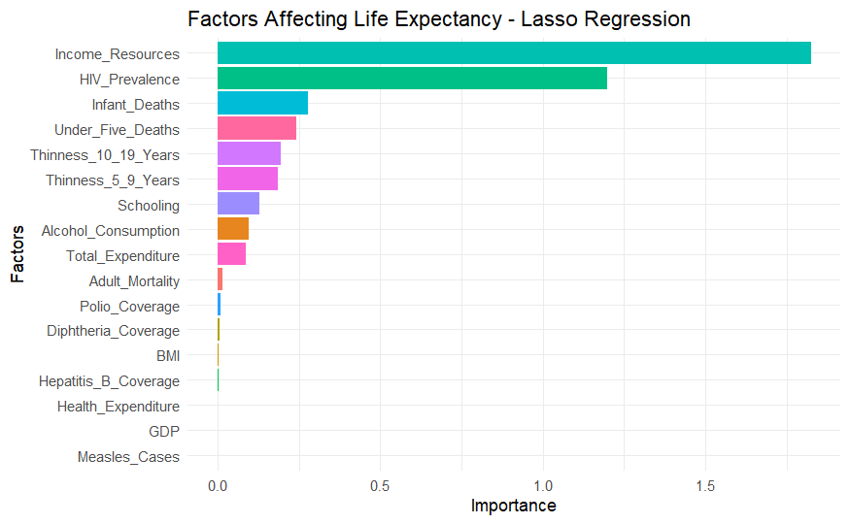
LASSO REGRESSION

Slide 22
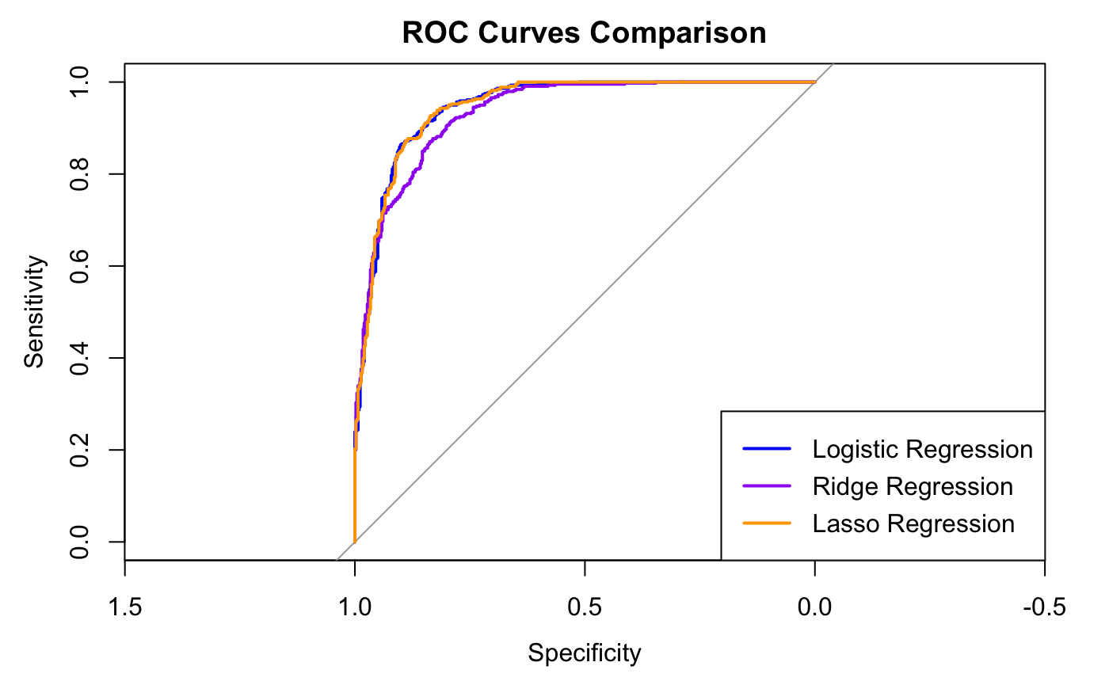
ROC CURVE COMPARISON

Slide 23
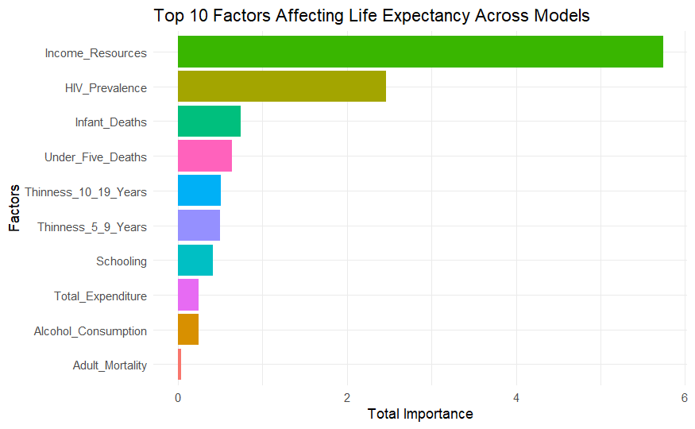
FACTORS AFFECTING LIFE EXPECTANCY

Slide 24
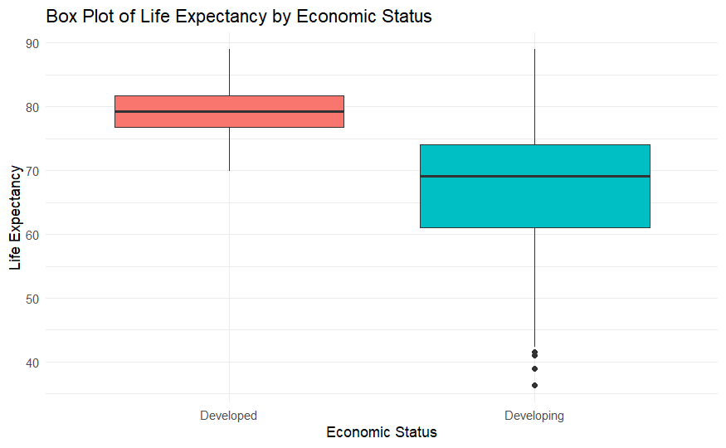
LIFE EXPECTANCY VS ECONOMIC STATUS

Slide 25
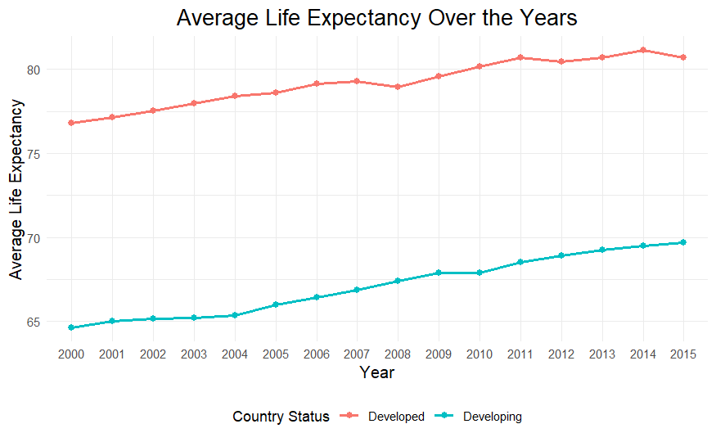
LIFE EXPECTANCY OVER TIME

Slide 26
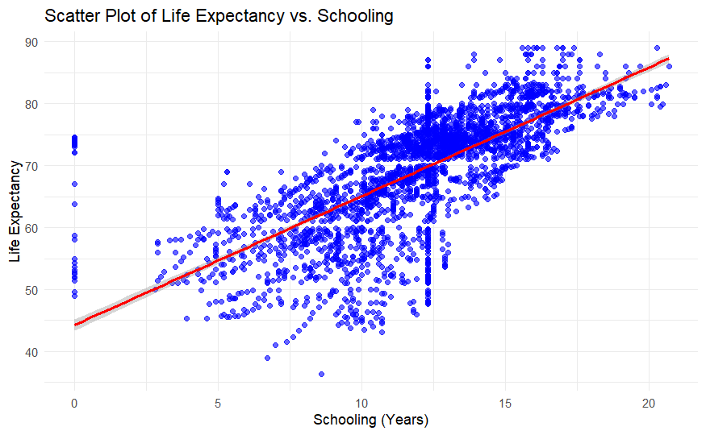
LIFE EXPECTANCY VS SCHOOLING

Slide 27
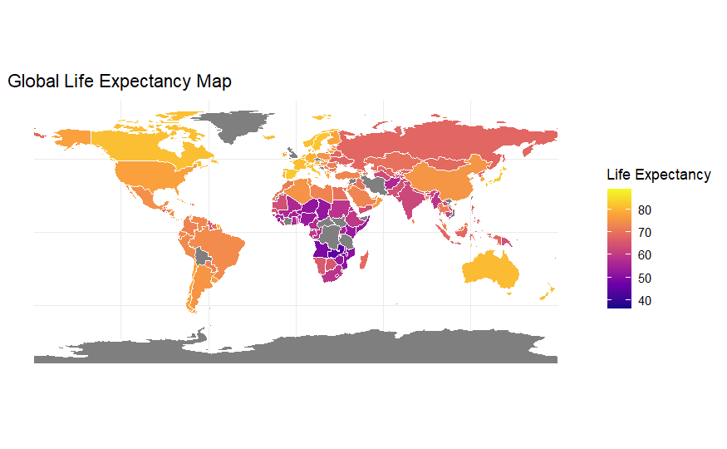
GEOSPATIAL VISUALIZATION

Slide 28
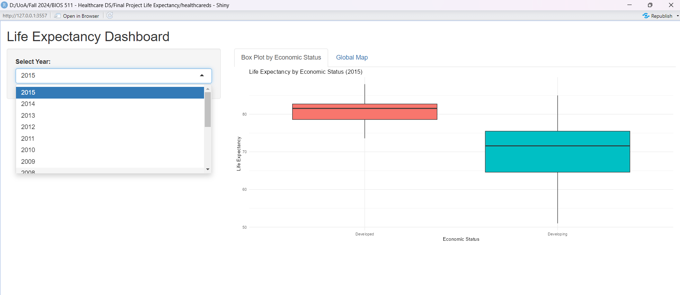
R SHINY APPLICATION

Slide 29
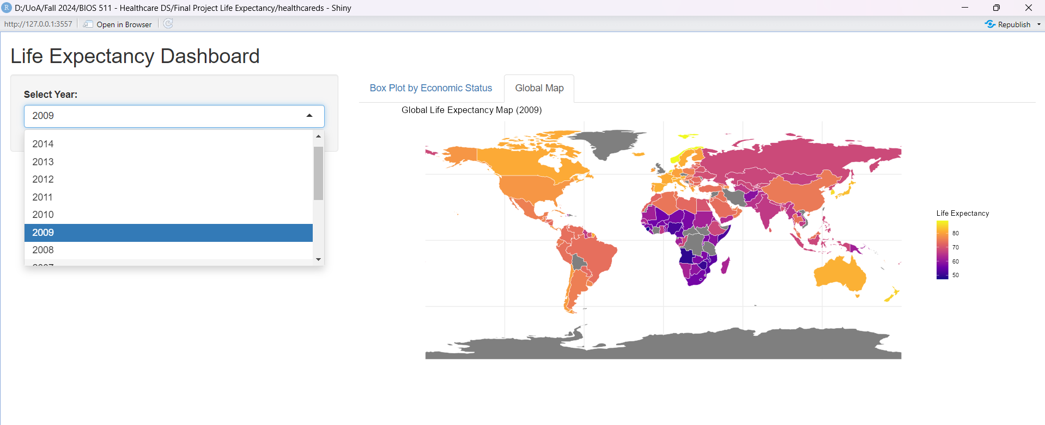
R SHINY APPLICATION

Slide 30
CONCLUSION
Key Determinants of Life Expectancy:
Income Composition of Resources, HIV Prevalence and Infant Deaths
Model Accuracy:
Logistic and Lasso Regression have performed better than Ridge Regression.
Disparities Between Countries:
Life Expectancy is better in Developed Countries than in Developing Countries.
Temporal Trends:
Average Life Expectancy is increasing over the years.
Role of Education:
Schooling shows a significant improvement in LIfe Expectancy.

Slide 31
FUTURE ENHANCEMENTS
Leverage machine learning algorithms, such as Gradient Boosting or Neural Networks, to improve life expectancy predictions.
Explore region-specific trends to identify areas with significant improvements or declines.
Add variables such as income inequality (Gini index) and employment rates to assess their impact on life expectancy.
Create a "What-If" scenario analysis to evaluate the potential outcomes of policy changes, such as increased vaccination rates or reduced infant mortality.
Explore disparities in life expectancy between urban and rural areas or among different socio-economic groups within countries.

Slide 32
REFERENCES
https://www.kaggle.com/datasets/kumarajarshi/life-expectancy-who
https://en.wikipedia.org/wiki/Life_expectancy
https://www.who.int/data/gho/data/themes/mortality-and-global-health-estimates/ghe-life-expectancy-and-healthy-life-expectancy
https://medium.com/@shaileydash/understanding-the-roc-and-auc-intuitively-31ca96445c02
https://cran.r-project.org/web/packages/rnaturalearth/vignettes/rnaturalearth.html
https://shiny.posit.co/r/getstarted/shiny-basics/lesson1/

Slide 33
THANK YOU!

