Slide 1
Collaborative Filtering in Python
Massimo Quadrana
6th October 2016

Slide 2
Recpy
Recsys framework for this course
We will develop it together!
Clone the repository at this page, then follow the Install in README.md
https://github.com/mquad/recsys-course-2016-pub
Hint☺: git clone https://github.com/mquad/recsys-course-2016-pub

Slide 3
Recpy – from README.md
INSTALL
Install Miniconda for Python3.5 link
Create the virtual environment: conda create -n recsys-env --file recpy/requirements.txt
Activate the virtual environment: source activate recsys-env
Install recpy: cd recpy; sh install.sh; cd ..
Run one example: sh run_example.sh
NOTE: to deactivate the virtual environment run: source deactivate recsys-env

Slide 4
Recpy – from README.md
PACKAGES
recpy: main package
recpy/recommenders: recommendation algorithms
recpy/utils: dataset management and split utils
recpy/cython: Cython code

Slide 5
Recpy – from README.md
PACKAGES
recpy: main package
recpy/recommenders: recommendation algorithms
recpy/utils: dataset management and split utils
recpy/cython: Cython code

Slide 6
Recpy – from README.md
recpy/recommenders
base.py: abstract recommender
non_personalized.py: TopPop and GlobalEffects
item_knn.py: Item2Item CF

Slide 7
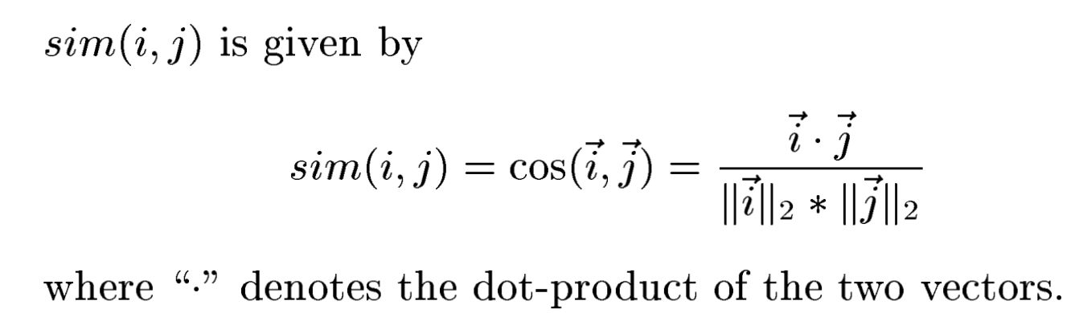
Cosine Similarity

Slide 8
Shrinkage factor

Slide 9
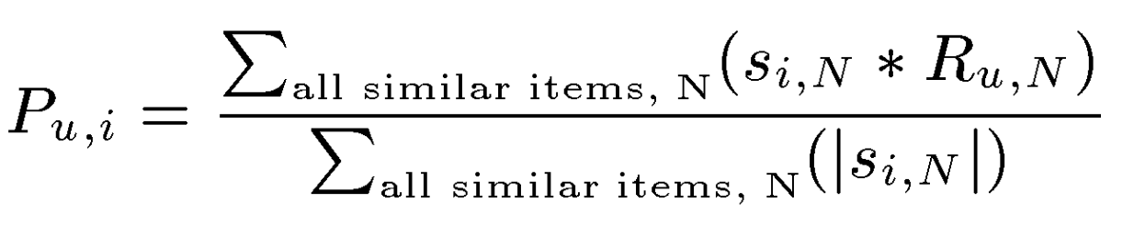
Prediction
Is equivalent to:

Slide 10
Tuning the shrinkage
Generate a validation set with split_dataset.py
Edit and run tuning.py

Slide 11
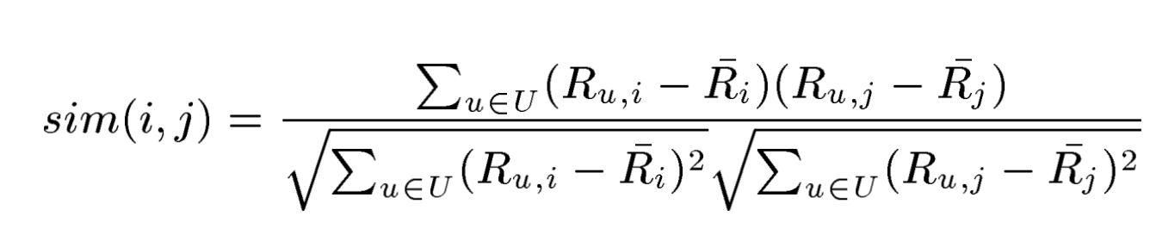
Pearson Similarity
IMPORTANT:
U is the set of common users between i and j

Slide 12
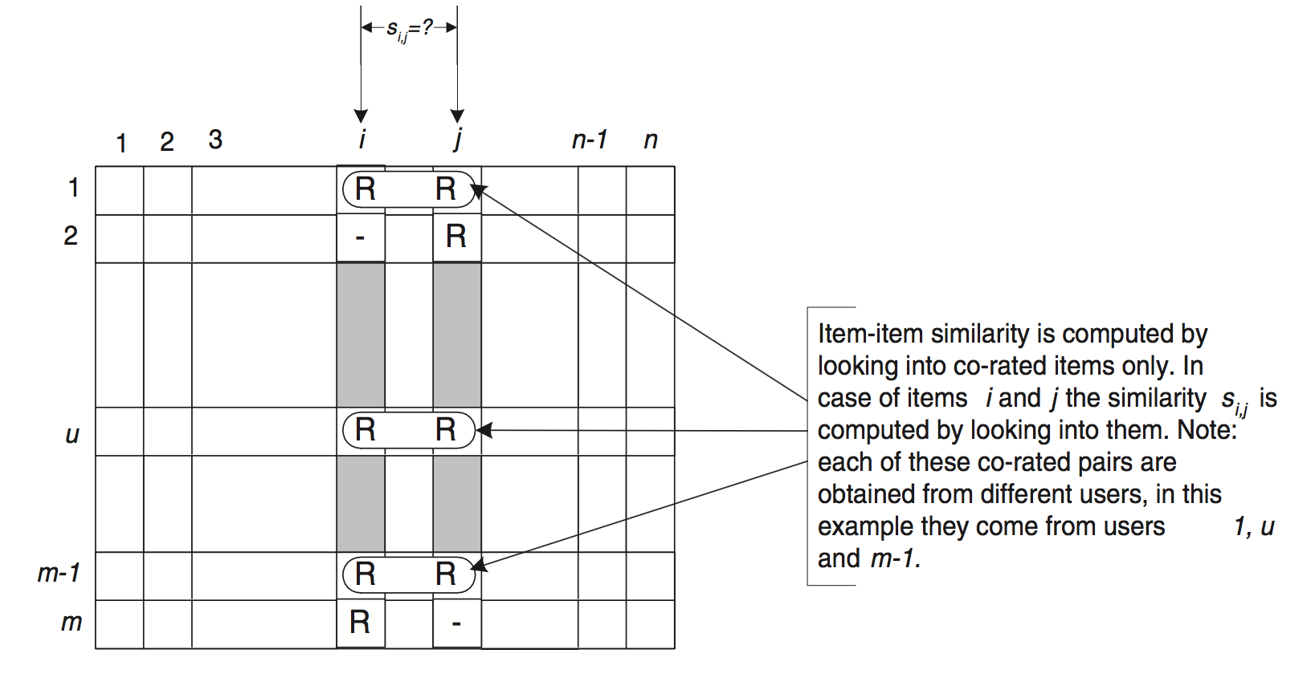
Pearson Similarity

Slide 13
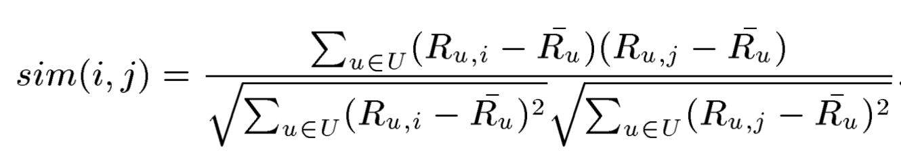
Adjusted Cosine
IMPORTANT:
U is the set of common users between i and j

Slide 14
Recpy – what’s new
Update your local repo:
1) Pull from the repository: git pull origin master
(or clone with git clone https://github.com/mquad/recsys-course-2016-pub )
2) Install recpy again (not necessarily the virtualenv!)
New features:
ItemKNN: cosine, pearson and adjusted cosine (w/ Cython code)
Efficient item_knn with sparse weights
K-Fold cross validation
New scripts: cv_eval.py, holdout_eval.py, main.py

Slide 15
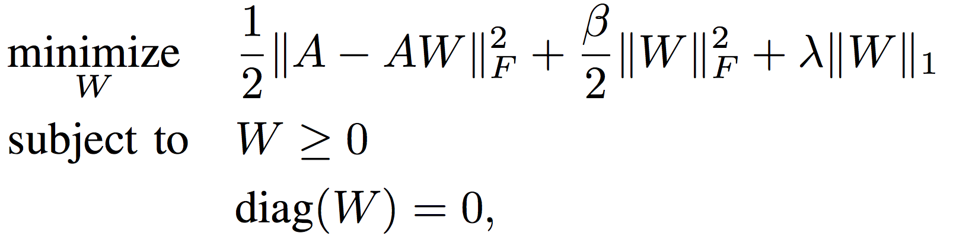
SLIM
Sparse Linear Methods for Top-N Recommender Systems (Ning 2011)

Slide 16
SLIM
Sparse Linear Methods for Top-N Recommender Systems (Ning 2011)
Key components:
Linear model

Slide 17
SLIM
Sparse Linear Methods for Top-N Recommender Systems (Ning 2011)
Key components:
Linear model
L2-norm (overfitting) + L1-norm (sparsity) regularization (=elastic net, Friedman 2010)

Slide 18
SLIM
Sparse Linear Methods for Top-N Recommender Systems (Ning 2011)
Key components:
Linear model
L2-norm (overfitting) + L1-norm (sparsity) regularization (=elastic net, Friedman 2010)
Non-negativity and zero-diagonal

Slide 19
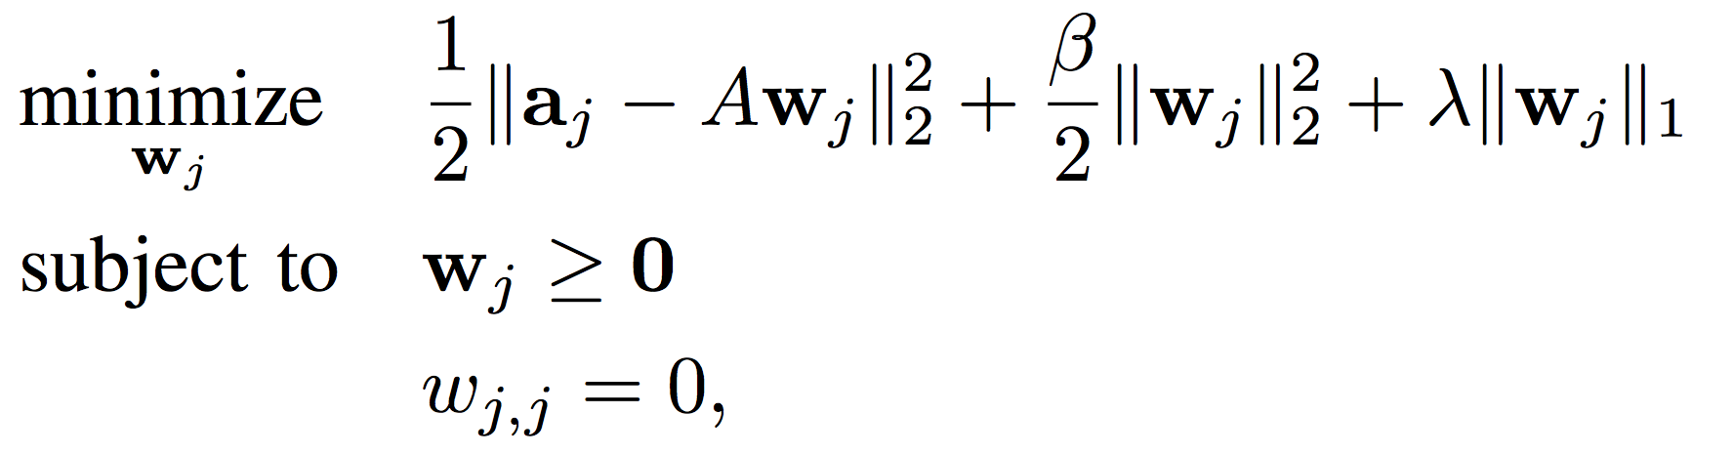
SLIM
Computing W:
Columns are independent
Each column w_{j} can be solved as a regularized regression having the j-th column as dependent variable (target) and the other n-1 columns as independent
(Optional): feature selection on the independent variables (fsSLIM)

Slide 20
SLIM
Options:
1) Train one ElasticNet (http://scikit-learn.org/stable/modules/generated/sklearn.linear_model.ElasticNet.html) for each column (covered in this practice)
2) Full training with Coordinate descent (preferable for performance)

Slide 21
SLIM vs I2I
Top-n recommendation → implicit ratings
Convert ml100k to implicit (manually, or with –make_implicit and --implicit_th 4 params)
Call main.py with recommender=SLIM or item_knn
Play with SLIM and item_knn params

Slide 22
SLIM vs I2I
Method | Parameters | Recall@10 | MAP@10 | MRR@10 | NDCG@10
Cosine I2I | Shrinkage=25, k=50 | 0.2238 | 0.1705 | 0.4890 | 0.2305
SLIM | L1_pen=0.001L2_pen=0.1 | 0.2497 | 0.2012 | 0.5471 | 0.2643
* Results computed with 5-fold cross validation on Movielens 100k
See the script compare_slim_i2i_cv.sh

Slide 23
TODO
User-to-user CF
Recommendations in batches
Stack ItemKNN with SLIM (fsSLIM)

