Slide 1



Best practices for Power BI
Hans Fousert
Julian Wissel

Slide 2

Agenda
An overview
Power BI and Microsoft Dynamics NAV
Best practices
Repeatability
Specific techniques
Integration
Skills

Slide 3





A short history
2010 – First steps
2013 – Growing up
2015 – Getting mature

Slide 4
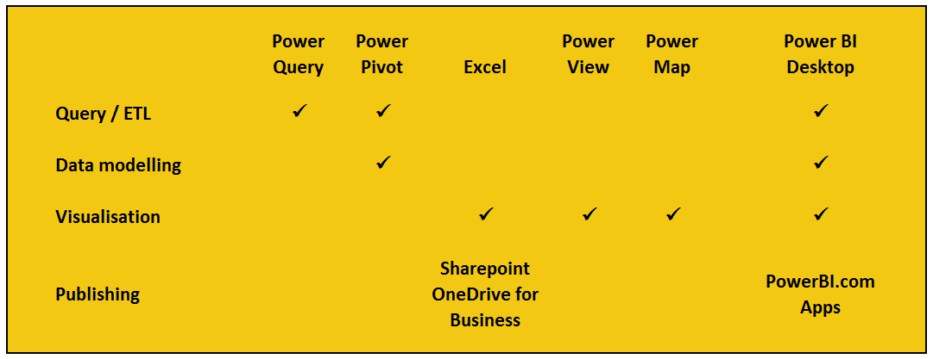
Power BI components

Slide 5
Lessons learnt
Excel 2010 has issues
Excel 2013 / O365 64 bit
Use Power Query for Query / ETL
Monthly updates

Slide 6

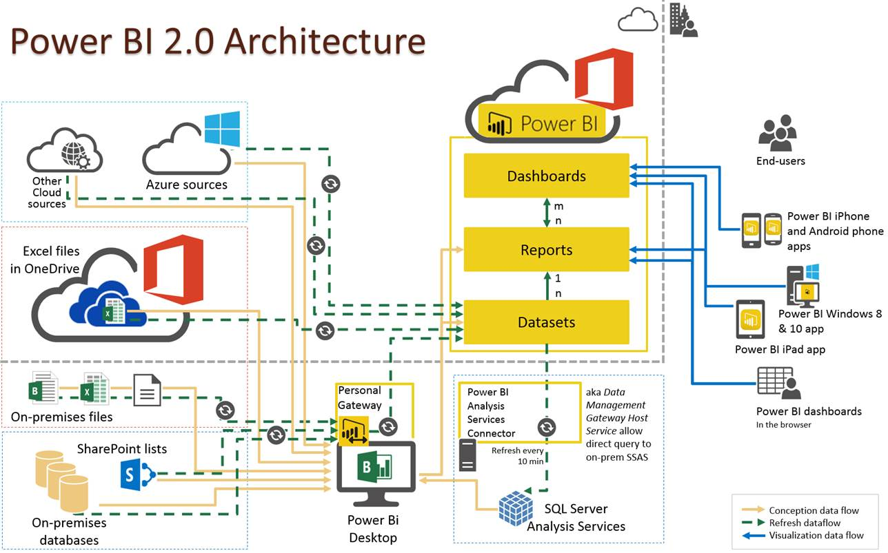
Created by Patrick Guimonet - yos365.wordpress.com

Slide 7


Getting your data
Past: SQL
Today/future: OData
Pages vs Queries

Slide 8

Examples

Slide 9
Best practices Power Query
Repeatability: flexible connection
Time intelligence: a date dimension
Multi-company and NAV Dimensions
Life-examples in Excel

Slide 10
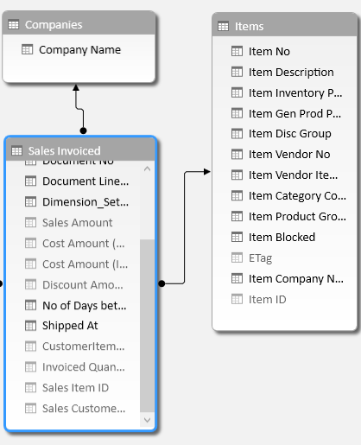
Data modeling
How do you make a report blazing fast and easy to use?
Lookup-tables
Naming of columns
Think outside of NAV data model

Slide 11
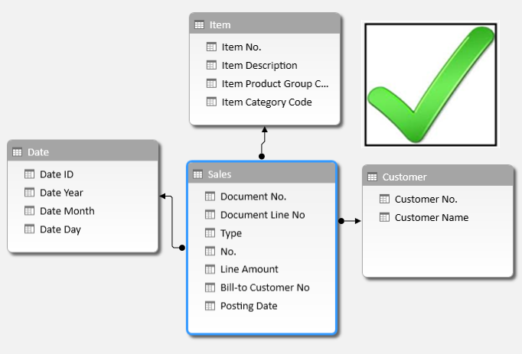
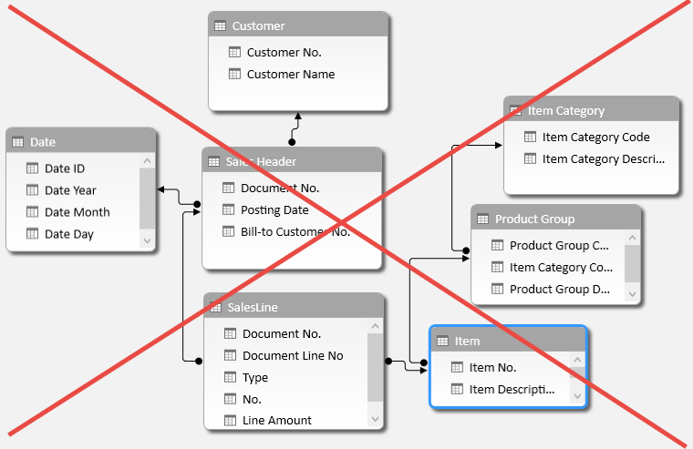
Denormalization

Slide 12
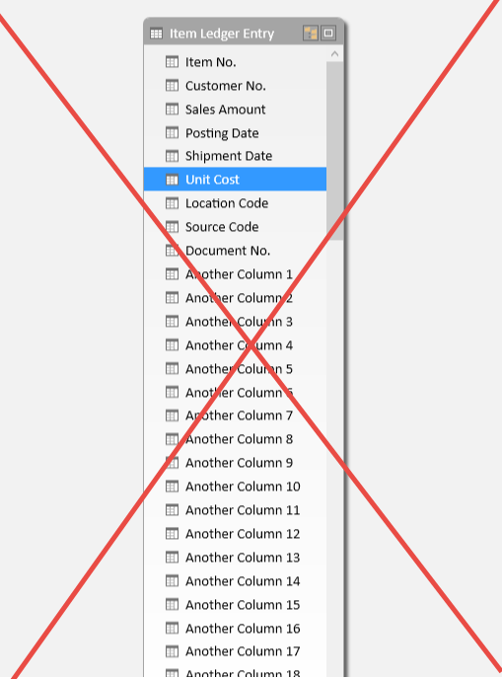
No flat tables!

Slide 13
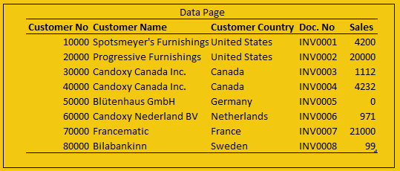
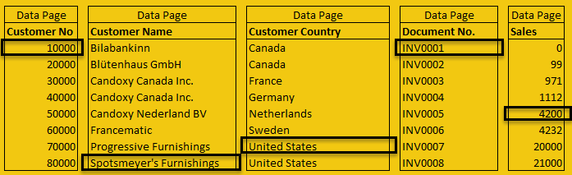
Data storage
ERP: row based
Power BI: column based

Slide 14
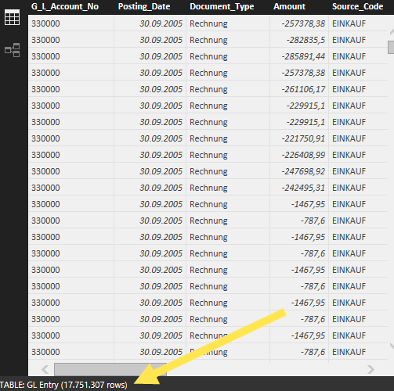

Compression
File with Entry No. Column: 305 MB
File without Entry No. Column: 28 MB
90 % compression!

Slide 15

Performance
Leverage compression
Filter as early as possible
Avoid iterators in DAX on fact tables
Pre-processing in Power Query

Slide 16
Best practices Power Pivot
Optimize for performance and usability
Data model: Star vs Snowflake
Measures: Separate table
DAX: looks easy… but is not

Slide 17
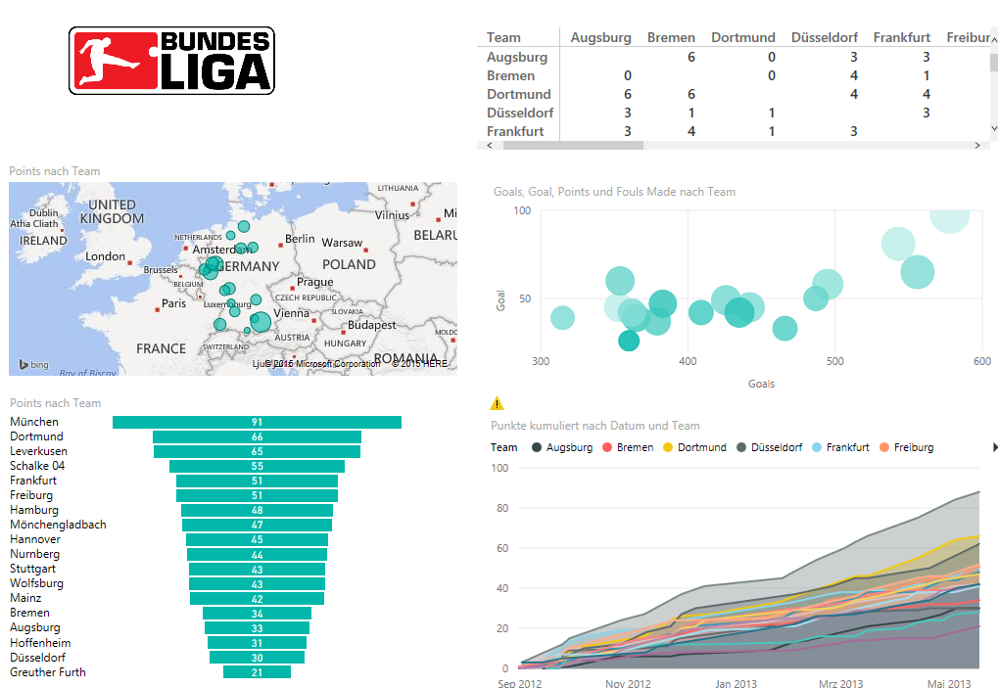
Visuals

Slide 18




Power BI Investment – update paths
Import – N/A yet
Import
Connect to – inofficially available
Connect
to
Connect to - N/A yet
Upload
Upload
Import
Not available
Indirect / Import
Connect to
Direction connection

Slide 19
SQL Cube vs Power BI
Cube if:
Local Data
Excel as frontend
Advanced security
Power BI if:
Visualisation
Mobile BI
Q&A
Easy installation & no maintanance

Slide 20
Best practices Integration
Open NAV Page from Power BI and vice versa
Actionable insights (NAV-Segment)
Power BI Development API

Slide 21

Consultants / End users
Perfect for proto-typing
Documentation of data model
Analyzing and vizualization
Excel: pivot tables / charts and CUBE functions
Power BI Desktop

Slide 22
2016
Excel 2016
Dynamics NAV 2016

Slide 23
Hands-on workshops
Workshop Tuesday 3.45PM or
Power BI “Trip” Wednesday 9.00AM
9 to 10 – first part of workshop
10 to 11 – Microsoft Power BI Session
11 to 12 – second part of workshop
4 different exercises, different levels
Own computer
Excel 2013 incl Power BI modules
Power BI Desktop
NAV 2015 with Cronus database (current build-version recommended)

Slide 24
Thank you!
Hans Fousert
Julian Wissel

