Slide 1
Linux/Unix + Slurm Overview
George & Nick
2026/08/13

Slide 2
George & Nick
2026/08/13
Introduction
Linux/Unix
Slurm and FIJI
Workshop

Slide 3
Learning Objectives
George & Nick
2026/08/13
Introduction
Understand the basics of Linux/UNIX command line
Learn key commands for navigation and file management
Understand the structure and capabilities of CU Boulder’s FIJI supercomputing cluster
Learn how to run jobs on FIJI (SLURM, job scripts, modules)
Access resources for continued learning

Slide 4

Download VPN
George & Nick
2026/08/13
Introduction
To access FIJI when not using CU Boulder Campus wifi, you must connect to Boulder’s VPN
Cisco Secure Client (VPN):
oit.colorado.edu/services/network-internet-services/vpn
Tutorial:
Accessing FIJI

Slide 5

Connect to FIJI
George & Nick
2026/08/13
Introduction
FIJI uses Linux based OS, regardless of what the OS is on your computer, the rest of this presentation is steered toward FIJI, but also applicable if your OS is:
Mac
Linux / Unix
Tutorial:
Accessing FIJI
Command:
ssh <identikey>@fiji.colorado.edu

Slide 6
Structure
George & Nick
2026/08/13
Follow along
Tune in-and-out
Workshop Time
If you’re new to CL/CC, I recommend following along, we will take breaks for check-ins and hands on time
If you’re familiar with CL/CC, I recommend tuning in-and-out for information you did not know but working through the workshop materials
If you’re comfortable with CL/CC, I recommend working through the workshop materials and if and when you finish let me know as I have another task for you to attempt

Slide 7
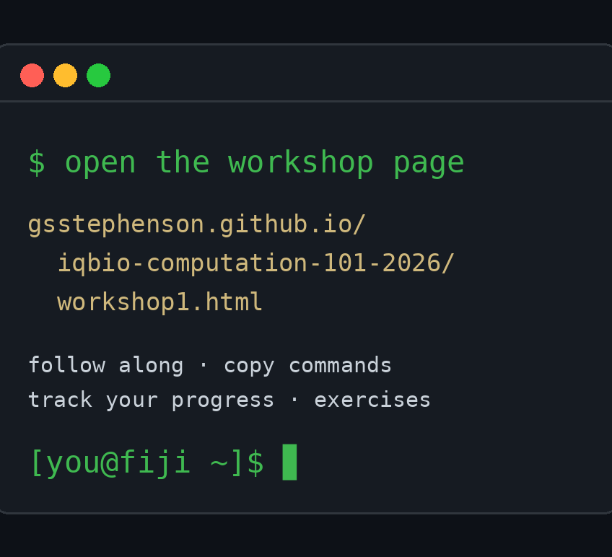
Workshop materials
George & Nick
2026/08/13
Everything lives on the bootcamp website — follow along there
Link
4 Levels:
Beginner
Intermediate
Advanced
Expert

Slide 8

Asking for Help
George & Nick
2026/08/13
Email FIJI
fiji-help@colorado.edu
Website
bit.colorado.edu/biofrontiers-computing/fiji/
Email BIT
bit-help@colorado.edu

Slide 9

What is Linux/Unix
George & Nick
2026/08/13
Linux/Unix
UNIX: An early operating system, foundation of many modern OSes
Linux: Open-source UNIX-like OS (e.g., Ubuntu, CentOS)
Powers most servers, cloud infrastructure, and supercomputers
Focus on command-line interface (CLI)

Slide 10
Why use Command Line
George & Nick
2026/08/13
Efficiency & automation (especially for large data)
Remote access and control (via ssh)
Reproducibility via scripts
Essential for working with HPC clusters like FIJI
Google, LLMs, forums, are your friend. It is impossible to remember everything. Get good at looking things up
Tips

Slide 11
Basic Linux Commands
George & Nick
2026/08/13
Command | Description
pwd | Print working directory
ls | List files in current directory
cd | Change directory
mkdir | Make new directory
touch | Create empty file
cp / mv | Copy / move files
rm | Delete files
man | Show manual for command

Slide 12
Linux Command Structure
George & Nick
2026/08/13
General format:
Command [options] [arguments]
Example:
ls -l /home/
ls: list files
-l: long format (optional/flag)
/home/: directory (argument)
Most commands you will use have the argument of -h: which is the help argument giving you more information about the options and arguments
Tips

Slide 13
Commonly Used Flags
George & Nick
2026/08/13
Command | Common Flags | Description
ls | -l, -a, -h | Long list, show hidden files, human-readable sizes
cp | -r, -v | Copy directories recursively, verbose output
rm | -r, -f | Recursively delete, force no prompt
grep | -i, -r, --color | Case-insensitive, recursive, color match
tar | -xvzf | Extract, verbose, gzip, file

Slide 14
Combining Commands
George & Nick
2026/08/13
Pipes |: pass output from one command to another
ls -l | grep “.txt”
Redirects > and >>: Send outputs to a file
ls -l > ls.txt
Append with >>:
echo “new line” >> ls.txt
Run multiple commands:
cd data && ls -lh
BASH (Bourne Again SHell) is a scripting language derived from Bourne Shell (SH), developed for UNIX systems, it allows you to create functions, loops, and more
Tips

Slide 15
Useful tools to know
George & Nick
2026/08/13
Tool | Description
head, tail | View start/end of files
less | Scroll through long files
wc -l | Count lines
sort, uniq | Organize and deduplicate
cut | Extract columns from files
du -sh | Check disk usage of folder
top / htop | Monitor system resources

Slide 16
Editing files in the terminal
George & Nick
2026/08/13
Linux/Unix
Use CLI editors:
nano (simple)
vim or vi (powerful, steeper learning curve)
Syntax: nano filename.txt

Slide 17

Linux / Unix Resources
George & Nick
2026/08/13
Linux Journey
linuxjourney.com/
Youtube
youtube.com

Slide 18
Linux / UNIX workshop time
George & Nick
2026/08/13
Beginner
Intermediate
Advanced
Workshop Materials: Link

Slide 19

What is FIJI
George & Nick
2026/08/13
Slurm & FIJI
FIJI = CU Boulder's high-performance computing (HPC) cluster
Used for:
Bioinformatics, genomics
AI / ML / statistics
Physics, chemistry, engineering simulations
Free to first-year IQ Biology students
Access available to BioFrontiers researchers
Managed by BioFrontiers IT (BIT)

Slide 20

What is Slurm
George & Nick
2026/08/13
Slurm & FIJI
SLURM = Simple Linux Utility for Resource Management
It handles:
Job queues
Resource allocation (CPUs, memory, time)
Load balancing across compute nodes

Slide 21
Connecting to FIJI
George & Nick
2026/08/13
Command:
ssh <identikey>@fiji.colorado.edu
Campus WIFI or VPN required
Any terminal works — macOS/Linux Terminal, or Windows PowerShell (built-in SSH)
DO NOT run heavy computation directly on login nodes
Set up alias’ so you do not need to type full command to login into fiji
Eg:
fiji
Can also SSH port forward – ask one of us for help with this
Tips

Slide 22
FIJI File System Overview
George & Nick
2026/08/13
Directory | Purpose
~/ or /Users/<identikey> (home) | Permanent, small capacity
/scratch/Users/<identikey> | Temporary storage, high-speed I/O
/scratch/Shares/ | Temporary group space (request access)
/Shares/ | Shared group space (request access)
/projects/ | Shared group space (request access)
Use cd, ls, du -sh *, df -h to navigate and monitor

Slide 23
Types of Slurm Jobs
George & Nick
2026/08/13
Job Type | Command | Use Case
Batch | sbatch | Most common — run a script on the cluster
Interactive | srun or salloc | For debugging or quick tasks
Job status | squeue, sacct | Monitor your jobs
After starting an Interactive job you must SSH to the allocated node, otherwise you will be using the resources allocated to the login node (which is a no-no)

Slide 24
Modules and Software on FIJI
George & Nick
2026/08/13
FIJI used Lmod to manage software and environments:
module avail
module load python/3.11
module list
Use conda (or equivalent) if you need custom Python/R packages or environments
Before activating your conda environment run the following command to ensure that conda has been properly loaded
eval "$(conda shell.bash hook)"
(Thanks Ben Braun)
Tips

Slide 25
Basic Slurm Job Script
George & Nick
2026/08/13
#!/bin/bash
#SBATCH --partition=short
#SBATCH --nodes=1
#SBATCH --time=01:00:00
#SBATCH --job-name=test_job
#SBATCH --output=/scratch/Users/<IdentiKey>/slurm-%j.out
#SBATCH --error=/scratch/Users/<IdentiKey>/slurm-%j.err
#SBATCH --ntasks=1
#SBATCH --mem=4G
module load python/3.11
python my_script.py
Save this as job.sh
Submit with
sbatch job.sh

Slide 26
Sbatch arguments
George & Nick
2026/08/13
Essential #SBATCH Directives
#!/bin/bash
#SBATCH --job-name=myjob # Name of the job
#SBATCH --output=slurm-%j.out # Standard output (%j = job ID)
#SBATCH --error=slurm-%j.err # Standard error
#SBATCH --time=02:00:00 # Wall time (hh:mm:ss)
#SBATCH --mem=8G # Total memory (can use G or M)
#SBATCH --ntasks–per-node=4 # Number of task per CPU
#SBATCH --nodes=1 # Number of nodes (usually 1)
Optional / Helpful Directives
#SBATCH --mail-user=you@colorado.edu # Your email
#SBATCH --mail-type=ALL # When to email (BEGIN, END, FAIL, etc.)
#SBATCH --partition=short # Choose partition (short, long, etc.)
#SBATCH --requeue # Allow job to be requeued if it fails
#SBATCH --ntasks=1 # Total number of tasks (parallel jobs)
#SBATCH --gres=gpu:1 # Request GPUs (e.g., for deep learning jobs)
#SBATCH --dependency=afterok:<jobid> # Run after another job succeeds

Slide 27
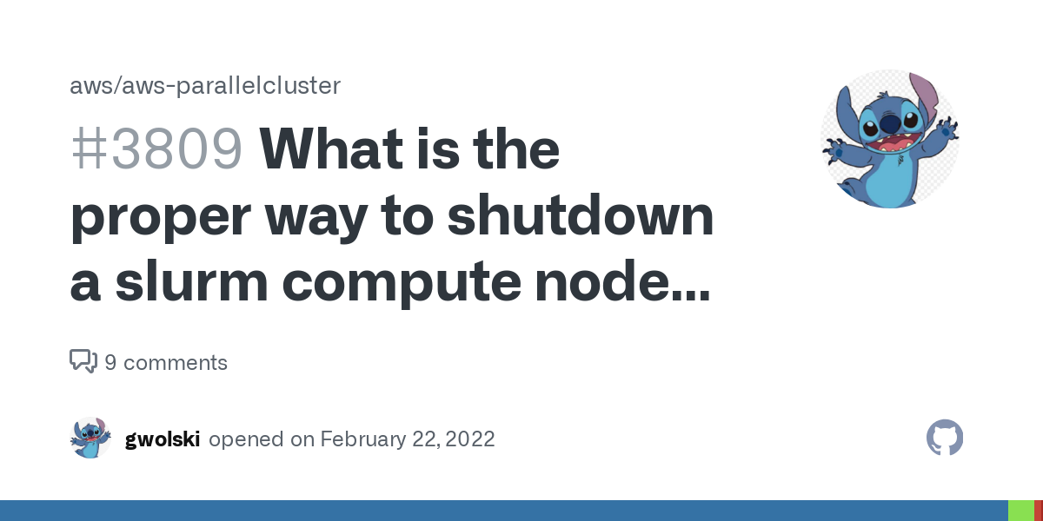
Monitoring Jobs
George & Nick
2026/08/13
Slurm & FIJI
View running jobs:
squeue -u <identikey> or $USER
squeue --me
View finished jobs:
sacct
Seff <job_id>
Cancel jobs:
scancel <job_id>

Slide 28
Uploading and Downloading Files
George & Nick
2026/08/13
Option 1: scp (Secure Copy)
Download
scp <identikey>@fiji.colorado.edu:<remote_filepath> <local_destination_path>
Upload
scp <local_destination_path> <identikey>@fiji.colorado.edu:<remote_filepath>
Option 2: rsync - Faster for large/repeated transfers
Download
rsync -avhP <identikey>@fiji.colorado.edu:<remote_filepath> <local_destination_path>
Upload
rsync -avhP <local_destination_path> <identikey>@fiji.colorado.edu:<remote_filepath>

Slide 29
Slurm workshop time
George & Nick
2026/08/13
Beginner
Intermediate
Advanced
Workshop Materials: Link

