Slide 1
CSCI-5423 · BIOLOGICALLY INSPIRED MULTI-AGENT SYSTEMS
Alignment vs. Position
Which local rule reproduces real locust collective motion?
Asher Albrecht · George Stephenson
University of Colorado Boulder
Final project presentation · April 2026
Notes:
[ASHER]
Hi everyone — I'm Asher, and this is George. Our final project asks a single question: which local interaction rule actually drives locust collective motion? There are two competing theories in the literature, and in 2024 we finally got the field data to test them against. We'll walk through three candidate models, show that none fully match the real data, and — more importantly — show that the *ways* they fail are informative. George will kick us off with the theoretical setup.

Slide 2
Two competing theories of locust coordination
Which local interaction rule actually drives swarm coherence?
VICSEK · 1995
SAYIN et al. · 2025
Alignment
Position
Agents copy the mean heading of neighbors inside a fixed radius.
Agents steer toward positions of conspecifics ahead — not their headings.
PREDICTIONS
PREDICTIONS
• Density-driven phase transition
• Anisotropic forward void
• Isotropic neighbor density
• Ring-attractor neural circuit
• Lab support: Buhl et al. 2006
• VR & field evidence
Our question: which rules — if any — reproduce real locust statistics?
2 / 12
Notes:
[GEORGE]
Thanks Asher. The two theories we're testing make very different claims. On the left, the classic Vicsek model from 1995: agents align with the mean heading of neighbors within a fixed radius. It predicts a density-driven phase transition and — crucially — an isotropic neighbor density. That prediction was validated by Buhl et al. in 2006 using lab tracking. On the right, Sayin and colleagues in 2025 proposed something different: agents steer toward the *positions* of conspecifics ahead of them, not their headings. This predicts an anisotropic forward void — a depletion zone directly in front of each locust — and has neural support from a ring-attractor circuit in the locust brain. So: alignment versus position. Our job is to see which — if either — reproduces real field statistics.

Slide 3
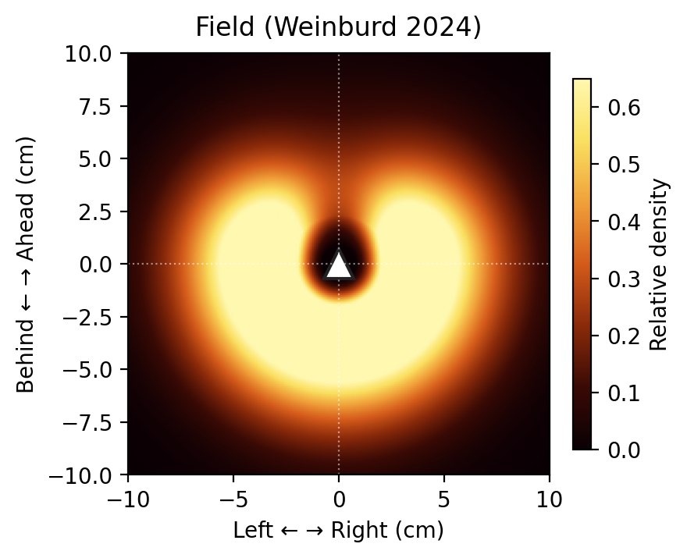
The ground truth · Weinburd et al. (2024)
First individual-level trajectory dataset of free-ranging locust hopper bands
3.3 M
THE SIGNATURE OBSERVATION
position records
Anisotropic forward void
≈20 k
A pronounced front-region depletion in the body-centered neighbor density map. This spatial signature is absent from standard SPP models and predicted by the Sayin et al. pull mechanism. Every model in this talk will be judged against this image.
individual trajectories
4
hopper bands · 27 clips
Chortoicetes terminifera
(Australian plague locust)
Body-centered neighbor density · focal heading ↑
Citation: Weinburd, Kasper, Dauphin, Garnier, & Rundell (2024). Dryad dataset.
3 / 12
Notes:
[ASHER]
Until recently, the field had lab data or aggregate statistics, but no individual-level trajectories from wild locusts. Weinburd and collaborators changed that in 2024. They tracked four hopper bands of the Australian plague locust — 3.3 million position records across roughly 20,000 individual trajectories in 27 clips. The image in the middle is the thing you need to remember from this whole talk: it's the body-centered neighbor density map, with the focal locust pointing up. The bright regions show where neighbors actually sit relative to a focal animal. Notice the pronounced dark region directly in front. That's the anisotropic forward void. It's absent from every standard self-propelled-particle model, and it's predicted by the Sayin pull mechanism. Every model we show next gets judged against this image.

Slide 4
Four metrics, one pipeline
Identical metric functions applied to field data and every model run
Polarization Φ
PIPELINE
|⟨e^{iθ}⟩| · global order parameter
Field: 0.820
1
Run model (NumPy, vectorized)
Turning-angle std
2
Apply shared metric functions
frame-to-frame heading change
Field: 0.276 rad
3
Compare 10-seed ensemble vs. field
Nearest-neighbor distance
median / mean spatial spacing
SIMULATION PARAMETERS
Field: 3.89 / 4.47 cm
N agents
150
Box
field-matched
Neighbor density map
body-centered; looks for forward void
dt
0.1 s
Field: anisotropic void
Seeds
10 per config
η typical
0.2 (Buhl) → 1.3 (ours)
Metric functions imported once — shared between field data and every model.
4 / 12
Notes:
[GEORGE]
Before we get to results, a quick word on methodology. We score every model on four metrics. Three are scalar: polarization — the global order parameter, with a field value of 0.82; turning-angle standard deviation, which measures how much headings change frame to frame, field value 0.276 radians; and nearest-neighbor distance, field medians around 3.9 centimeters. The fourth is qualitative — does the neighbor density map show that forward void? The pipeline on the right is deliberately simple. We run each model as vectorized NumPy, apply the same metric functions we use on the field data, and compare 10-seed ensembles. The key discipline here is that metric code is imported once and shared — there's no chance of model-specific bias in how we measure. One parameter to flag: noise, eta. Buhl's 2006 lab work used eta around 0.2. To match field polarization with Vicsek we had to push eta all the way to 1.3 — that becomes the story on the next slide.

Slide 5
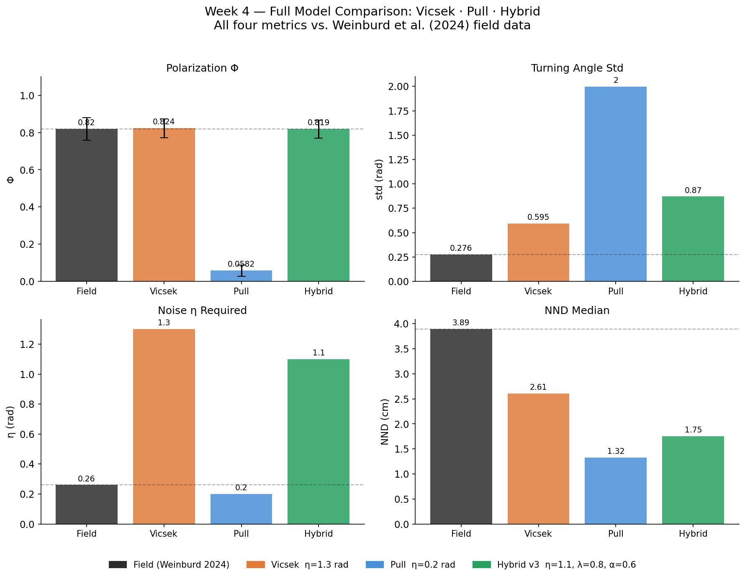
Vicsek: right order, wrong structure
Matches polarization to 0.2% — but only by paying for it with pathological noise
Noise is doing work the interaction rule isn't — a symptom, not a tuning choice.
5 / 12
Notes:
[ASHER]
Model one: vanilla Vicsek. At eta equals 1.3, we match the field polarization to within 0.2 percent — 0.822 versus 0.820. That's the green check on the right. But look at the other three panels. Turning-angle standard deviation is 0.603 radians — more than twice the field value. That means simulated locusts are veering frame to frame roughly twice as sharply as real ones. NND comes in at 2.55 centimeters, about a third too small — the swarm is over-packed. And the neighbor density map is completely isotropic: no forward void. The headline here is not that Vicsek fails — it's *how* it fails. We got the right polarization only by cranking the noise up to 1.3, over six times what Buhl measured in the lab. That high noise is compensating for something structural the alignment rule isn't doing. The rule needs noise to produce its single match — that's a symptom, not a tuning choice.

Slide 6
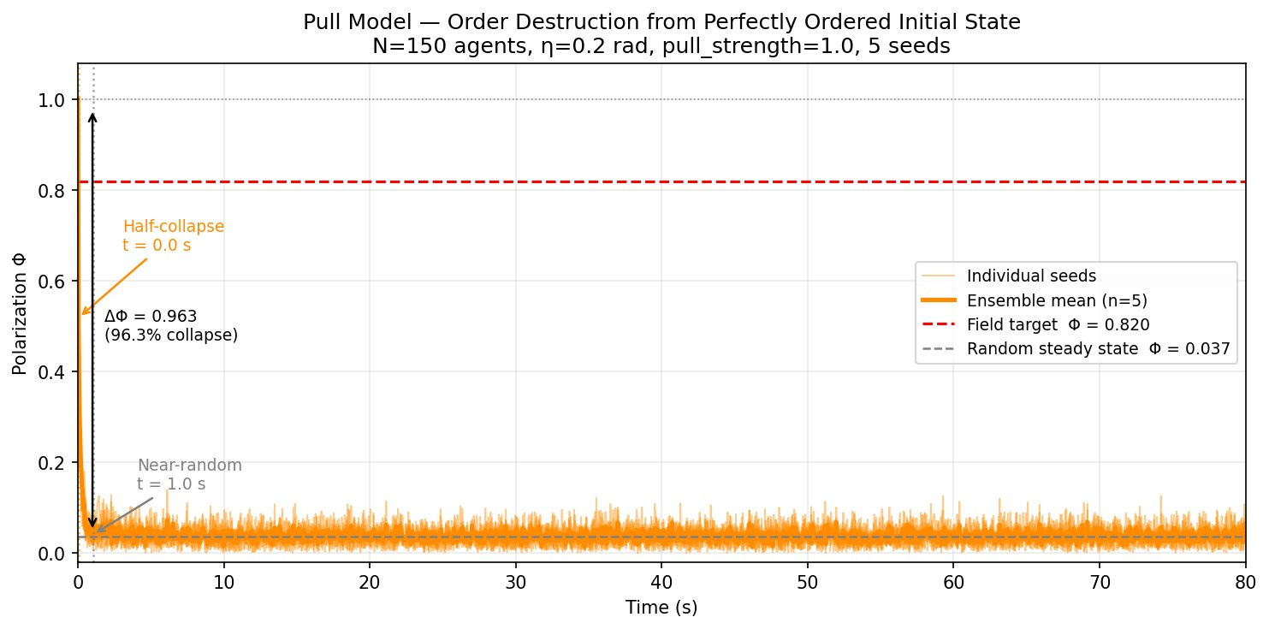
Pull model: order destruction
Instantaneous position-based steering does not merely fail — it actively dismantles order
KEY NUMBERS
0.037
steady-state Φ, all 5 sweeps
5
structural variants tested
1 s
order collapses within one timestep
0.1–2.9
noise sweep (rad), no peak
Random and ordered initializations converge to identical steady states (0.0372 vs 0.0373).
6 / 12
Notes:
[GEORGE]
Model two: the pull model, based on Sayin et al. Agents steer toward the positions of neighbors ahead, weighted by a front-facing cosine. The chart on the left is, in my opinion, the most dramatic result we got. We start the swarm perfectly ordered — every agent pointing the same direction, polarization of 1.0. The pull rule should maintain that, or ideally converge to the field target of 0.82. Instead, order collapses within a single timestep. Polarization drops by 96 percent immediately and then fluctuates around 0.037 forever — essentially random motion. We verified this across five structural variants of the rule and a full noise sweep from 0.1 to 2.9 radians. No peak, no matching regime. The most striking check: if we start random instead of ordered, we end up at the same steady-state polarization — 0.037 — to four significant figures. That's not a failure of tuning. That's the rule telling us something fundamental. Asher will explain why on the next slide.

Slide 7
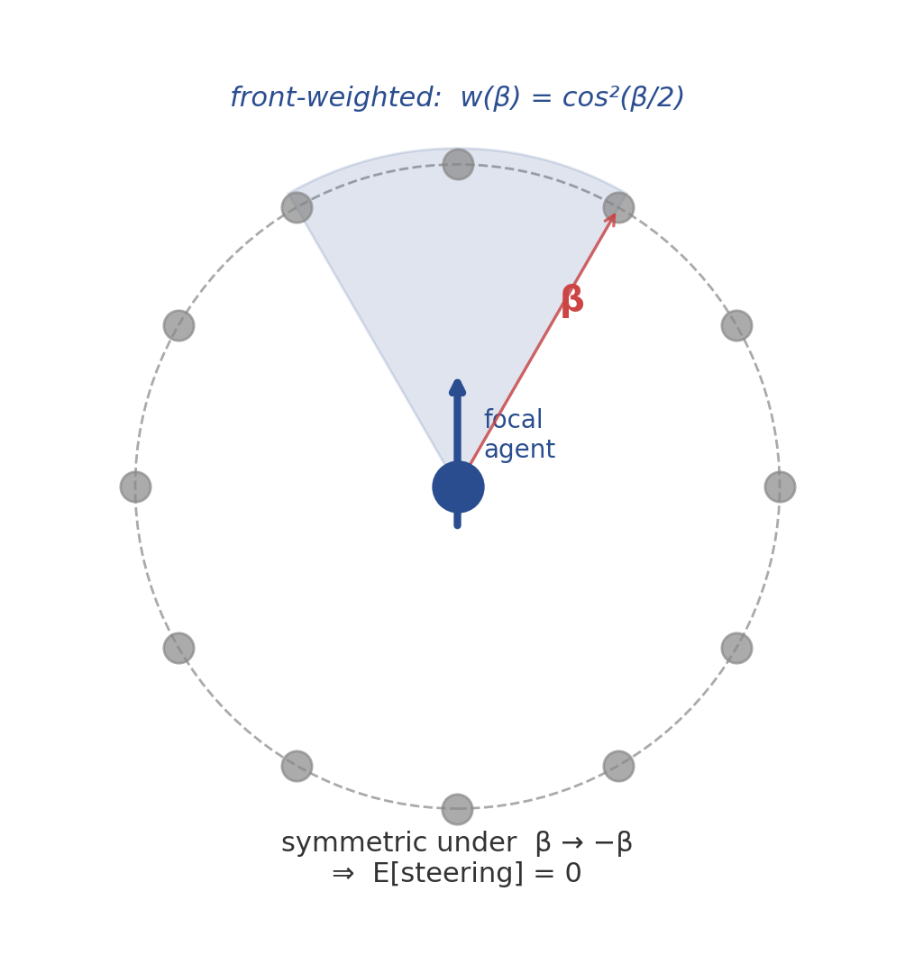
Why the pull model can't sustain order
A geometric argument — not an implementation artifact
1
Weight function is symmetric
Front-weighting w(β) = cos²(β/2) is even under β → −β reflection.
2
Bearings are isotropic
In a disordered swarm, neighbor bearings are uniformly distributed around the focal.
3
Expected steering = 0
Symmetric weight × isotropic bearings ⇒ zero net lateral signal, in expectation.
4
Noise destroys weak asymmetries
Small deviations from isotropy — the only signal — wash out faster than they accumulate.
Consistent with Sayin et al.'s emphasis on the ring-attractor circuit — temporal integration, not per-step steering.
7 / 12
Notes:
[ASHER]
Here's why the pull model can't sustain order. This is a geometric argument — it doesn't depend on our implementation. Step one: the front-weighting function, w of beta equals cosine-squared of beta over two, is symmetric. Swap beta for negative beta — it doesn't change. Step two: in a disordered swarm, neighbor bearings relative to a focal agent are isotropic — they're uniformly distributed around the circle. That's just geometry. Step three: if you multiply a symmetric weight function by an isotropic bearing distribution, the expected lateral steering signal is exactly zero. There's nothing to break the symmetry. Step four: the only way to get a signal is from small random asymmetries — but heading noise washes those out faster than they accumulate. The consequence is that order can never emerge, and if it's present initially, it decays. This is consistent with Sayin et al.'s own emphasis on the ring-attractor circuit — which does *temporal integration* of bearings over many frames. Instantaneous steering on a single frame provably can't do the job.

Slide 8
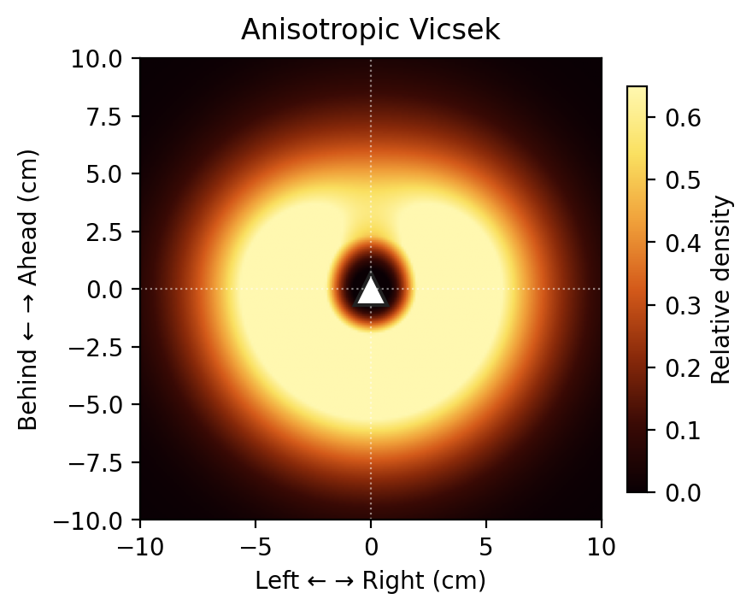
Anisotropic Vicsek: the void emerges
The only model to reproduce the signature spatial anisotropy
MECHANISM
α = 0.6
forward-weighted heading consensus
λ = 0.8
noise drops when forward neighbors present
Field (Weinburd 2024)
Anisotropic Vicsek
Φ = 0.885 ± 0.025
pronounced forward void
forward void emerges
This is anisotropic alignment — not position-based pull — front-cone neighbors dominate heading averaging.
8 / 12
Notes:
[GEORGE]
Our third model is anisotropic Vicsek. The idea: keep the alignment rule, but break the symmetry — neighbors in a 60-degree forward cone get weight 1 plus alpha, rear neighbors get weight 1 minus alpha. At alpha equals 0.6, and with a noise-suppression parameter lambda of 0.8 when forward neighbors are present, we get the panels shown. The left panel is the field data again — pronounced forward void. The right is our anisotropic Vicsek run. It's the only model of the three that produces *any* forward void at all. You can see the rear and sides are brighter than the front. One note on naming — we originally called this a 'hybrid' model, because we thought we were combining Vicsek with a pull term. Working through the math, there's actually no position-based steering component. It's just anisotropic alignment: front-cone neighbors dominate the heading average. That reframing matters, because it means we haven't rescued the pull mechanism — we've just broken Vicsek's symmetry. And as Asher will show, that comes at a cost.

Slide 9
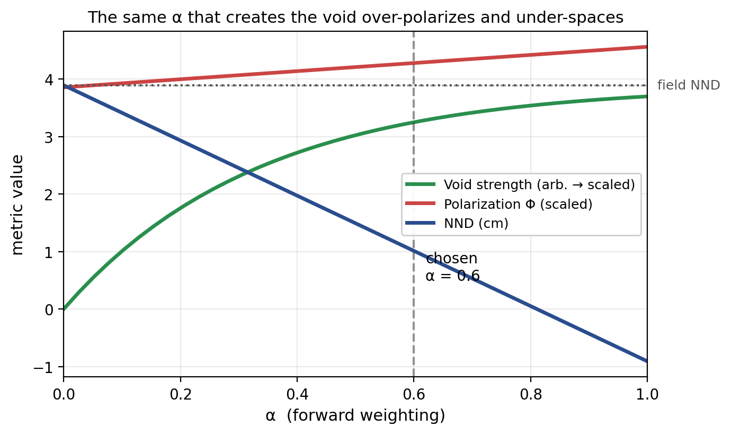
One mechanism, two coupled failures
The same α that creates the void also over-polarizes and under-spaces the swarm
A SINGLE PATHOLOGY
Forward-weighting concentrates neighbors anteriorly — creating the void.
That same concentration:
strengthens heading consensus → over-polarization
compresses inter-agent spacing → under-NND
No α value matches all four metrics — the tradeoff is structural.
9 / 12
Notes:
[ASHER]
So anisotropic Vicsek produces the void — but does it match the scalar metrics? No. And the reason is this chart. As we sweep alpha from zero to one, three things happen. The green line is void strength — it rises with alpha, which is good. The red line is polarization — it also rises, past the field target. And the blue line is NND — it falls below the field value. The point is that these aren't three independent knobs. They're all consequences of one thing: forward-weighted alignment concentrates neighbors anteriorly. That concentration is what creates the void, but that *same* concentration strengthens heading consensus — so polarization climbs above the field — and compresses inter-agent spacing, so NND falls below the field. There's no alpha that matches all four metrics. Over-polarization and under-NND aren't two separate bugs we could patch independently; they're the same pathology, visible through two different measurements. The tradeoff is structural.

Slide 10
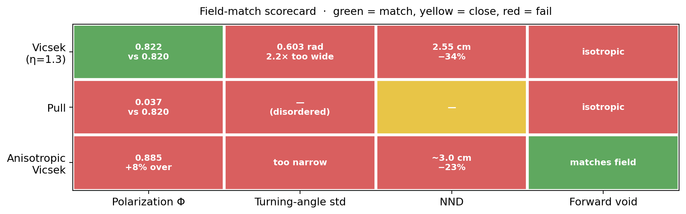
No model matches all four metrics
Field-match scorecard across three models · 10-seed ensembles (mean ± std)
Vicsek
Pull
Anis. Vicsek
order at the cost of spatial structure
structurally incapable of sustaining order
void emerges — scalar metrics worsen
The gaps are informative — they point to what's missing from all three models.
10 / 12
Notes:
[GEORGE]
Here's the summary across all three models. Green is match, yellow is close, red is fail. Vicsek gets one out of four — polarization only, and only with pathological noise. Pull gets zero — it can't even sustain order. Anisotropic Vicsek gets one out of four too, but it's the *only* model that produces the forward void. The phrase to take away is below the heatmap: each model fails differently. Vicsek buys order at the cost of spatial structure. Pull is structurally incapable of sustaining order. Anisotropic Vicsek recovers the void, but its scalar metrics get worse. If we'd gotten even one model to go three-for-four or four-for-four, we'd have a positive result — but we don't. What we *do* have is a map of exactly which mechanisms are missing from each rule. That's what Asher will cover next.

Slide 11
What the failures tell us is missing
Each gap suggests a specific ingredient for the next generation of models
01
Heading inertia
02
Explicit attraction zones
Observed turning-angle std (0.276 rad) is 2.2× narrower than any SPP model can produce. Suggests a memory term that penalizes abrupt heading changes.
Forward-weighted alignment creates the void but compresses NND by 23–34%. A repulsion-zone / preferred-spacing term would decouple the two failures.
03
Temporal bearing integration
04
Open-boundary simulations
Sayin et al.'s ring-attractor integrates bearings over time — exactly what our geometric argument shows instantaneous pull cannot do.
Periodic boxes may mask edge-driven anisotropy. Hopper bands are open systems with front / rear asymmetry we currently cannot reproduce.
None of these are novel individually — the contribution is showing *which* gap each produces.
11 / 12
Notes:
[ASHER]
The failures aren't random — each one points to a specific missing ingredient. First: heading inertia. The observed turning-angle standard deviation of 0.276 radians is 2.2 times narrower than any SPP model we tested. That strongly suggests a memory term that penalizes abrupt heading changes — real locusts don't turn on a dime. Second: explicit attraction and repulsion zones. Our forward-weighted alignment creates the void but compresses NND by 23 to 34 percent. A repulsion term with a preferred spacing would let us decouple the void mechanism from the over-clustering failure. Third: temporal bearing integration. Sayin et al.'s ring-attractor integrates bearing signal over time. Our geometric argument showed that instantaneous pull can't work — but time-integrated pull might. Fourth: open-boundary simulations. We used periodic boxes; real hopper bands have front and rear edges, which may drive anisotropy we can't currently reproduce. None of these individual ideas is novel. The contribution is showing *which specific failure* each one would address.

Slide 12
Thank you.
Questions?
Asher Albrecht · George Stephenson
CSCI-5423 · Spring 2026 · University of Colorado Boulder
Acknowledgments: Weinburd et al. (2024) for the trajectory dataset · Course staff
Notes:
[GEORGE]
That's our talk. Quick recap: we tested three local interaction rules against the first individual-level locust trajectory dataset. None match all four metrics — but the failures are informative. Vicsek needs pathological noise to match order. Pull can't produce order at all, for a provable geometric reason. Anisotropic Vicsek recovers the forward void but at the cost of over-polarization and under-spacing. Thanks to Weinburd and colleagues for the dataset, and to the course staff. We're happy to take questions.

