Slide 1

Indian Institute of Information Technology Senapati, Manipur
Automatic Attendance System
Presented by
Guided by
Guthy Saiteja (19010104)
Dr N Kishorjit Singh
Submitted for the course named
Project - IIl (CS400)
Computer Science and Engineering
Nov - 2022

Slide 2
Content
Abstract
Problem Statement
Introduction
Theory and fundamentals
Methodology
Tools and technologies
Limitations
Conclusion
References
Automatic Attendance System
Nov - 2022
2

Slide 3
1. Abstract
The project has created a working Automated Facial Recognition System for IIIT Manipur and its students. With the use of Open CV library through programming language, Microsoft Visual Studio, OpenCV consists of Voila and Jones machine learning algorithms for face detection and extraction. The system is programmed fully with Microsoft Visual Studio 2022. The project’s main objective was to find out if the Facial recognition system is effective at recording attendance of students than Card-based system/paper based system that is currently in place. By implementing the Automated Facial Recognition Attendance System with the students, it would be more effective at recording attendance, as most factor being that it saves, the students, valuable time and makes it easier for them to record their attendance.
Automatic Attendance System
Nov - 2022
3

Slide 4
2. Problem Statement
There are no applications at IIIT Manipur that centralizes this information. For example, when there are, more or less, 100 students in a single classroom, it will take a long time for each one to scan their student cards to record attendance as each one has to queue to touch their respective cards into the card reader. This is hard, as the queue moves very slow if the card-system is slow as well, leading to late class start. This could put mental stress into the students, leading to not being able to concentrate and learn important topics in class. It will be better if there was a system, where all students could come and shit down and they will be singed in automatically. This makes the class flow smoothly as the lecturers/staff can just carry on with the class and do not have to wait for the students to finish recoding their attendance for the class
Automatic Attendance System
Nov - 2022
4

Slide 5
3. Introduction
Being a student in IIIT Manipur for 3 and half years, it has been difficult to record attendance. It was mainly paper-based attendance system. Even the card-based system is still very slow at times, where it takes more than 4-5 seconds to record attendance. It isn’t just myself, with this problem. Many students and friends, have the same problem.
The Automated Facial Recognition Attendance System is a system that helps the students record their attendance without a card. It has a Facial Recognition feature which automatically detects and instantly records attendance of the detected students. Automated Facial Recognition Attendance System allows students, not to worry about student cards, whether it is forgotten at home or lost, they can still come into university and have their attendance recorded in their respective classes.
Automatic Attendance System
Nov - 2022
5

Slide 6
4. Theory and fundamentals
Face recognition steps and techniques
Usually, two steps are included in facial recognition. At first, detection occurs and then compared with the databases for verification. Face as a biometric feature was less reliable due to variations in illumination conditions, poses, and expressions.
3D facial recognition methods resolved the reliability issues like pose change and lighting. With the advancement of technology, different techniques improved the situation and face became a more secure biometric feature as compared to other characteristics e.g., fingerprint etc.
Automatic Attendance System
Nov - 2022
6

Slide 7
4. Theory and fundamentals
Face recognition model
Face recognizers generally take face images and find the important points such as the corner of the mouth, an eyebrow, eyes, nose, lips, etc. Coordinates of these points are called facial-features points, there are such 66 points. In this way, a different technique for finding feature points give different results.
Automatic Attendance System
Nov - 2022
7

Slide 8
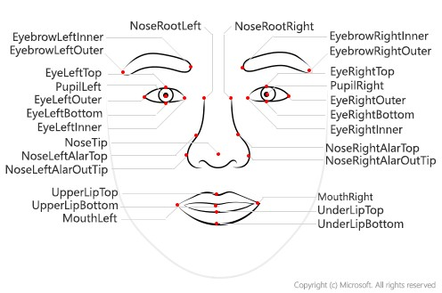
4. Theory and fundamentals
Figure 1 - Face recognition model
Automatic Attendance System
Nov - 2022
8

Slide 9
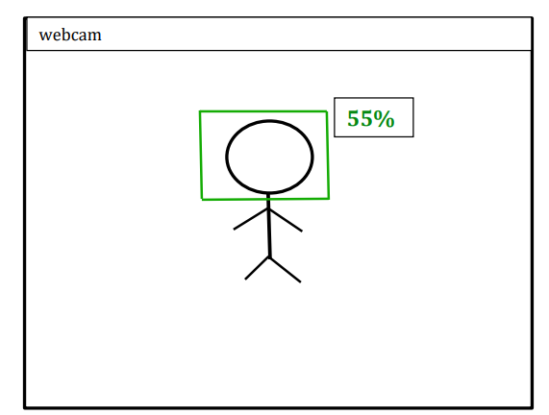
5. Methodology
Main Screen
This is the first screen the user will see, upon starting the system. Although there was no requirement for how the interface of the ‘Main screen’ should look like.
Automatic Attendance System
Nov - 2022
9

Slide 10
5. Methodology
Adding Faces
In order to match the captured image with all student images, we must create a list of all student images.
In order to accomplish this, we create an images folder and store the clear face visible photos of all the students in it.
Every time a face is captured, it is matched against all of the faces stored in this folder.
Automatic Attendance System
Nov - 2022
10

Slide 11
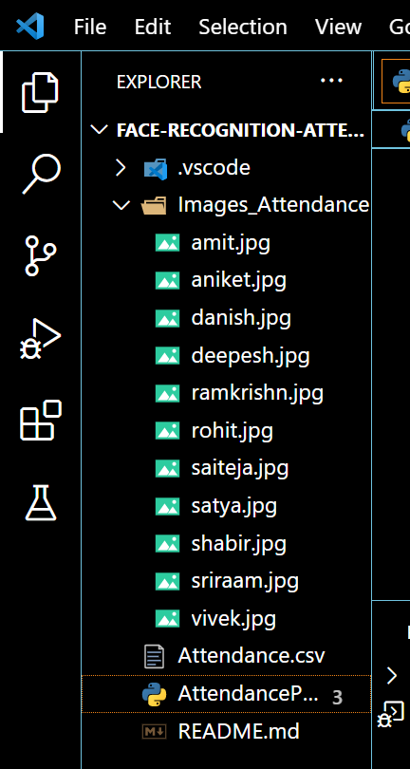
5. Methodology
Automatic Attendance System
Nov - 2022
11

Slide 12
5. Methodology
Mark Attendance
Following a match between the face and the image, the system must mark the student's attendance.
Once the perfect match has been detected, the system retrieves the name of the detected student, along with the date and time of the match.
Once the system has retrieved all the information, it opens an Excel spreadsheet and writes it there.
Automatic Attendance System
Nov - 2022
12

Slide 13
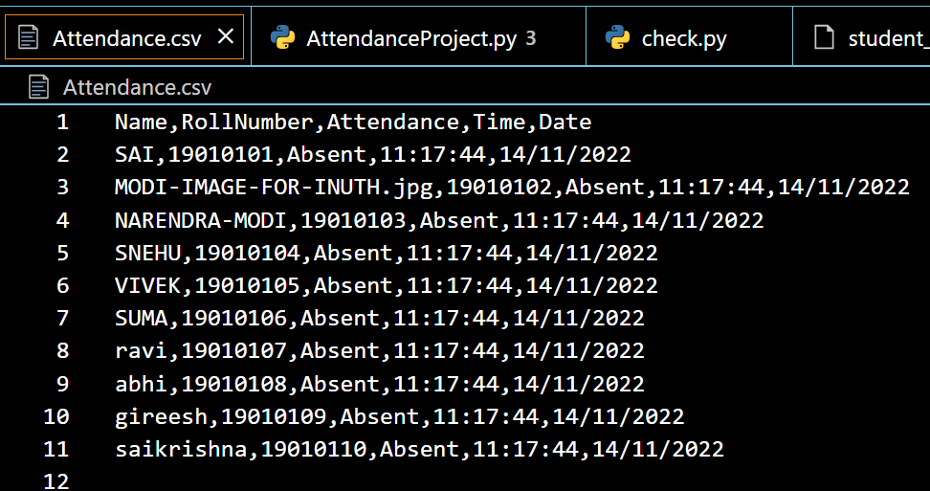
5. Methodology
Attendance Report
Automatic Attendance System
Nov - 2022
13

Slide 14
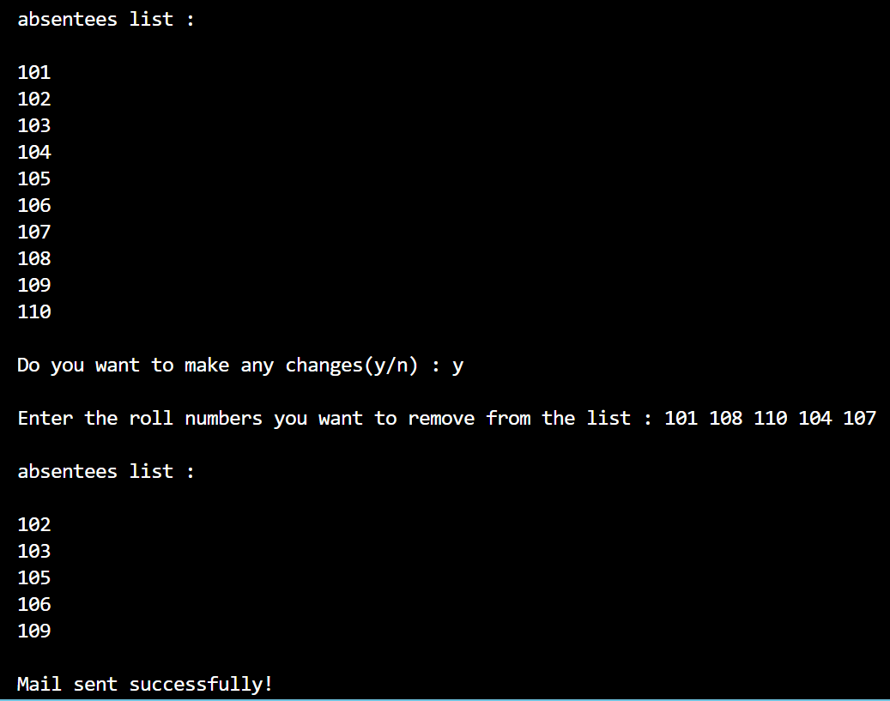
5. Methodology
Sending Mail
Automatic Attendance System
Nov - 2022
14

Slide 15
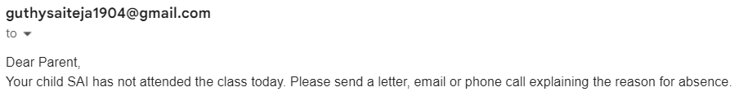
5. Methodology
Automatic Attendance System
Nov - 2012
15

Slide 16
6. Tools and technologies
Python
OpenCV
Visual Studio Code
Face recognition
Numpy
smtplib
Automatic Attendance System
Nov - 2022
16

Slide 17
7. Limitations
Illumination: It changes the face appearance drastically; it is observed that the slight changes in lighting conditions cause a significant impact on its results.
Pose: Facial Recognition systems are highly sensitive to the pose, which may result in faulty recognition or no recognition if the database is only trained on frontal face view.
Facial Expressions: Different expressions of the same individual are another significant factor that needs to be taken into account. Modern Recognizers can easily deal with it though.
Low Resolution: Training of recognizer must be done on a good resolution picture, otherwise the model will fail to extract features.
Aging: With increasing age, the human face features shape, lines, texture changes which are yet another challenge.
Automatic Attendance System
Nov - 2022
17

Slide 18
8. Conclusion
The aims and objectives of The Automated Facial Recognition Attendance System were successfully met and therefore the overall project is considered successful. The system has shown strengths, going through months of development which included, prototypes of various features and functionalities. As testing is done to the system, it proves that the system is fully functional, stable and reliable to use, this is further confirmed by the user acceptance testing. Although there are always some bugs that will always be missed, even with intense testing, all knows bugs are detected and debugged off the system.
Automatic Attendance System
Nov - 2022
18

Slide 19
9. References
Manual Testing
GitHub
Automatic Attendance System
Nov - 2022
19

Slide 20


