Slide 1
Installing SeaBreeze on Windows 8.1 (64-bit)
Mark Zieg
Mar 5, 2014

Slide 2
Statement of the Problem
Ocean Optics has not [yet] paid to have our drivers “signed” by Microsoft for Windows 8 / 8.1. (We did have this done for earlier versions of Windows.)
64-bit versions of Windows, in particular, are reluctant to install unsigned drivers.
There is a process to install unsigned drivers in Windows 8 / 8.1 (64-bit), but it’s a little cumbersome.
Google “Disable Windows 8.1 Device Driver Verification” for wider discussion of the issue.
Procedure assumes 64-bit SeaBreeze installer has been run
(C:\Program Files\Ocean Optics\SeaBreeze exists)

Slide 3
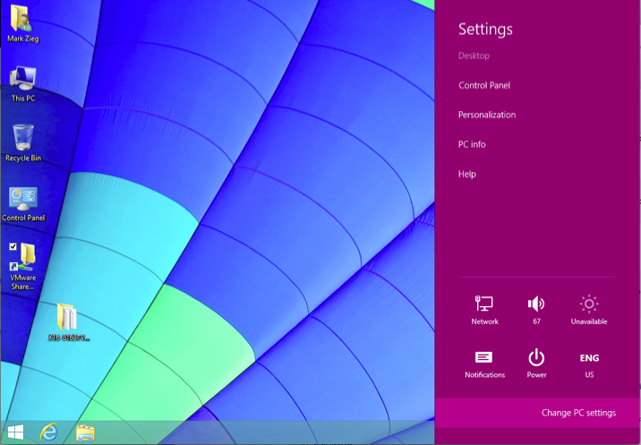
Charms Menu → “Change PC Settings”

Slide 4
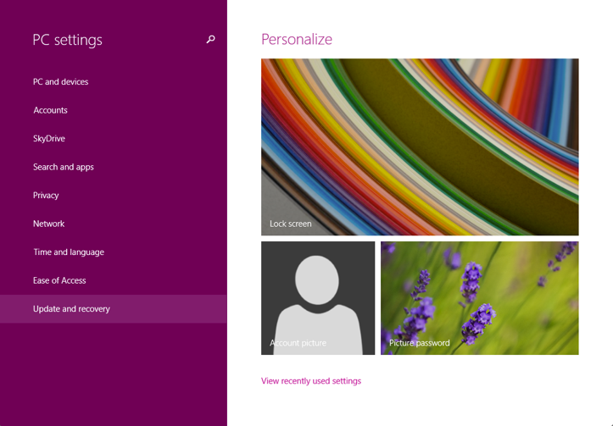
Click “Update and Recovery”

Slide 5
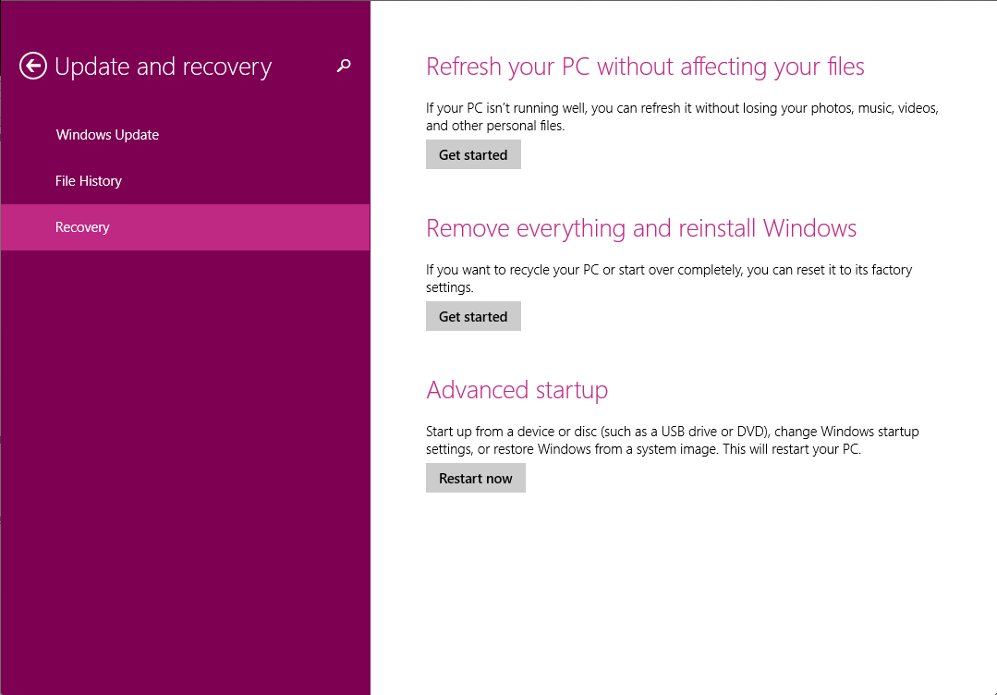
Click Recovery → “Restart Now”

Slide 6
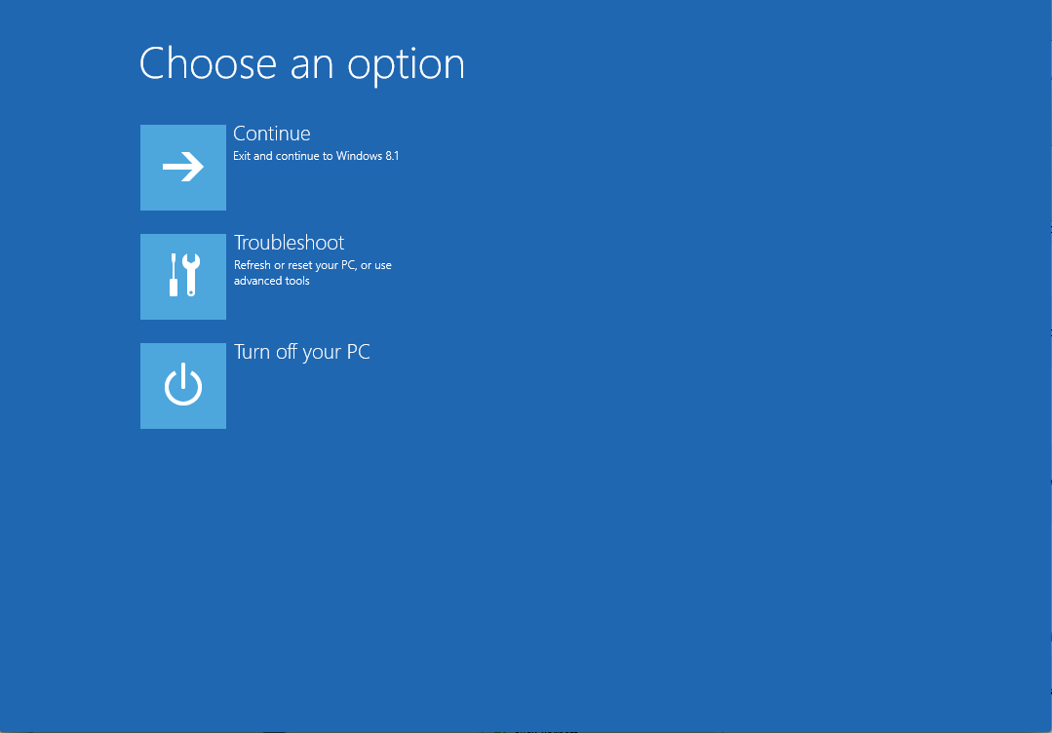
Click “Troubleshoot”

Slide 7
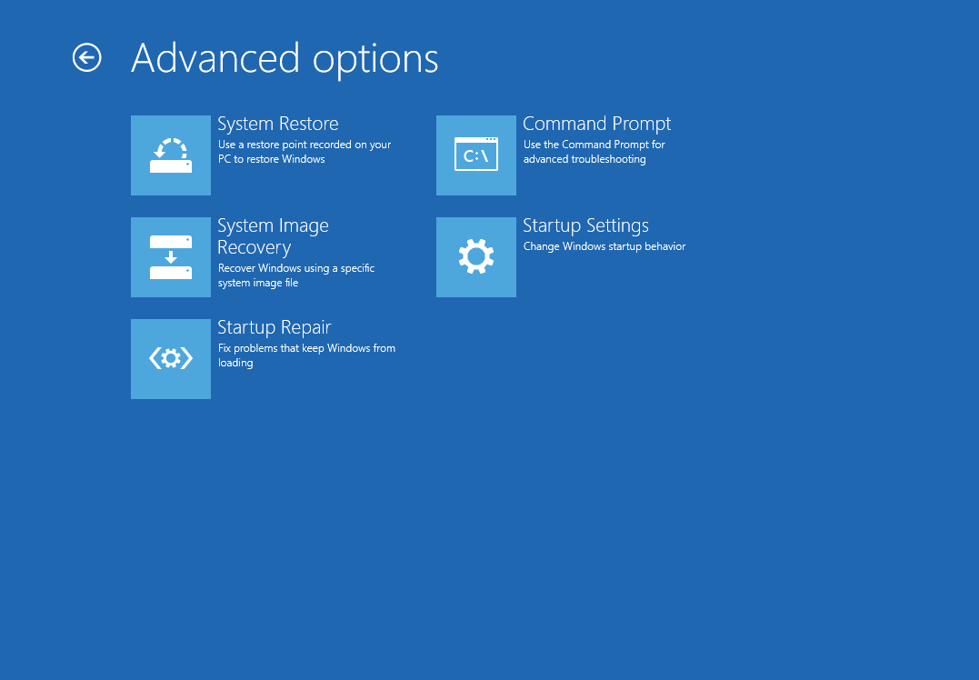
Click “Startup Settings”

Slide 8
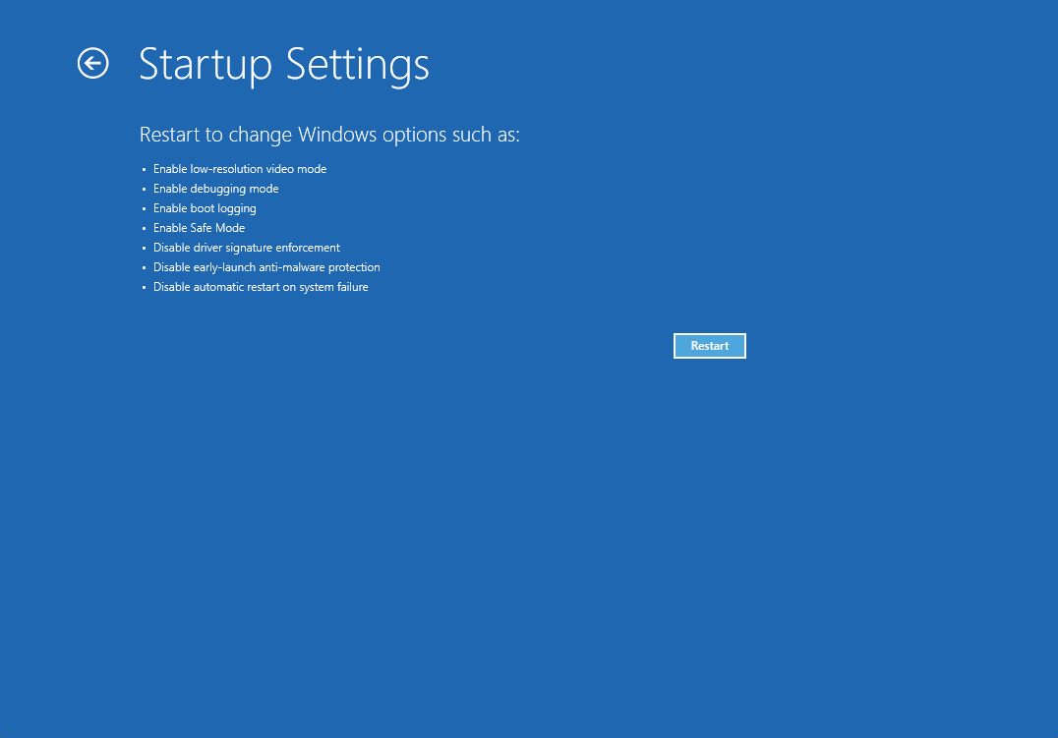
Click “Restart”

Slide 9
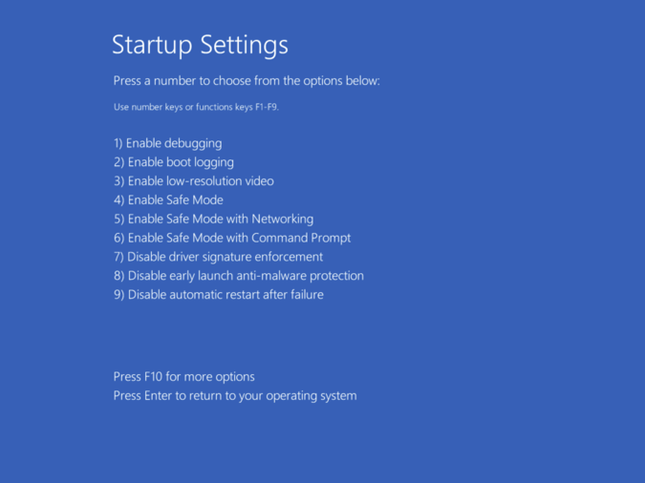
Press “7” (tablets must use USB keyboard)

Slide 10
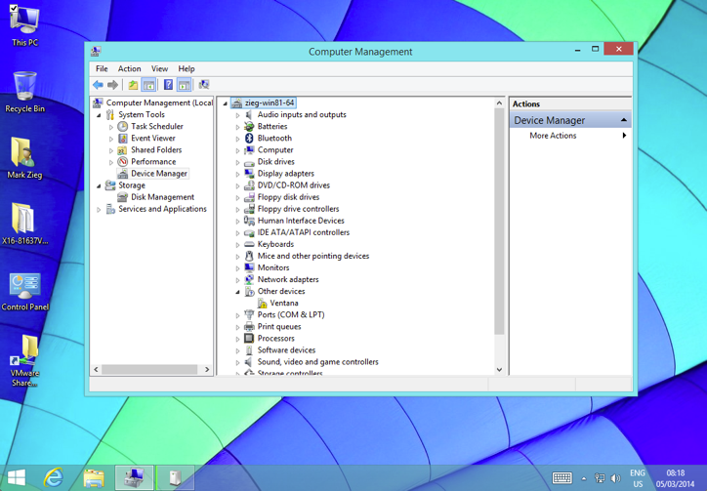
Right-click “ThisPC” → Manage

Slide 11
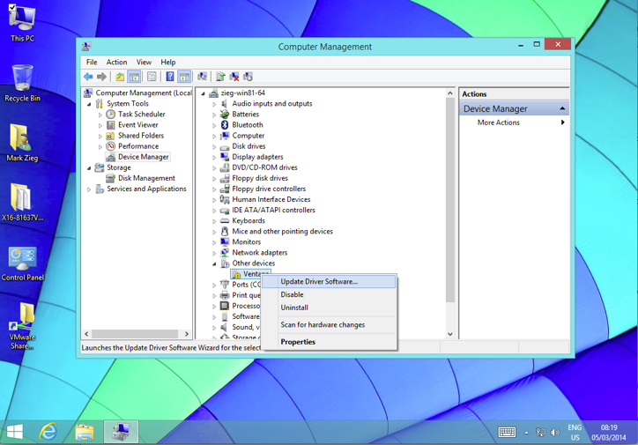
Right-Click Ventana (etc) → Update Device Driver

Slide 12
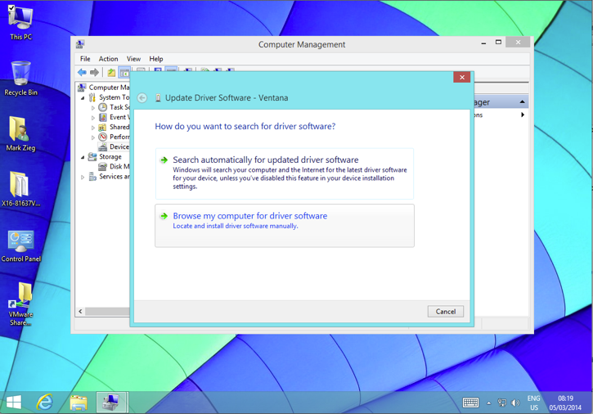
Click “Browse my computer…”

Slide 13
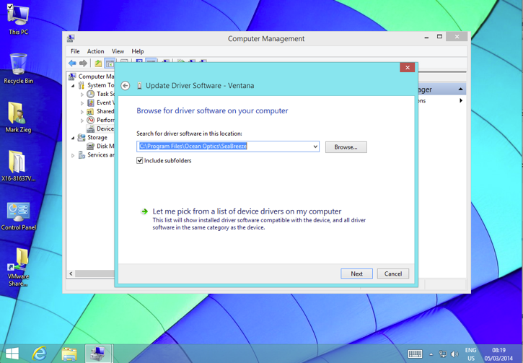
Browse to SeaBreeze, tick “Include subfolders”

Slide 14
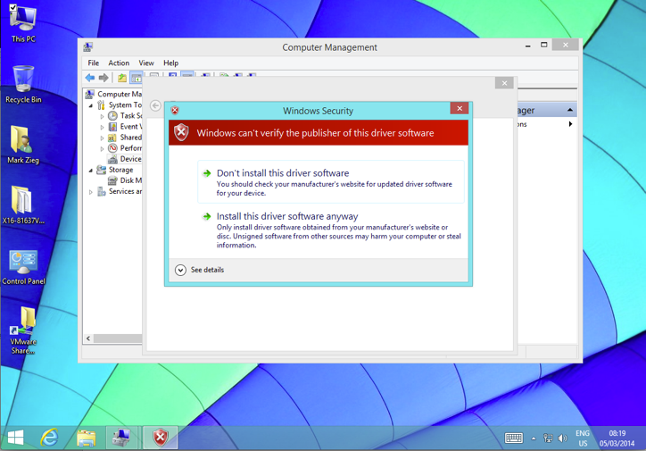
Click “Install this driver anyway”

Slide 15
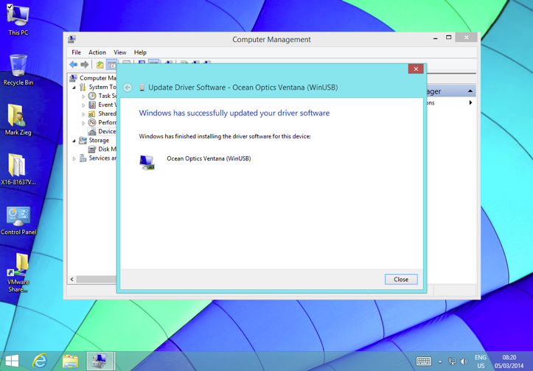
Confirm driver successfully installed

Slide 16
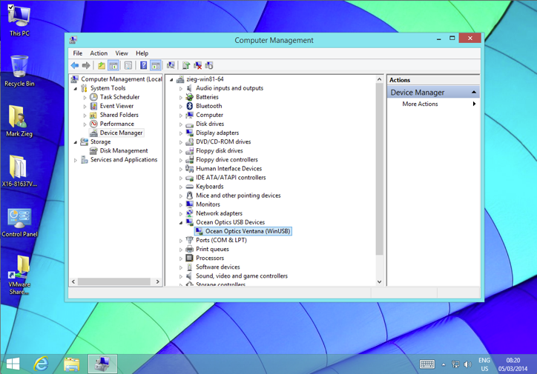
Confirm driver name ends with “(WinUSB)”

