Slide 1

X Marks the Spot
Gargi Tawde, Areebah Iqbal, Fariha Ahmed

Slide 2
Project Description
X Marks The Spot is a geography learning game site, where users can participate in quiz game sessions by themselves or with others to learn new geography concepts.
Competitors: Kahoot, Quizlet
Users will earn points in the game session based on accuracy, speed, and question difficulty, and the points will go towards their account total.
Users can earn certain tokens for every milestone they pass based on the total number of points they have accumulated, which they can view on their user dashboard
True/False, Free Response, or MCQ Questions
Leaderboard to compare overall performance
Notes:
Fariha

Slide 3
Our Progress
Completed Action Items:
Finish Product Design Specifications report
Brush up on technologies needed for project
Set up Flask App and Created Basic Pages
Action Items that were Committed to Since Last Meetup:
Finish Product Design Specifications report
Brush up on technologies needed for project
Set up Flask App and Created Basic Pages
Milestone Progress:
Missing Milestones: none
Milestones Completed: M1 (Finalize Design + Features)
Milestone in Progress: M2 (Database Setup + User Auth)
Target Completion Date for Current Milestone: 2/29
Notes:
Fariha

Slide 4
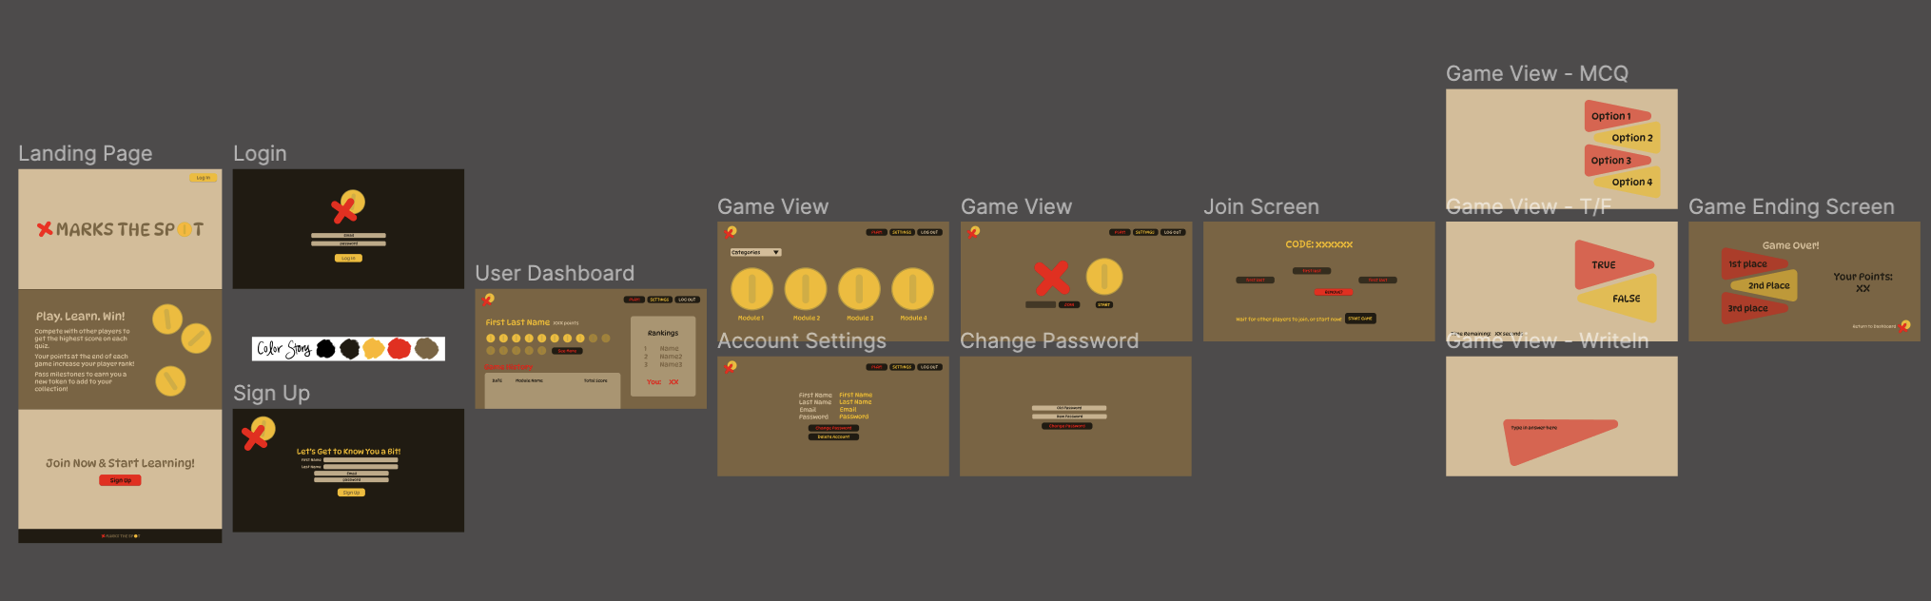
Wireframes
Notes:
Gargi

Slide 5
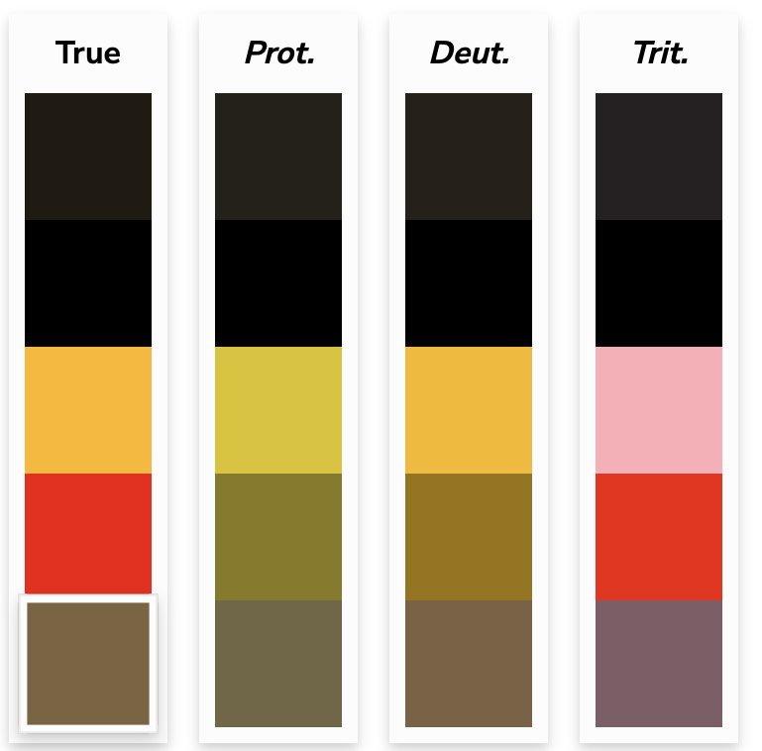
Wireframes - Accessibility
Prot. (Protanopia): Unable to perceive any ‘red’ light
Deut. (Deuteranopia): Unable to perceive any ‘green’ light
Trit. (Tritanopia): Unable to perceive any ‘blue’ light
Source
Notes:
Gargi

Slide 6
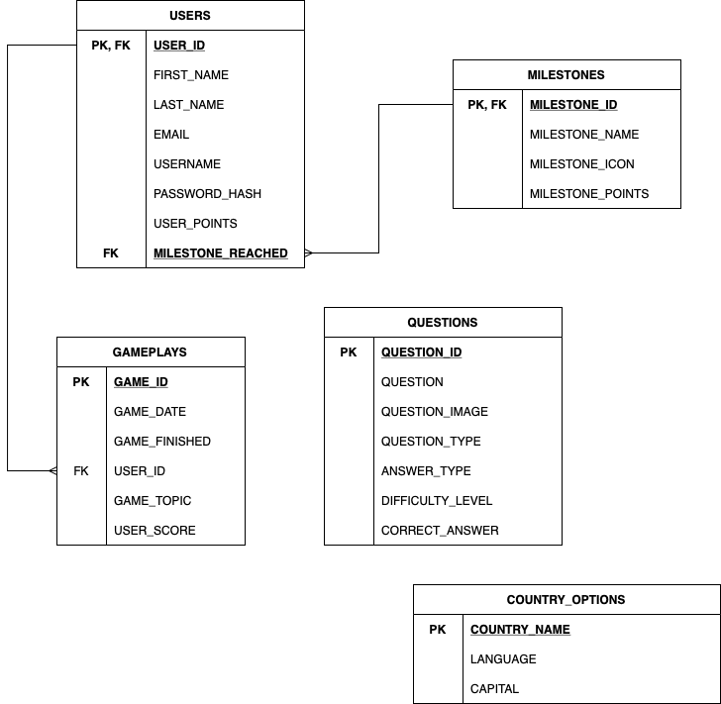
Database
We will be using MySQL to implement the database
The USERS table will store user information
The MILESTONES table will have the milestones of the game
The GAMEPLAYS table will have the game history of each quiz game, as well as the user’s score
The QUESTIONS table will store the questions of each quiz
The COUNTRY_OPTIONS table will have the information about the answers
Notes:
Areebah

Slide 7
Product Issues - Void & Bugs
Void:
ByteSquad Feedback:
Include multiple question types (MCQ, free response, T/F): We were already planning to include different types of questions
Professor Tsao Feedback:
Include user leaderboard to build competitiveness: We were already planning to include a leaderboard to allow users to see overall performance compared to others
Bugs: We currently don’t have any bugs (i.e., immediate feature concerns that need to be addressed)
Notes:
Gargi

Slide 8
Product Issues - Enhancements
Short-Term: N/A
Long-Term:
ByteSquad Feedback:
Notification system to remind users to play quizzes or achieve more milestones
Notification system to notify make users about new features
Points able to unlock new game features, customizable profiles, and/or premium study content
Variety of collectibles for rewards (not just flags)
Professor Tsao Feedback:
Ensure the game is accessible to users with different abilities, including those with visual, auditory, or cognitive impairments
E.g., text-to-speech options, high-contrast visuals, or alternative input methods
Reliance on quiz formats could be seen as outdated, failing to leverage innovative educational methodologies or technologies that engage modern learners
Notes:
Areebah

