Slide 1

X Marks the Spot
Gargi Tawde, Areebah Iqbal, Fariha Ahmed

Slide 2
Build Instructions
Front-end:
Navigate to dev/frontend.
Once in the folder, run npm i.
Then, run npm start.
Go to http://localhost:3000 to interact with the front-end.
Back-end:
Navigate to dev/backend.
Installations: pip3 install Flask; pip3 install flask_cors; pip3 install jsonify; pip install flask-mysqldb; and pip install pyyaml;
Once in the folder, run python3 server.py.
Go to http://localhost:5000 to interact with the back-end.
Optional Steps: Use the Back-end with a Virtual Environment
Run python3 -m venv venv in the backend folder
Navigate to source venv/bin/activate.
Run the installations commands.
After installing, run python3 server.py.
Go to http://localhost:5000 to interact with the back-end.

Slide 3
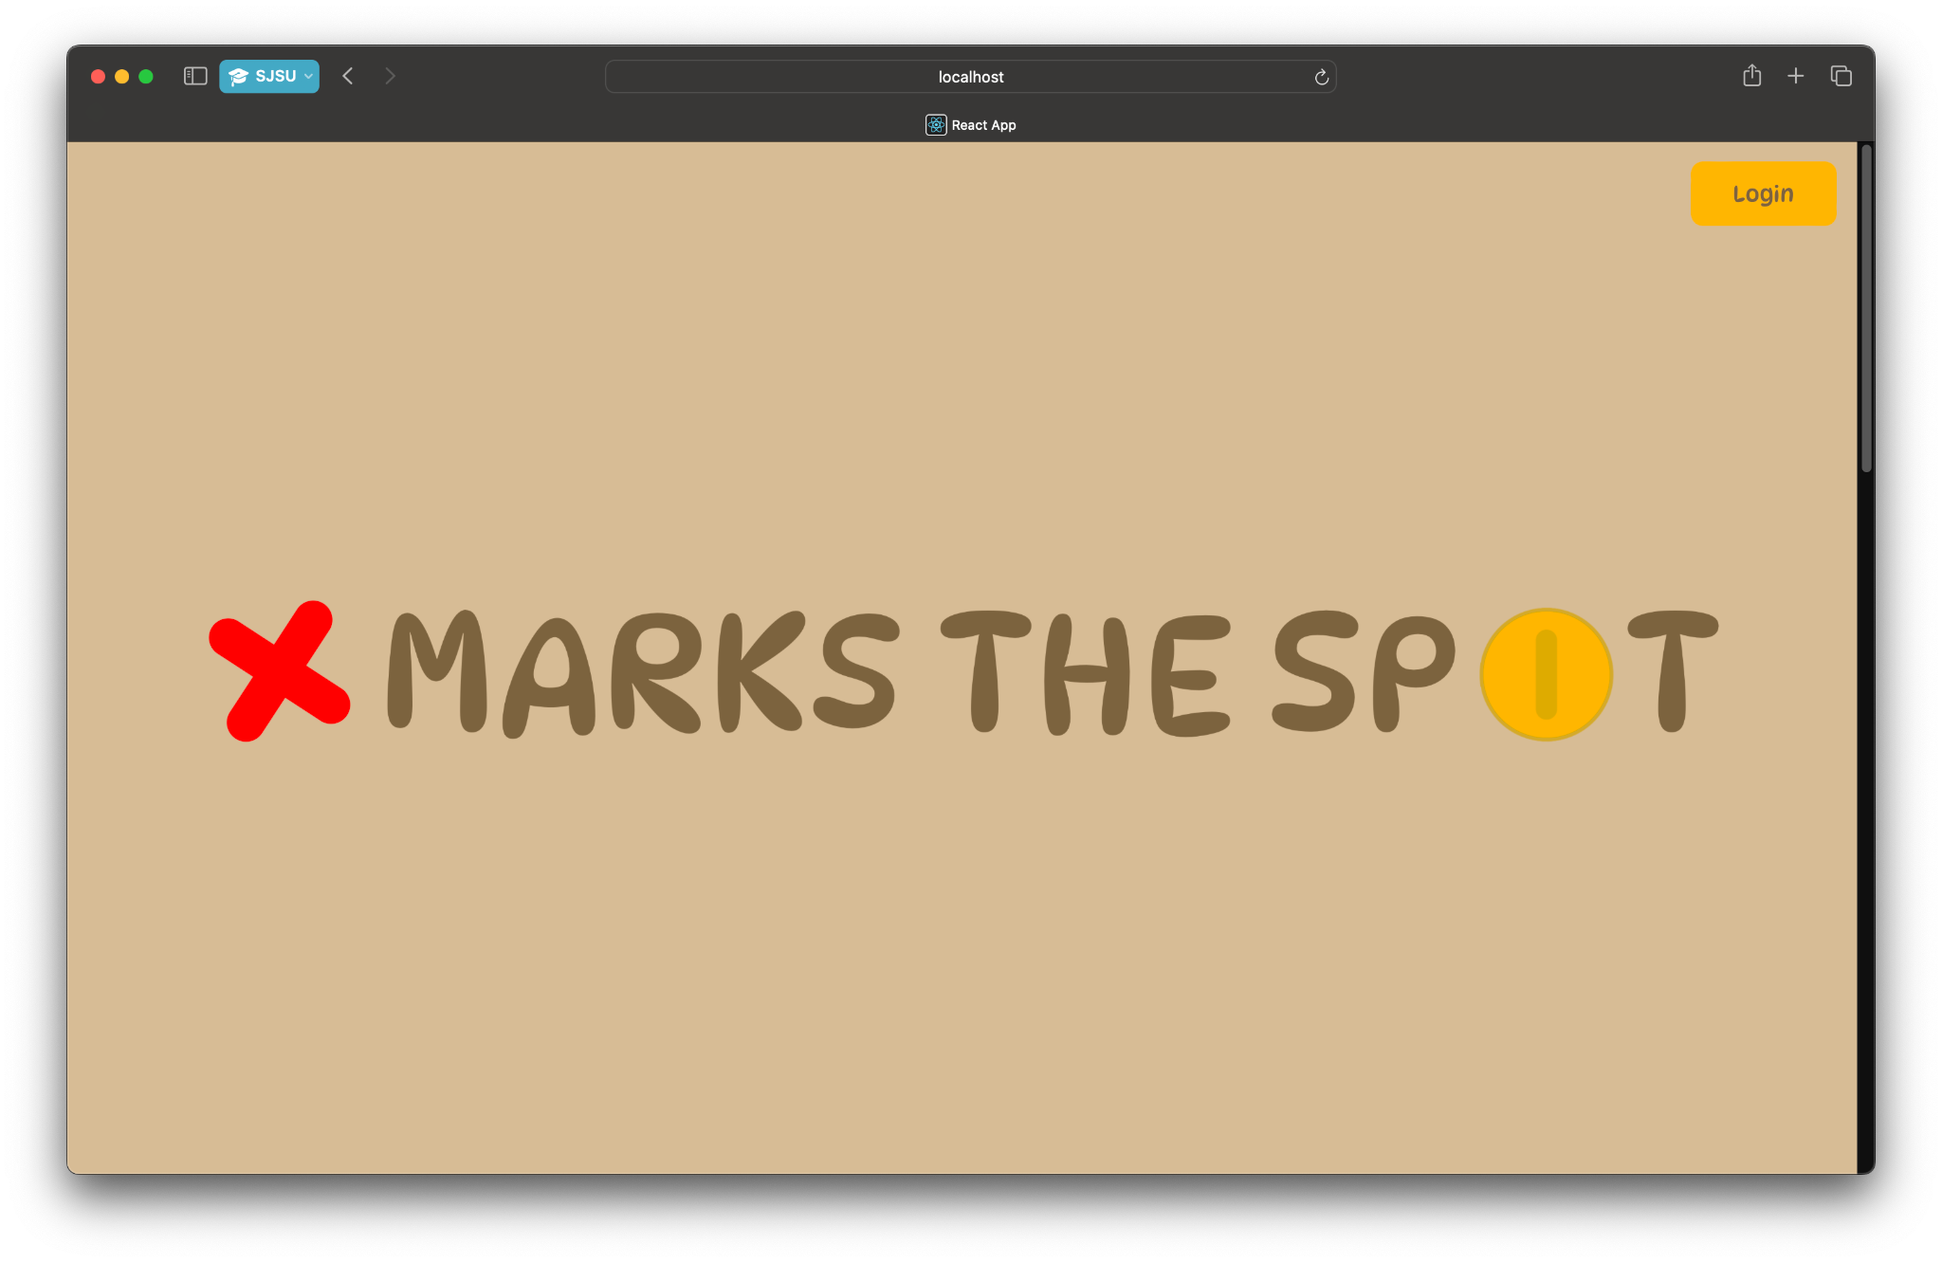
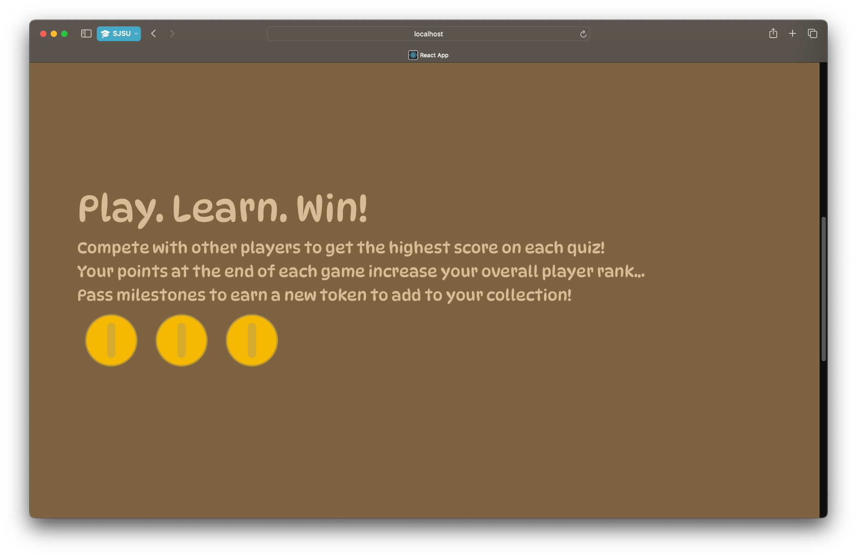
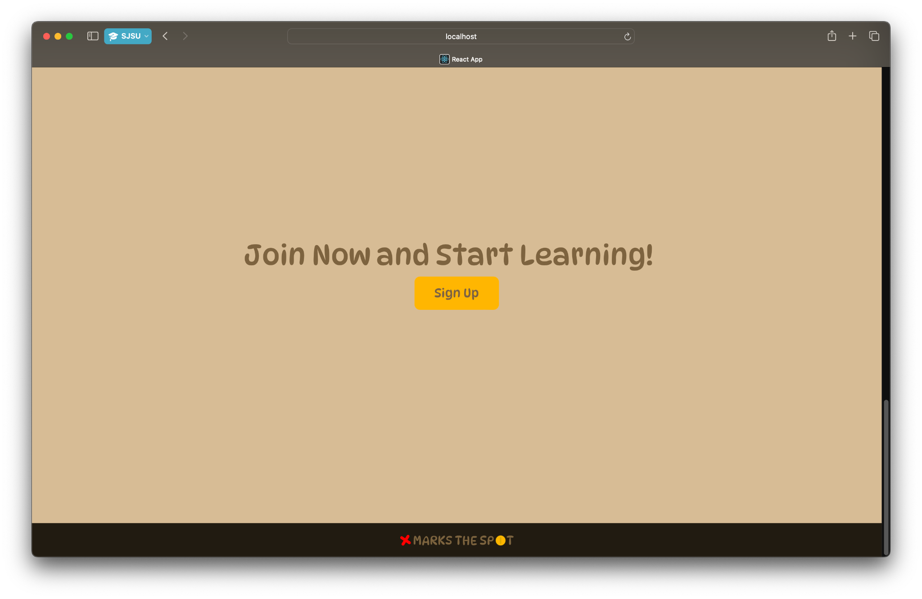
Landing Page (scrollable view)

Slide 4

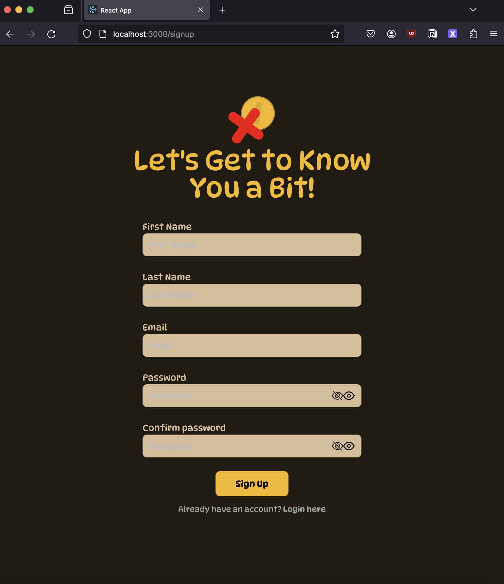
Login and Signup Page

Slide 5
List of Product Features
Completed:
Landing Page
Login Page
Sign Up Page UI
Initial Database Setup
User Dashboard Page UI
In Progress:
User Authentication
Sign Up API
Game Page UI
Module Selection Page
Start/Join Page
UI for each of the Question Type Views

Slide 6
Time for the Demo!

Slide 7
Partner Teams
Previous Teams:
Week 3: Beyond Bottles
Week 5: Geounity
Verified build worked
Current Team:
Week 7: Jump and Launch
Verification of build TBD
Notes:
Fariha

Slide 8
Issues
Accessibility concerns for screen-reading (ensuring image description for a picture-based question does not give away the answer)
Cannot be addressed yet; only applicable further into work on game mechanics
Looked into making the “free response” questions into something simpler for grading (fill-in-the-blank)
Notes:
Fariha

