Slide 1

Modello tecnologico

Slide 2
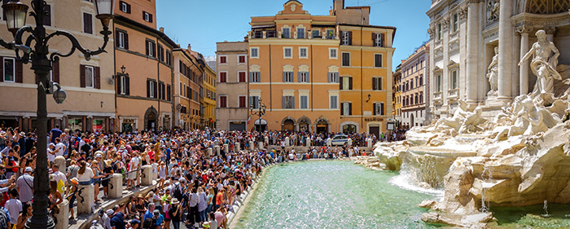
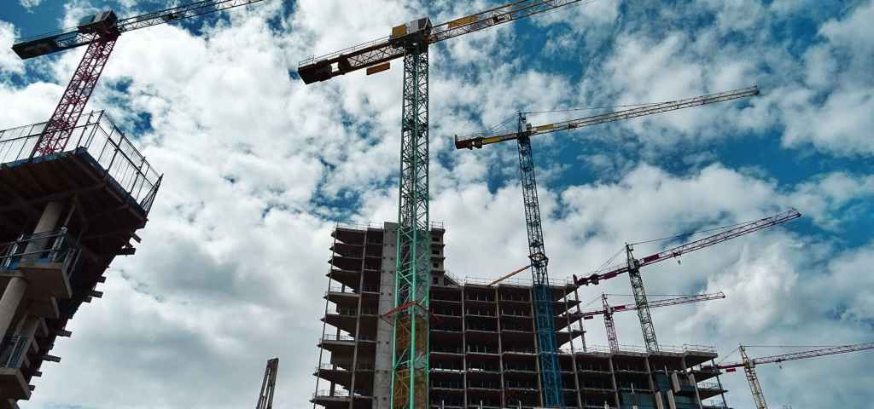

Waste management and uncertainties
Overturism
Changing habits
Growing (evolving) towns

Slide 3
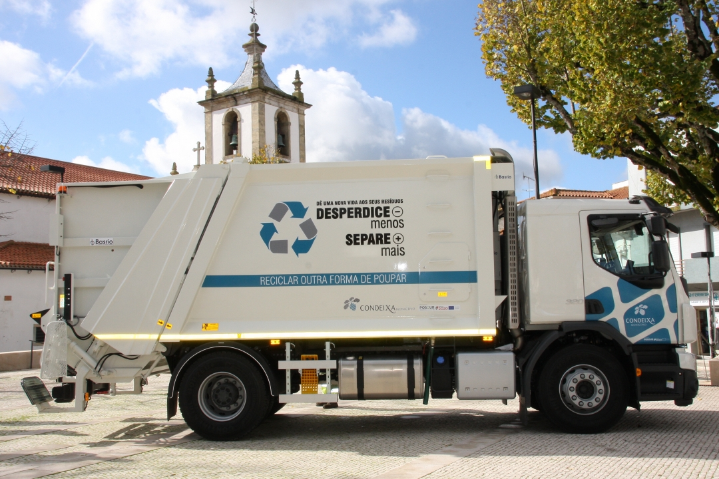
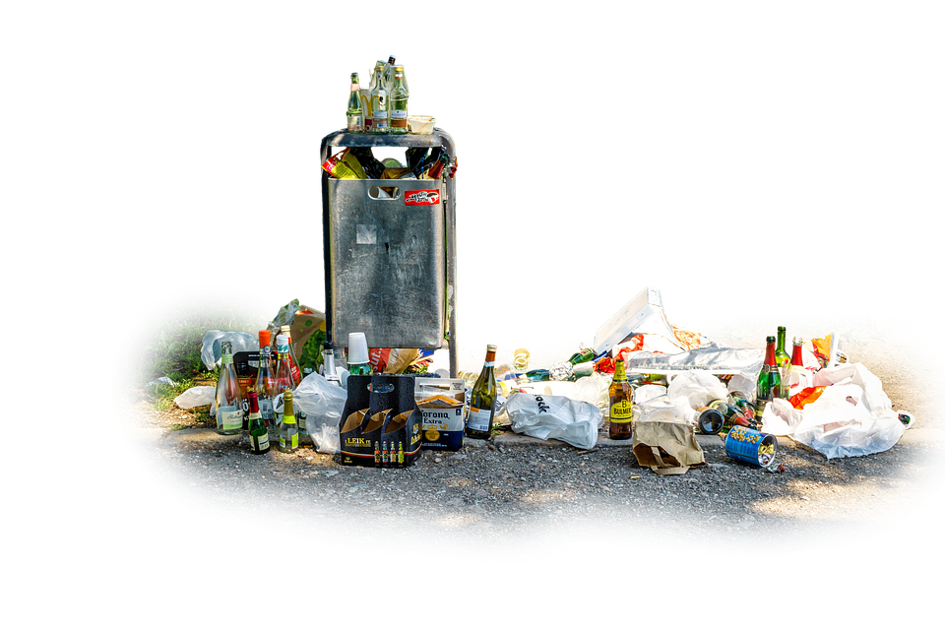
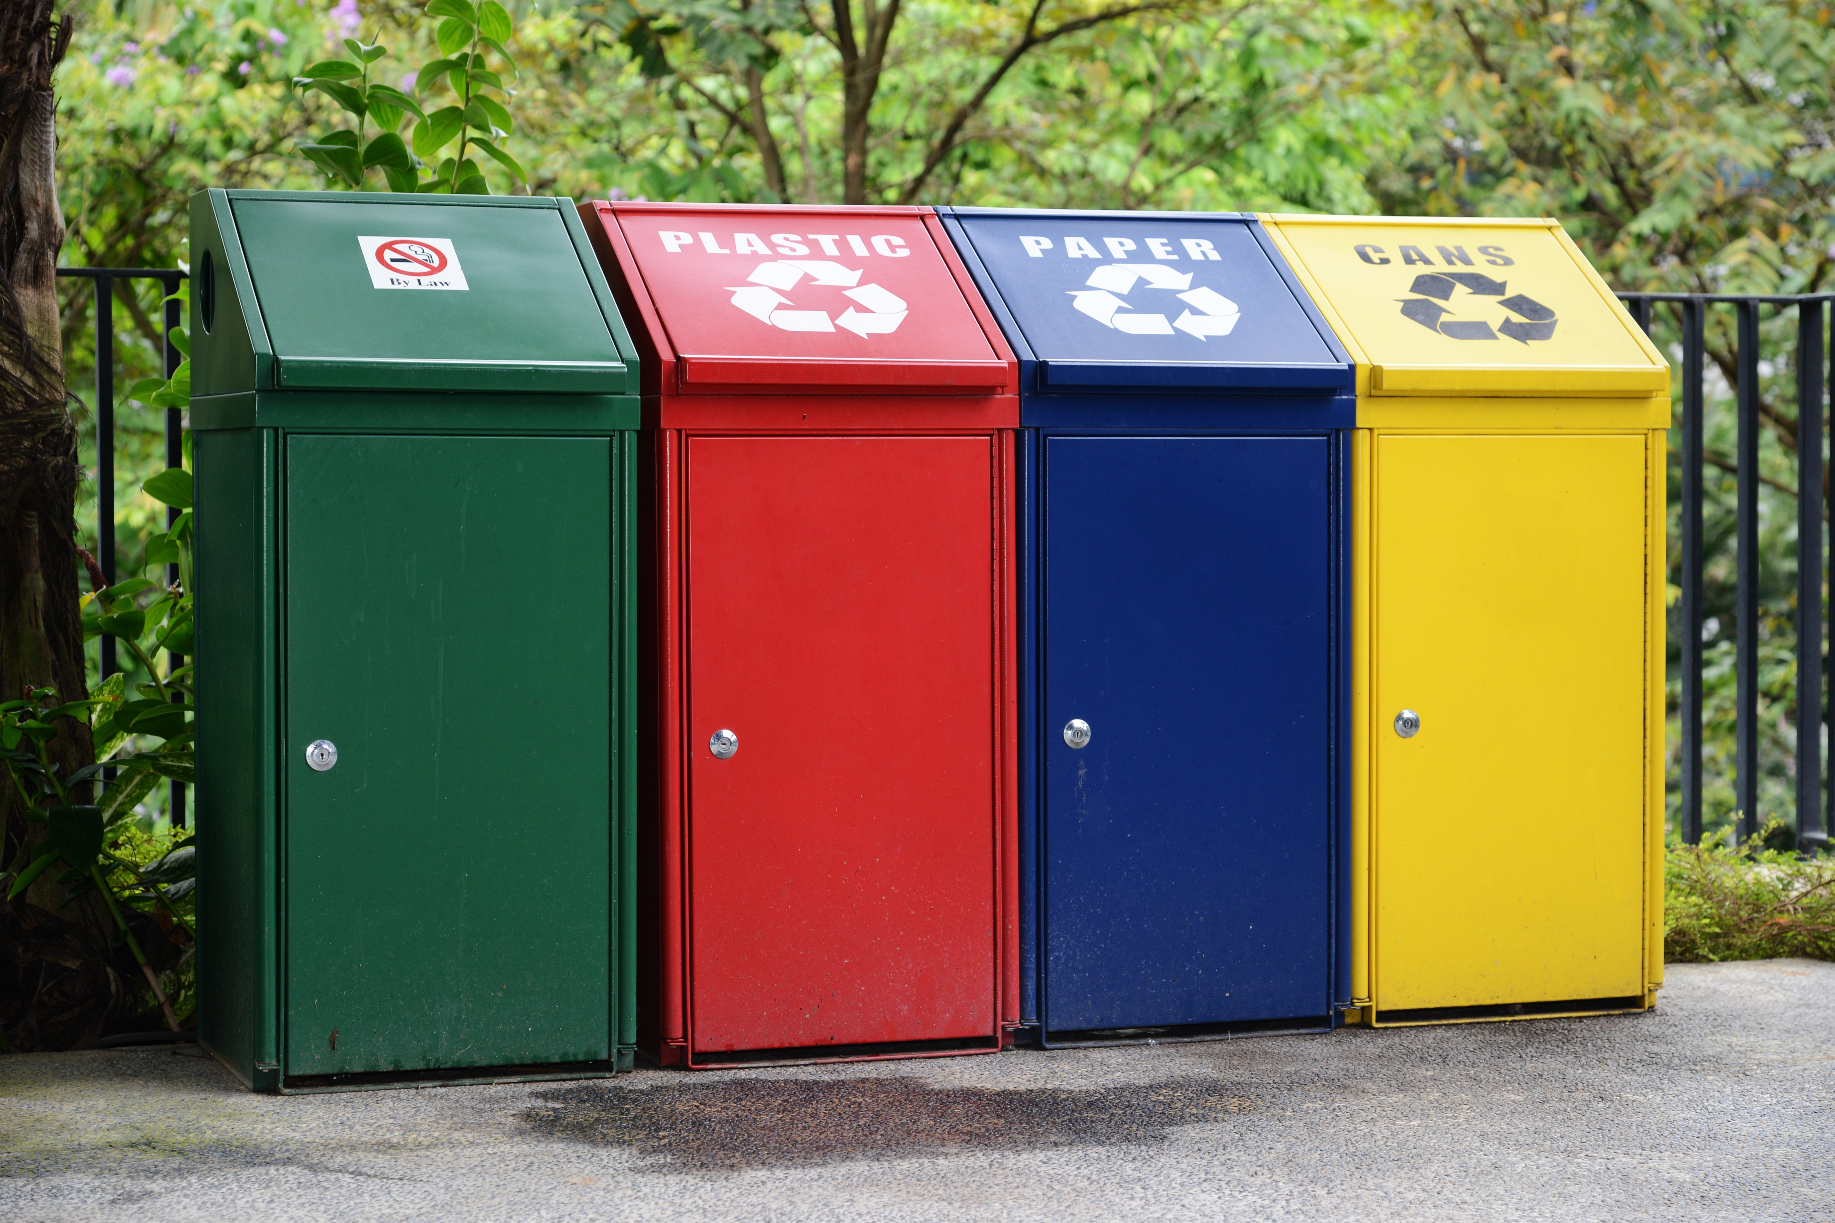
Waste management and stochasticity
Unespected demand
Process (vehicles) disruption
Extra shifts
Need for new planning policies

Slide 4
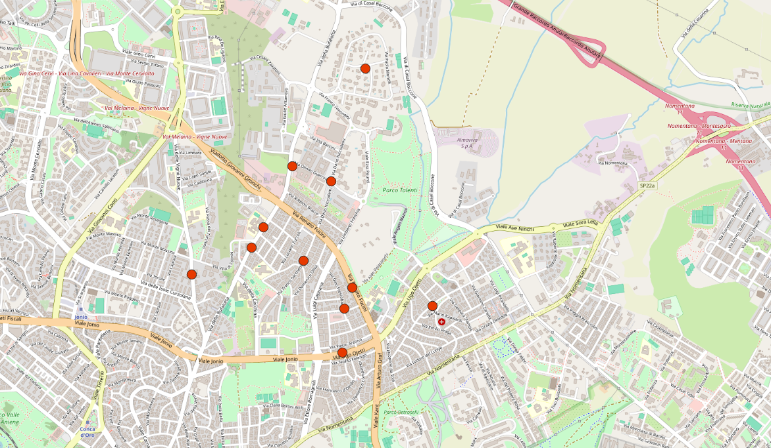





Depot
Home
Restaurant
Cafè / Commerce
School / University

Slide 5
Requisiti tecnici
Rete
Satellite
Collegamento

Slide 6

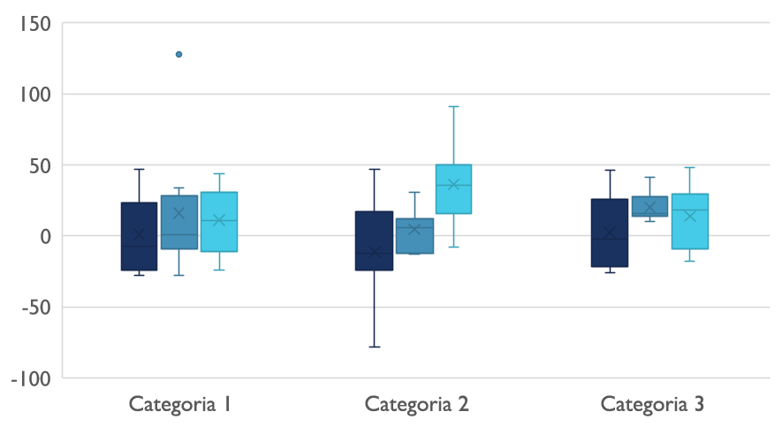
Waste management and variability

Slide 7

Comunicazioni digitali
Nuvola
Locale
Ibrido

Slide 8

Grazie
prova@example.com

