Slide 1
Ace of Spades
Diana Soto, Gerrit Steinbach, Bar Slutsky,
Kezaram Tharmasegaram, Jonathan Jung-KyUN An

Slide 2
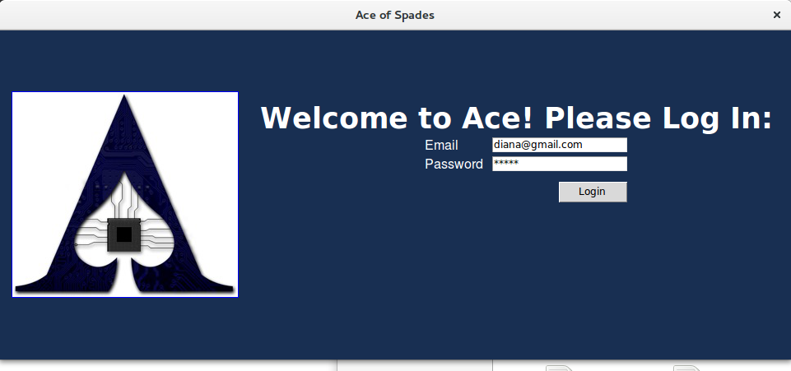
Simple, efficient, helpful

Slide 3
What we implemented
Admin | Student
Login to the admin part of the application To create, edit and delete questions from database Enter latex code for questions Use formula to automatically generate questions Add, edit and remove user information to the software Create and edit an assignment View all and individual student results on specific assignments. Sort student assignment results by grade, student uid, and number of attempts for an assignment. See a leaderboard of students sorted by highest to lowest overall grade then, in case of a tie, lowest to highest completion time | Login as a student to the application View posted assignments Complete an assignment Get hints for the questions I am completing on the assignment Receive immediate results for my submission Save progress in the middle of work, close the app and come back to it later. Review my entire work after submission, by looking at an attempt View past attempts for any particular assignment Download a pdf version of a current attempt for an assignment See my standing on the class leaderboard

Slide 4


Slide 5
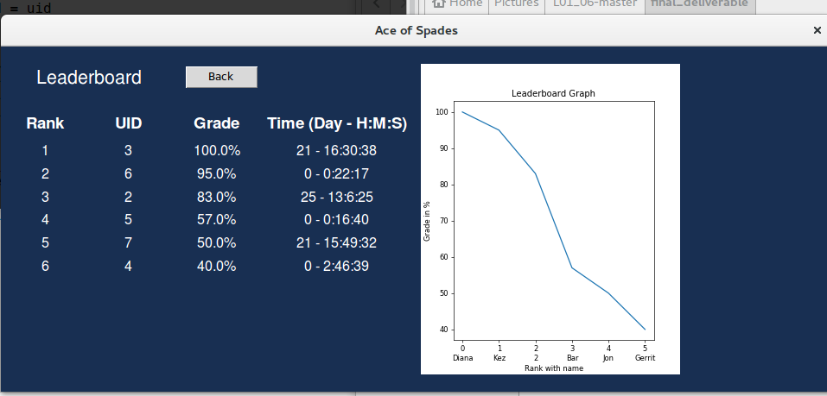
Feature: leaderboard FOR ALL ASSIGNMENTS
How could we engage students to use our software more? By drawing into their competitive side!
A graph displaying mark distribution amongst the students
The ‘Grade’ is calculated from all attempts and assignments completed by the student
Time is calculated from assignment start time to the student’s last submission

Slide 6
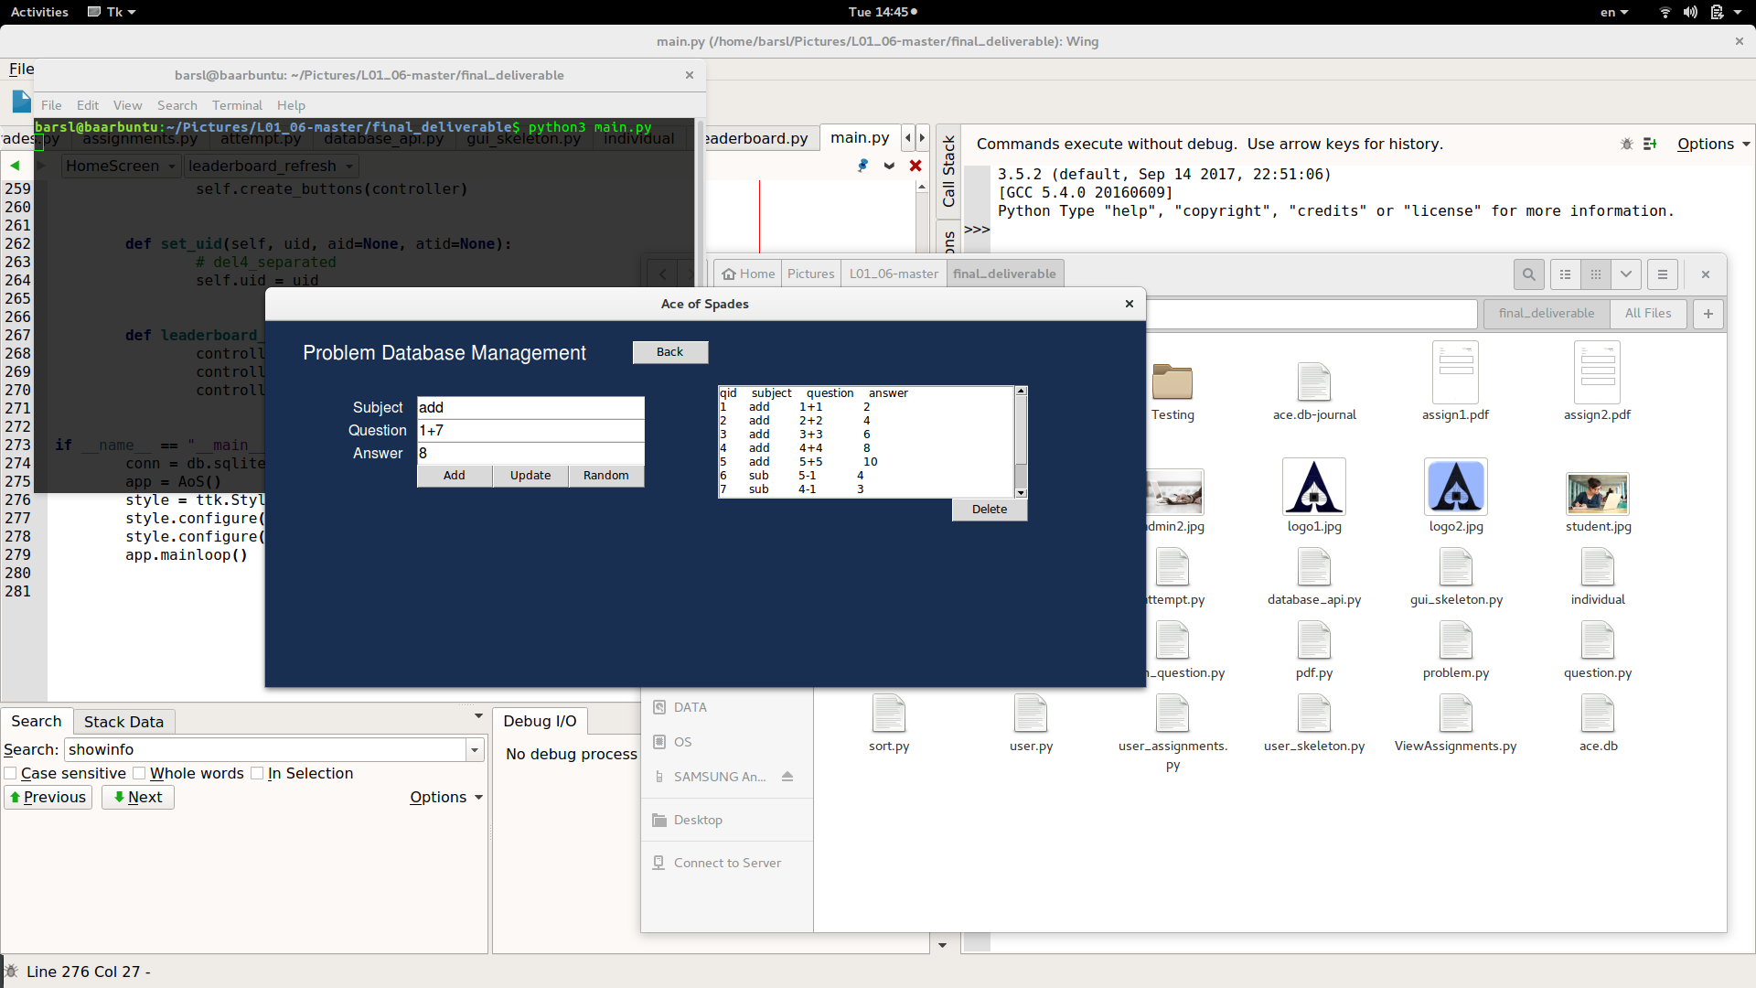

FEATURE: question generator
We took into consideration that adding or updating a question should be simple!
However we also provide the option for an admin to input variables, range and a formula and we generate ‘Num’ amount of questions with the same format, as specified by the user
Only unique questions generated by the system are added to the database.

Slide 7
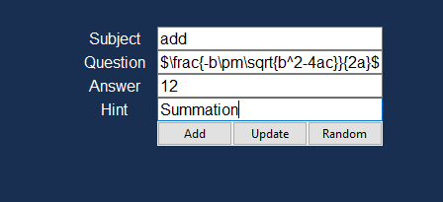
FEATURE: LATEX
All professors love Latex: True or False?
When an admin is creating a question, latex input is accepted and converted by our system
Students see the generated result when completing their assignment
Regular text and expressions such as “1+1” are also formatted with latex for better display

Slide 8
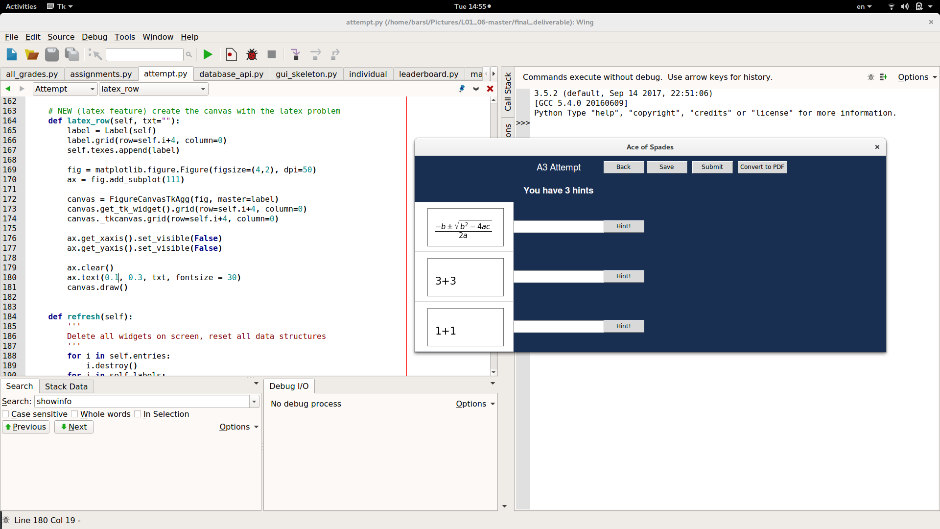
Feature: save, submit, download
When Completing a assignment, students can:
Save their progress by entering their answer in the entry boxes, exiting the screen and resuming later out
Submit their assignment and receive a grade immediately
Convert to pdf their assignment , to finish on the go or ask for help in tutorial
Students have the option of using # of hints for each attempt,
for individual questions

Slide 9
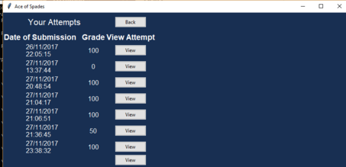
FEATURE: VIEW PAST ATTEMPTS
We implemented a screen for students to see their previews attempts for a specific assignment. To view the actual questions and answers they simply need to click on ‘View’
This allows students to learn from experience, see their mistakes and do better on their next attempts and future assignments

Slide 10

It’s time!

