Slide 1
Northwestern IT Research Computing and Data Services provides free consultations for all Northwestern Researchers. We help with: ● troubleshooting code ● getting started on a project ● statistical advice ● data storage and management ● HPC and cloud computing ● machine learning and AI models ● text analysis ● data collection ● more – just ask! Click on the link in my email signature to request a consultation!

Slide 2
Upcoming Python workshops
Thursday, June 27 9:30-3:30
Friday, June 28, 9:30-3:30
Python Pandas and Matplotlib
Pandas: Working with data shaped in rows and columns. It’s good for basic data cleaning, viewing data, and selecting subsets of data for statistics, machine learning, and plotting. Pandas is written for a more functional programming style.
Matplotlib: Data visualization in Python! Learn how to make and customize plots.
Python Machine Learning with Scikit-learn
Teaches machine learning concepts, in addition to the Python code.
Taught by efrén!
Link to register is at the bottom of our bootcamp GitHub repo.

Slide 3
Goals for this afternoon
Learn about the object-oriented programming style
Learn the basics of coding object classes in Python
See how OOP can be used to play out different scenarios without changing code.

Slide 4
Coding Styles
There are multiple programming styles, also called paradigms, that you can use when writing code. Many coding languages support multiple styles, though some languages are better for different styles. Different people may also have a natural preference for different styles.

Slide 5
Coding Styles
A coding style is about how you organize your code.
You choose the style based on:
Programming language
Personal style
Your data
Goals for the code

Slide 6
Coding Styles
This is how we’ve been coding so far this week.
Procedural style
Python, C, BASIC, FORTRAN
Personal style: You like logic puzzles and you want to know exactly how everything is being done.
Your data: Irregular, unpredictable
Code looks like: lots of loops and if statements
Useful for: Custom algorithms, complicated data puzzles, speed

Slide 7
Coding Styles
Functional style
R, Haskell, OCaml, Python
Personal style: You want your code to be standardized across projects. You like code to be clean and neat.
Your data: Predictable, rectangular
Code looks like: Lots of function calls
Useful for: Statistics, Machine Learning

Slide 8
Coding Styles
Object-oriented style
Python, Java, JavaScript, C++, C#
Personal style: You like to classify and group. You like to set up rules first before starting.
Your data: Entities with specific metadata and behaviors
Code looks like: Lots of code for defining objects, very little code for the actual execution.
Useful for: Simulations, Video Games, Real-Time data

Slide 9
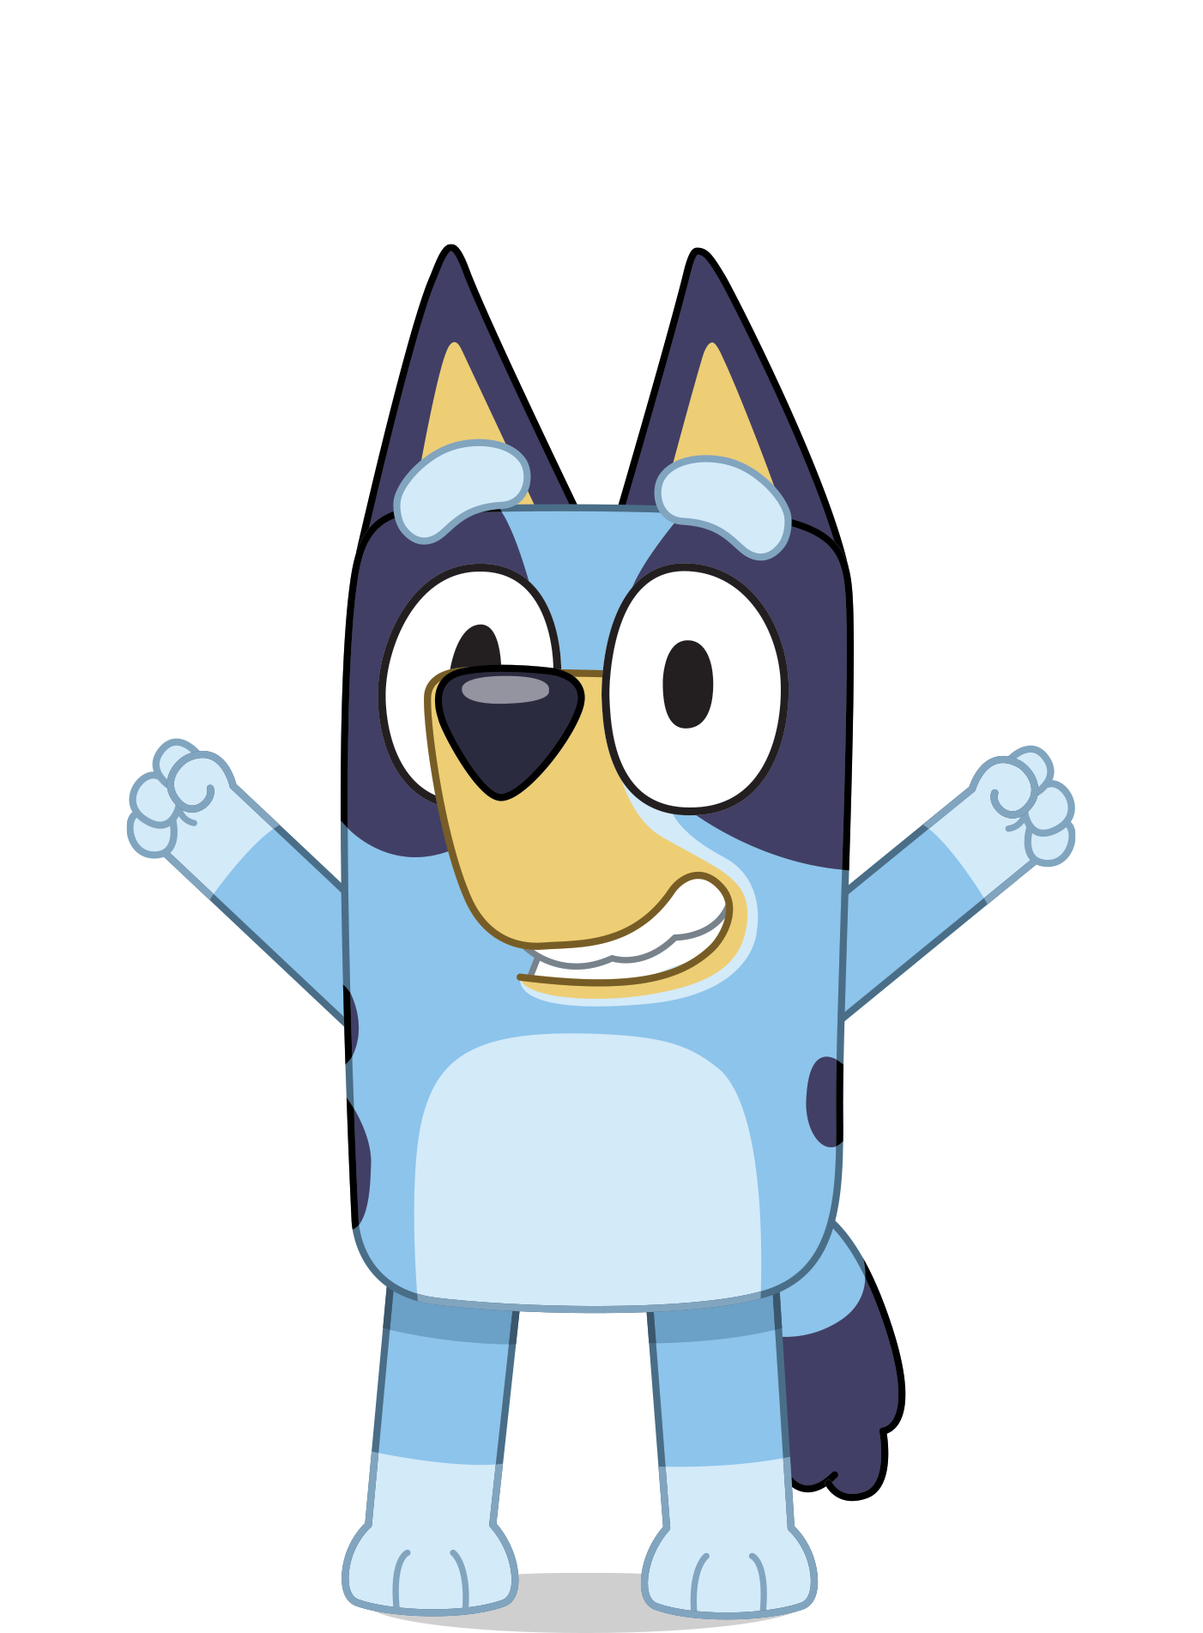
OOP
It can be challenging to explain a coding style, but luckily, Bluey can explain Object-Oriented Programming better than I can. Specifically, Season 1, Episode 23: Shops.
What you need to know
Bluey is set in a universe exactly like ours, except dogs evolved to be the sentient beings who drive cars and go to work. Humans don't seem to exist.
The show is Australian. I will turn on the subtitles.
The episode is about 7 minutes long.

Slide 10
OOP
Who here was like Bluey when they were a kid?
Who was like Mackenzie?

Slide 11
OOP
What did we learn about Object-Oriented Programming?

Slide 12
OOP
Examples from research areas with clear object entities:
Astronomy (stars, planets, etc.)
Genetics (Biopython is a great OO package with a sequence object)
Chemistry and Materials Science (elements, compounds, molecules)
Language (sentences, words, stems, etc.)
Transportation (trucks, warehouses, drivers)
Many more…

Slide 13
OOP – First, we “decide stuff”
We define our object classes:
Shop, shopkeeper, assistant, customer, kitten, merchandise, etc.
We decide on attributes for each class (aka properties, traits, characteristics, metadata)
The shop has merchandise to sell, the customer has dollarbucks, the shopkeeper can be healthy or not healthy, kittens have kitten treats, etc.
We decide on methods for each class (aka behaviors, actions, functions)
Kittens can meow. The assistant can hand stuff to the shopkeeper, etc.

Slide 14
OOP – Next, we “decide who everyone is going to be”
Once all the rules are defined, we create object instances of our object classes:
We create an instance of shopkeeper called Chloe, an instance of kitten called Bluey, an instance of kitten called Honey, etc.
You can have many object instances of each object class. Each instance of the same class has the same methods (has to follow the same rules) and has the same attributes, though the attributes can store different data:
Honey the kitten can have 2 kitten treats, and Bluey the kitten can have 10 kitten treats

Slide 15
OOP – Finally, we can start
Once the classes are defined and the instances are created, we can have the instances interact.
We can call our object methods and the objects will behave as we coded them to behave.

Slide 16
Let’s code!

