Slide 1
Vuteq Project Final Meeting
Injection Molding Machine
Pin Detection System
April 23, 2020

Slide 2
Agenda
Introduction of the Project
Initial Research findings
Development Approach
Implementation Approach
Research results
Summary and Recommendations

Slide 3
Introduction– Problem statement
Background:
Injection molding leaves completed part in mold.
Mold will eject the part through the use of “ejector pins.”
Ejector pins will automatically retract
The Problem Statement:
Occasionally one or more ejector pins will fail to retract causing damage to mold surface.
The failed retraction cannot be detected through physical means, solution must be completely vision based.
Solution must notify of failed pin before mold closes.

Slide 4
Introduction - Objective
Research and develop solution for detection of pins which have failed to retract.
Produce proof of concept to demonstrate technologies capability to solve problem.
Provide suggestions regarding further development of solution for final implementation with an actual injection molding machine environment .

Slide 5
Initial Research Findings
The technologies mentioned below was initially considered researching and implementing into a feasible solution.
Thermal Image Analysis
Surface Analysis using Image Recognition
Point Cloud Analysis / Depth Analysis

Slide 6
Development Approach
After distinguishing the advantages and disadvantages that the previously stated technologies may provide, we have finalized Point Cloud Analysis Approach

Slide 7
PoC Procedure
Convert CAD model into point cloud
2. Collect point cloud from Intel Depth Camera for further analysis.
3. Render point cloud data using GUI tools for visualization.
4. Align both sets of point cloud data within the environment so that deviations can easily be seen through a process called point cloud registration.
5. Show anomaly in the result.

Slide 8
Implementation Approach
In order to accomplish the Point cloud analysis procedure, we have implemented proof of concept with two different tools.
Mock Mold.
Training Mold.

Slide 9
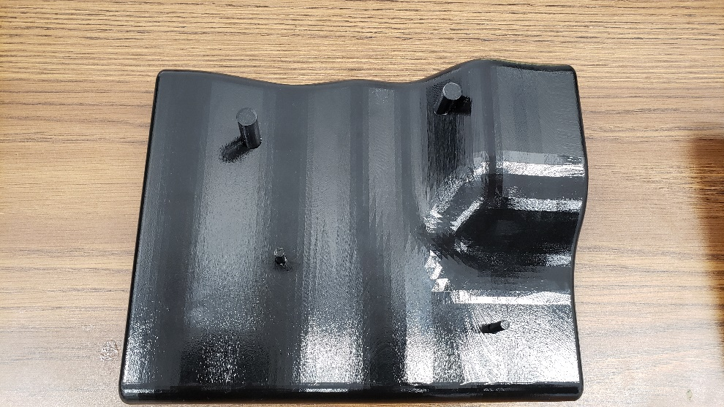
Implementation Approach - Mock Mold
The mold surface is contoured to simulate dynamic surface of Vuteq mold and it also mimics the reflectiveness of it.
[Top View]

Slide 10
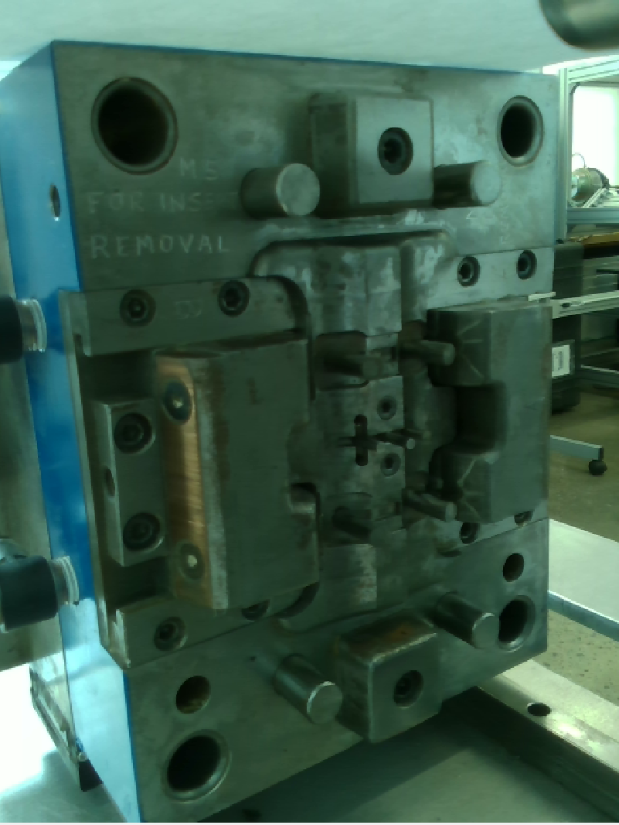
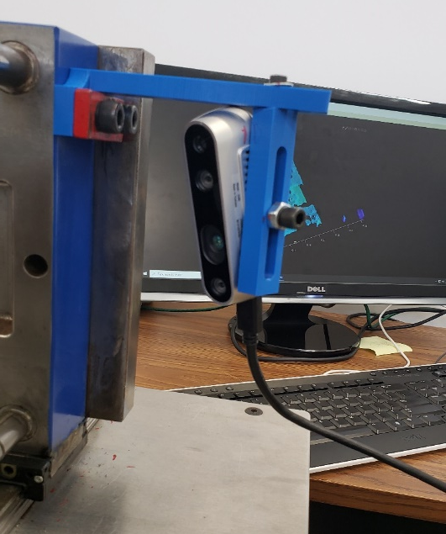
Implementation Approach – Training Mold
The Training Mold provided by Vuteq after the first demonstration of the proof of concept more closely resembles the real mold..
[ Camera mounted diagonally ]
[ View from Camera ]

Slide 11
Computation Environment
Implementing proof of concept based on Mock mold and Training mold using two different technologies.
Python/Open3D
MATLAB

Slide 12
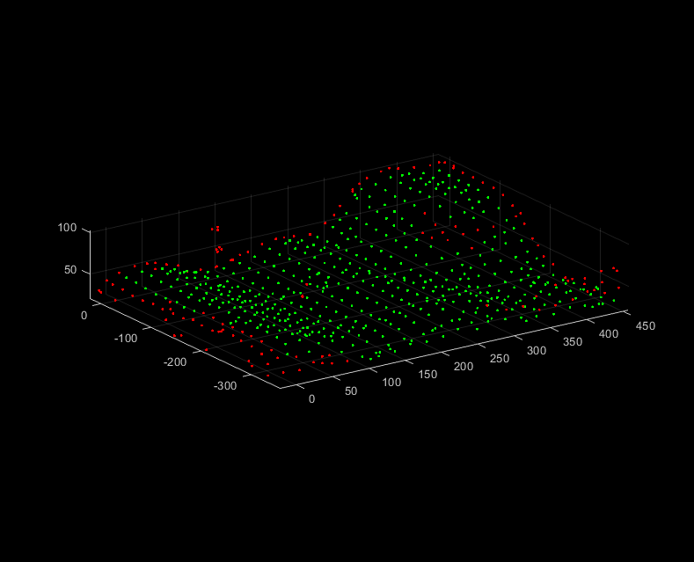
Research Results - 1
Anomaly detection Utilizing Mock Mold
[RED POINTS DEPICT PINS AND EDGES]
[GREEN POINTS DEPICT MOLD SURFACE]

Slide 13
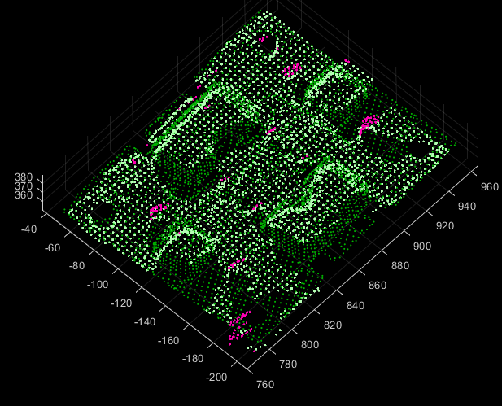
Research Results – 2(a)
Anomaly detection Utilizing Training Mold with MATLAB environment.
[Unreacted pins are depicted in pink color]

Slide 14
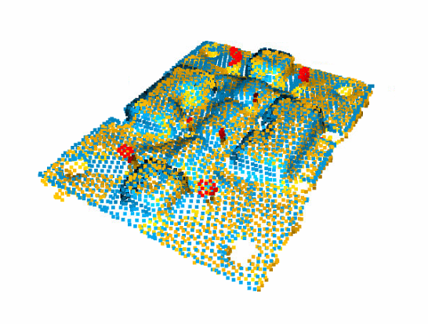
Research Results – 2(b)
Anomaly detection Utilizing Training Mold with Python environment.
[Unreacted pins are depicted in Red color]

Slide 15
Summary and Recommendation -1
3D surface analysis through point cloud registration was determined to be the most fruitful of our available technologies and was therefore developed into a working analysis concept on both a plastic Mock mold and a realistic Training mold.

Slide 16
Summary and Recommendation - 2
In the next stage of the project, we recommend running the proof of concept on the actual mold surface and for that we have suggested possible 3D cameras which can be used for achieving satisfactory results including how an ideal system will look like.

Slide 17
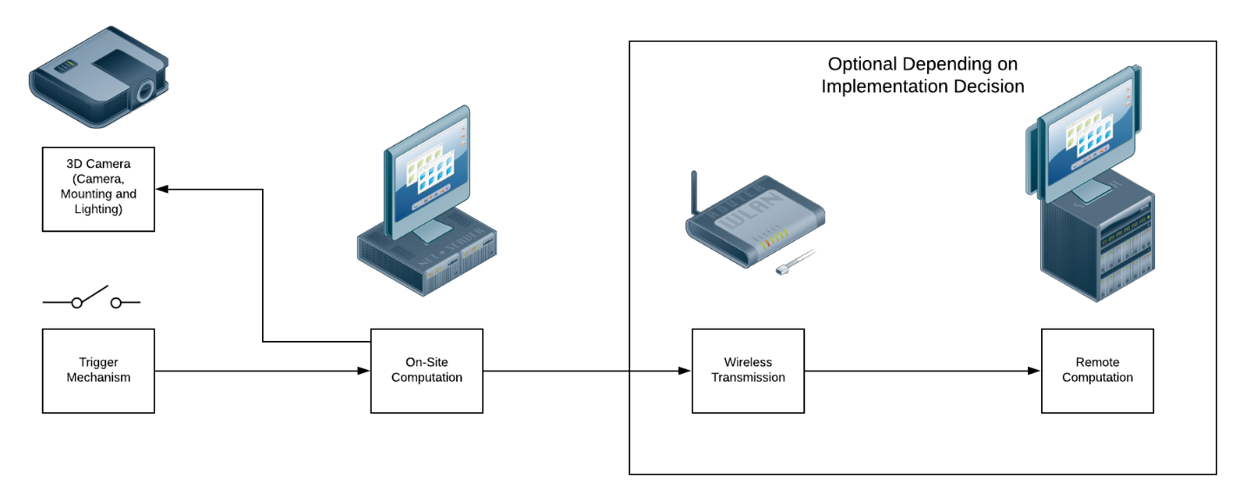
Recommendations – Ideal System Design
The diagram above illustrates the interaction between individual system components.

Slide 18
Ideal System Design – Trigger Mechanism
Trigger mechanism can be a limit switch which can be used to generate an analog pulse.
Pulse/ Signal can be transferred to On-site Computation for further processing.
For now, we would expect that switch positioned with the Vuteq’s Molding machine can be utilized.

Slide 19
Ideal System Design – On Site Computation
On-Site Computation environment processes the pulse and commands the 3D camera.
Camera captures the depth frame of the mold surface.
Computation environment itself executes the point cloud analysis strategy to find Anomaly on the mold surface.

Slide 20
Recommendations – 3D camera
The reason that below described cameras have been chosen is that they are equipped with quality hardware and technologies that provide the highest quality 3D output.

Slide 21
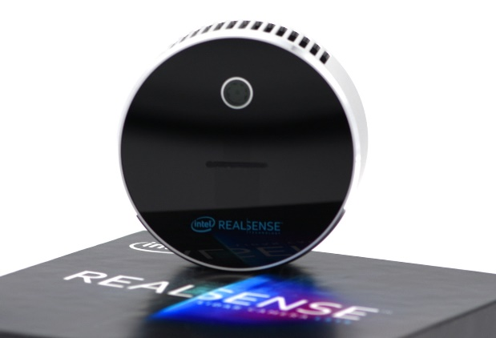
3D camera- Intel Real Sense L515 LiDAR
DEPTH TECHNOLOGY | LiDAR
DEPTH FIELD OF VIEW(FOV) | 70° × 55° (±2°)
DEPTH STREAM OUTPUT RESOLUTION | Up to 1024 x 768
DEPTH OUTPUT FRAME RATE | 30 fps
MIN – MAX DEPTH DISTANCE | Approx. 0.25 m – 9 m
SCANNING TECHNOLOGY | Laser Scanning
CAMERA DIMENTION | 61 mm x 26 mm
USE ENVIRONMENT | INDOOR
PRICE | $349
SOURCE | https://www.intelrealsense.com/lidar-camera-l515/
Solid state LiDAR camera provides better scanning range with High Definition Depth output.
Small form factor makes it easy to mount.
Suitable for indoor applications.

Slide 22
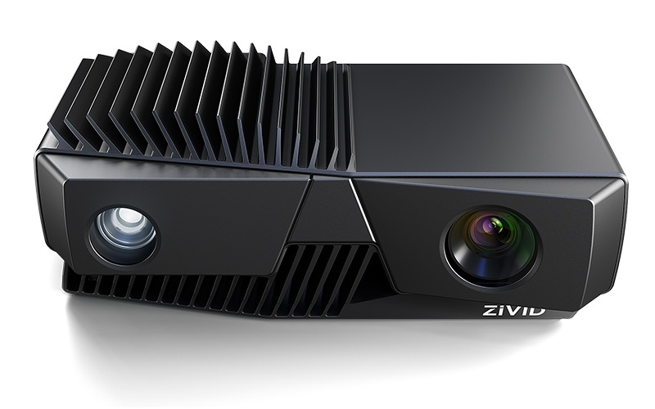
3D camera - Zivid One+ Large
3D TECHNOLOGY | STRUCTURED LIGHT
FIELD OF VIEW, MIN – MAX DEPTH DISTANCE | 843 x 530 @ 1.2 m 2069 x 1310 @ 3.0 m
POINT CLOUD OUTPUT | 3D(XYZ) + COLOR(RGB) + CONTRAST(C) FOR EACH PIXEL
BRIGHTNESS | 1/4 TO 1.8x, 1x = 400 lumens
KEY APPLICATIONS | Medium to large objects, Reflective metal surfaces
SOFTWARE SUPPORT | Zivid SDK
API + LIBRARIES | C++, .NET , Python, ROS
PLATEFORM | WINDOWS, LINUX
SOURCE | http://www.zivid.com/zivid-one-plus-large-3d-camera
Structured light technology generates wide range of depth details in terms of point cloud which also contains color data.
Built-in LED illuminate the scene to record quality data eliminating noise.
Suitable for reflective surfaces.

Slide 23
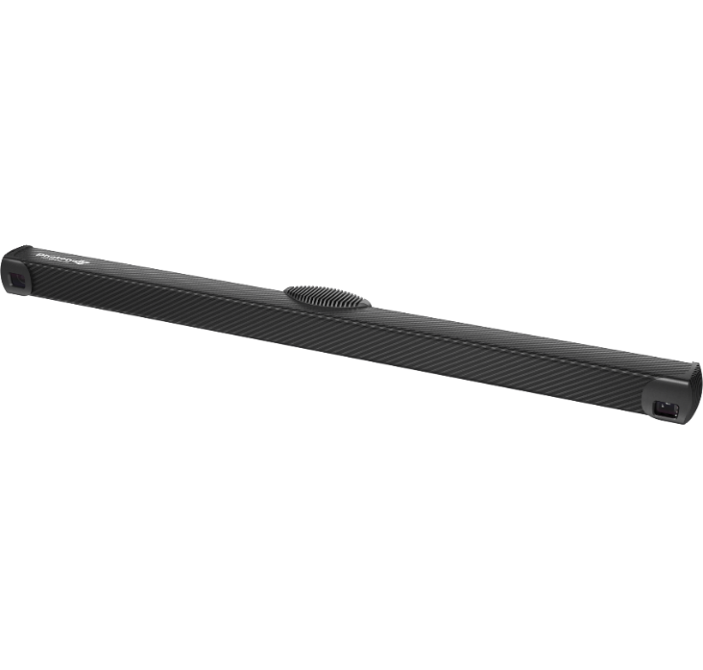
3D camera – Photoneo phoxi 3D scanner XL
3D TECHNOLOGY | STRUCTURED LIGHT
DEPTH RESOLUTION | Up to 3.2 Million 3D points
DEPTH SCANNING RANGE | 1680 – 3780 mm
OPTIMAL SCANNING DISTANCE | 2326 mm
3D POINTS THROUGHPUT | 16M points per second
DIMENTIONS | 77 x 68 x 941 mm
API + LIBRARIES | C++ AND OTHER 3RD PARTY
SOURCE | https://www.photoneo.com/products/phoxi-scan-xl/
Industry’s best quality depth sensor enhances the performance and overall efficiency.
Covers large scanning range.
Supports 3rd party libraries to develop machine – vision application.

Slide 24
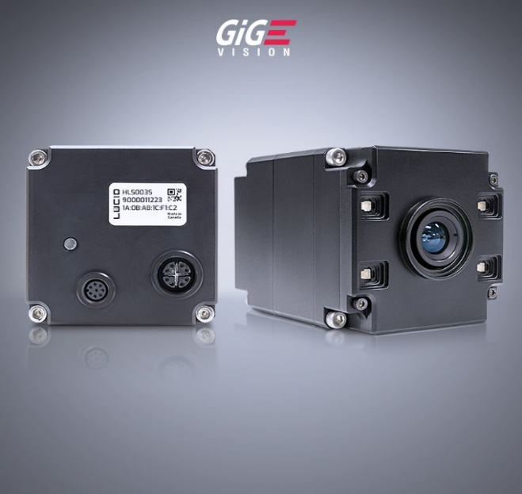
3D camera – Helios ToF
3D TECHNOLOGY | Time Of Flight
DEPTH RESOLUTION | 640 x 480 px
MIN – MAX DEPTH DISTANCE | 0.3 to 6.0 m
FRAMERATE | 15 fps / 30 fps
SOFTWARE SUPPORT | Arena SDK
API + LIBRARIES | C, C++, C#, Python
PLATEFORM | Windows and Linux
Source | https://thinklucid.com/product/helios-time-of-flight-imx556/
Uses Time Of Flight (ToF) 3D scanning technology to detect the depth between the obects.
Ignores the ambient light noise automatically.
Long distance scanning does not affect the accuracy.

Slide 25
Questions?

Slide 26
Thank You

