Slide 1
HCISR
“Holy Crap It Shoots Rockets”
Ben Crysup
Ben Harris
CS 345
Dr. Cannata

Slide 2
Project Goals
Scripting language
  Fast. Will be run as script in game
  Easy to learn
Features
  Near - English
  Templates
  First - class Functions
  Exceptions
  Static Typing and Scoping

Slide 3
Requirements
Substitution
First - class Functions
Static Scoping
Static Typing
Interpretation of AST
Notes:
High level language – don't need Substitution
First class functions only lack plugin
- all hard problems are solved
- string passed with function information
Static Scoping – variable/label inside a scope can't be referenced outside a block
- variable/label outside a scope can be referenced inside
Static Typing – No type checking yet “no idiot checking” - but all the information is there
-staticly typed except for downcasting

Slide 4
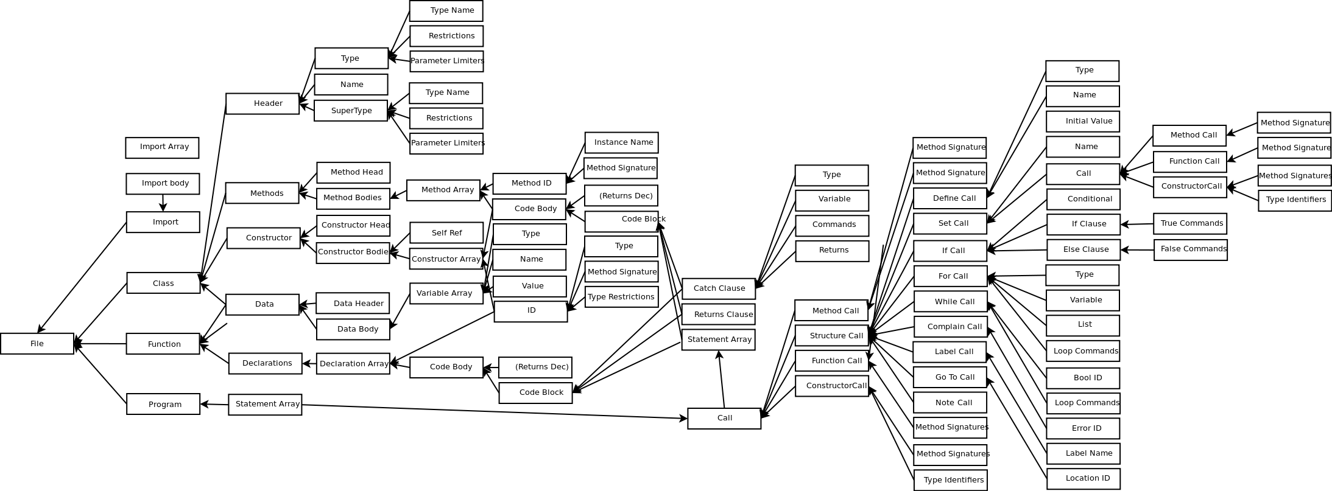
Requirements
Interpretation of AST

Slide 5
Code Comparison
HCISR
this file describes a program
this file uses hcisr/lib/HCISRString.hcisr
this file uses hcisr/lib/HCISRStandardOutput.hcisr
.
define a String named HW which initially equals String:Hello World!
print HW
println
Java
class helloWorld
{
public static void main(String args[])
{
System.out.println("Hello World");
}
}

Slide 6
Future Goals
Less Verbose
Type Checking
Recycle Stack Frames
Plug-ins
  Game Code
  Primitives
Notes:
Initialize inside define statement
Use identifiers without language trying to call it
4575 Lines of code – no type checking

