Slide 1
HCISR
“Holy Crap It Shoots Rockets”
Ben Crysup
Ben Harris
CS 345
Dr. Cannata

Slide 2
Project Goals
Scripting language
  Fast. Will be run as script in game
  Easy to learn
Features
  Near – English
  Generics
  First - class Functions
  Exceptions

Slide 3
Requirements
Substitution
  HCISR is high level – no need for substitution
First - class Functions
  Pass String describing function into Initialization
Static Scoping
  Variables assigned locations in memory
Static Typing
  Objects carry their types with them
  Objects cannot change type
Interpretation of AST

Slide 4
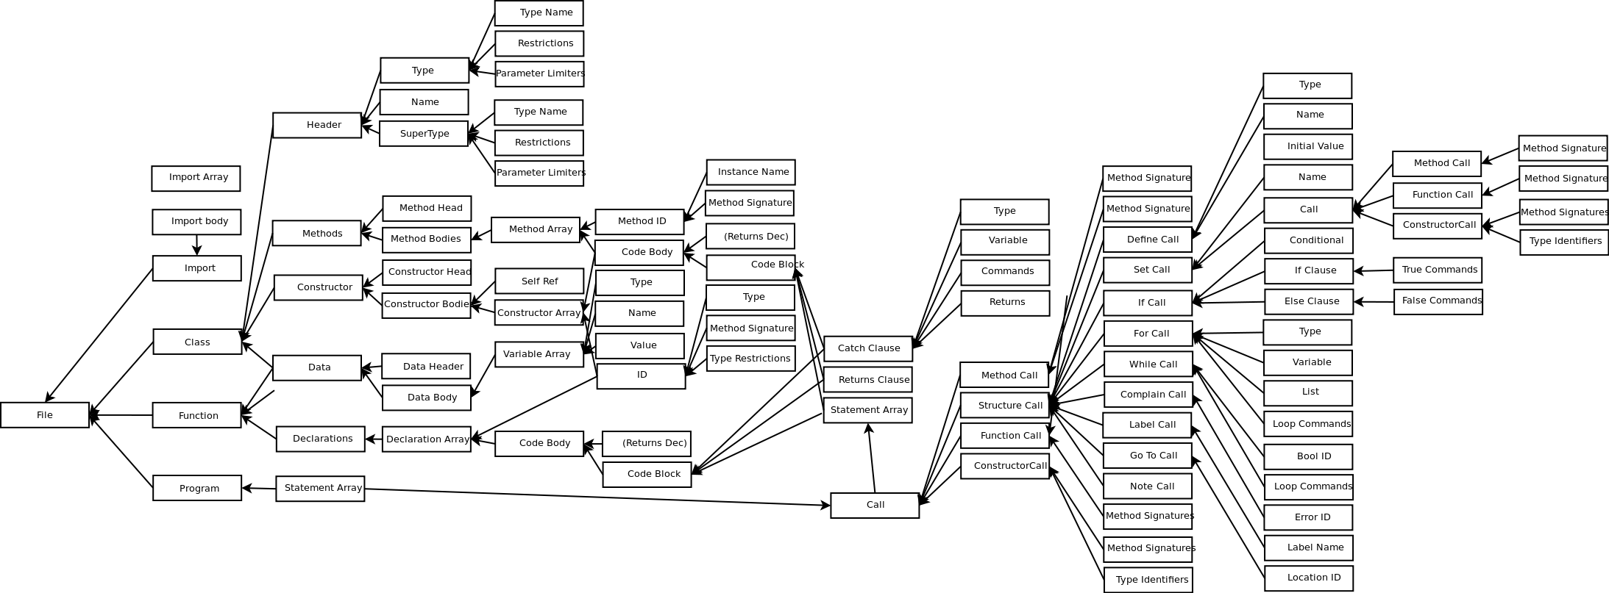
Requirements
Interpretation of AST

Slide 5
AST

Slide 6
Project Reality
Scripting language
  Fast?
  Easy to learn?
Features
  Near – English?
  Generics?
  First - class Functions: shown

Slide 7
Is it Fast?
Not sure
Benchmarks
  Merge Sort
  Matrix Manipulation
  Update Particle system

Slide 8
Easy to learn?
Easy to Understand
  Structured loosely like Sentence
  “external type Integer is a subtype of Object
  and an instance I understands the following commands” ...
  English instead of symbols
Maybe not easy to learn
  Force specific English words – Large vocabulary
  Ambiguities in English could cause confusion

Slide 9
Generics

Slide 10
Near – English?
Readability vs. Verbosity
  HCISR highly readable
  Limited options for code anyway
  While java uses symbols, HCISR uses english
  Ambiguity inherent in English
    “=” translates to “equals”, “set to”, “is”, etc...
    Only allow one possibility

Slide 11
Near – English?
BrainF***
>+++++++++[<++++++++>-]<.>+++++++[<++++>-]<+.+++++++..+++.[-]
>++++++++[<++++>-] <.>+++++++++++[<++++++++>-]<-.--------.+++
.------.--------.[-]>++++++++[<++++>- ]<+.[-]++++++++++.
HCISR
this file describes a program
this file uses hcisr/lib/HCISRString.hcisr
this file uses hcisr/lib/HCISRStandardOutput.hcisr
.
define a String named HW which initially equals String:Hello World!
print HW
println

Slide 12
Near - English?
HCISR
this file describes a program
this file uses hcisr/lib/HCISRString.hcisr
this file uses hcisr/lib/HCISRStandardOutput.hcisr
.
define a String named HW which initially equals String:Hello World!
print HW
println
Java
class helloWorld
{
public static void main(String args[])
{
System.out.println("Hello World");
}
}

Slide 13
Development Hurdles
Javacc
Generics
First-class Functions
Method calls – boolean calls integer?!
Ben is way smarter than Ben

