Slide 1
Overclocking
By: Gabriel Stroe

Slide 2

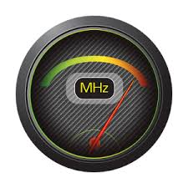
What is Overclocking?
Overclocking is increase the clock speed of hardware components for the purpose of increase the performance of said hardware.

Slide 3


What can be overclocked?
Almost anything that uses a timer (clock) match its operations with the rest of the systems.
CPUs - Server, desktop, laptop and mobile.
GPUs
RAM
Motherboard Chipsets
Raspberry Pis
A monitors refresh rate
Etc…

Slide 4

Why Overclock?
There are a few advantages to overclocking and almost all of them have to do with an increase in performance.
Bring cheaper components up to par with more expensive and better performing components.
Performance increase for no extra costs (financial).
Reduce the “bottleneck” of the part.

Slide 5
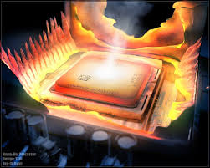

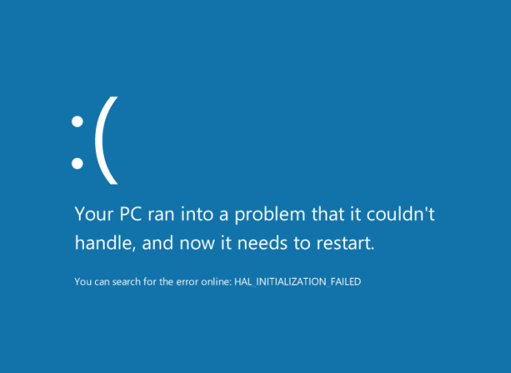
What are the Disadvantages?
Overclocking makes your parts hot!
It also will increase your power consumption when modifying the voltage of a processor.
Reduces system stability.
Not all chips are identical.

Slide 6


Ok but why is this even possible?
Good question! As the manufacturing of hardware components get more complicated, the smallest of imperfections have bigger effects on the component’s performance.
So what hardware manufactures do is use the lowest common denominator as the spec for that part.
This allows almost all parts to go above that base spec!
The term “Silicon Lottery” comes from this principal.

Slide 7
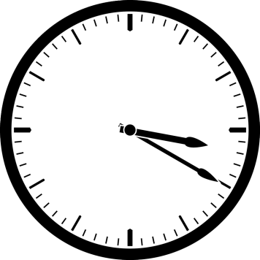




How is it done?
Well that is very specific to the hardware component in question, but let us use an intel (unlocked) processor for an example.
Intel processors (and most modern processors) have what is called a base clock. This is multiplied by some factor to get the final clock speed.
35=
100 MHz
3.5 GHz

Slide 8
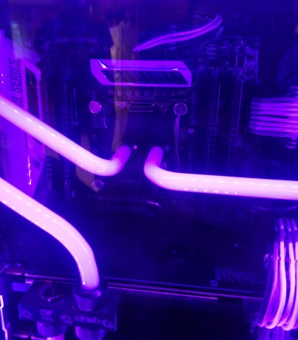
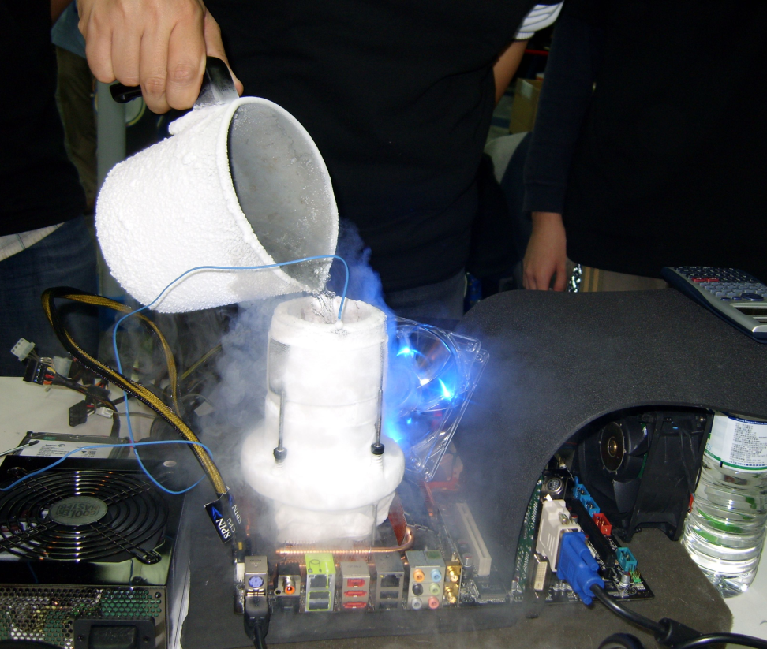
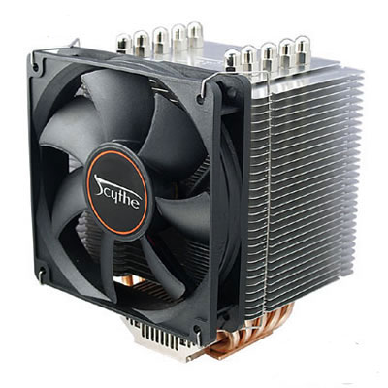
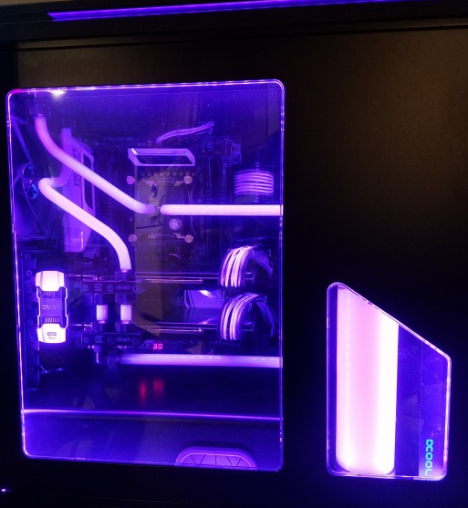
How is it done?
Now there are a few issue one may start to experience. The first is that the heat will increase, so new cooling methods have to be experimented with.

Slide 9
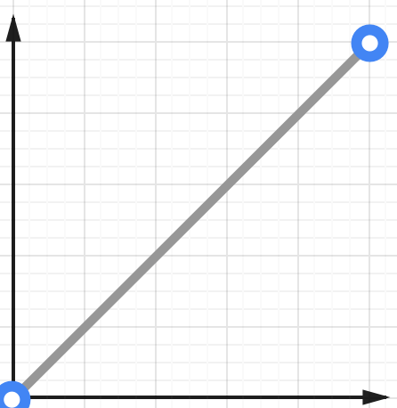
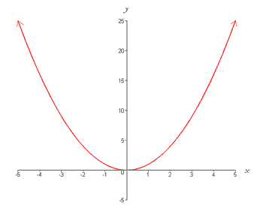
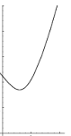



How is it done?
The next issue is that the system cannot draw enough power and loses stability. So to fix this one can increase the voltage applied to the hardware.
This will increase the power consumption and the heat output of the product.
A very fast increase
x²+x=y
Clock speed increase
Voltage increase
+
=

Slide 10
How is it done?
Another method of overclocking a CPU is to actually increase that base clock frequency. This is much less stable.
35=
100 MHz
3.5 GHz
35=
105 MHz
3.675 GHz

Slide 11
Some historical tid-bits.
The oldest method of overclocking is changing the clock crystals in early electronics
Overclocking has generally being a consumer trend.
Business applications have existed before but the reduced stability makes this more unfavorable.
Most CPUs and GPUs now have passive overclocking method today. Usually know as “turbo boosting”.
The trend really started gaining traction in the consumer base when intel released the Celeron 300A. It frequently saw a 50% or greater increase in clock speed.

Slide 12
Some historical tid-bits.
Today intel and many other manufactures lock the multiplier on their CPUs and only allow “special” processors to be overclocked.
Due to better manufacturing processes the amount products can be overclocked has seen a downward trend.
Multicore processors today are also able overclock individual cores. This can be a larger performance increase for single threaded applications.
The current world record for overclocking is by a Finish team called The Stilt. They brought a AMD FX-8370 (base speed of 4.0 GHz) to 8.722 GHz. That’s a 118% increase!

Slide 13

Questions?

Slide 14
Sources
http://www.ocinside.de/html/workshop/amd_socketa_overclock.html
http://www.ethernetworks.de/imac_g4_usb2_overclocking.html
https://hwbot.org/benchmark/cpu_frequency/halloffame
http://www.pcworld.com/article/2044751/how-to-overclock-your-new-haswell-cpu-like-a-pro.html
http://www.nerdparadise.com/tech/hardware/overclockinghistory/

